Slide 1
Lab 19
Ticks & mites

Slide 2
C. Order: Acari (Acarina)
The segmentation is not clear on the body.
Larvae with 3 pairs of legs, nymph and adult
with four.
Classified on base of breathing spiracles.
Generally divided into:
1. Ticks 2. Mites

Slide 3
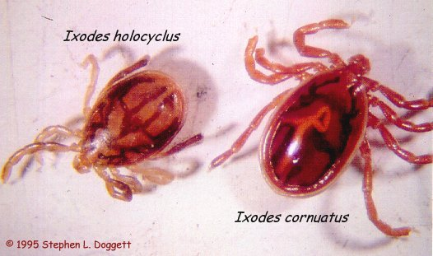

2. Ixodidae (hard tick):
Mouth parts protrude in
the front, not under the body.
In Iraq we have several
genera and species.
Most of which parasitize
cattle, sheep, goats, doges and
other carnivorous.
They are vectors of protozoa
(babasia), rickettsia (tick
typhus), viruses (Arboviruses,
RSSF= Russian summer spring
fever), and spirochaetes (lyme
disease).

Slide 5
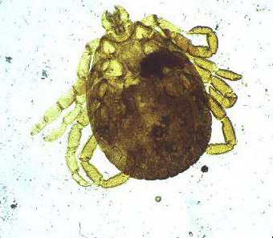
HARD TICKS

Slide 7
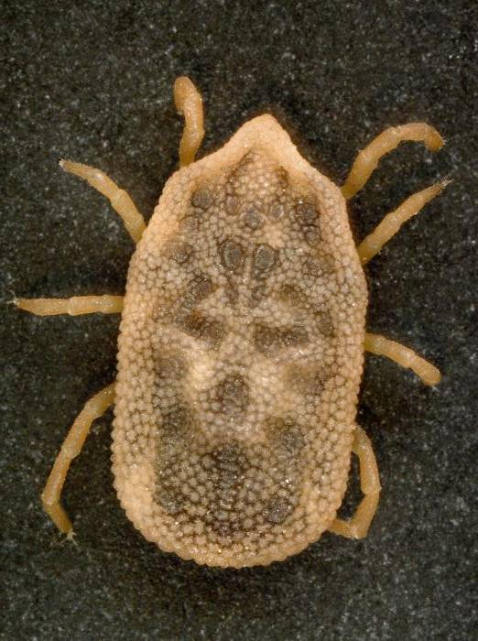
Ticks:
Argasidae (soft tick):
Orthodoros moubata, Tholozane, .
Mouth parts not protruded forward,
under body.
Main vectors of endemic
relapsing fever.

Slide 8
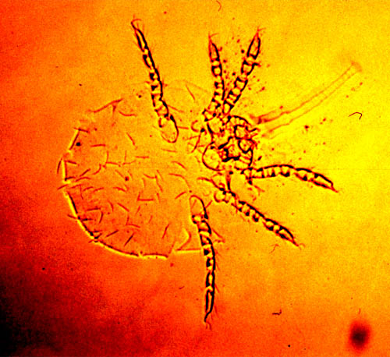
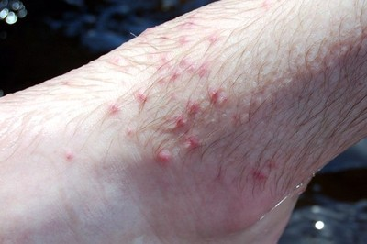
Mites:
very small to microscopic.
No hypostome,
feed by different ways.
Only one rickettsial disease is known to be transmitted by chigger mite.
Mites can cause itching, inflammation and rash (scabies).
There are eight families,
many of which feed on plants and other feeds on poultry, mammals or man
Chigger’s mite
Chigger’s mite bite

Slide 10
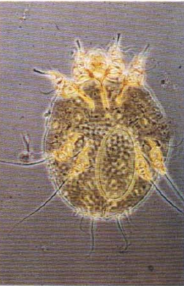
Scabies: Sarcoptes scabiei

Slide 11
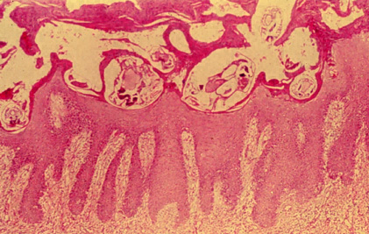
Cross sectional view of the burrows created in the epithelium by Sarcoptes scabei

Slide 12
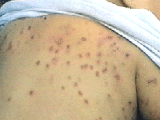
Mites burrowing under the skin cause a rash,
which is most frequently found on the hands,

Slide 14
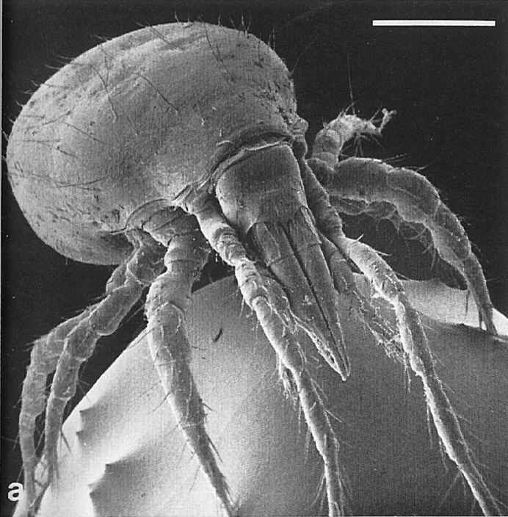
HOUSE DUST MITE

