Slide 1
Lab. Sand-fly (Al-Hermis)

Slide 2
Phylum: Arthropoda
Class: Insecta
Order: Diptera
Family: Phlebotomidae

Slide 3
Phlebotomus papatasi: it is the most dominant species.
P. sergenti: an important species.
P. Alexandri
Sergentomyia bagdadi & S. dentata
They are important spp. to keep the infection among rodents.
Lutzomayia it is important in the New World, not Old World.

Slide 4
Phlebotomus (Sandfly)
adult Female & male
with dark colored hair.
Sandy colored.
Have piercing- sucking mouth parts.
Eyes are large and filling the head.
Fragile insects, weak fliers, hump (jump).
Long legs, wings stand up and never
fold on abdomen.
Adult Phlebotomus papatasi ♀: with hair, dark colored may be the most important vector for Leishmania and papatasi fever.

Slide 5
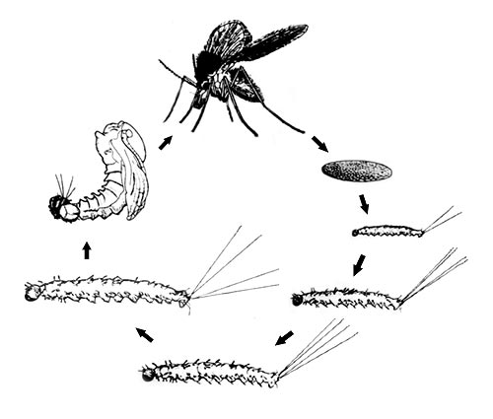
Adult
sausage shape, mosaic, yellow color, never found in nature
Pupa
Egg
1
4
4rth stage larvae, with black capsule-like head and spins on body & 2 or 4 hairs at the end.
2
4 Larval Instars
3

Slide 6
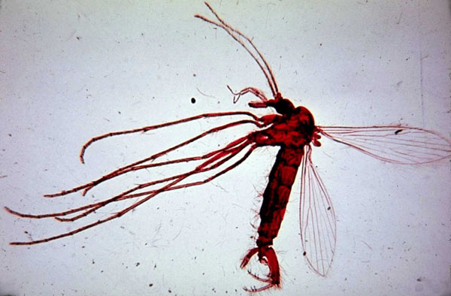
Adult Phlebotomus papatasi ♂: with outer genitalia, was seen at the end of body…with lower claspers and aedigus.

Slide 7
Egg of sand fly: sausage shape, mosaic, yellow color, never found in nature…7-10 days.
4rth stage larvae, with black capsule-like head and spins on body & 2 or 4 hairs at the end.
Pupa with old exuvae at end.

Slide 8
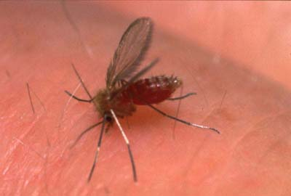
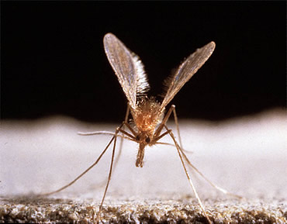
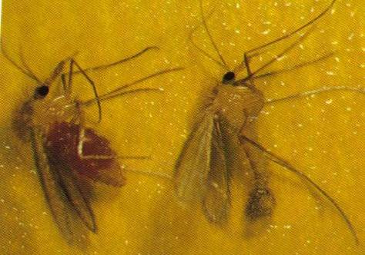
Resting position
Feeding female
Female
Male

Slide 9
Sand fly larva
black capsule-
like head
spins on body
2 or 4 hairs at
the end

