Slide 1
Lab Common flies & myiasis

Slide 2
Phylum: Arthropoda
Class: Insecta
Order: Diptera
Suborder: Cyclorhapha

Slide 3
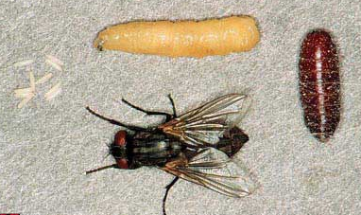
Complete metamorphosis
5-6 days from eggs to egg-lying
Larva
Eggs
Pupa
Adult
25-30 days

Slide 4
Family Muscidae: The housefly family, Medium to small size. Gray to shiny colors. Wings broad reduced veins. subfamily: Muscinae (House fly) Gray color, Lapping mouth parts. Lower lip modified with spongy wide tip. Do not bit. Lived on filthy, decayed, semi fluid. Ex: houseflies; Musca domestica: annoying, mechanical transmission. Larvae are maggot type (pointed front & wide end).
Musca domestica

Slide 5
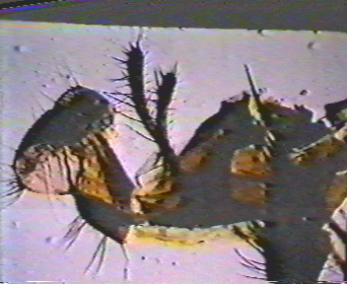
Spongy mouth part of House fly

Slide 6
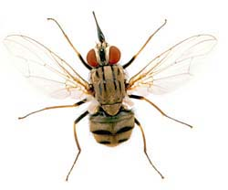
Family Muscidae: Subfamily: Stomoxyinae
1. Stable fly Stomoxis calcitrans
Medium size
modified mouthparts for
biting and blood sucking.
Live in houses, gardens,
parks.
Vector of surra disease
Trypanosoma eyeansi on
animals…
Reproduction by
oviparous larvae like
these of house flies.
Stomoxis calcitrans

Slide 7
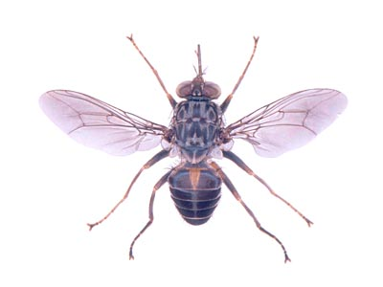
Family Muscidae: Subfamily: Stomoxyinae :
2. Glossina (tse tse fly)
Found only in Africa,
Vector of African sleeping
sickness.
Reproduce by viviparous.
give birth to larvae very
mature soon become pupa
in soil.
Parasitic on blood… give
birth to one larva at time,
every needs or so.

Slide 8
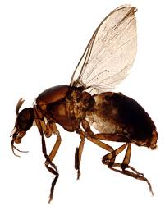
Order: Diptera Family: Simuliidae Black fly (Simulium) Onchocerca volvulus causes onchocerciasis or "river blindness"

Slide 9
Black fly (Simulium)

Slide 10
Myiasis

Slide 11
Myiasis:
Invasion of living tissues & organs by
larva of advanced flies….
Larvae live on host, pupa in soil,
many of them are viviparous (give birth
to larvae).
Larvae are maggot or bot which stubby,
two ends are recusal.

Slide 12
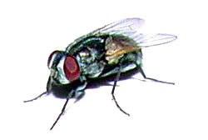
Myiasis producing families:
Family:Muscidae…….common house flies
False Intestinal myiasis.
Musca domestica

Slide 13
2. Family: Sarcophagidae (flesh fly) True Intestinal myiasis. Large, less board like, gray in color.

Slide 14
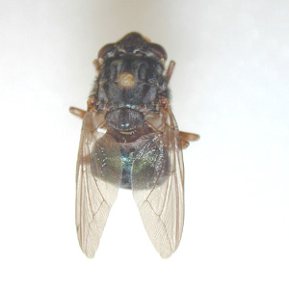
3. Family: Calliphoridae.
shining colors. Ex:
Hypoderma ovinus,
2. Dermatobia hominis
3. Cordylobia antheropophaga
Tumbu fly
4. Chrysomyia bezziani
Dermal myiasis: a. Creeping irretation: Hypoderma spp. Dermatobia hominis
Dermatobia hominis

Slide 15
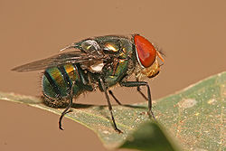
3. Family: Calliphoridae.
shining colors. Ex:
Hypoderma ovinus,
2. Dermatobia hominis
3. Cordylobia
antheropophaga
Tumbu fly
4. Chrysomyia bezziani
Chrysomyia bezziani
Traumatic myiasis: Chrysomyia bezziana

Slide 16
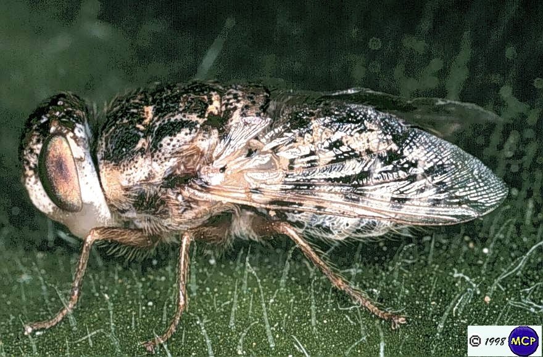
4. Family: Oesteridae.
naghaf flies. Ex: Oesterus ovis
Nasophayngeal myiasis: Oesteris ovis, nasopharynx in sheep, ophthalmomyiasis in man .

Slide 17
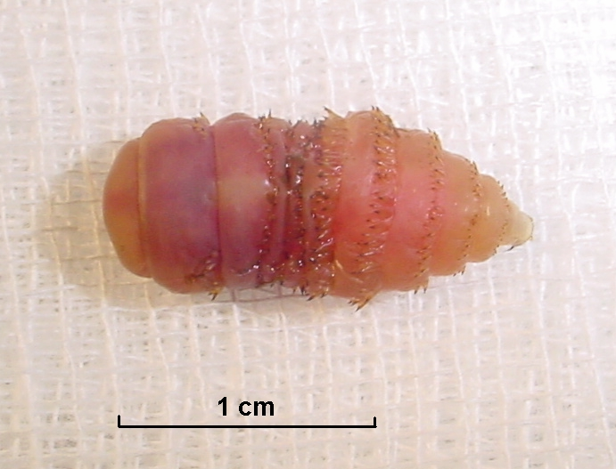
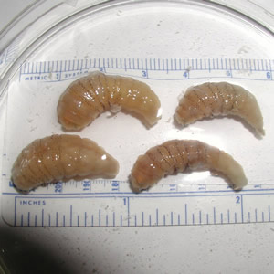
Bot larvae

Slide 18
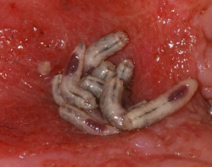
Maggot larva

