Slide 1
Lab.
Arthropod groups-2

Slide 2
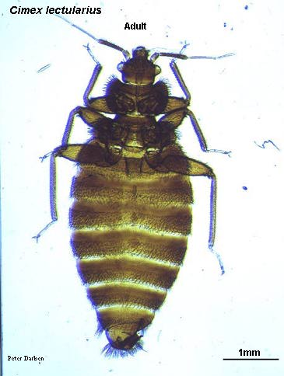
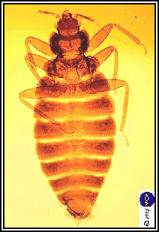
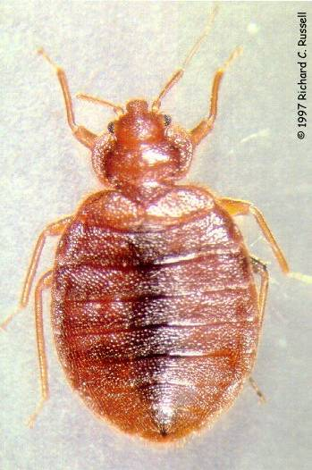
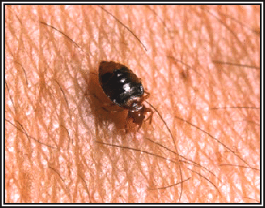
Class Insecta:
Very important vectors.
Three body regions,
Three pairs of legs.
Most insects are winged.
Undergo metamorphoses.
Four important orders:
1. Order: Hemiptera (نصفية الاجنحه):
A. Family: Cincidae: non vector,
but annoying…..
(Bed bug).
Feeding bedbug

Slide 3
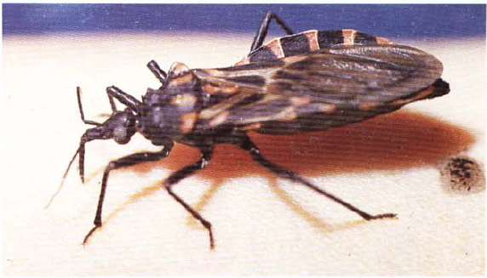
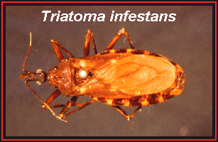
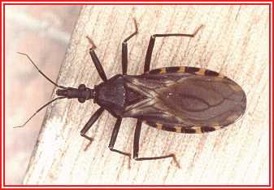
2. Family:Reduviidae: vectors of chagas disease.
Triatomine bug (assassin bug)

Slide 4
Lice

Slide 5
Order: Anoplura [sucking lice, القمل الماص]
Two genes of lice infest humans: Pediculus
humanus capitis (head louse), Pediculus
humanus corporis (body louse) and Phthirus
pubis (crab louse, pubic louse).
Lice are dorsoventrally flattened insects, about 1.5–4mm in length, wingless, with reduced eyes,
Short (five-segmented) antennae, piercing and
sucking mouthparts, and strong claws designed to
cling to hairs.

Slide 6
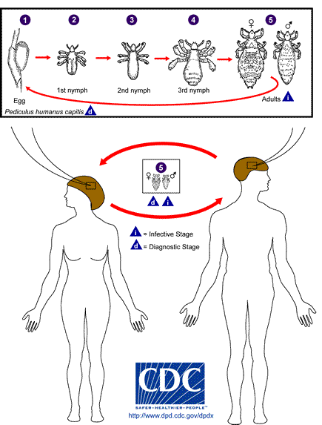
It transmitted mainly via:
head-to-head contact.
Less commonly, via fomites (such as hats, scarves, coats, sports uniforms, or hair ribbons).

Slide 7
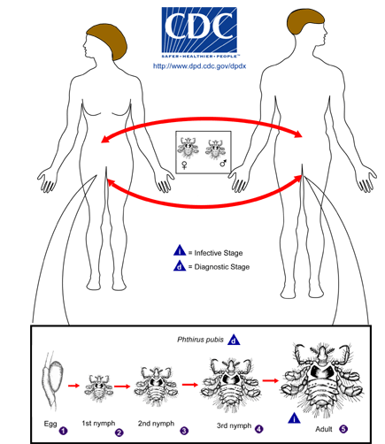
Pubic lice are transmitted from person to person most-commonly via:
sexual contact,
fomites (bedding, clothing) may play a minor role in their transmission.

Slide 8
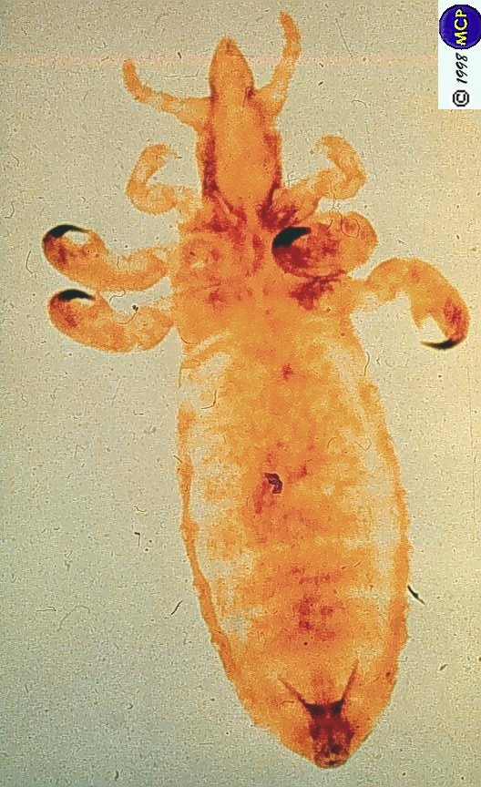
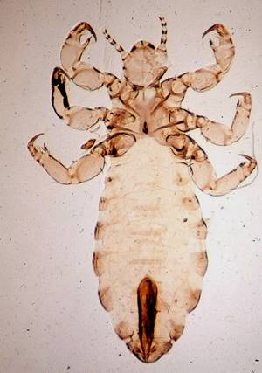
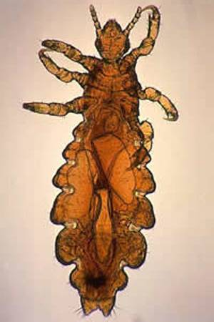
2. Order: Anoplura (القمل الماص):Pediculus
vector of epidemic
typhus and relapsing
fever.

Slide 9
Eggs (called nits) are laid on hair shafts and
are held tightly by cement like substance,
making them difficult to remove.
Lice remain on a host permanently;
Both males and females are hematophagous
and require frequent blood meals.

Slide 10
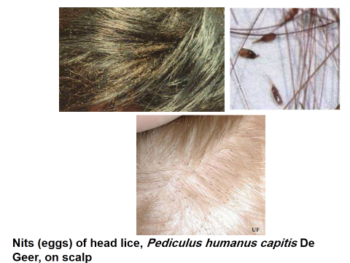

Slide 11
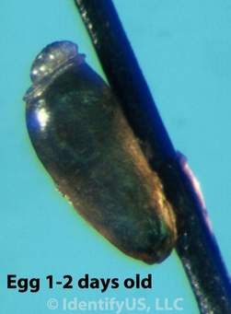
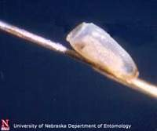
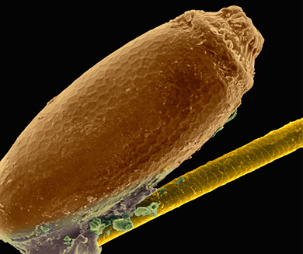
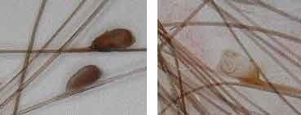
Phylum: Arthropoda
IV. Class Insecta:
2. Order: Anoplura (القمل الماص):
Pediculus spp. قملة الجسم
Eggs (Nits)

Slide 12
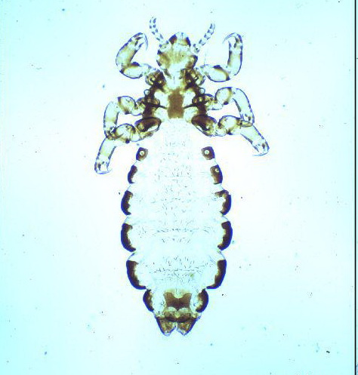
Pediculus humanus capitis (head louse adult)

Slide 13
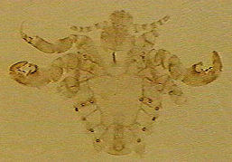
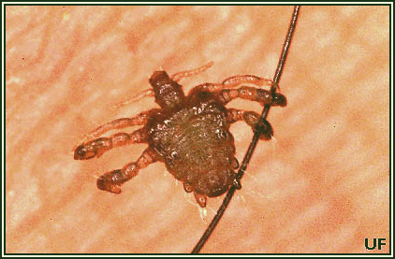
Phthirus pubis (crab louse, pubic louse)

Slide 14
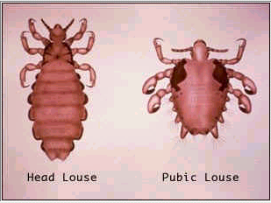
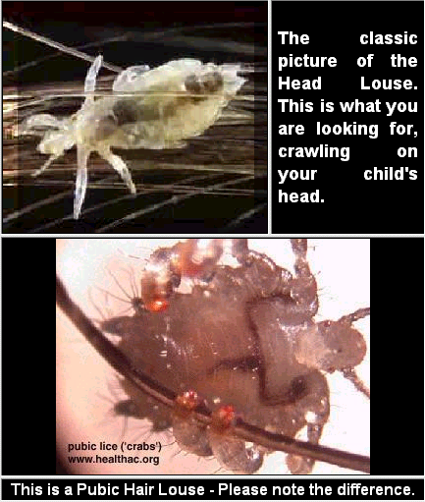
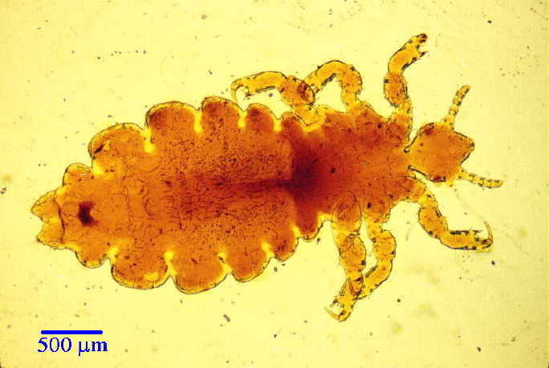
Lice
Lice, pediculus humanus Var. capitis, head louse and phthirus pubes, crab louse

Slide 15
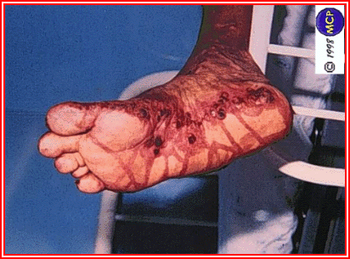
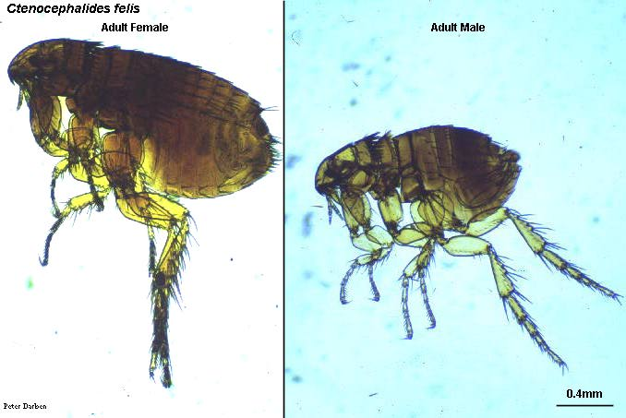
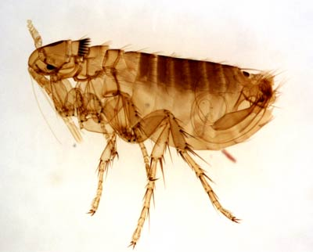
3. Order: Siphonoptera (fleas):
vectors of plaque and
endemic typhus.

Slide 16
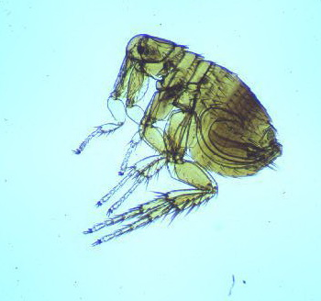
Insecta:
Flea

Slide 17
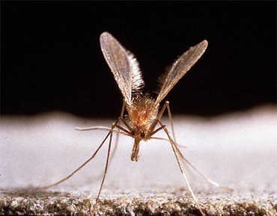
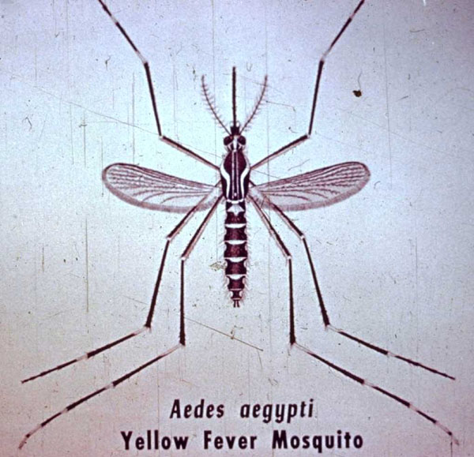
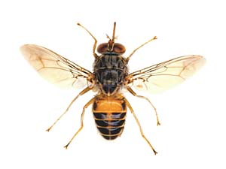
4. Order: Diptera: ثنائية الاجنحه:
one pairs of wings
many important families,
i.e. mosquitoes, sand flies,
common flies……etc.

