Slide 1
Lab Arthropod groups-1

Slide 2
Characters of Arthropoda:
Bodies & appendages (legs, mouth parts, antennae
and genitalia) are segmented.
Body walls are made up of a complicated
saccharine & proteins secretion (non-living
materials called chitin) which is resistant to water
lose, to grow the animal mast be molt.

Slide 3
Adult (male & female)
Eggs
Larva
Pupa or nymph in some groups

Slide 4
Phylum: Arthropoda
4 medical important Classes
Myriapoda
Crustacia
Arachnida
Insecta

Slide 5
I. Class Myriapoda:
The most primitive,
Elongated bodies,
Many segments,
Many legs
With antennae & chewing mouthparts.
Diplopoda (millipeds (خاتم سليمان
Chilipoda (centipeds (ام سبعة وسبعين

Slide 6
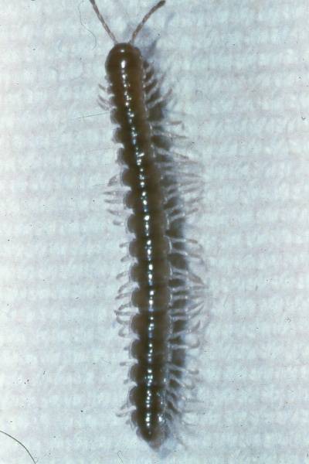
A. Diplopoda (millipeds خاتم سليمان ):
Many segments,
Segments circular,
Two pairs of legs per segment,
Live on plant materials in
gardens (herbaceous)
Body covered with minute
hairs & glands,
If bothered either spray
poisoning secretions or
through hairs or both,
causing sensitivity, rash,
swelling but not killing.

Slide 7
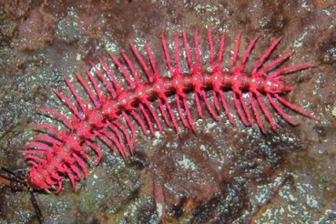
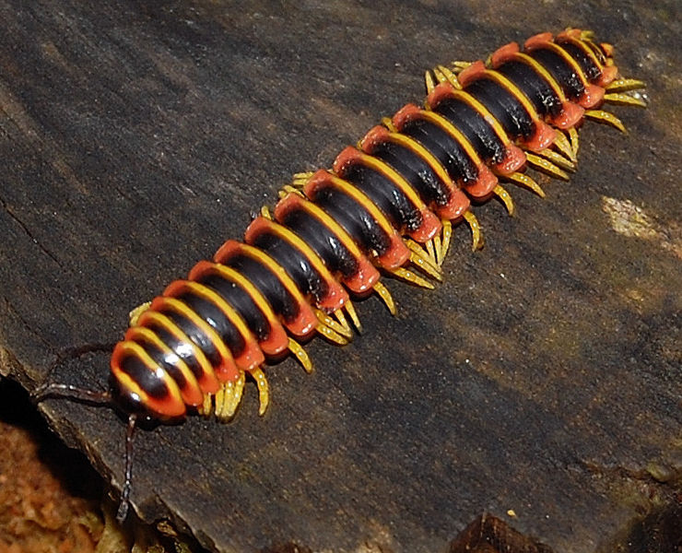
2 pairs of legs - segment
Antennae
Body segments

Slide 8
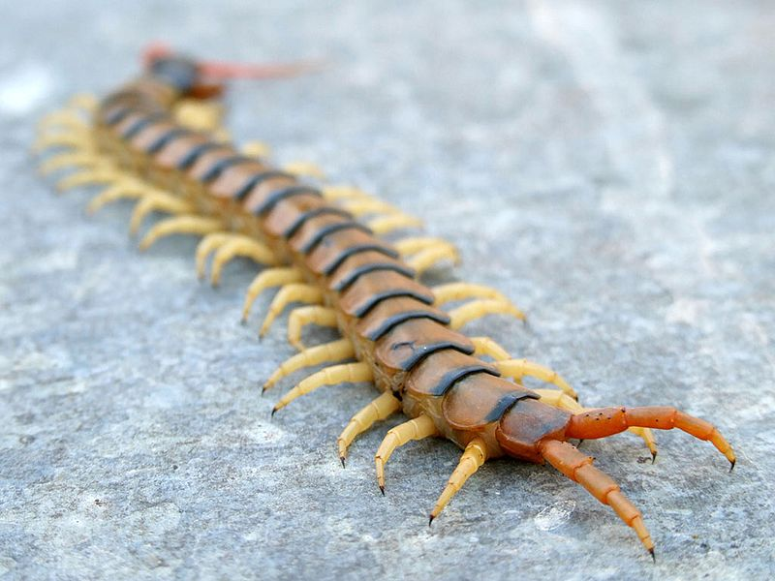
Chilipoda (centipeds ام سبعه وسبعين ):
Many broad segments,
One pair of legs in each
segment,
Predacious on other small arthropods,
Provided with poison
glands,
First pair of leg modified
into claws to inject poison
Painful bite may be killing.
Claws
1 pair of legs -segment

Slide 9
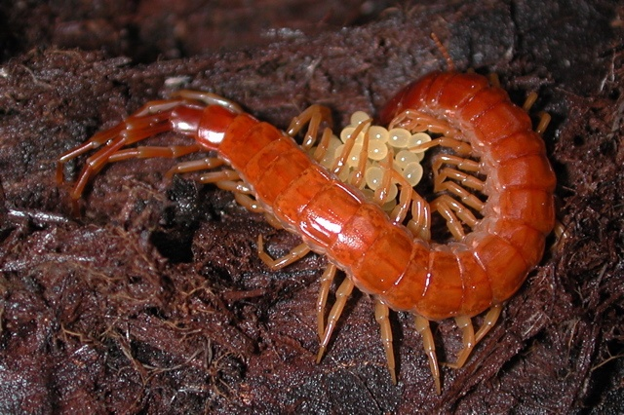

Slide 10
II. Class Crustacia
Mostly aquatics, like prakin = روبيان crab = ابو الجنيب
….etc,
Very important as protein foods for people who live on
sea or ocean shores.
Body are of two (some times three) regions, one pair of
legs in each segment.
The body regions are cephalothoraxes and abdomen.
Legs are modified to function in feeding, walking,
swimming & meeting.
One order which is terrestrial called saw bugs.

Slide 11
Medically the important spp. belong to copepod, small aquatic called water flea.
The genus Cyclops is the transmitter (vector) of nematodes Dracunculus medinensis ,

Slide 12
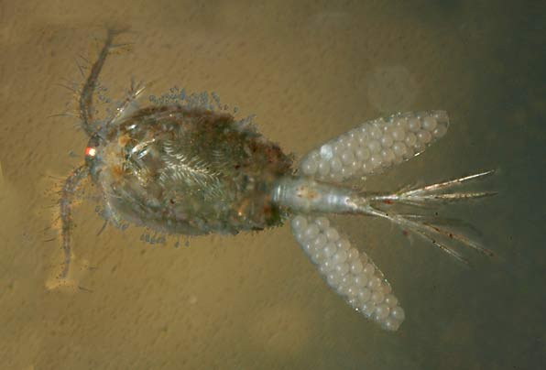
Water flea (Cyclops) or copepod

Slide 13
III. Class Archanida (العنكبوتيات)
like spiders, scorpions, ticks & mites.
They are characterized by having:
A. 2 body regions…… cephalothorax & abdomen.
B. In adult 4 pairs of legs, on the cephalothorax.
No appendages on abdomen.
C. No sensory antennae.
D. Mouth parts all of sucking types (piercing,
cutting, rupturing and then sucking). mouth
parts composed of chelicerae & peripoda.

Slide 14
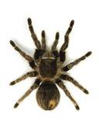
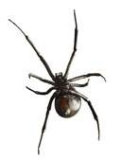
A. Order :Aranida (Spiders)
Terrestrial & predacious.
The abdomen joins to the cephalothorax by a narrow pedicel.
All spiders are poisonous
and silk producing,
But very few of them are dangerous, or even killing.
The black widow is the dangerous group.

Slide 15
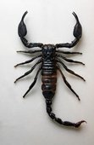
B. Scorpions:
Large to medium,
Two body regions,
Two modified clasping
peripoda,
Cephalothorax with 4
pairs of legs,
Chelicerae small.
The abdomen of two parts:
a. wide anterior portion
b. narrow, long posterior
portion ending with sting
needle and a poison gland.

Slide 16
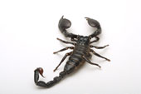
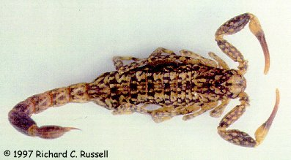
Al- Jarrar scorpion:
Found in the eastern
of Zagros Mountain, Khanaquin, Mendili, Badrah, Jassan and down to Ahwaz (Iran).
The scorpion when moving draws the tail behind and not having it stand on the ready.
Very dangerous, may kill children or leave a large spot….

Slide 17
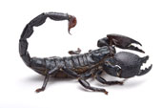
2. The black scorpion:
Large,
All over Iraq,
Black and dangerous.
There are mentions of
killing children and even
adult in Iraq.

Slide 18
