Slide 1
Protozoa

Slide 2
Lab
Apicomplexa
Toxoplasma gondii
Sarcocystis

Slide 3
Apicomplexa
Toxoplasma gondii (Toxoplasmosis)

Slide 4
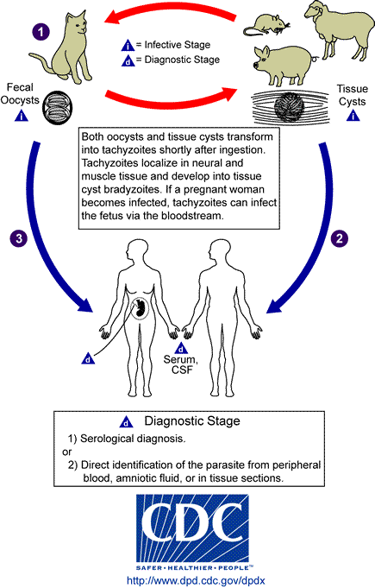

Slide 5
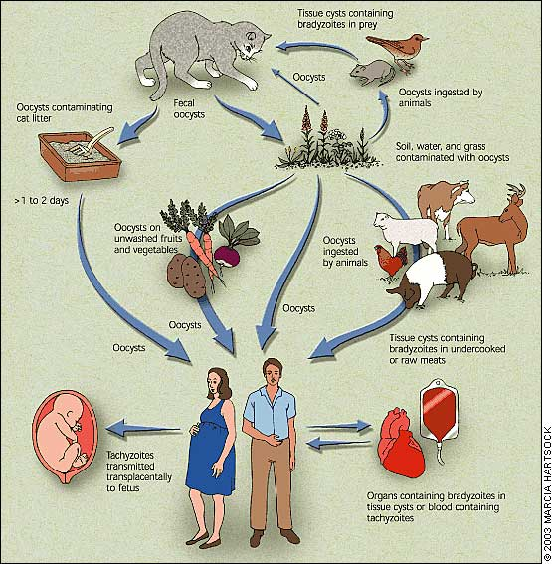
Transmission of T. gondii
Notes:
Ingestion of oocysts(cat).ingestion zoites in meat. Congenital. Organ transplant. Blood transfusion.
5

Slide 6
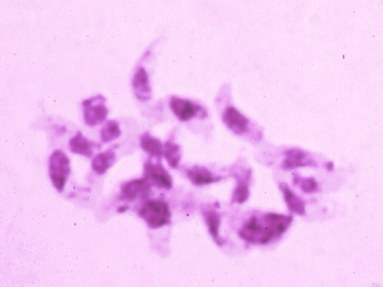
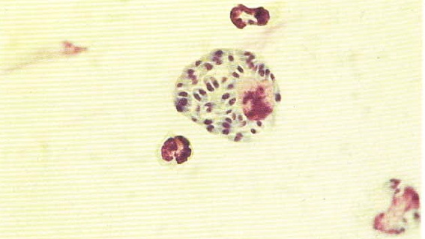
Apicomplexa 1. Toxoplasma gondii a. tachyzoite: shape pyriform; interacellular nucleus single, at wider end organism.
Tachyzoites
Tachyzoites in leukocyte

Slide 7
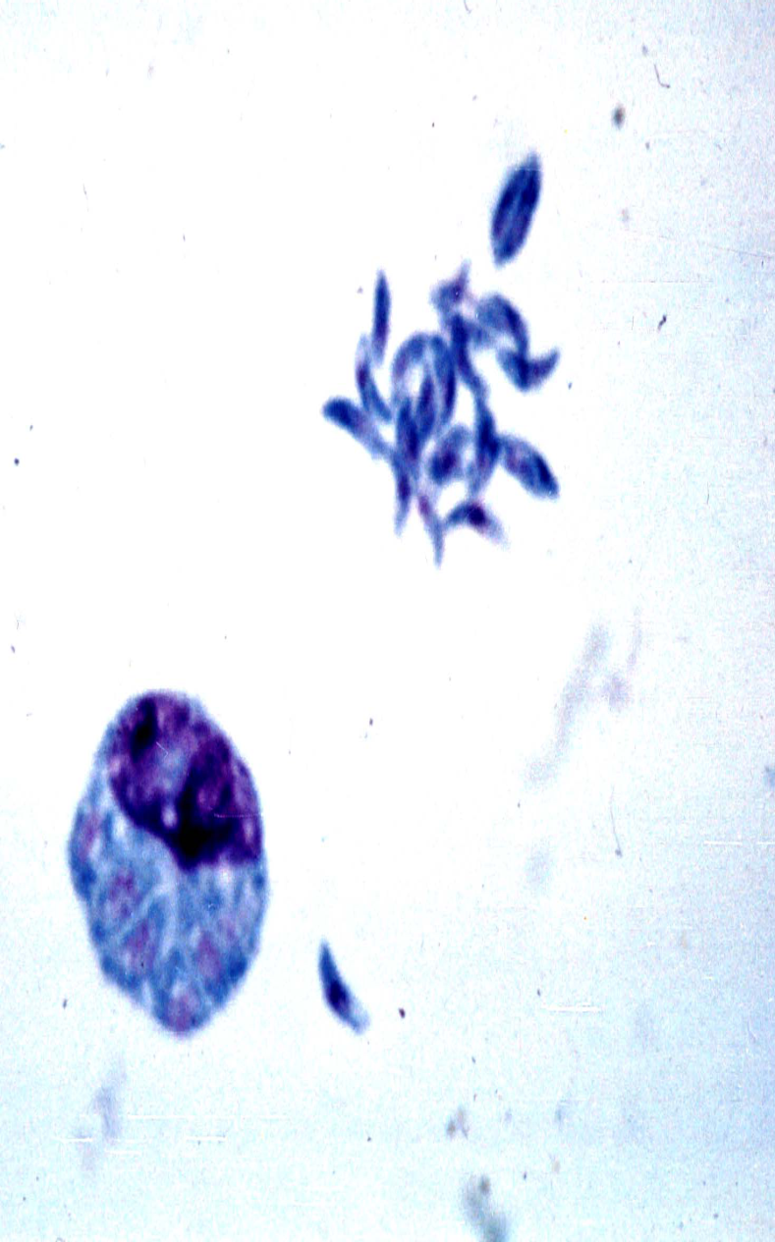
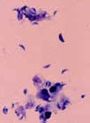

Slide 8
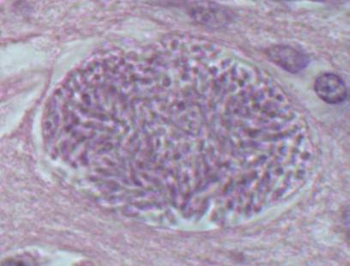
Toxoplasma gondii b. bradyzoite: similar to tachyzoite, but smaller; within sarcocyst or neurocyst, in hundreds.
bradyzoites

Slide 9
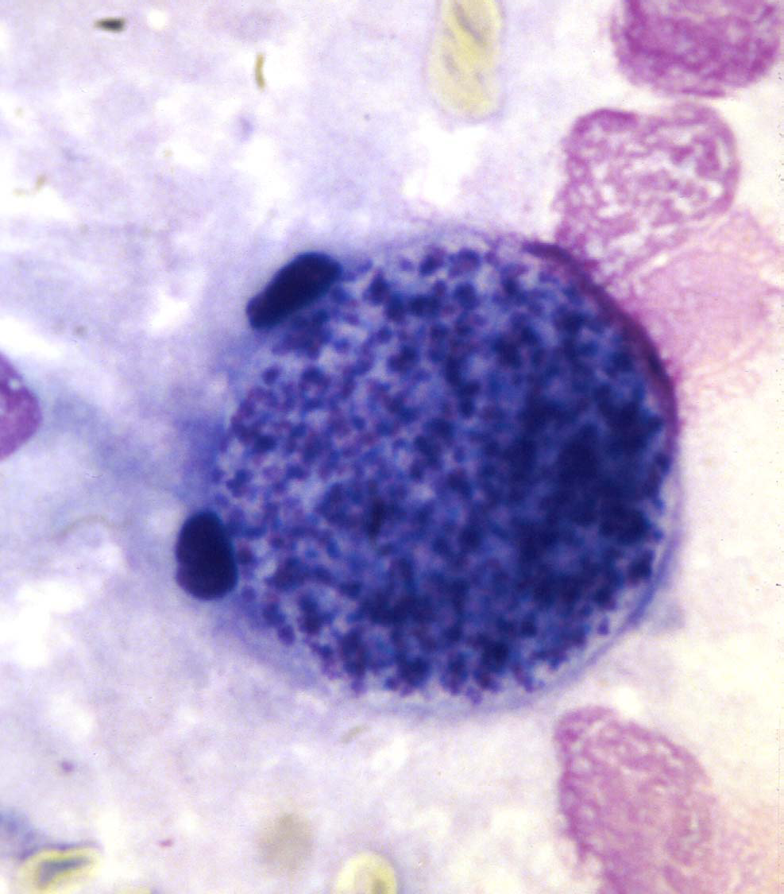

Slide 10
Life cycle of S. lindmanni (sexual-gamogony &sporogony occur in animal while asexual-schizogony occur in human)
Human intermediate host
In definitive host

Slide 11
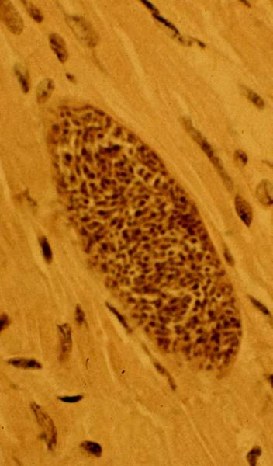
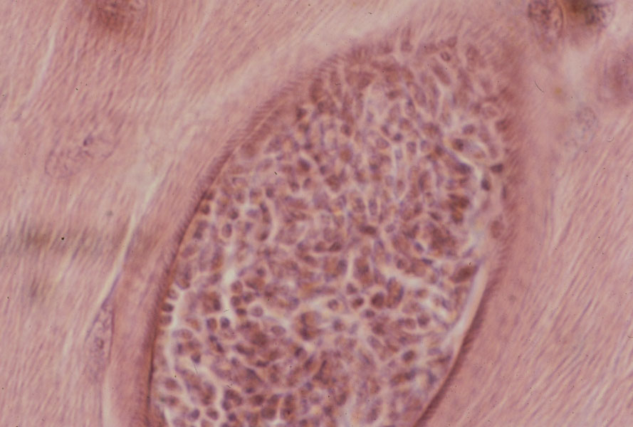
2. Sarcocystis lindmanni sarcocyst in striated muscle; bradyzoites numerous.
Bradyzoites
Thick wall sarcocyst
Bradyzoites
Thin wall sarcocyst

Slide 12
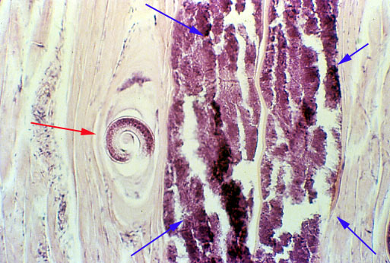
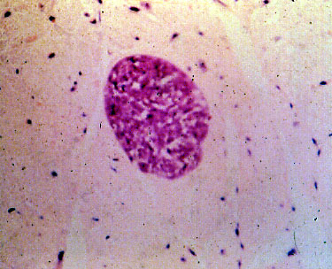
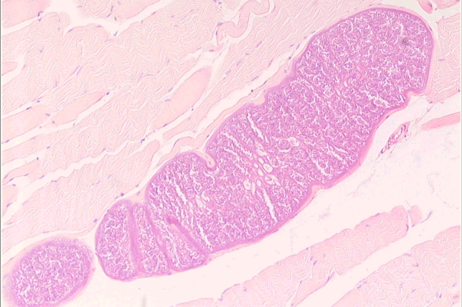
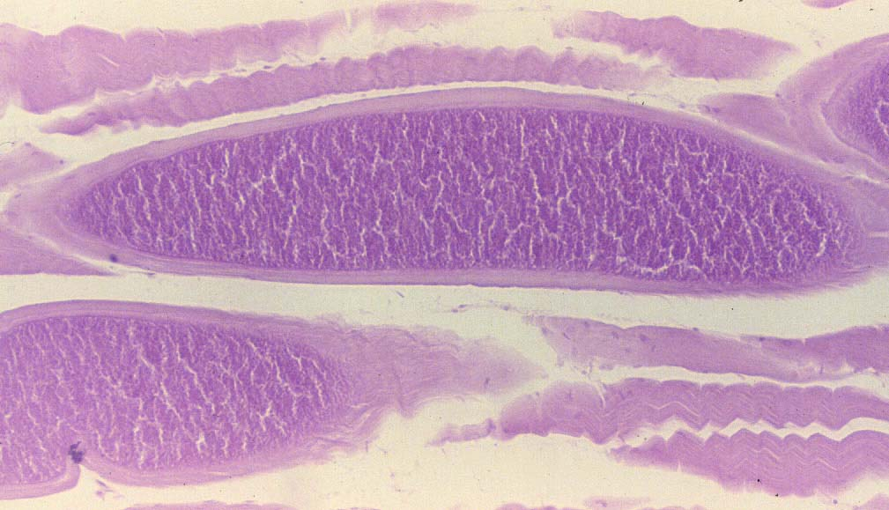
156
Sarcocytis lindemanni
Sarcocytis lindemanni Mieschers Tubules
sections in human skeletal muscles and myocardium
Hematoxylin – eosin s.

