Slide 1
Protozoa

Slide 2
LabPlasmodium spp.
Part II

Slide 3
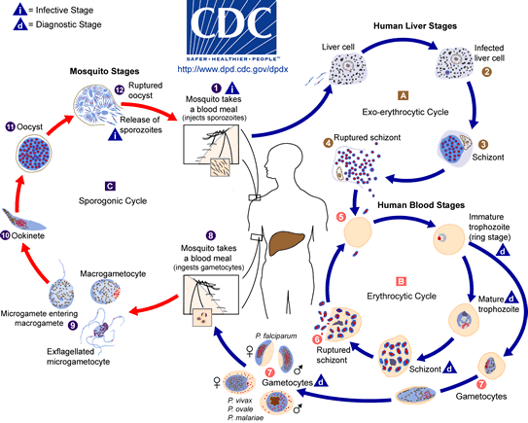
Life Cycle:
Tow transfers stages: sporozoite (from mosquito to man) & gametocytes (from man to mosquito)

Slide 4
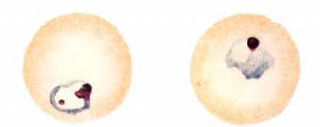
1. Plasmodium vivax
E. Ring stage (early trophozoite):
Infected erythrocyte enlarged,
Schüffner’s dots may be present
Cytoplasm thin, enclosing a large vacuole,
Light blue-gray;
Nucleus single, staining red;
Parasite resembling signet ring.

Slide 5
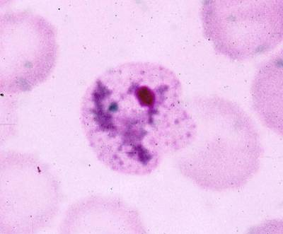
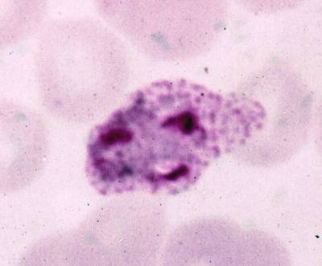
1. Plasmodium vivax
F. Amoeboid stage(matyre trophozoite)
Infected RBC enlarged;
Schüffner’s dots present;
Parasite occupying most of RBC;
Shaped amoeboid; vacuoles several;
Nucleus single.
Early
Late

Slide 6
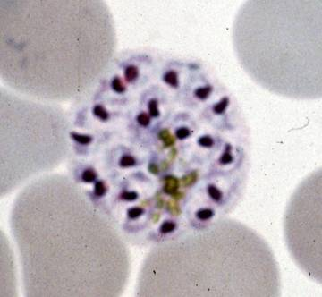
1. Plasmodium vivax
G. Schizont:
Infected RBC enlarged;
Schüffner’s dots present;
Parasite occupying most of RBC;
Nuclei 2-24;
Vacuoles absent.
Merozoites
Mature

Slide 7
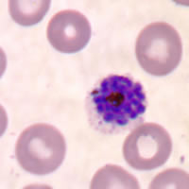
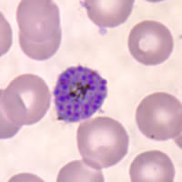
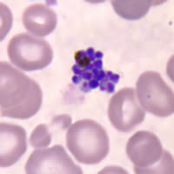
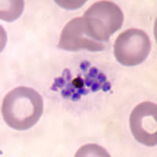
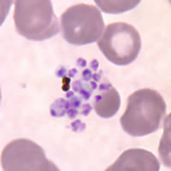
P. vivax ( X 1000 )
122
A
B
C
D
E
A, B: Mature schizonts
C, D, E: Ruptured schizonts

Slide 8
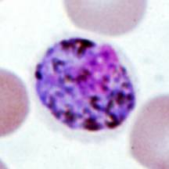
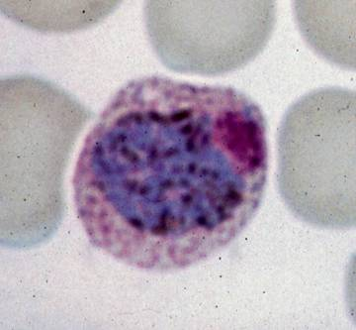
1. Plasmodium vivax
H. Gametocytes:
Infected RBC enlarged;
Schüffner’s dots present;
Parasite occupying most of RBC;
Shape round;
Nucleus single.

Slide 9
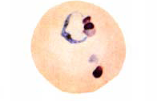
2. Plasmodium falciparum
A. Ring stage (early trophozoite):
Infected erythrocyte not enlarged,
Schüffner’s dots absent;
Slightly smaller
  Marginal forms
  Cytoplasm thin, enclosing a large vacuole,
  Nucleus single, or double (multiple infection)
staining red; Parasite resembling signet ring.

Slide 10
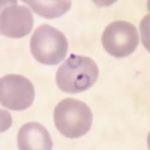
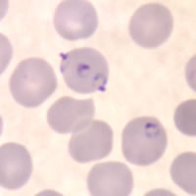
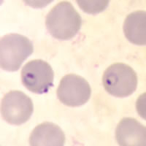
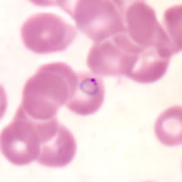
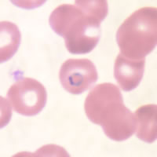
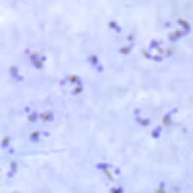
138
A
B
C
D
E
F
A, B, C: Multiply infected red blood cells with appliqué forms in thin blood smears
D: Signet ring form.
E: Double chromatin dot
F: A thick blood smear showing many ring forms of P. falciparum (X 1000)

Slide 11
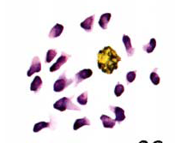
2.Plasmodium falciparm
B. Schizonts
  Not normally in peripheral circulation
  Compact parasite
  16-24 (up to 36) merozoites in infected RBC.
Immature
Mature

Slide 12
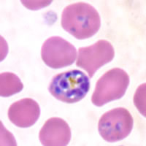
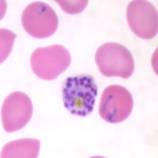
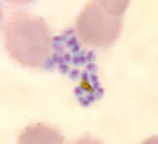
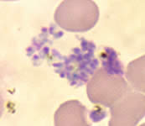
P. falciparum ( X 1000 )
A
B
C
D
A: Immature schizont in a thin blood smear.
B: Mature schizont
C, D: Ruptured schizonts in a thin blood smear

Slide 13
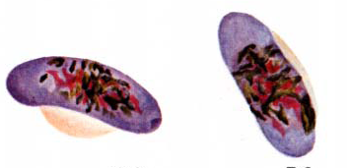
5. Plasmodium falciparum
A. Gametocyte:
Infected RBC not enlarged;
Schüffner’s dots absent;
Shape crescentic;
Nucleus single.
Microgametocytes with defuse nucleus, cytoplasm pale.
Macrogametocytes with compact nucleus, cytoplasm stained deep blue.
Macrogametocytes
Microgametocytes

Slide 14
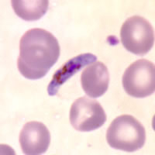
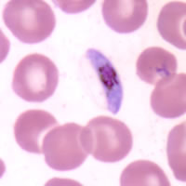
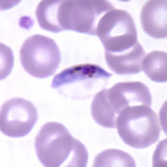
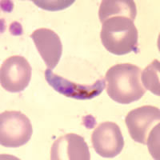
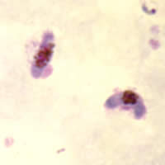
141
( X 1000 )
A
B
C
D
E
A, B, C, D: Gametocytes of P. falciparum in thin blood smears. Note the presence of a “Laveran’s bib”, which is not always visible
E: Two gametocytes captured from a thick blood smear

Slide 15
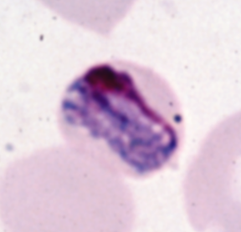
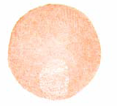
4. Plasmodium malariae
A. Band form:
Infected RBC not enlarged;
Schuffner’s dots absent;
Cytoplasm compact, extending nearly along entire diameter of RBC;
Nucleus single.

Slide 16
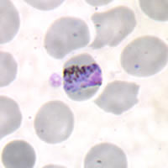
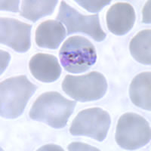
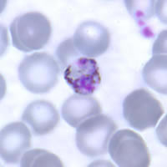
P. malariae ( X 1000 )
A
B
C
A, B, C: Mature trophozoites in thin blood smears. A and B are band forms. C is a "basket" form

