Slide 1
Protozoa

Slide 2
Lab: 15 Haemosporina
Plasmodium spp.
Part -I

Slide 3
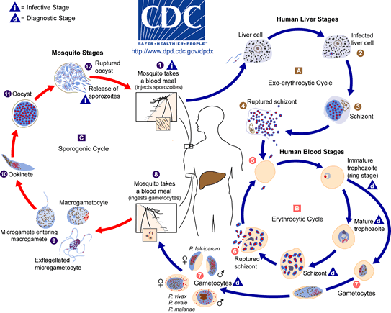
Life Cycle:
Tow transfers stages: sporozoite (from mosquito to man) & gametocytes (from man to mosquito)

Slide 4
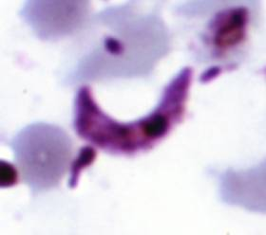
1. Plasmodium spp. A. Ookinete: Shape pyriform; Nucleus central

Slide 5
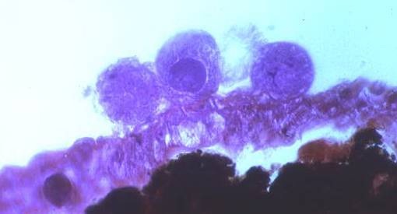
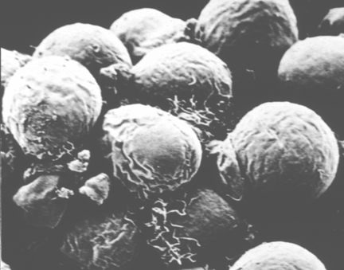
1. Plasmodium spp. B. Oocyst: In mosquito stomach; Globular, on outer surface Mosquito stomach; many; Sporocyst numerous in each oocyst

Slide 6
1. Plasmodium spp. C. Sporozoites: Shape crescentic, Slender; Nucleus central; Usually numerous.

Slide 7
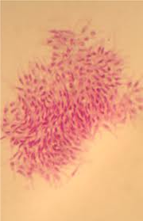
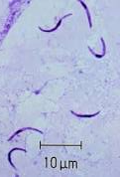

Slide 8
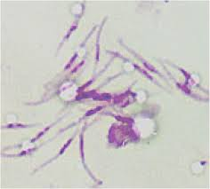

Slide 9
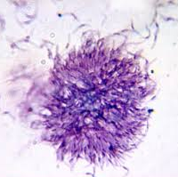

Slide 10
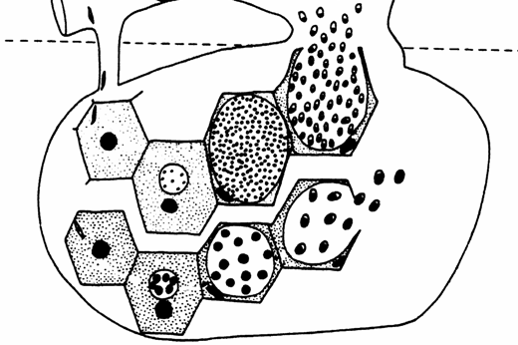
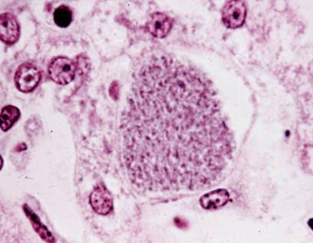
1. Plasmodium spp. D. Schizont in liver: Parasite within hepatocyte; Hepatocytes much enlarged; Parasite with thousand nuclei.

Slide 11
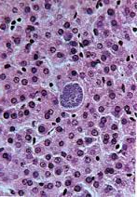

Slide 12
