Slide 1
Protozoa

Slide 2
Lab.
Ciliates
Balantidium coli

Slide 3
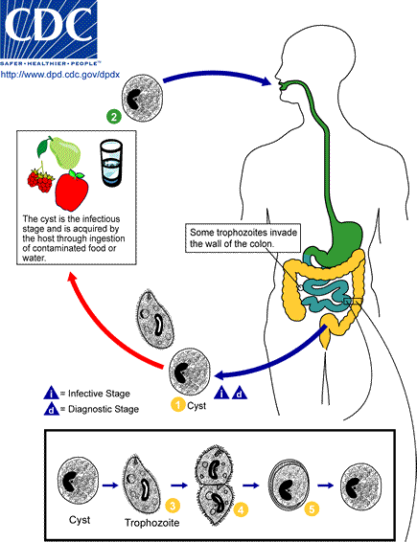

Slide 4
Balantedium coli A. trophozoite: shape ovoid; cilia cover the body; cytostom present; nuclei 1 small (micronucleus), 1 large (macronuclues).

Slide 5
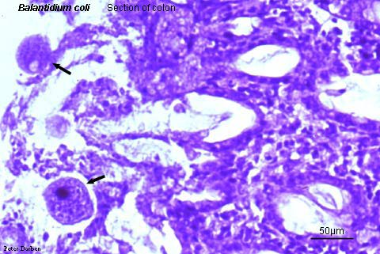
Hematoxylin - eosin stain
Balantidium coli trophozoite in section of colon

Slide 6
Balantedium coli B. Cyst: Shape round, 2 Nuclei micro- and macronuclues.

Slide 7
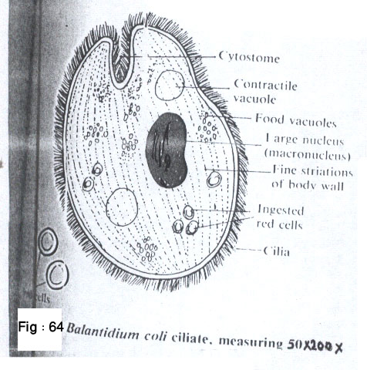
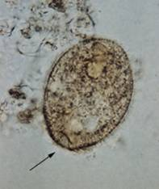
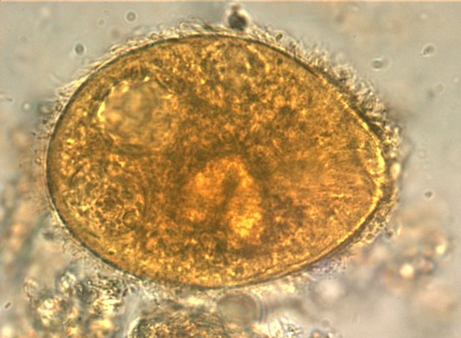
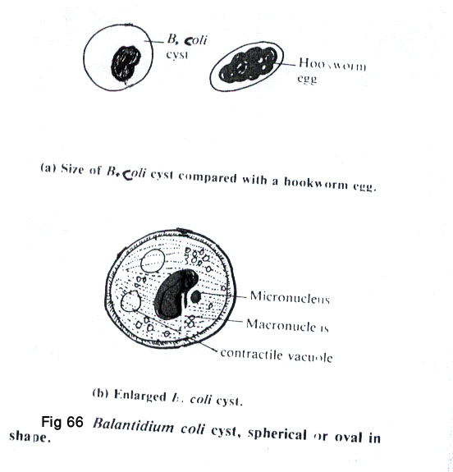
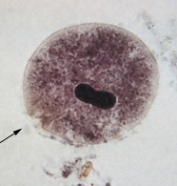
( X 1000 )
Iodine stain
Balantidium coli Trophozoite, stool smear ( 60 – 200 µm )
Trichrome stain
Balantidium coli Cyst stool smear ( 50 – 60 µm )

