Slide 1
Protozoa

Slide 2
LAB : 3
Flagellates of digestive tract and genital organs
Giardia lamblia
Chilomastix mesnili
Trichomonas vaginalis

Slide 3
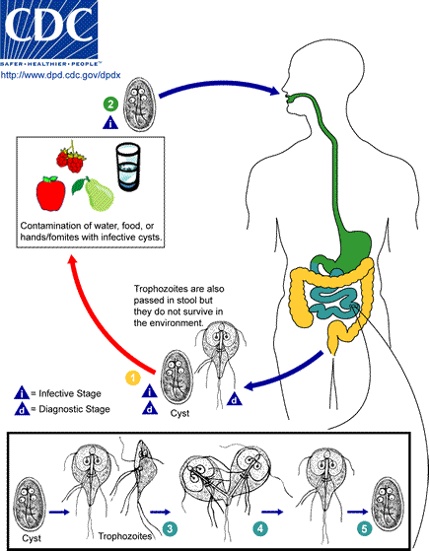

Slide 4
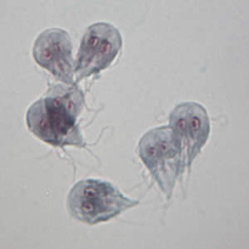
Giardia lamblia A. trophozoite: pyriform shape (pear-shape); nuclei 2, sucking disc 2; axonemes central; flagella 4 pairs.

Slide 5
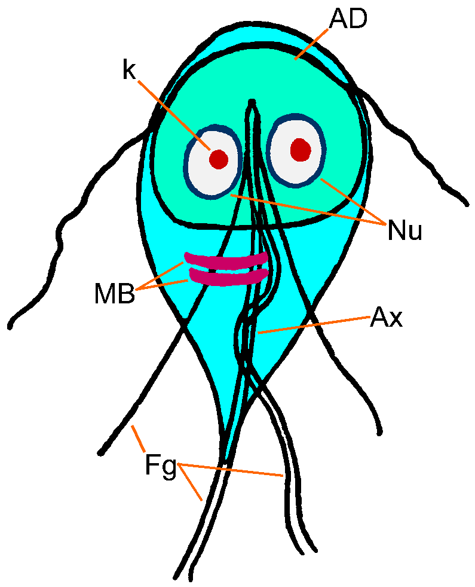
Trophozoites
Fibrils (axonemes) evident
bilateral symmetry
Pair of claw-shaped median bodies
Adhesive disk (not always evident)
4 pair flagella
motility likened to falling leaf
inhabit the small intestine mucosa

Slide 6
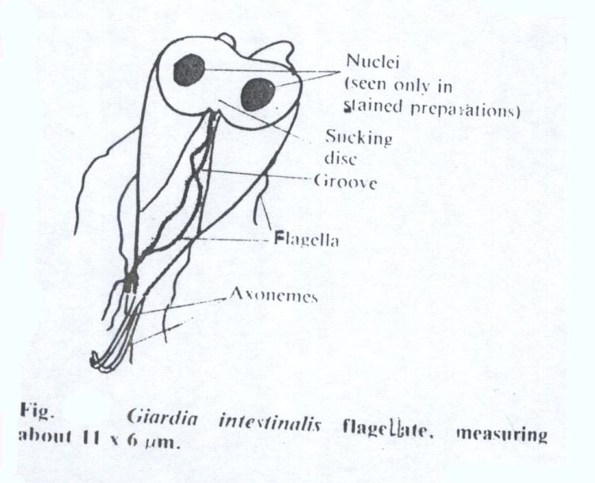
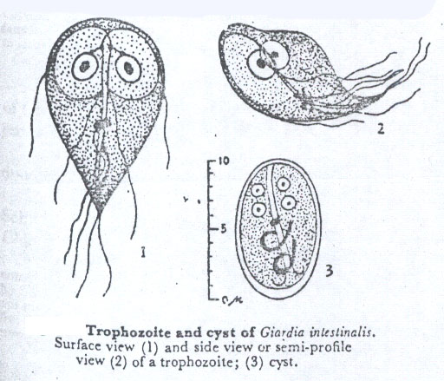
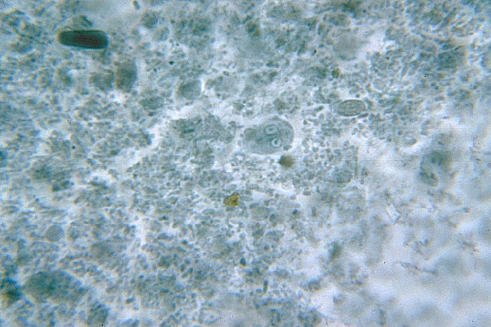
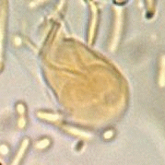
44
Fig 45
Iodine stain
Saline s.
Giardia lamblia Trophozoite, stool smear ( 12 – 16 µm )
Note : the motile in saline, twisting – jerky

Slide 7
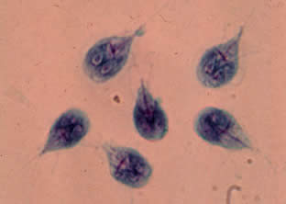
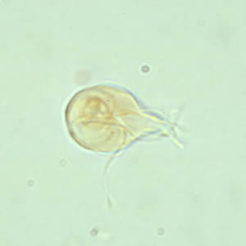
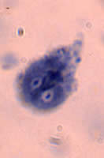
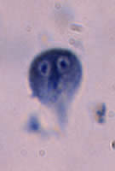
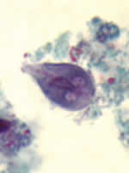
Giardia intestinalis in culture. In preparations the flagellae ( four pairs .per cell are clearly visible
B
C
A
A, B, C: three trophozoites of Giardia intestinalis. Stained with trichrome (A) and stained with iron hematoxyline (B and C) each cell has two nuclei with a large, central karyosome. Cell size: 9 to 21 µm in length ( duodenal aspiration smear )

Slide 8
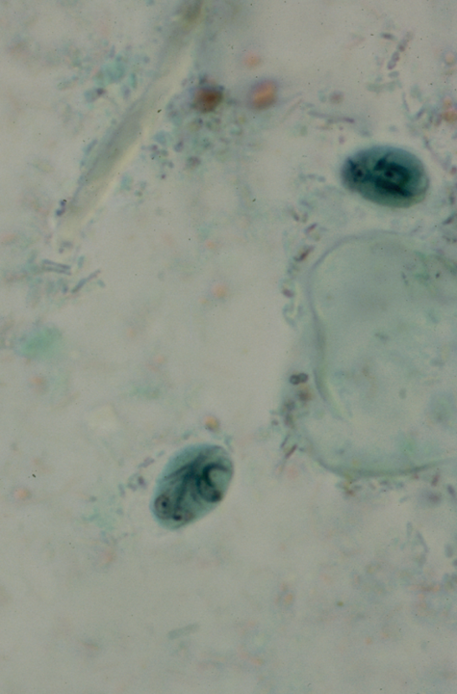
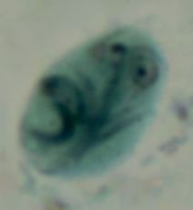
Giardia lamblia B. cyst: ovoid; 1-4 nuclei; axonemes crossing.

Slide 9
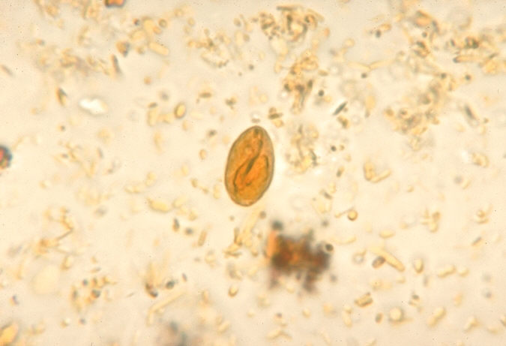
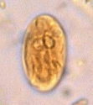
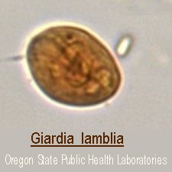
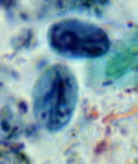
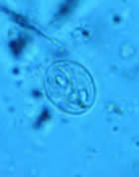
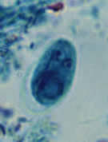
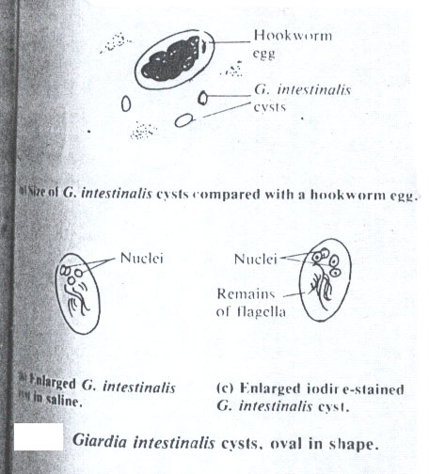
Iodine stain
( X 40 )
Fig 50
:Giardia lamblia Cyst in a wet preparation and stained with iron – hematoxylin,
these cysts have two nuclei. Each ( more mature ones will have four ) ( 10 – 13 µm )
( X 1000 )

Slide 10
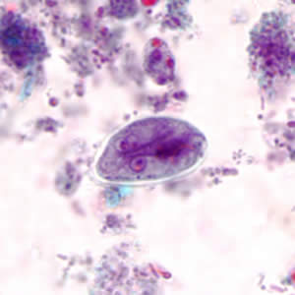
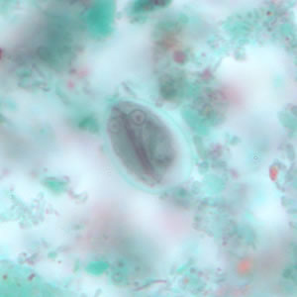
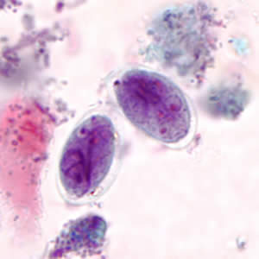
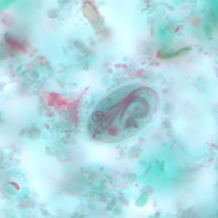
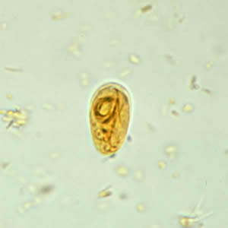
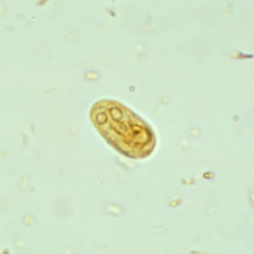

Slide 11
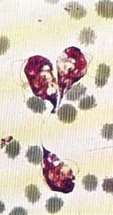
Chilomastix mesnili A. trophozoite: pyriform shape; flagella 3; anterior cytostome present, with in-curved flagellum.

Slide 12
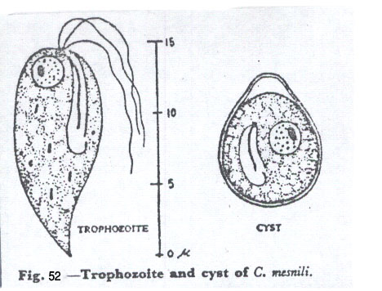
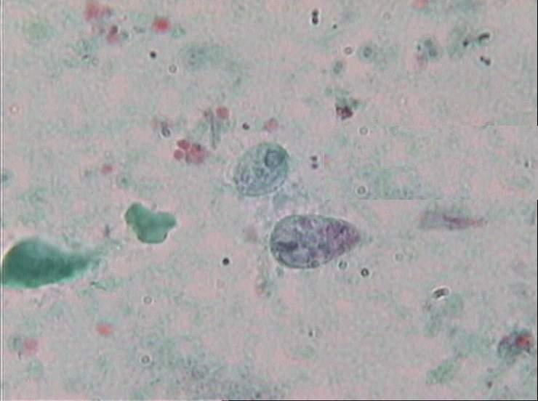
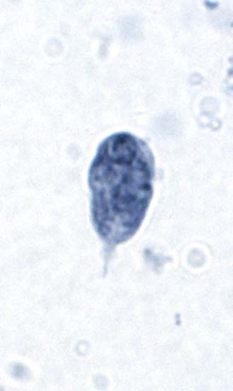
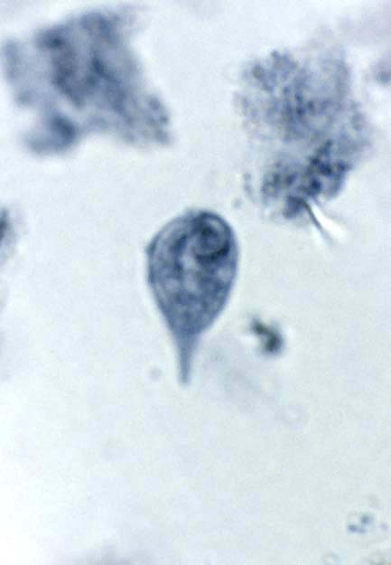
Dimethyl sulfuxide – modified (DMSO) stain
DMSO STAINE
11 – 14 µm ( X 1000 )
Iron – hematoxylin stain
Chilomastix mesnilli (Trophozoite), stool smear
Note : the motile in saline spiral – jerky

Slide 13
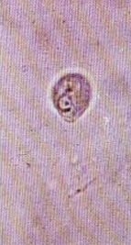
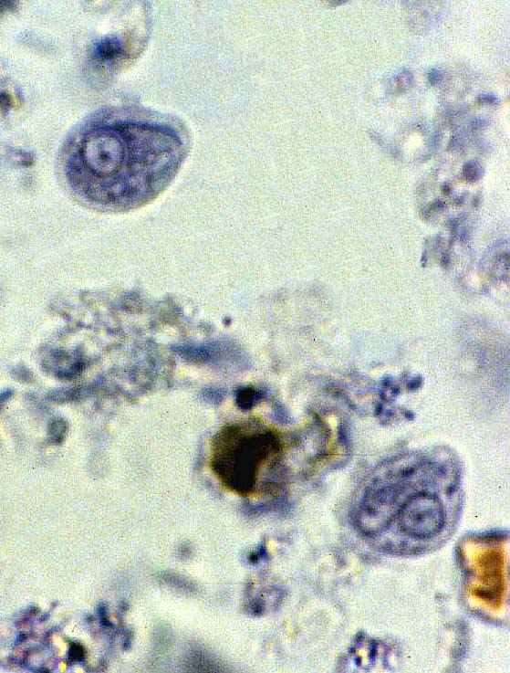
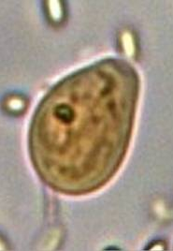
Chilomastix mesnili B. cyst: shape lemon-like; nucleus single; cytostome with flagellum.

Slide 14
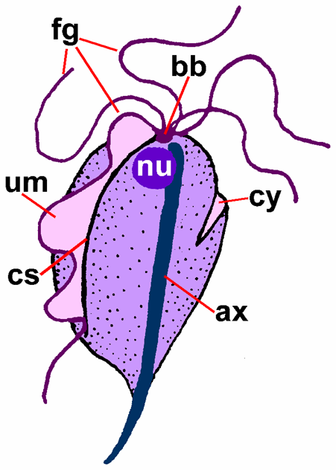
TRICHOMONADS
3-5 anterior flagella
one undulating membrane
axostyle

Slide 15
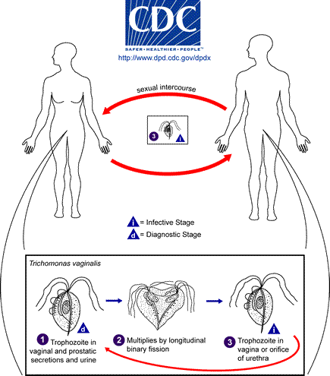

Slide 16
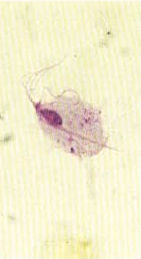
Trichomonas vaginalis shape pyriform; flagella 4 anterior, 1 trailing along undulating membrane; axostyle present.
trophozoite only

Slide 17
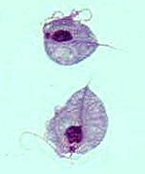
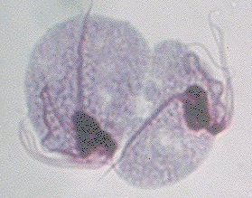
Trichrome stain
Trichomonas vaginalis Trophozoite 15 – 30 µm ( X 1000 )
Note : the motile, rotary – clock – wise for all Trichomonas spp.

Slide 18
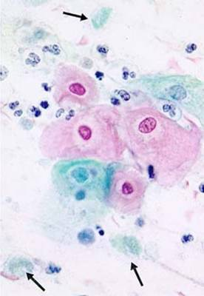
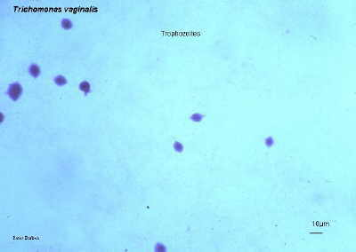
A
B
Methylene blue S.
Trichomonas vaginalis, trophozoite A smear from swab of vagina from infected female, B smear from urtheral discharge from infected male

Slide 19
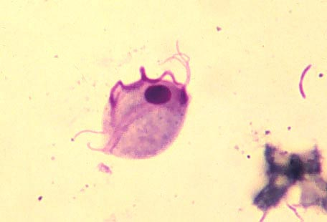
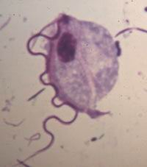
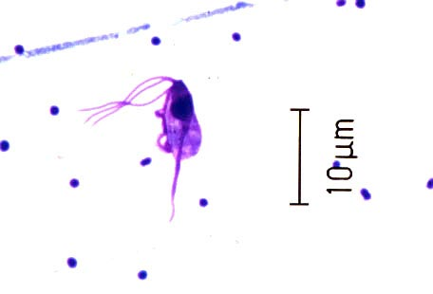
Trichrome stain
(X 1000)
trophozoite of Trichomonas hominis, stool smear ( 8 – 20 µm )
trophozoite of Trichomonas tenax, smear of scraping from mouth
( 5 – 12 µm )

Slide 20
