Slide 1
Protozoa

Slide 2
Lab: 2
Intestinal Protozoa
Commensal amoeba

Slide 3
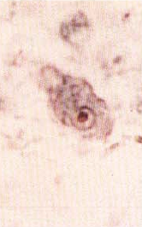
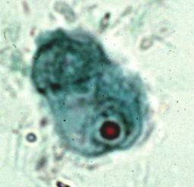
Endolimax nana A. Trophozoites: karyosome large, centric or eccentric, without peripheral chromatin

Slide 4
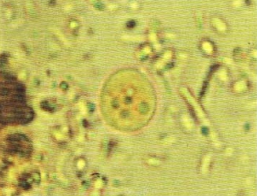
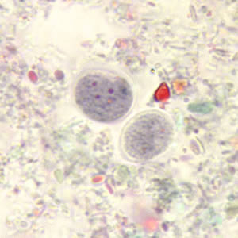
Endolimax nana B. cyst: ovoid in shape; nuclei 1,2,or 4; karyosome large with little or no peripheral duration.

Slide 5
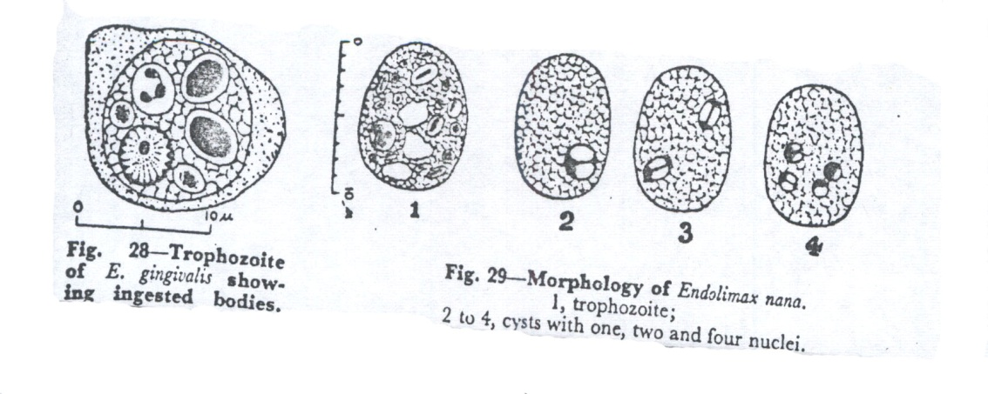
Dimethyl sulfuxide – modified (DMSO) stain
Endolimax nana Cyst
(I. H.) Stain
Endolimax nana Cyst in Iodine
Endolimax nana Trophozoite
Endolimax nana from stool smear

Slide 6
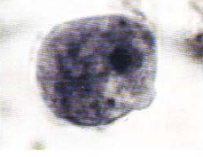
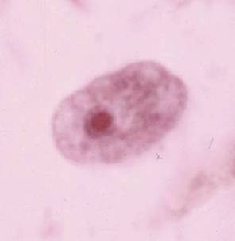
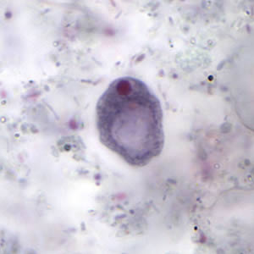
Iodamoeba butschlii A. Trophozoites nuclei with large central karyosome; karyosome surrounded by small chromatin granules;

Slide 7
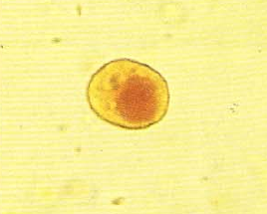
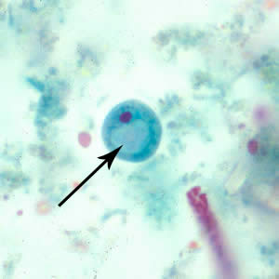
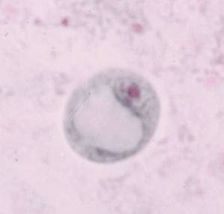
Iodamoeba butschlii B. cyst: large glycogen vacuole; nucleus as in trophozoites.

Slide 8
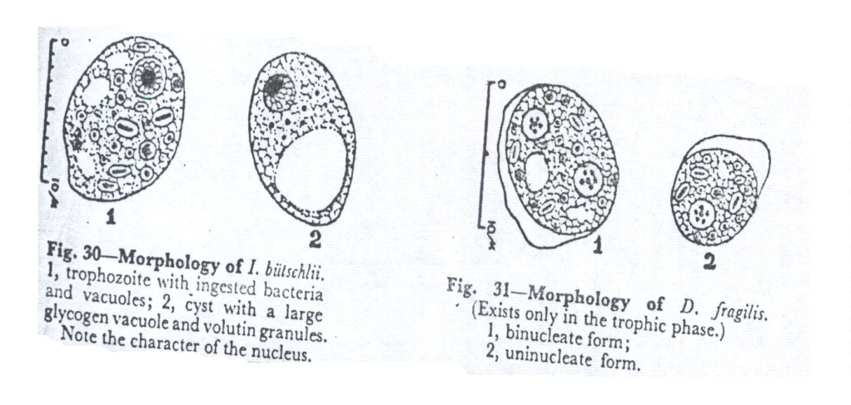
Iron hematoxylin stain
Iodine stain
Iodamoeba butschlii Cyst ( 7 – 18 µm )
31
Iodine stain
Iodamoeba butschlii Trophozoite
Iodamoeba butschlii from stool smear

