Slide 1
Protozoa

Slide 2
Lab: 1
Intestinal Protozoa
Entamoeba histolytica

Slide 3
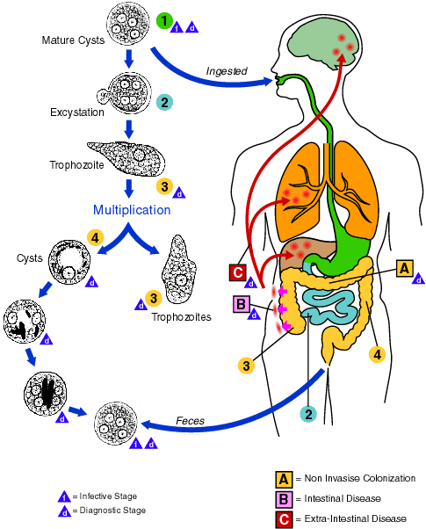

Slide 4
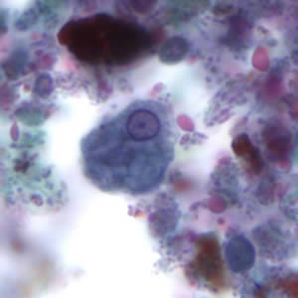
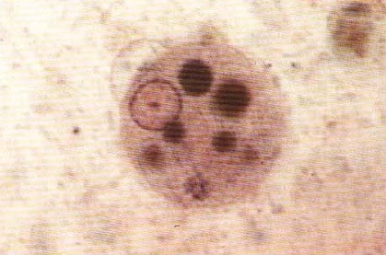
Entamoeba histolytica
A. Trophozoites
Irregular shape.
Transparent ectoplasm
Granulated endoplasm
small nucleus with
perinuclear chromatin dots,
regular in size & spacing.

Slide 5
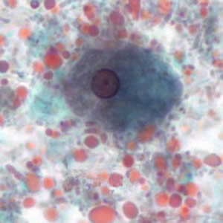
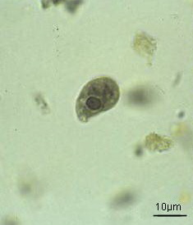
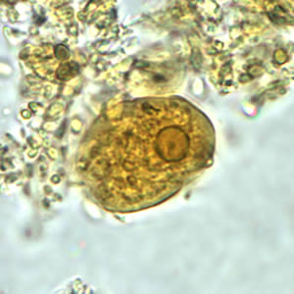
Trophozoites of Entamoeba histolytica

Slide 6
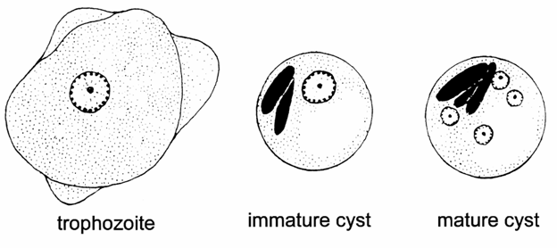

Slide 7
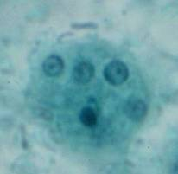
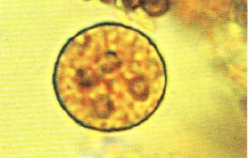
1. Entamoeba histolytica
b. cyst, note:
round in shape
outer cyst wall
nuclei 1,2 or 4
chromatin bars may be present.

Slide 8
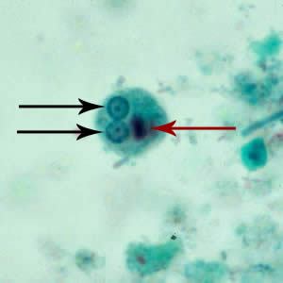
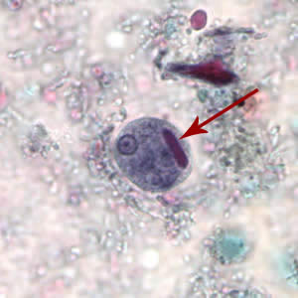
Cigar shape chromatoid body
Cysts of E. histolytica

Slide 9
1. Entamoeba histolytica
c. Section in infected intestine- note:
Columnar epithelium,
Lamina propria,
Muscularis mucosae,
Sub-mucosa, muscularis and serosa in intact
mucosa
Clusters of amebae extending from epithelium
through lamina propria and muscularis mucosa and
muscularis.
Some amebae show their nuclei and / or ingested
RBCs if the section passes through these structures.

Slide 10
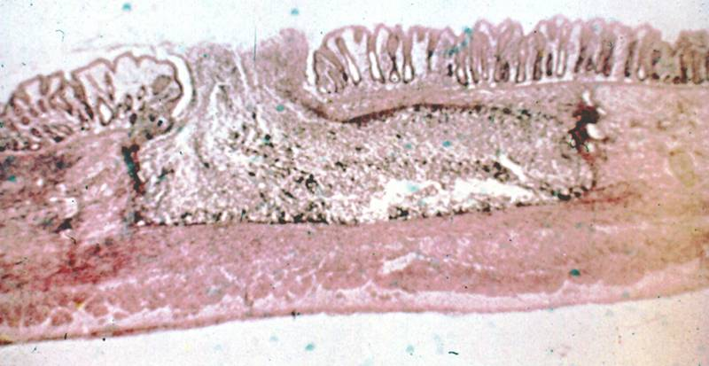
Flask like ulcer caused by E histolytica

Slide 11
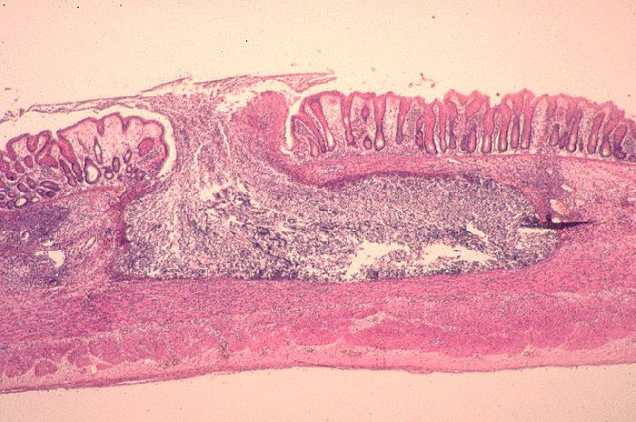
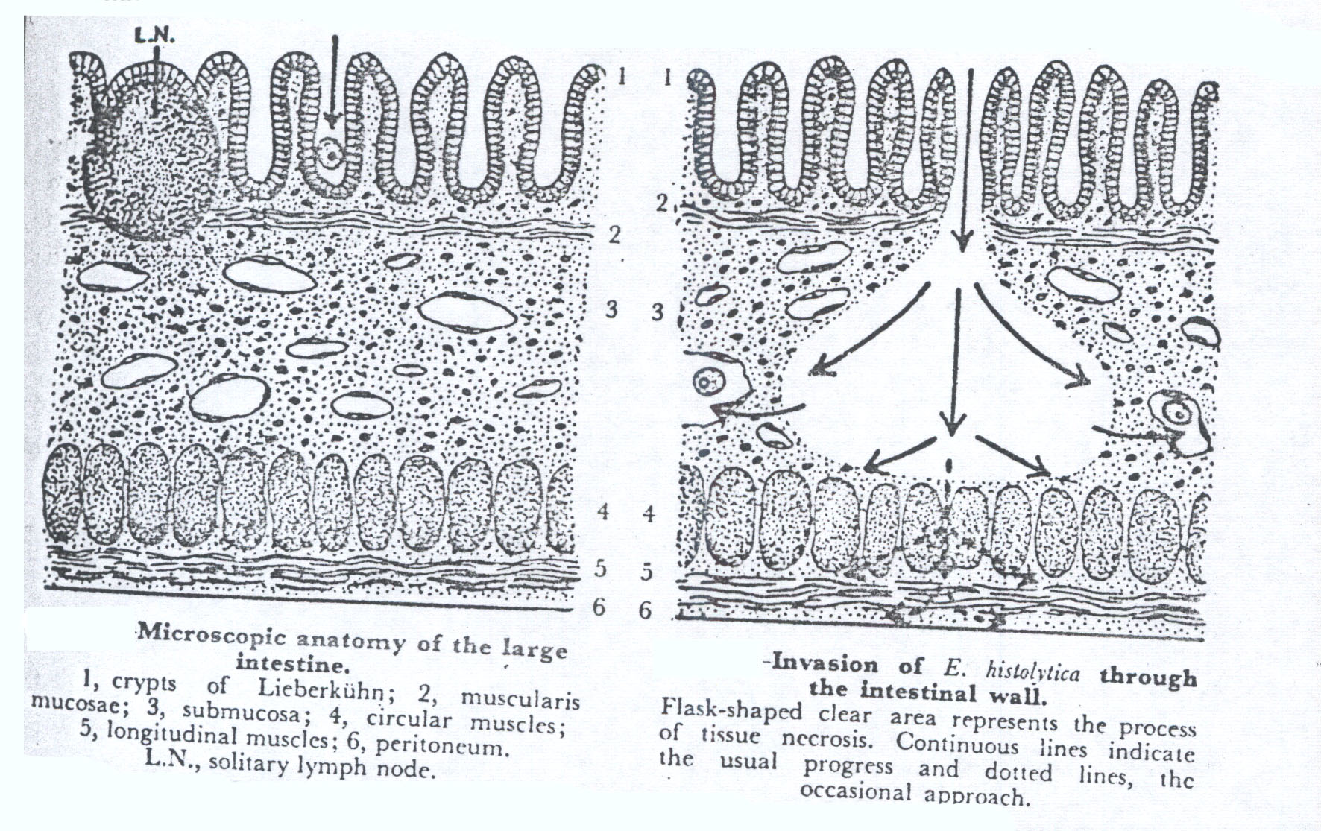
ulcer of E.histolytica in large intestine
Fig 23-A
Fig 23-B

Slide 12
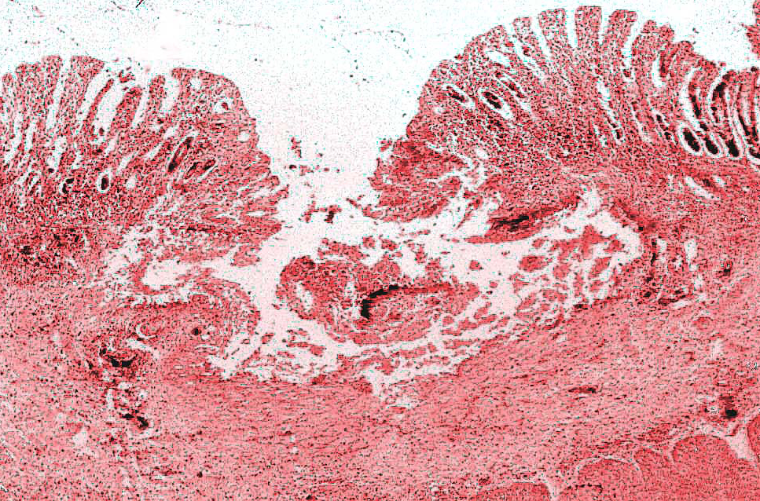

Slide 13
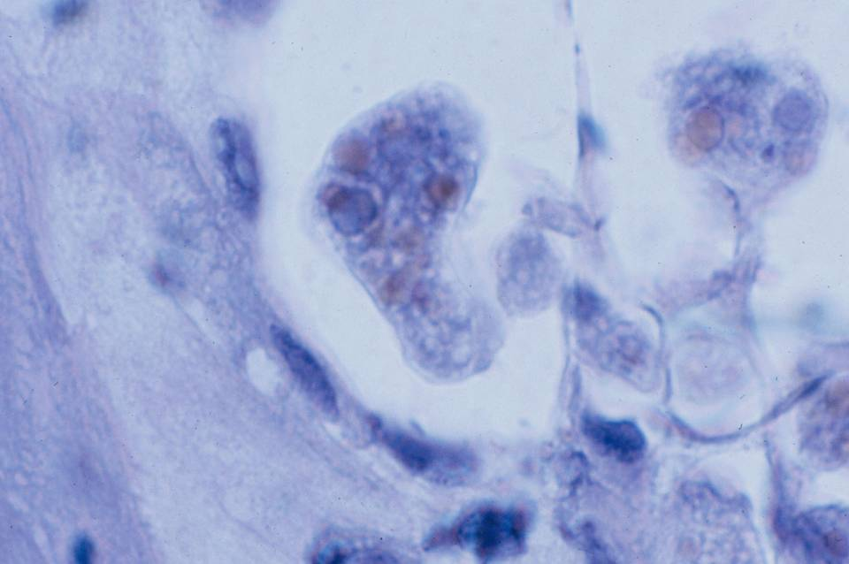
Digested RBCs
Hematophagous’ trophozoites

Slide 14
Intestinal Protozoa
Commensal amoeba

Slide 15
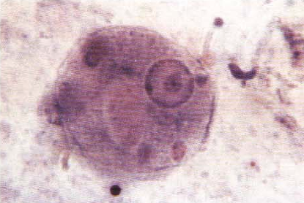
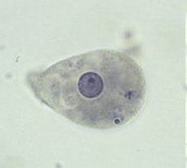
Entamoeba coli
A. Trophozoites:
Irregular shape but
more compact than E.
histolytica;
Ectoplasm thin;
Granulate endoplasm;
Small nucleus with
perinuclear chromatin
dots irregular in size &
spacing.

Slide 16
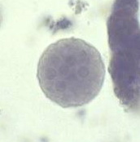
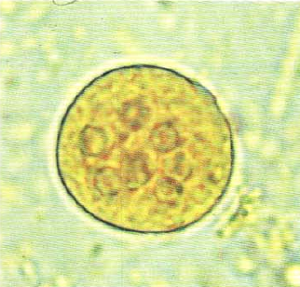
Entamoeba coli
B. Cyst
Large; nuclei 1,2,4 or 8;
Chromatoid bars with pointed end.

Slide 17
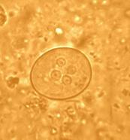
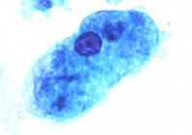
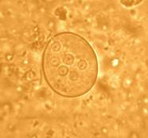
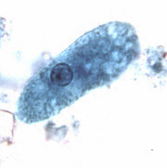
Entamoeba histolytica Trophozoite
( 18 – 60 µm )
Entamoeba histolytica Cyst ( 5 – 20 µm )
Entamoeba Coli Trophozoite ( 20 – 50 µm )
Entamoeba Coli Cyst ( 15 – 33 µm )
trophozoite and cysts of E. histolytica and E. coli form stool smear

