Slide 1
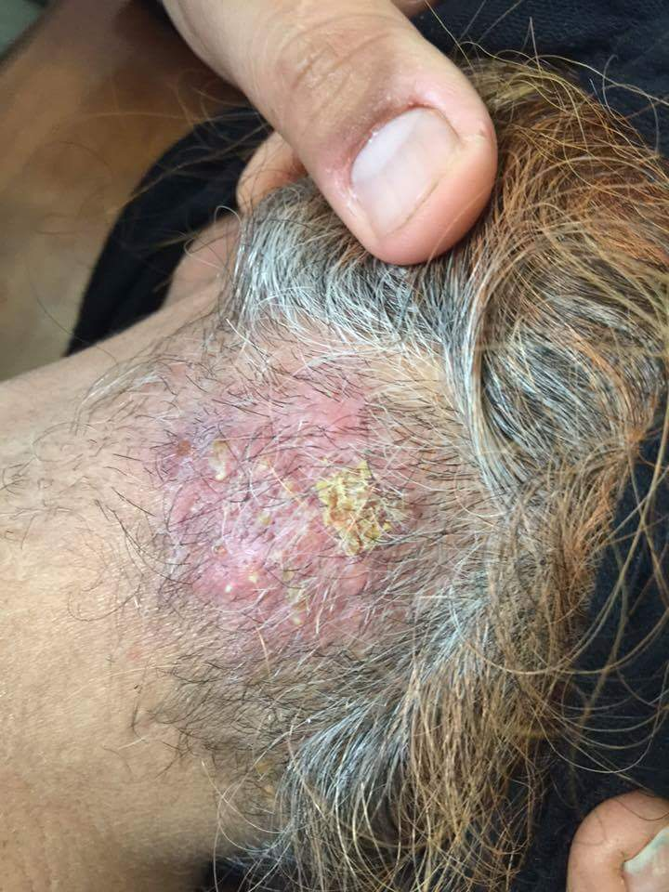
Carbuncle is a cluster of furuncles, more extensive, deeper, communicating, in filtrated lesion that develops when suppuration occurs in elastic skin. It usually involves the nape of the neck, back or thighs and usually occurs in the setting of underlying diabetes mellitus, alcoholism, malnutrition, blood dyscrasias, iatrogenic or other immunosuppression including HIV infection. Fever, malaise, prostration accompany. DDX: tinea capitis, herpes zoster

Slide 2
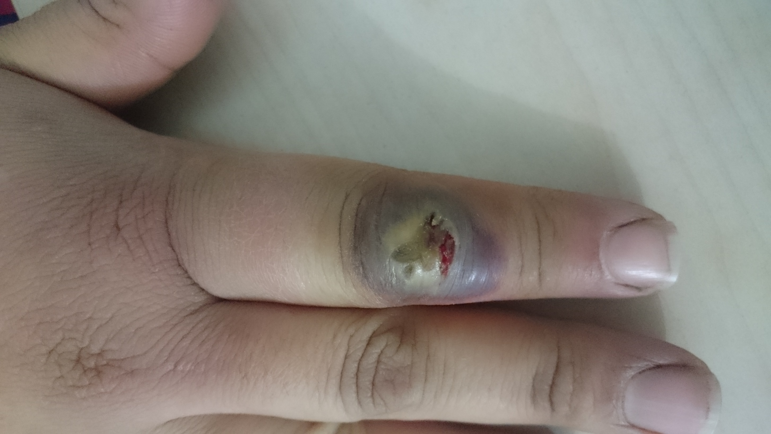
Orf Lesions, which may be single or multiple, start as small firm papules that change into flat-topped, apparently pustular nodules with a violaceous and erythematous surround . The condition clears up spontaneously in about a month. DDX : Milker’s nodules, staphylococcal furuncles.

Slide 3
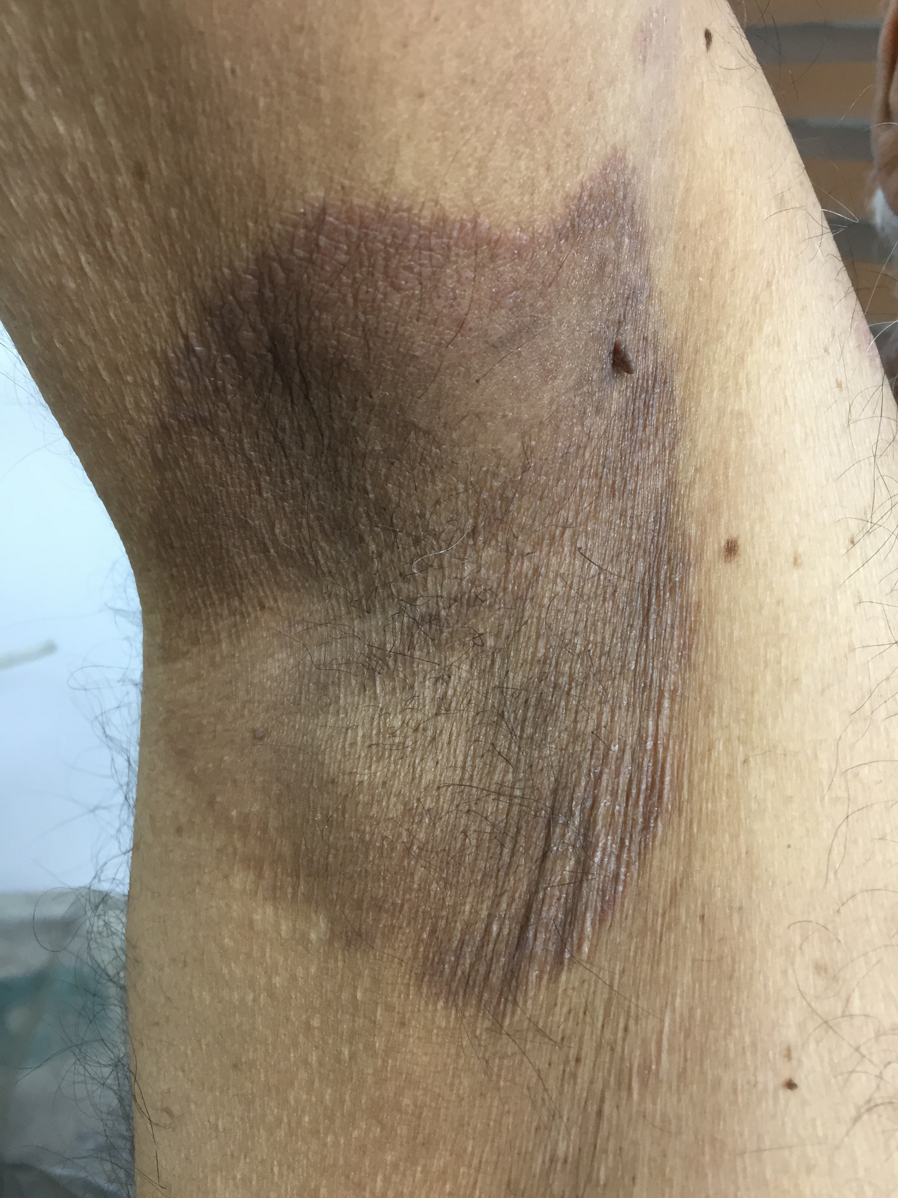
Erythrasma symptom-free macular wrinkled slightly scaly pink, brown or macerated white areas, most often found in the armpits or groins, or between the toes. Diagnosis is helped by the fact that the porphyrins produced by these diptheroids fluoresce coral pink with Wood’s light. RX :Topical fusidic acid or miconazole will clear the condition. DDX Tinea cruris Involves the groin but seldom the scrotum Candidias Beefy red with satellite papules and pustules Erythrasma Brown patches of the upper thighs Irritant contact dermatitis Burning sensations may predominate Allergic contact dermatitis The scrotum may be oedematous Inverse psoriasis red marginated plaques extend up glutea Seborrhoeic dermatitis Look at the scalp Neurodermatitis It feels wonderful to scratch an itchy groin Intertrigo Skin breaks down from maceration

Slide 4
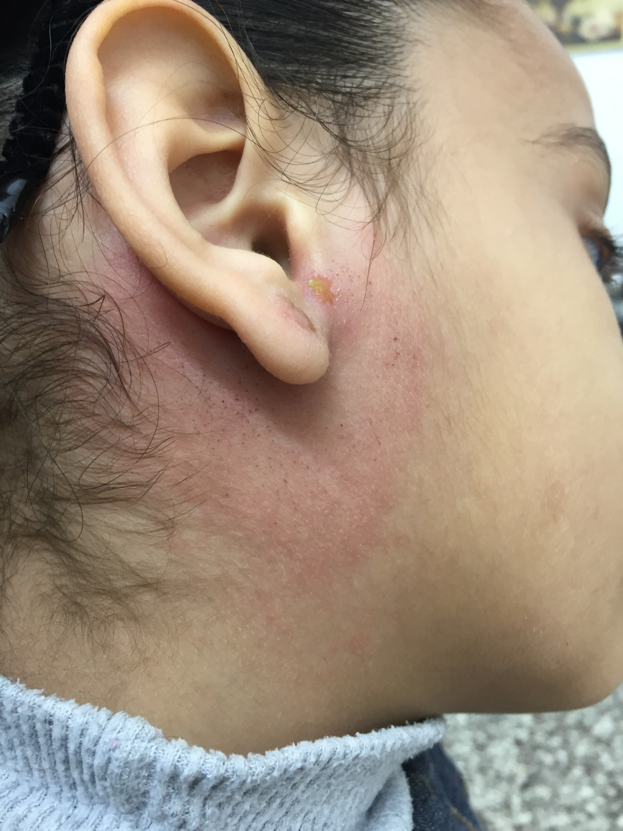
Erysipelas a bacterial infection of the dermis and upper subcutaneous tissue.Erythema, warmth, swelling and tenderness are constant features . In erysipelas,the edge of the lesion is well defined and raised, but in cellulitis it is diffuse. The leg is the commonest site; the next most frequent site for classical streptococcal erysipelas is face. RX : For presumed streptococcal infection, penicillin is the treatment of choice. DDX : angioedema,allergic contact dermatitis, cellulitis

