Slide 1
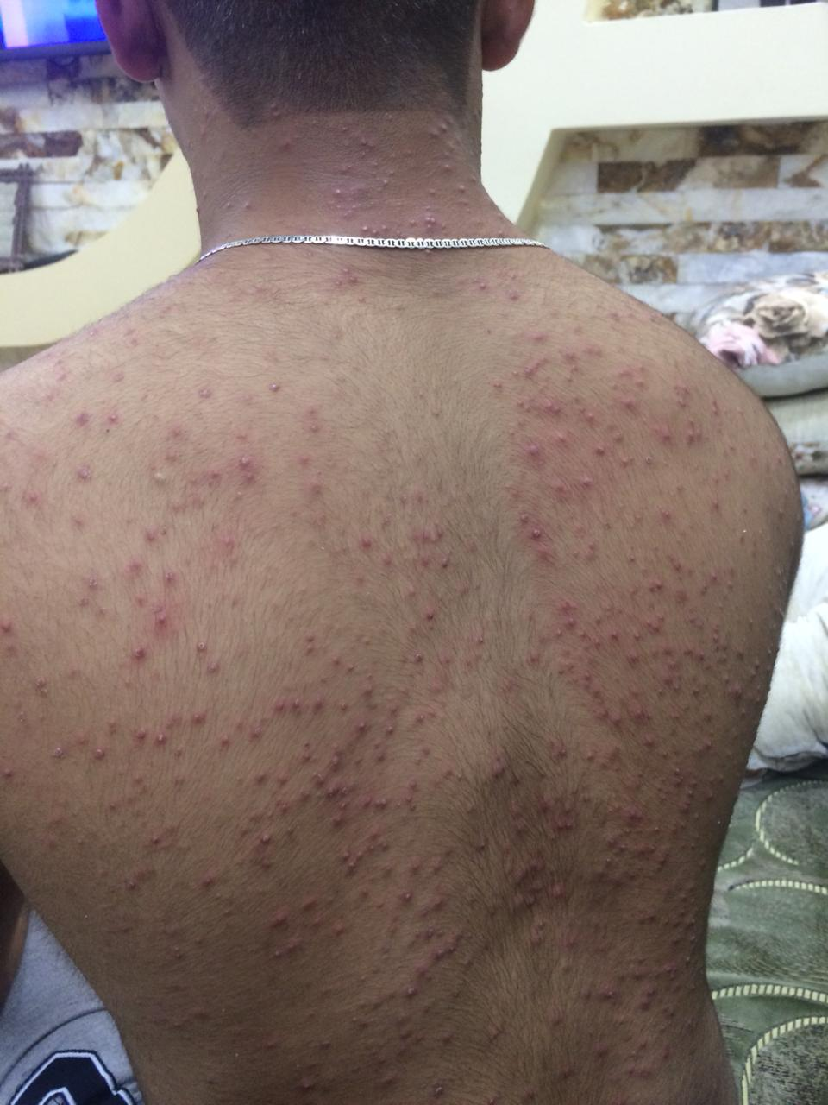
Drug-induced acne : Corticosteroids, androgenic and anabolic steroids, gonadotrophins, oral contraceptives, lithium, iodides, bromides, antituberculosis and anticonvulsant therapy can all cause an acneiform rash. Suspicion should be raised when acne, dominated by papulopustules rather than comedones, appears suddenly in a nonteenager and coincides with the prescription of a drug known to cause acneiform lesions . Some athletes still use anabolic steroids to enhance their performance.

Slide 2
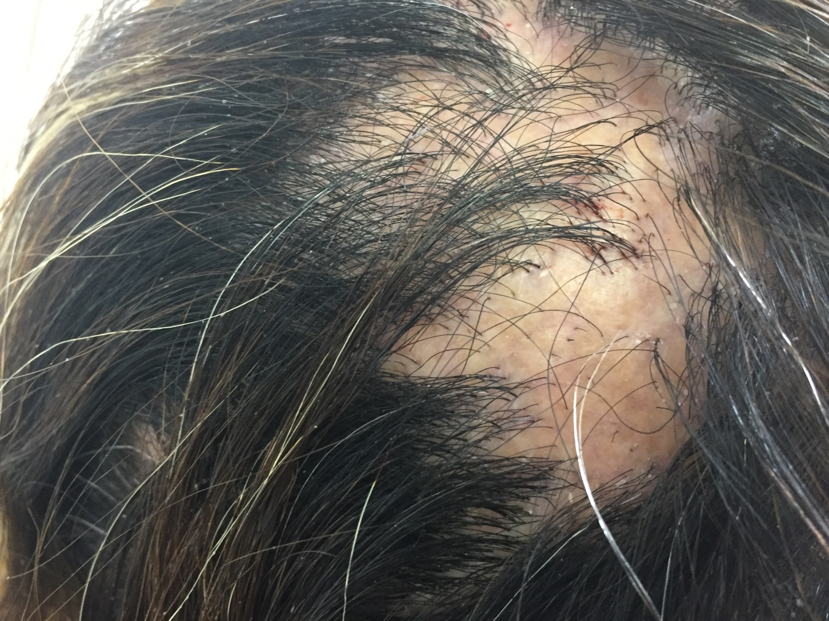
Scarring alopecia Hair follicles can be damaged in many ways. If the follicular openings can no longer be seen with a lens, regrowth of hair cannot be expected. severe burn, trauma, a carbuncle or an episode of inflammatory scalp ringworm. Discoid lupus erythematosus , lichen planus and morphoea can also lead to scarring alopecia.

Slide 3
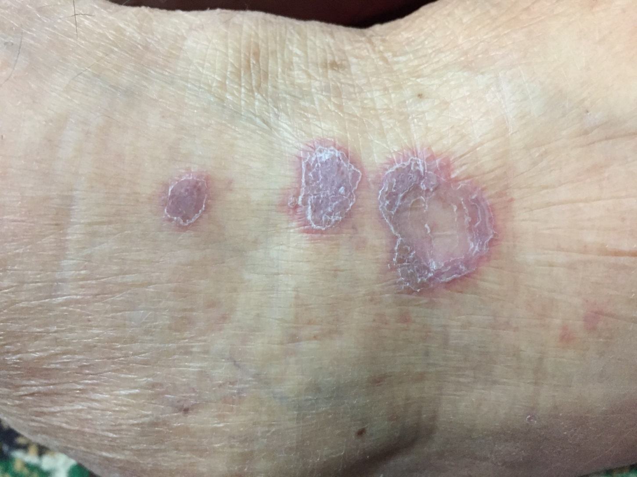
Lichen planus violaceous, intensely itchy, ﬂat-topped papules on the dorsal aspectof the leg. With a close look you can see a white streaky pattern on the surface of these papules known as Wickham’s striae

Slide 4
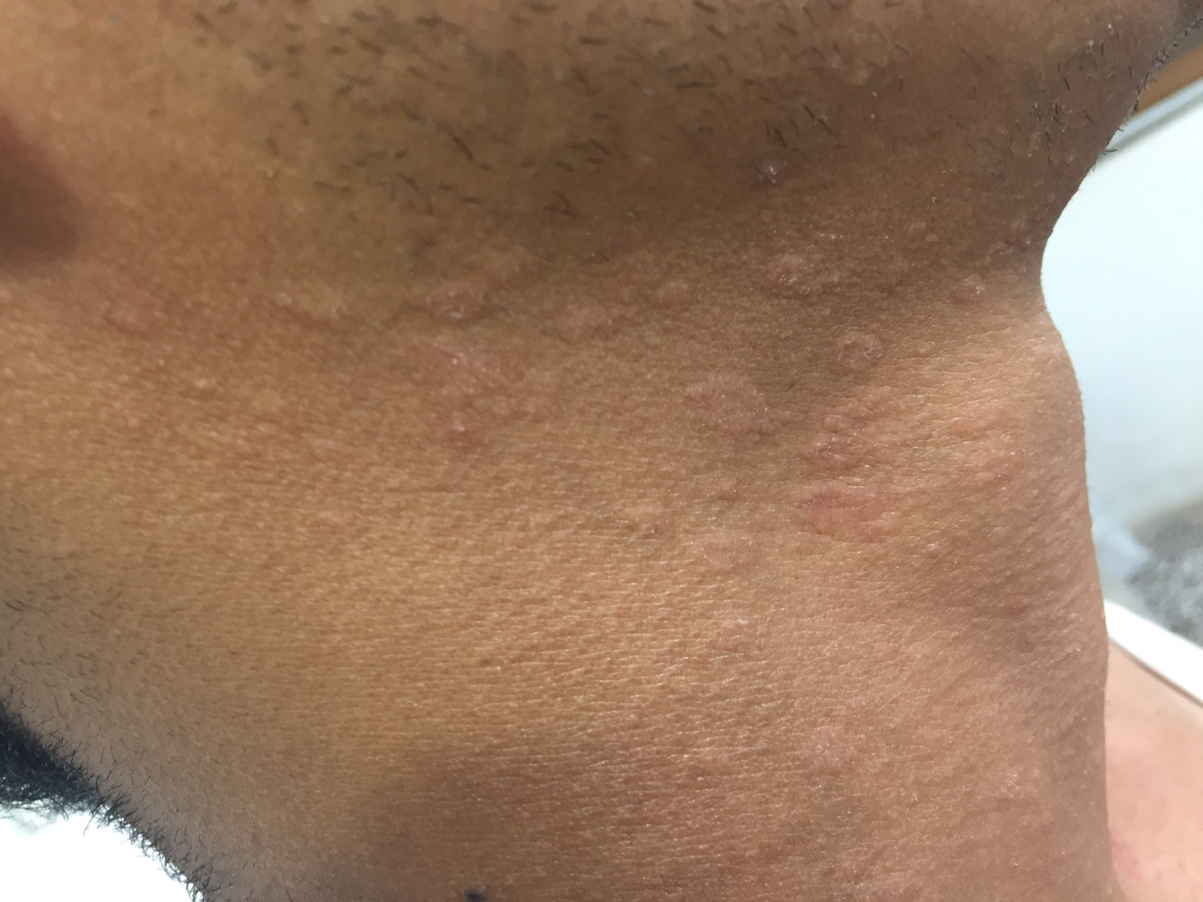
Pityriasis rosea many small oval erythematous scaly plaques appear, mainly on the neck, but some also on the trunk and extremities.
DDX : guttate prsoriasis, tinea versicolor, drug reaction, secondary syphilis

