Slide 1
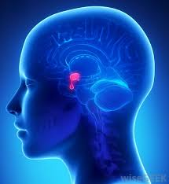
Hyperprolactinemia
Dr. Alaa Ibrahim

Slide 2
Etiology
Elevated circulating PRL levels can be caused by various physiologic activities including pregnancy, sleep, eating, and coitus.
Following chest wall stimulation such as occurs with suckling, breast examination, chest wall surgery, herpes zoster infection, or nipple piercing.

Slide 3
PRL secretion is primarily regulated through tonic inhibition by dopamine released by the hypothalamus.
PRL secretion is increased by serotonin, norepinephrine, opioids, estrogen, and TRH.
medications that block dopamine-receptor action (phenothiazines) or deplete catecholamine levels (monoamine oxidase inhibitors) may increase PRL levels .

Slide 4
Primary hypothyroidism
low circulating thyroid hormone levels produce a reflex increase in hypothalamic TRH levels due to loss of feedback inhibition.
TRH can bind directly to anterior pituitary lactotropes and stimulate PRL production.

Slide 5
Prolactin-secreting adenomas, also termed prolactinoma.
A ffected women typically present with microadenomas and signs of PRL excess such as galactorrhea and amenorrhea.

Slide 6
Diagnosis
Normal PRL levels are typically < 20 ng/mL in nonpregnant women, although the upper limit of normal varies by assay.
Importantly, PRL levels rise nearly 10- old during pregnancy and make detection of a prolactinoma.

Slide 7
For all patients with confrmed hyperprolactinemia, MR imaging is advisable.
Some advocate limiting imaging to women with a PRL level > 100 ng/mL, as lower levels are most likely due to small microadenomas.
mildly elevated PRL levels also may be due to pituitary stalk compression by a nonprolactin-secreting macroadenoma or craniopharyngioma, diagnoses with severe potential consequences.

Slide 8
Standard head radiography : view of the sella turcica.
Computed tomography (C ) scanning provides useful in formation on tumor size.
MR imaging, using both 1- and 2-weighted images, has become the preferred radiologic approach due to its high sensitivity.

Slide 9
Associated Amenorrhea
The primary mechanism linking hyperprolactinemia and amenorrhea is believed to be a reflex increase in central dopaminem levels. Stimulation of the dopaminergic receptors on the GnRH neurons alters GnRH pulsatility, thereby disrupting folliculogenesis.
As dopamine receptors have also been identified in the ovaries, detrimental effects on folliculogenesis may also play a role.

Slide 10
Pituitary Adenomas
Comprise approximately 15 percent Of all intracranial tumors.
Clinically, symptoms of galactorrhea, menstrual disturbances, or infertility may lead to its diagnosis.
Most tumors are benign, and only an estimated 0.1 percent of adenomas develop into frank carcinoma with metastasis.
pituitary adenomas may cause striking abnormalities in both endocrine and nervous system unction.

Slide 11
Classification:
Pituitary adenomas classified by their hormonal expression pattern as determined by immunohistochemistry .
Adenomas are further grouped by size into
microadenomas (< 10 mm in diameter)
macroadenomas (> 10 mm in diameter).
The most common adenomas secrete PRL alone. However, adenomas may secrete any of the pituitary hormones either singly (monohormonal adenoma) or in combination (multihormonal adenoma).

Slide 12
Symptoms
Pituitary adenomas may cause symptoms via excess hormone secretion and lead to clinical conditions such
hyperprolactinemia
Acromegaly
Cushing disease
Alternatively, adenomas may result in hormone defciency due to damage of other pituitary cell types or the pituitary stalk by an expanding adenoma or following treatment of the primary lesion.
Macroadenomas frequently present with patient symptoms from invasion of surrounding structures.

Slide 13
Any pituitary mass can lead to reproductive dysfunction that may include delayed puberty, anovulation, oligomenorrhea, and infertility.
Macroadenomas likely affect reproductive function either by compressing the pituitary stalk, which results in hyperprolactinemia, or less commonly, by directly compressing gonadotropes.

Slide 14
Signs and symptoms include:
acute visual changes.
severe headache.
neck stifness.
hypotension.
loss o consciousness, and coma. These symptoms result rom:
(1) leakage o blood and necrotic material into the subarachnoid space.
(2) acute hypopituitarism,
(3) a rapidly expanding hemorrhagic intrasellar mass that compresses the optic chiasm, cranial nerves, or hypothalamus and internal carotid arteries.

Slide 15
Treatment of Hyperprolactinemia and Pituitary Adenomas
Most pituitary tumors grow slowly, and many cease growth after attainment of a certain size.
Thus, asymptomatic patients with a microprolactinoma may be managed conservatively with serial MR imaging and serum PRL levels every 1 to 2 years as the risk o progression to a macroadenoma is < 10 percent
When tumors of any size are associated with amenorrhea or galactorrhea, therapy is considered .
Neurosurgical evaluation is mandatory when visual field defects or severe headaches are present.

Slide 16
cabergoline treatment is generally better tolerated than bromocriptine.
Cabergoline also has a longer half -life, allowing once- or twice-weekly dosing compared with the multiple daily doses that may be required or bromocriptine.
typical initial cabergoline dosages are 0.25 mg orally twice weekly. Cabergoline has been found to be more effective than bromocriptine in normalizing PRL levels.

Slide 17
Bromocriptine
started at a low dose. tab or 0.125 mg—each night to minimize associated nausea and dizziness. This dose can be slowly increased to three times daily as tolerated.
Reliable measurement of posttreatment serum PRL levels can usually be obtained 1 month following a steady medication dose.

Slide 18
Neurosurgery is required or refractory tumors or those causing acutely worsening symptoms.
The pituitary is approached through a transsphenoidal route whenever possible .
Complications of surgery, although rare, include intraoperative hemorrhage, a cerebrospinal fluid leak (rhinorrhea),diabetes insipidus, damage to other pituitary cell types, and meningitis.
Radiation therapy may be used or patients with surgically nonresectable, persistent, or aggressive tumors.

Slide 19
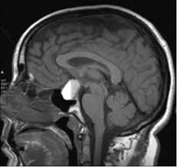

Slide 20
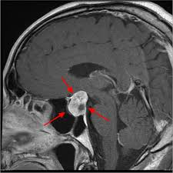

Slide 21
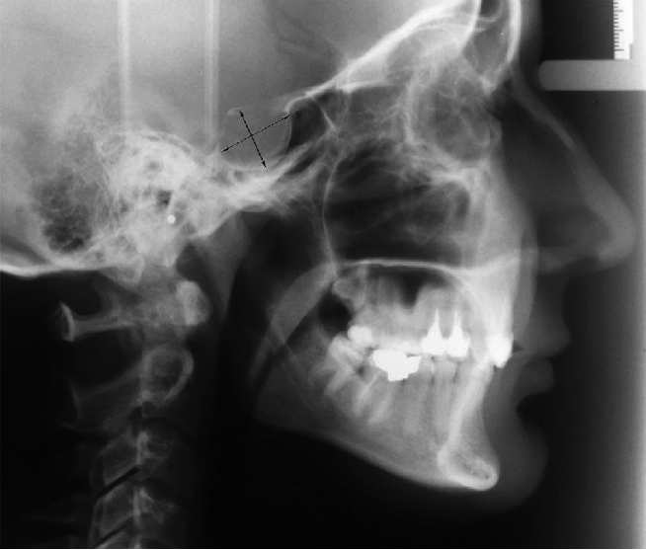

Slide 22
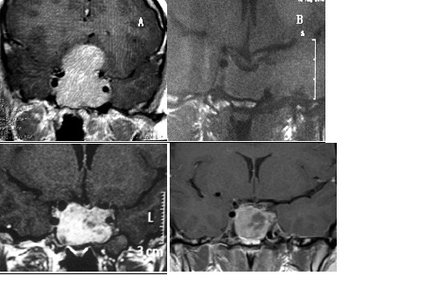

Slide 23
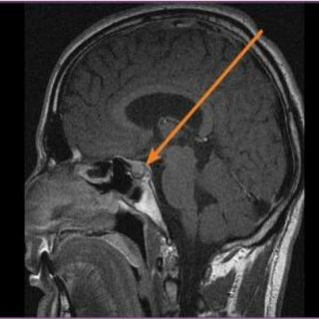

Slide 24
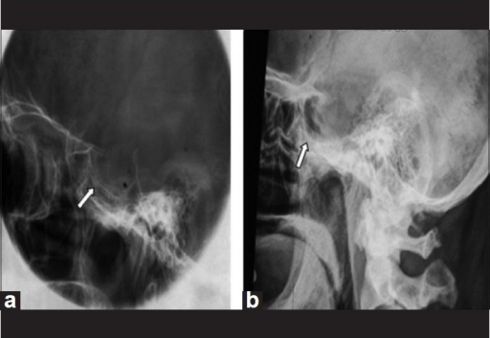

Slide 25
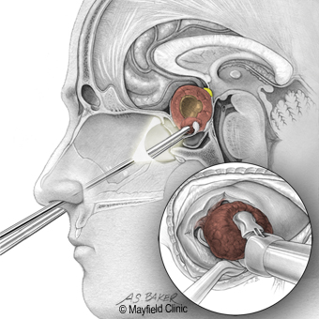

Slide 26
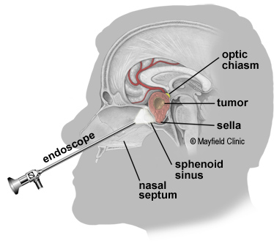

Slide 27
Thank you

