Slide 1
Young adult presented with bilateral symmetrical itchy scaly erythematous patches involving the inguinal folds and extending on the medial sides of the thigh, with elevated polycyclic borders
DDX : intertrigo,candidiasis, tinea cruris, seborrheic dermatitis, psoriasis
DX : tinea cruris

Slide 2
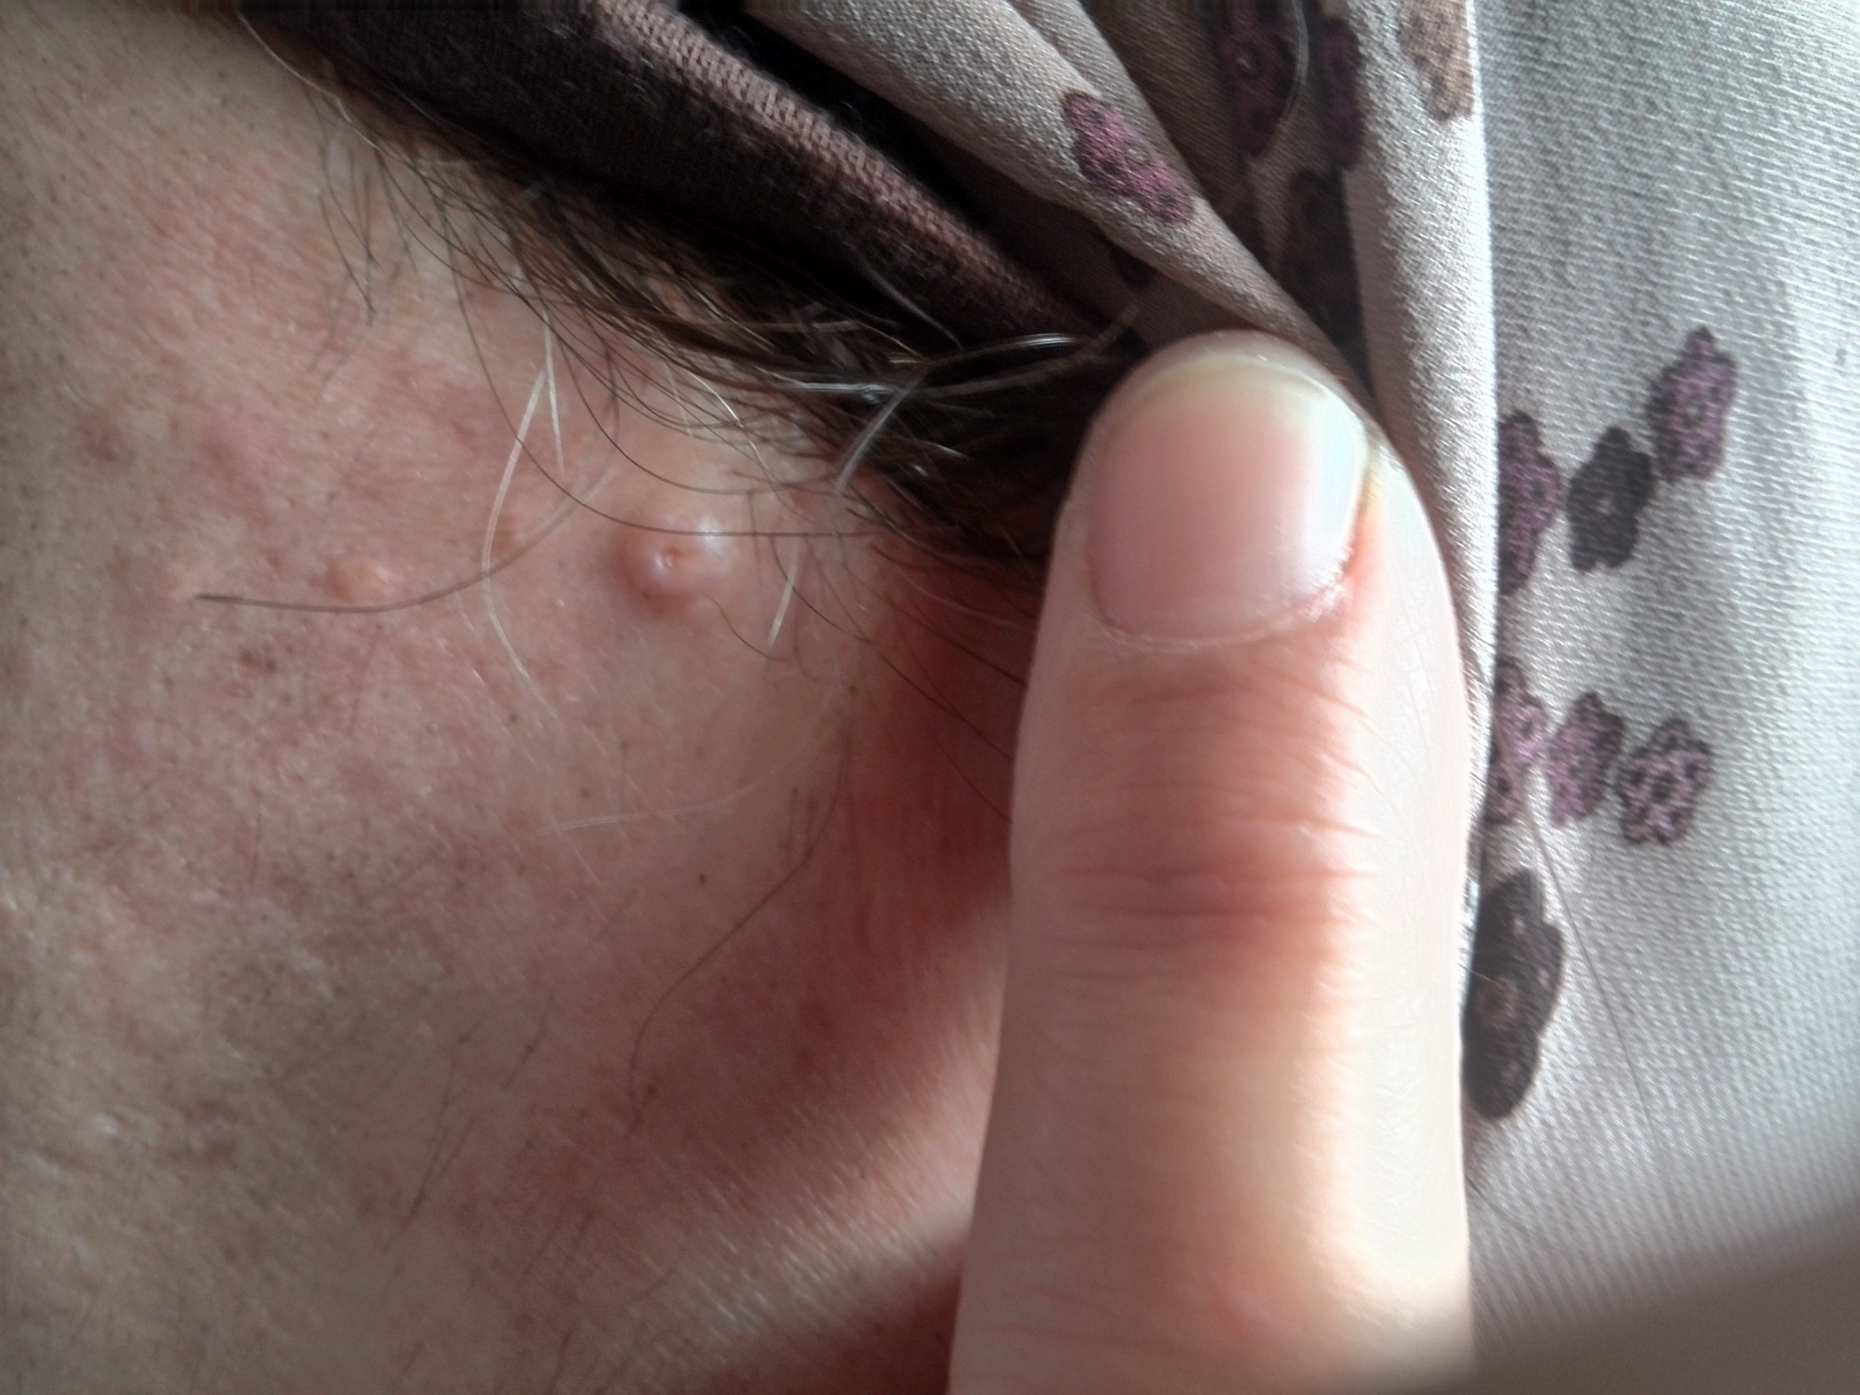
Adult female presented with dome shaped papule, yellowish in color, with central depression, not itchy for several weeks with similar lesions in nearby area.
DDX : wart, molluscum contagiosum, insect bite
DX : molluscum contagiosum

Slide 3
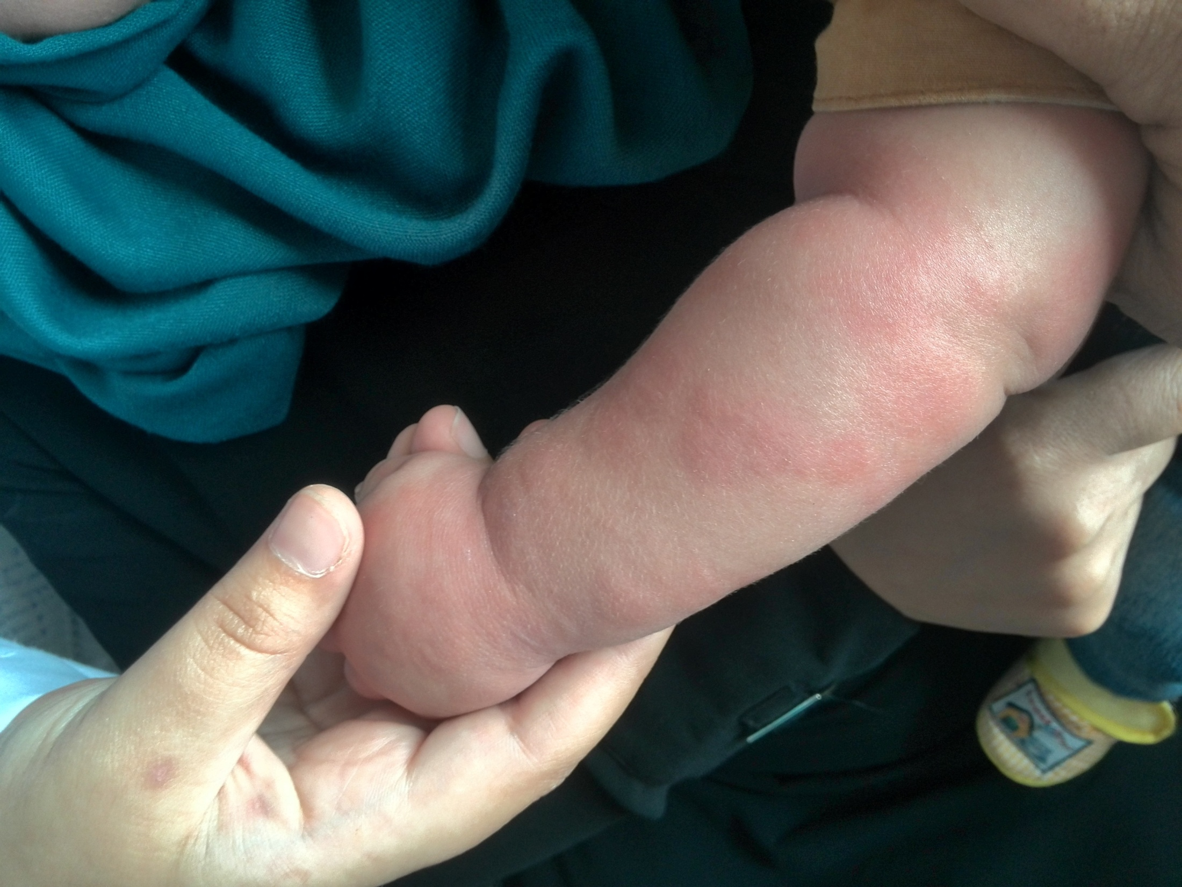
Two years old child presented with multiple widespread itchy edematous plaques, pinkish in color resolving within 24 hours to appear in another sites
DDX : urticarial. Atopic dermatitis, scabies, drug eruption
DX : urticaria

Slide 4
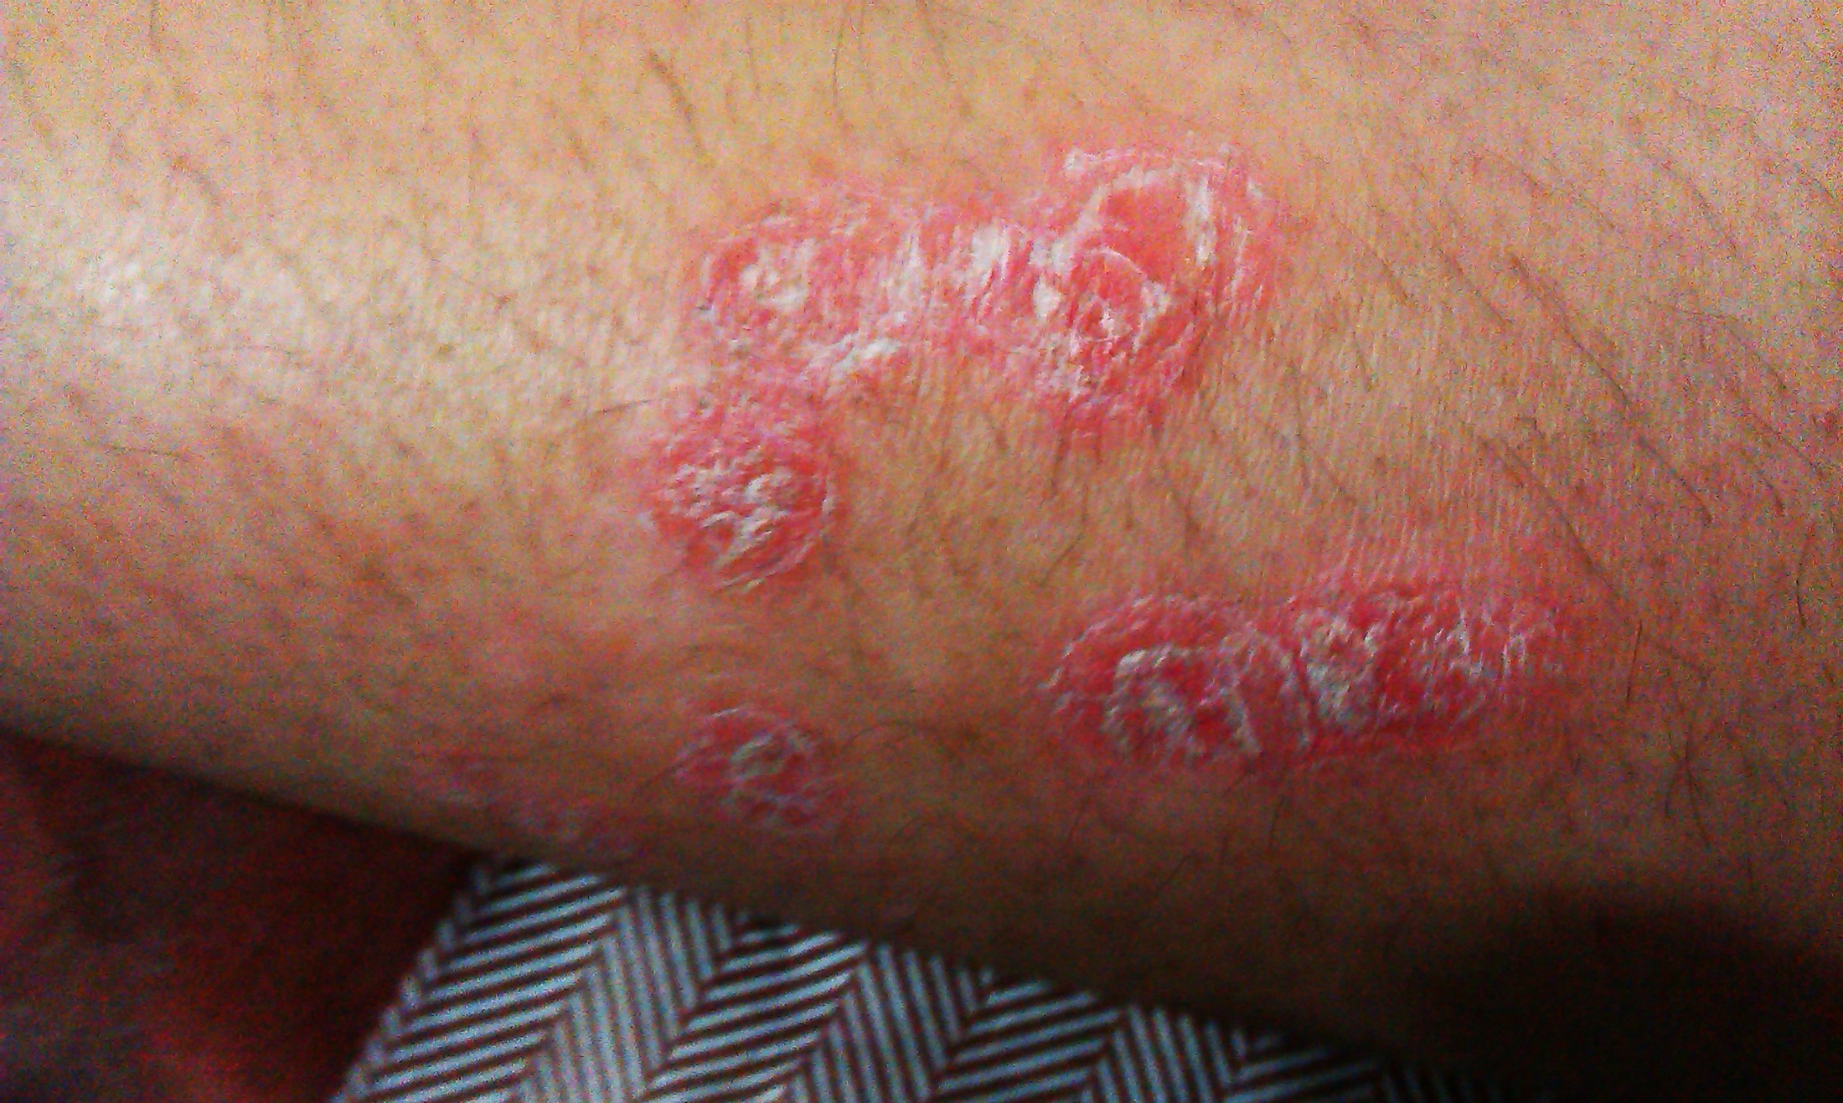
Multiple scaly erythematous circular plaques on the dorsal forearm recurrent for several months
DDX : psoriasis, discoid dermatitis, contact dermatitis
DX : psoriasis

