Slide 1
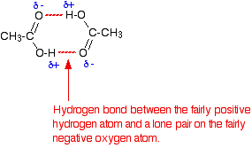
Lecture No.3عضوية
Aldehyde, Ketone, and carboxylic acids
Functional group
In most organic compounds, atom or group of atoms arrange within a molecule to give a compound new chemical, and physical properties.
Mostly the functional group is the non- hydrocarbon part, sometimes are atoms often (contain O, N, S, or P) in an organic compound.
Figure 1: The functional groups of Alcohol, Aldehyde, Alkene, carboxylic acid, and Ketone. Carbonyl group (>C=O) is a functional group of (Aldehyde, Ketone), Double Bond (> C = C <), and in carboxylic acid both carbonyl group and hydroxyl group (-OH) are the functional groups functional group
Functional Groups Reactivity
Functional groups play a significant role in increasing its reactivity, by controlling the direction of the reactions; Alkyl chains (R₃ C - C R₃) are nonreactive, but when substituted ( R₂ C = C R₂ ) give unsaturated alkyl chains, the presence of functional group (> C = C <) allow for relative increase in both reactivity and specificity.
Carbonyl Compounds
Carbonyl Compounds are consist of carbon- oxygen double bounded (>C=O). Its polar or water soluble due to ability to form Hydrogen bonding, respectively as in, figure(2) bellow.
Aldehyde, Ketone, and carboxylic acids are all containing of carbonyl group, so they called Carbonyl Compounds.
Figure(2): carbonyl group, and hydrogen bonding.
Functional group of Hydrocarbon | Hydrocarbon Chemical Formula
Hydroxyl group (-OH ) | Alcohol ( R- CH2 – OH )
Carbonyl group ( -C H =O ) | Aldehyde RCHO
Double Bond (> C = C <) | Alkene ( R2 C = C R2 )
Carboxyl group(-COOH), & Hydroxyl(-OH). | Carboxylic acid RCOOH
Carbonyl group (>C=O ) | Ketone R₂CO

Slide 2
Aldehyde, Ketone, and carboxylic acids
Biological Significance of Ketone Bodies:
Aldehydes, and ketones are critical in human body , they present as carbohydrates, fats, proteins, nucleic acids, hormones, vitamins, other organic compound, and Drugs.
Acetone is the most important ketone to your health, and present in less than 1 mg/100 mL of blood. An excess of acetone in the bloodstream is a common symptom of diabetes. Insulin is a hormone that allows glucose from the bloodstream to enter cells. Diabetic is a persons with deficient in insulin, either lacking insulin or are resistant to insulin. Because there is no insulin in the body, a diabetic is forced to break down fatty acids and proteins for energy, which produces a large quantity of ketone bodies. This can be prevented by monitoring insulin levels within the body. However, if a diabetic's body is subjected to stress, such as an illness, disruption to insulin treatment, or surgery, a condition called diabetic ketoacidosis (DKA) can occur.
When a diabetic's body is in a stressful situation, it produces hormones such as adrenaline, which increase the rate of converting fatty acids to energy. This causes ketone bodies to accumulate. When so much acetone builds up in the blood, the body attempts to eliminate it all by causing excessive urination.
Symptoms of diabetic ketoacidosis include dehydration, deficiencies in salts such as potassium, nausea, fatigue, confusion, abdominal cramping, excessive thirst, and decreased perspiration. DKA can be treated through undergoing insulin therapy, replenishing the body with the fluids and electrolytes, and diminishing stress. The most common way to test for an excess of ketones in the bloodstream is a urine test, also blood test will be more accurate. Although it is dependable way of determining ketone buildup, ketone breathe excess is often associated with fruity smelling breath.[Reference: https://chem.libretexts.org/ and 5.3 Functions and Applications of Aldehydes and Ketones Difficulty Level: Basic | Created by: CK-12]

Slide 3
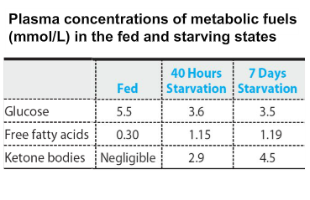
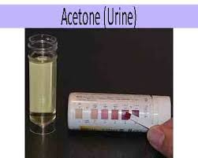
(a) (b)
Figure (3): a- Plasma concentration of Glucose, and Ketone Bodies at starvation. b--The Acetone-Urine test is a simple urine test to detect the level of acetones in the body. When the acetones in the blood go above a certain level. Reference http://gooddayshealthcare.in/product/acetone-urine/
The presence of Aldehyde, Ketone, and carboxylic acids:
Aldehyde, Ketone, and carboxylic acids are present in different compounds of human body, here is some of them:-
①-Monosaccharide's: Monosaccharide's are carbohydrates which can not be hydrolyzed to small molecules, contain carbons with functional aldehyde, or keto group are present in nature. Aldohexose is glucose, Fructose is ketohexose respectively. Glucose is present in our blood, and gives rise to energy on oxidation.
②- Aldopentose Ribose is constituent of nucleic acids monomer of
DNA.
③ -Ketone Bodies: Ketone Bodies are : acetoacetate, beta-hydroxy butyrate, &acetone. Ketone Bodies are water soluble fuels normally exported by the liver but overproduced during fasting or diabetes mellitus. Ketone Bodies are formed in the hepatic mitochondria to be used as fuel for human activities.
CARBOXYLIC ACIDS: A class of organic compounds consist of a carbonyl group( >C=O ), attached to a hydroxyl group ( -OH ) to generate a carboxyl group( -COOH ), it’s a weak acid. Acetic acid meaning Vinegar, the other example in human body is fatty acid. Using the definition of an acid as a "substance which donates protons (hydrogen ions) to other things", the carboxylic acids are acidic because of the hydrogen in the -COOH group. In solution of water, a hydrogen ion is transferred from the ( -COOH ) group to a water molecule, you get an acetate ion formed together with a hydroxonium ion, H₃O⁺. CH₃COOH + H₂O ↔ CH₃COO¯ + H₃O⁺.

Slide 4
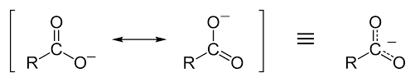
The pH of carboxylic acid solutions
What makes a carboxylic acid more acidic?
Acidity of carboxylic acid is higher than alcohols. Carboxylate ion, the conjugate base of carboxylic acid is stabilized by two equivalent resonance structures in which the negative charge is effectively delocalized between two more electronegative oxygen atoms. Fig.4.
Fig.4: Carboxylic acid resonance structures showing increasing acidity, where R = CH₃.The Normal Arterial pH in Human Body is (7.35-7.45). At low pH the Arterial pH cause. Metabolic Acidosis, which refer to increase acid generation.
Fig.4: Carboxylic acid resonance structures
showing increasing acidity, where R = CH₃.
Metabolic Acidosis cause:
1- Ketoacidosis, when you have diabetes and don't get enough insulin, and get dehydrated, your body burns fat instead of carbohydrates as fuel, and that makes ketones accumulation in your blood, so turn it acidic.
2- Alcoholism, People who drink a lot of alcohol for a long time and don't eat enough also build up ketones.
3- Renal tubular acidosis. Healthy Kidneys Kidney take acids out of your blood and get rid of them in your pee. Kidney diseases as well as some immune system and genetic disorders can damage kidney so they leave too much acid in your blood.
4- Ingestion Salicylates.
The clinical Features:The clinical Features evolved rapidly over 24 hours and early signs: Cause nausea, vomiting, and abdominal pain.
The Carboxylic Acid Derivatives: The group (RC=O) is called the acyl group, which is a part of the functional group of the carboxylic acid derivatives, these derivatives include, esters, and amides. Figure bellow.
The Carboxylic Acid Derivatives
Carboxylic Acid Derivatives | Esters | amides
Examples in living systems | acetyl coenzyme A | Paracetamol, penicillin.

Slide 6
LECTURE TWO
Organic Chemistry
Stereochemistry:
Stereoisomerism, Chirality & Isomerism.

Slide 7
Organic Chemistry Contents:
Stereochemistry.
Optical Activity.
Chiral Sample.
Enantiomers.
Chiral Compounds and Living System.
Chirality and drug development.
Isomerism.
Stereochemistry of tetrahedral.

Slide 8
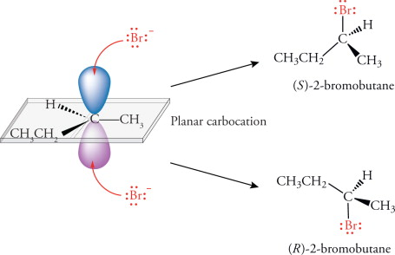
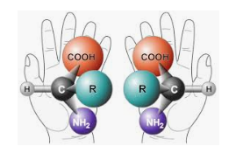
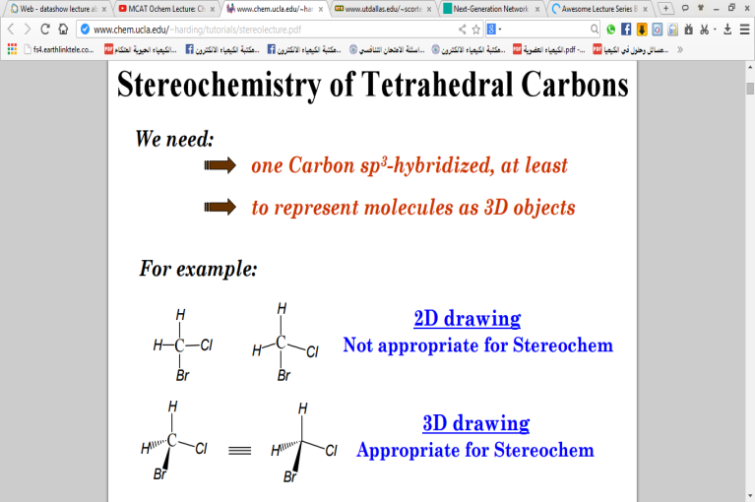
Lecture Two
Organic Chemistry
Stereochemistry
Stereochemistry:
Is the study of the different spatial arrangements of toms in our space. The stereo chemical configuration of any stereo center is the using of naming 'R ' (from the Latin rectus, meaning right-handed) or ' S ' (from the Latin sinister, meaning left-handed).
These two structures are not identical.
The following structures indicate that designations in Figure 1 A & B.
1 A.
1 B.
Figure 1 A & B :
1 A Designations of 'R ' &' S '.
1 B Indicate the way of binding of Bromine ion with Carbon atom (stereo center ), to give 'R ' &' S ' Isomers.
The –Br group( ) which bound carbon atom below the page gives is (R), whereas (S) in this case group –Br which bound carbon atom above the page. The positions of the –Br group are reversed for each structure.

Slide 9
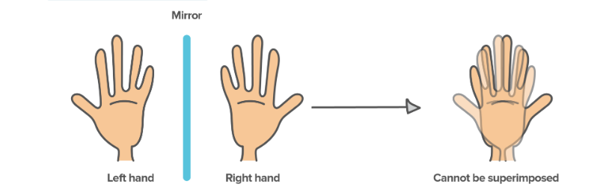
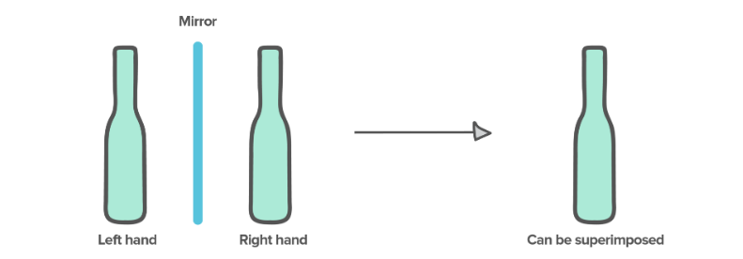
Isomerism
Isomerism:
The branch of chemistry that deals with the special arrangement of atoms in molecules, and the effects of such arrangements, on the chemical, and physical properties of the molecules, especially where asymmetric centers, of substitution lead, to optical rotation, as shown in Fig 2 & Diagram (1).
Fig 2: The two isomeric crystals were non-superimposable mirror images of each other, they had the same physical properties, but differed in their ability to rotate plane polarized light. This property was termed as optical activity.
The two structures (A and B) differ only in the way; that the four groups bonded to the carbon are oriented in space. Consequently, they are stereoisomers. Fig 1.

Slide 10
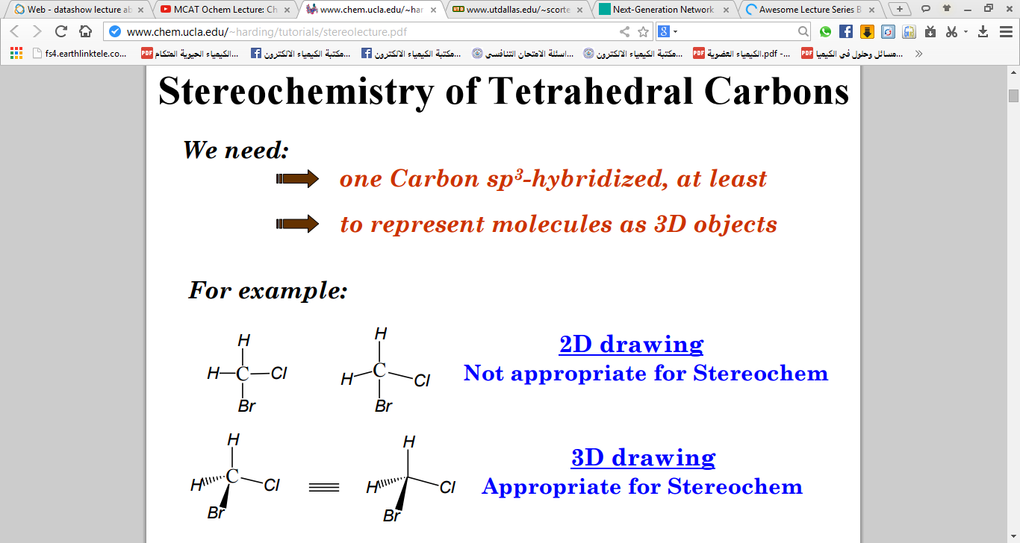

Slide 11
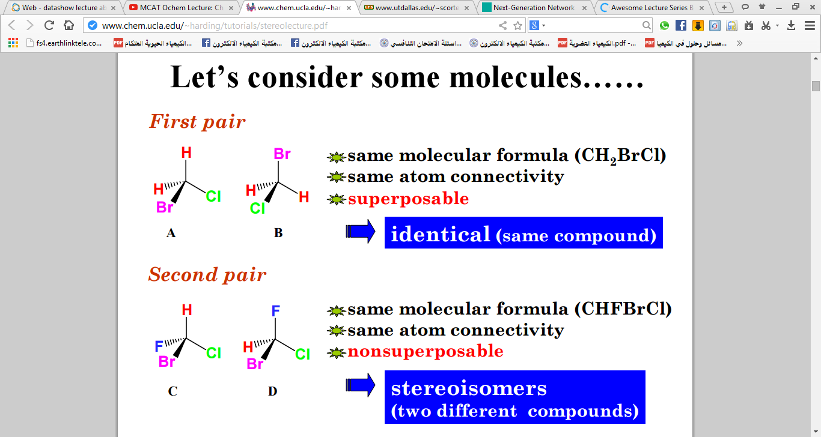
Isomerism ,Stereoisomerism &Chirality

Slide 12
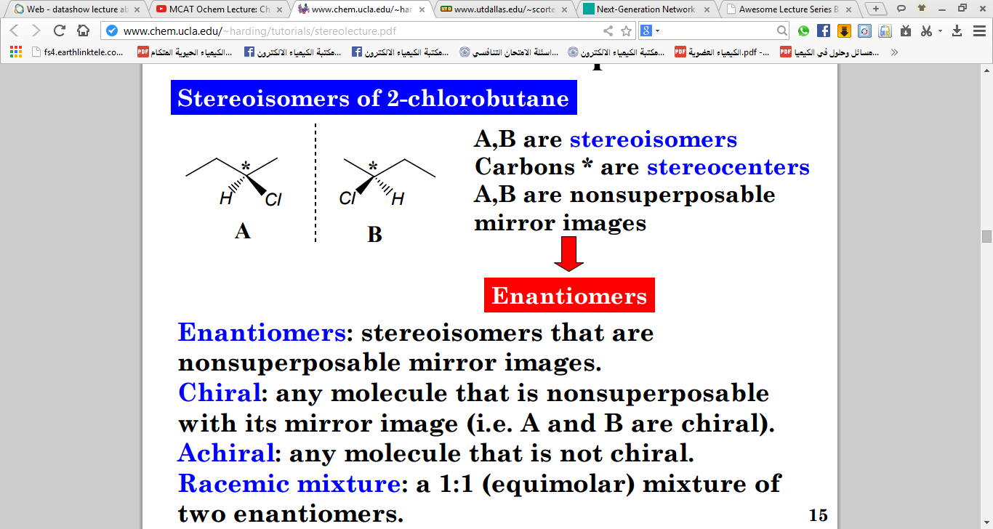
Isomerism ,Stereoisomerism &Chirality
REFERENCE: https://chem.libretexts.org/Bookshelves/Organic_Chemistry/Book%3A_Organic_Chemistry_with_a_Biological_Emphasis_v2.0_(Soderberg)/03%3A_Conformations_and_Stereochemistry/3.06%3A_Optical_Activity

Slide 13
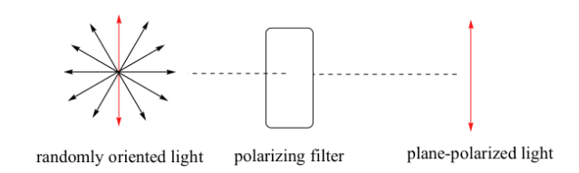
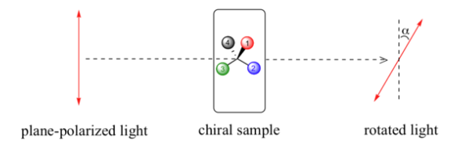
Isomerism ,Stereoisomerism &Chirality.
Optical Activity:
The ability of some substances to rotate plane polarized light, rotates plane-polarized light to the right is called Dextrorotatory (+), while to lift is called Levorotatory (-). When ordinary light is passed through a polarizing filter, all planes of oscillation are filtered out except one, resulting in plane-polarized light. A beam of plane-polarized light passed through a sample of a chiral compound, interacts with the compound in such a way that the angle of oscillation will rotate polarized light. This property is called optical activity. Racemic mixture: its 1:1 {equimolar of Dextrorotatory (+), & Levorotatory (-) } mixture of two enantiomers.
See Figure 3.
Figure 3: optical activity : A beam of plane-polarized light passed through a sample of a chiral compound, interacts with the compound in such a way that the angle of oscillation will rotate polarized light.
Chiral Sample:
Chiral from Greek word meaning hand. A sample have Chiral or an asymmetric carbon atom in its structures, and this atom is a carbon atom attached to four different groups, and its optically active.
Chiral: any molecule that is non superposable with its mirror image.
*
CH2 CHO ــــــCH ــــــ HOCH2
OH

Slide 14
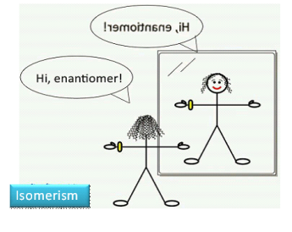

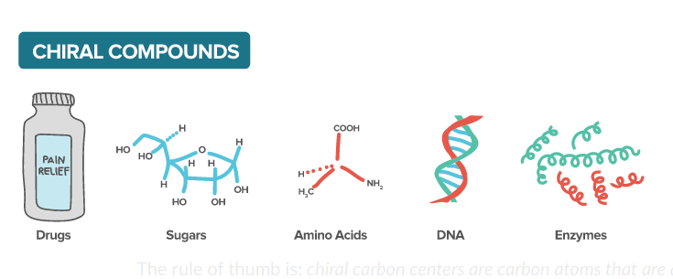
Diastereomers: Compounds that contain two or more chiral center.
Enantiomers: are chiral molecules, that are mirror images of one another. Furthermore, the molecules are non-superimposable on one another. This means that the molecules cannot be placed on top of one another and give the same molecule. Chiral molecules with one or more stereo centers can be enantiomers.
Racemic mixture: its 1:1 (equimolar) mixture of two enantiomers.
Chiral Compounds and Living System: The enzyme consist of amino acids , these amino acids contain chiral centers in its structures. Enzyme reacts with a substrate (enantiomers), to form a complex with only one enantiomer of the substrate, to give product, while the other unreacted, Fig.4 show Types of Chiral Compounds.
*
*
CH CHO ــــــCH ــــــ HOCH2
OH
OH
Fig.4: Types of Chiral Compounds

Slide 15
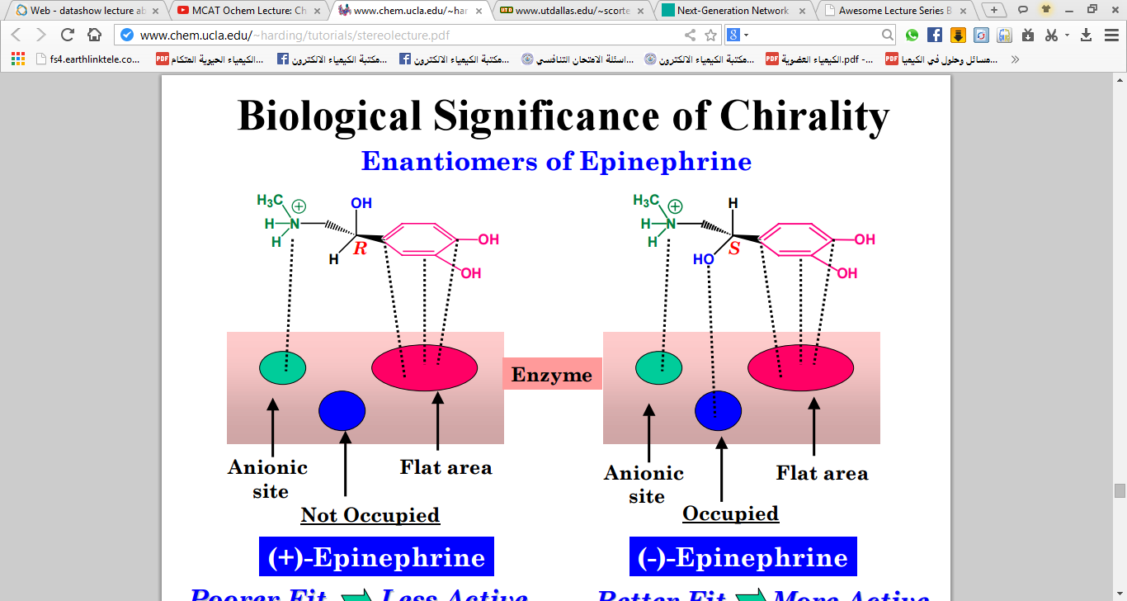
The enzyme Epinephrine has three binding sites, one specific for A, another for B, and a third for Z . To form an E-S complex, * Only the D-enantiomer can bind to the surface with all three groups attached to the correct binding sites. The L-enantiomer can bind to a maximum of two sites. In this way the enzyme can distinguish between the two enantiomers. Fig.(5&6).Indicate the Enantiomers of Epinephrine binding specific Enzyme.
fig.(5): Enantiomers of Epinephrine to bind specific Enzyme .

Slide 16
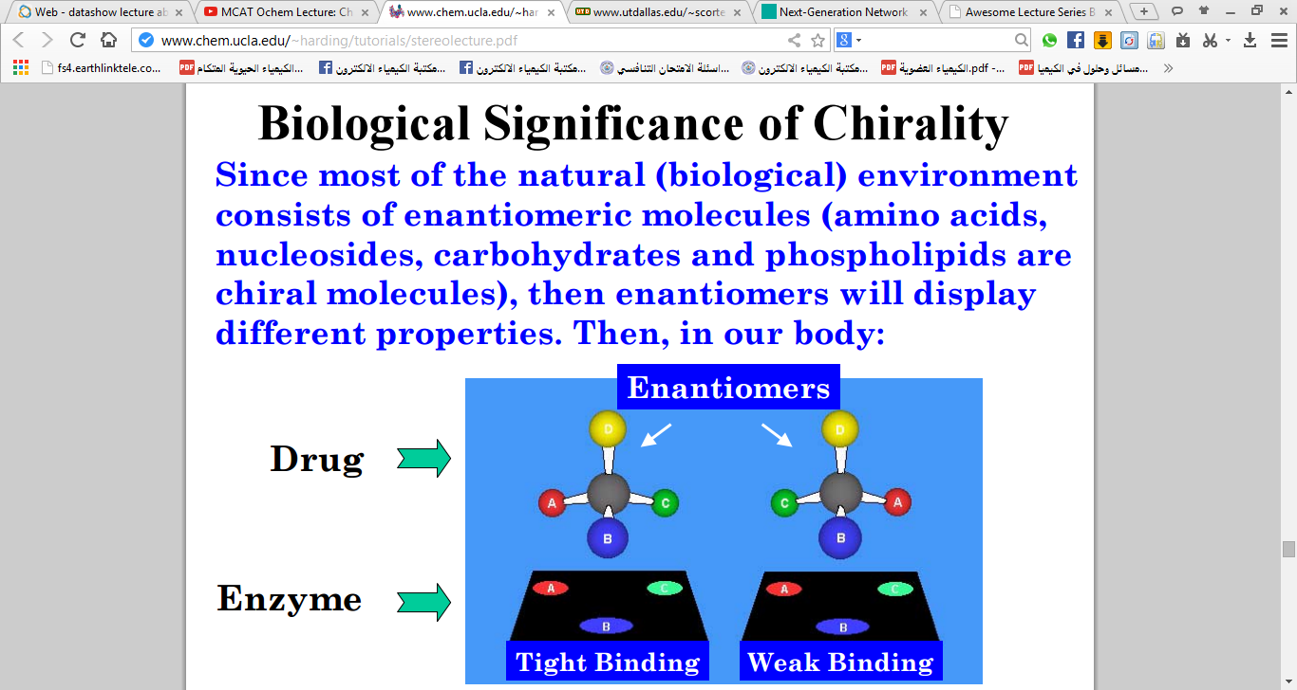
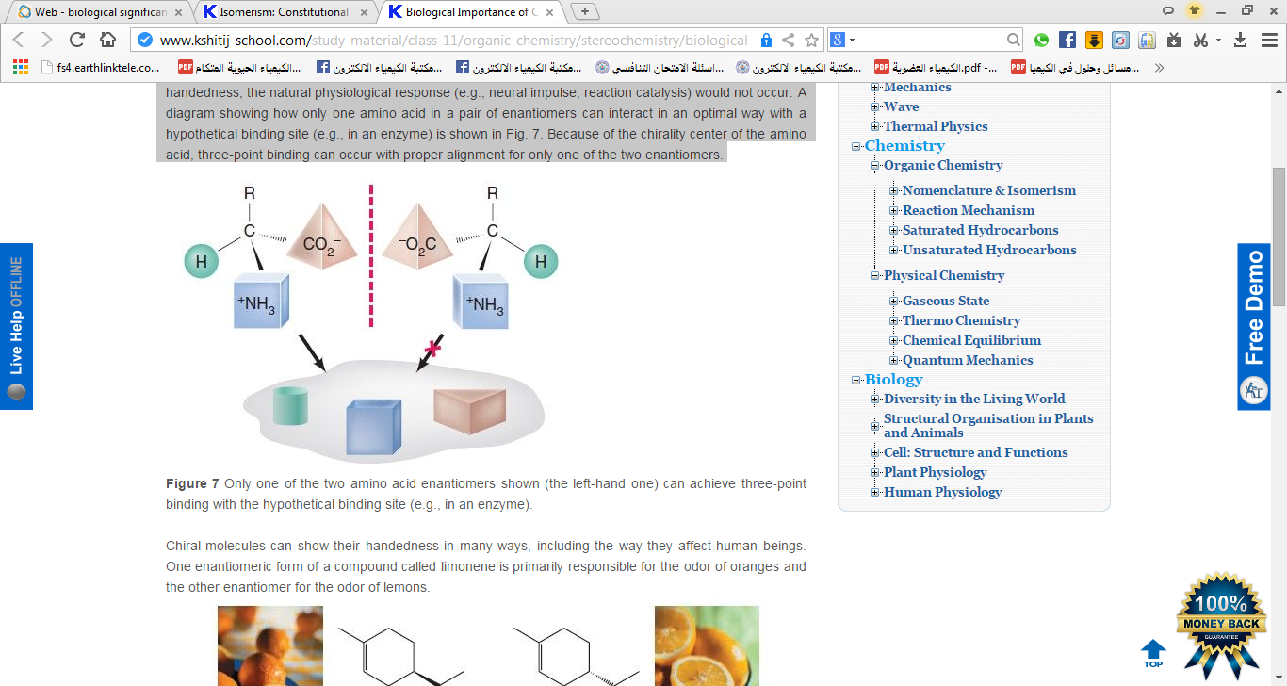
fig.(6): Enantiomers of Epinephrine to bind specific Enzyme .

Slide 17
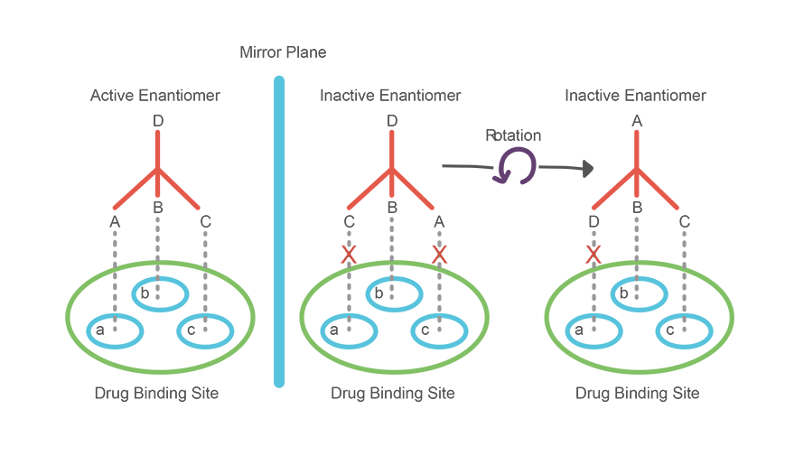
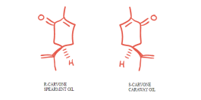

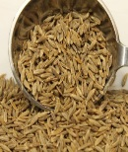
These molecules are mirror images of one another. Additionally, these molecules are non-superimposable because one of these molecules is dextrorotary, and the other levorotary, Fig.7.
Fig.7: Enzyme reacts with a substrate (enantiomers), to form a complex with only
one enantiomer of the substrate.
Chirality and drug development:
The importance of chiral drugs appear in the drug development of pharmaceutical industries, 56% of the drugs currently in use are chiral molecules .
Although the enantiomers of chiral drugs have the same chemical connectivity of atoms; they exhibit marked differences in their pharmacology, toxicology, pharmacokinetics, metabolism. The enantiomers of a chiral drug differ in their interactions with enzymes, proteins, receptors and other chiral molecules too. Human olfactory sensory organs are chiral, so the following pair of enantiomers smell very differently to us. R-isomer of carvone smells like spearmint leaves, while S-isomer of carvone smells like caraway seeds. Fig 8&9 indicate chirality, and drug development.
Fig 5: R-isomer & S-isomer of carvone.

Slide 18
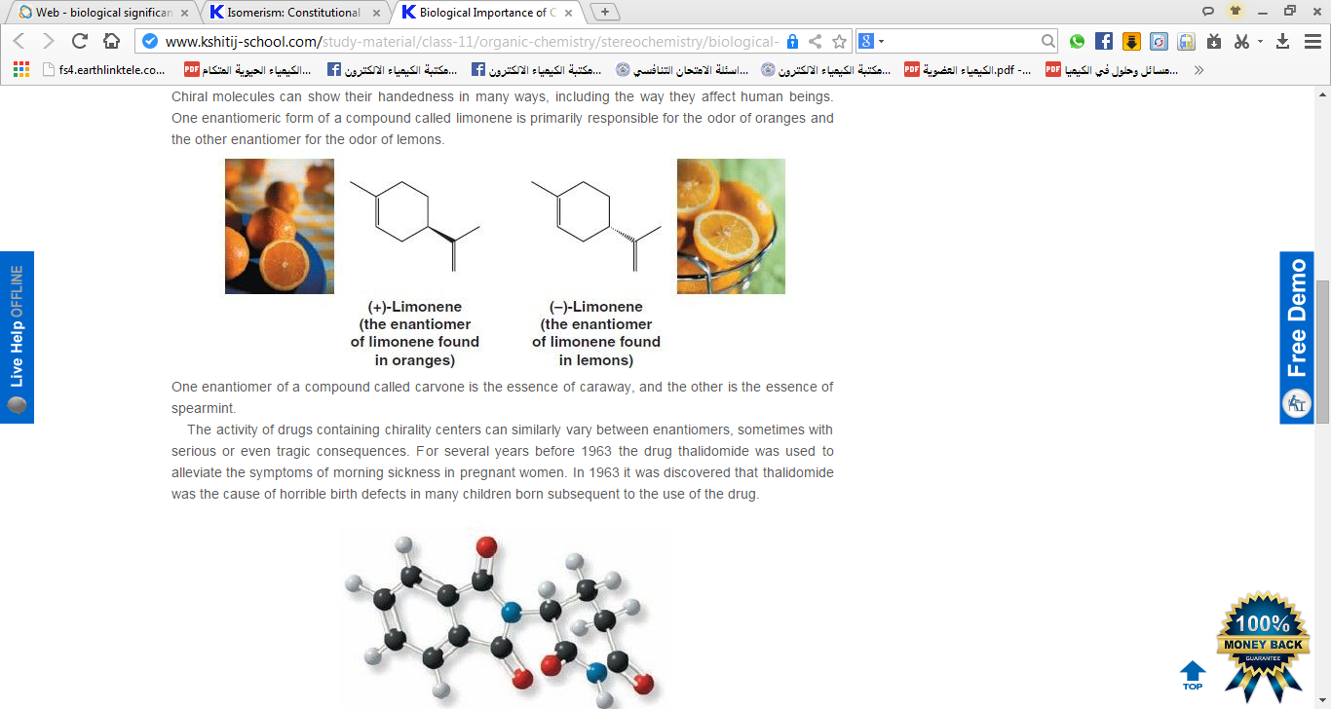
Thalidomide is a racemic mixture: One enantiomer has the intended effect of curing morning sickness & the other enantiomer, may be the cause of the birth defects. Now Thalidomide strict regulations for treatment of some forms of cancer and a serious complication associated with leprosy. Its potential for use against other conditions including AIDS and rheumatoid arthritis.
Fig 9: R-isomer & S-isomer of carvone.

Slide 19
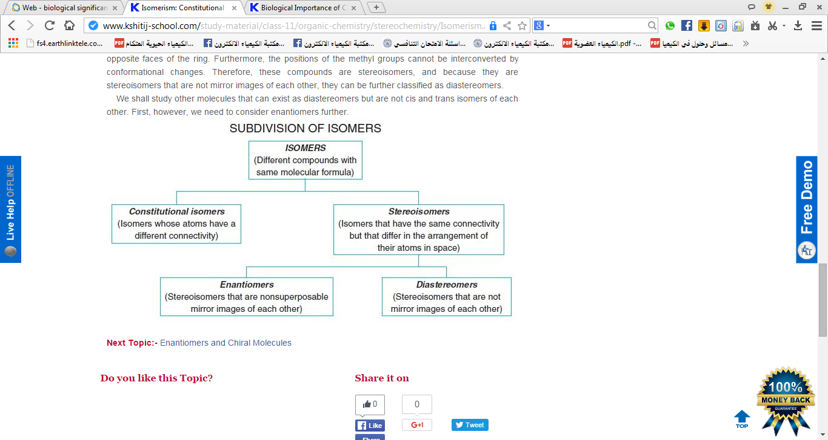
للاطلاعTo see
Diagram(1): Diagram for Indicating the types of subdivision of isomers.
Reference:
1-Stereochemistry,Stereochemistry may be a consequence of steric
effects of a nearby stereocenter which favor one pathway over another
(diastereoselectivity), e.g.4
From: Enantioselective Chemical Synthesis, 2010.
2-Chemistry LibreTexts
3.6: Optical Activity - Chemistry LibreTexts.
3- ]Type here by Henry Schmücke

Slide 21
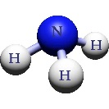
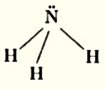
lecture 3عضوية Organic Chemistry
AMINES
Amines:
Amines are a group of organic compounds that are derived from ammonia (NH₃) Figure 1, compounds that has a nitrogen atom connected with two hydrogen atoms (-NH₂), and a single group of some other atoms for example(R), are amines . If hydrogen atoms are replaced by other atoms are also amines.
Figure 1: Formula structure of ammonia (NH₃).
Classification of Amines:
Amines are classified by the number of organic compounds attached with the central nitrogen atom as shown in figure (2), & as follow:
1- Primary amines compounds (RNH₂) consist of one carbon atom attach to NH₂ group, & will be RNH₂ where "R" is an alkyl group. Primary amines are water soluble.
2- Secondary amines compounds (R₂NH) have N–H groups, two of the hydrogen in an ammonia molecule have been replaced by hydrocarbon groups R₂NH.
3- Tertiary amines compounds (R₃N) haven't N–H group (water insoluble). Although the tertiary amines don't have a hydrogen atom attached to the nitrogen, and so can't form hydrogen bonds with themselves, they can form hydrogen bonds with water molecules just using the lone pair on the nitrogen R₃N.
4- Quaternary amines compounds (NR₄⁺) are positively charged polyatomic ions of the structure NR₄⁺ with R being alkyl or aryl groups.

Slide 22
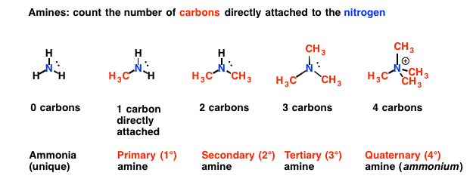
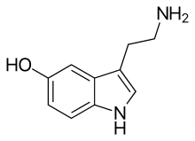
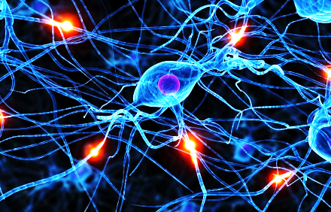
figure (2): Classification of Amines. Amines are classified, by the number of organic compounds attached with the central nitrogen atom as primary, secondary, tertiary , and Quaternary amines.
Reference:
https://www.google.com/url?sa=i&source=images&cd=&ved=2ahUKEwi0r-aP_5fnAhXC3KQKHRTzCMsQjB16BAgBEAM&url=https%3A%2F%2Fwww.masterorganicchemistry.com%2F2010%2F06%2F16%2F1-2-3-4%2F&psig=AOvVaw1lIblnF7dTCL43Y1_FuXWg&ust=1579809451408066
Amines In Our Life:
Amines are present in amino acids the building blocks of proteins, hemoglobin of the blood, and many vitamins & enzymes in living beings.They are built from amino acids.
Serotonin is an important amine, that functions as one of the primary neurotransmitters, for the brain. It controls the feelings,
of happiness, hunger, and helps in regulating the sleeping, and waking-up Cycle, of the brain.
Figure-3: Serotonin chemical formula act as neurotransmitter.

Slide 23

Amines are extremely important functional groups in medicine, and are present, in many drugs (Medicines) Table 1.
Table 1: Amines are present, in many drugs (Medicines).
Manufactured as Medicines & Their Function are: | Amine compounds.
commonly used as analgesics for relieving pain. | Demerol
plays role in the production of some neurotransmitters in the human body that make the brain work properly. | Choline (alkyl ammonium salts).
Use: Emergency disinfection of drinking water. Required dosage: 8 ppm of iodine. | Tetra methyl ammonium Iodide.
Many drugs can contain amines also, including over the counter cold tablets, nasal drops or sprays, some pain relievers, and some antidepressants.
The presence of Amine in foods:
All foods are made up of hundreds of naturally occurring compounds that can have varying effects on us, depending on how much we eat and how sensitive we are Table 2.
The amine content of foods varies greatly due to differences in processing, age, handling, storage and many other factors.

Slide 24
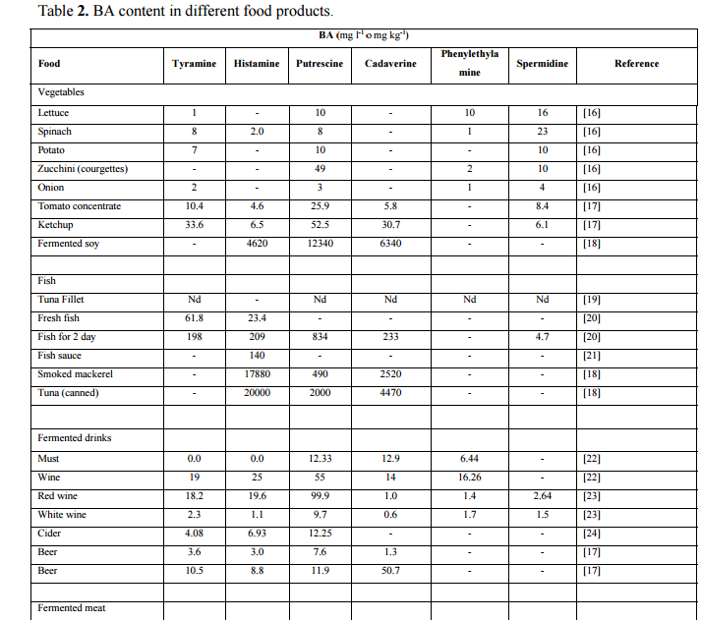
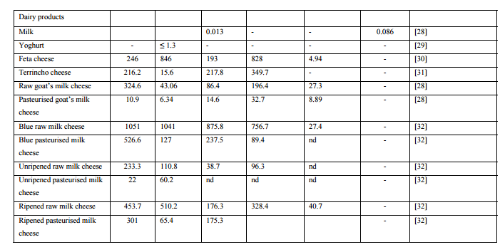
Table 2: Amine present in different foods:
soy sauce | Chocolate | vegetables such as mushrooms | some fruit such as: bananas and avocados | some meats | cheese | Fish
Basically any protein food can contain amines.
The content of amines in foods:-
Amines are present in many forms in human body (Proteins, DNA & others),also in plants (food). Amines are an unavoidable food, that can’t be removed from food. Simply, you can’t buy amine free food. All foods are made up of hundreds of naturally occurring compounds that can have varying effects on us, depending on how much we eat and how sensitive we are (Table -3).
Table -3: Different contents of Amines in foods. FOR SEEN ONLY

Slide 25
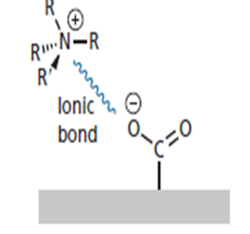
Effect of Amines on Health
The meat distribution in our supermarkets is a problem for amine responders. All meat is now vacuum packed, repacked, and sold as fresh which means, it can be up to ten weeks old when you eat it. Studies show that vacuum packing can inhibit the growth of bacteria but does nothing to retard the development of amines.
Biogenic amines are organic bases with low molecular weight, and are synthesized by microbial vegetable and animal metabolisms. In food and beverages they are formed by the enzymes of raw material or are generated by microbial decarboxylation of amino acids.
Biogenic amines are formed by the breakdown of proteins in foods. They can affect brain functioning, blood pressure, body temperature.
Also amines have been associated with migraines, and headaches, as well as other symptoms of food intolerance, including irritable bowel symptoms, eczema and depression.
Solubility:-
In many cases, the amines can form Hydrogen bonds with water Amines with 6 carbon atoms are water soluble due to this Hydrogen bonding. Water solubility decrease as the length of Hydrocarbon portion of the molecule increase.
Alternatively, a strong ionic interaction may take place with a carboxylate ion in the binding site Figure 4.
Fig.4: Hydrogen bonding of Amines.

Slide 26
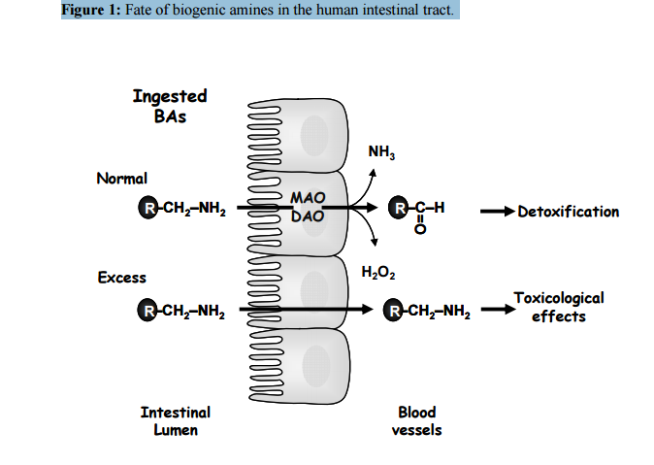
Biogenic amines (BAs):- Biogenic amines (BAs) are formed by the breakdown of proteins (in foods), by metabolism process with the help of enzymes.
Figure (5):- The fate of Biogenic amines (BAs). appear when they absorbed by intestinal microvilli's to be converted directly into RNH₂, H₂O₂, & RCHO.
The fate of Biogenic amines (BAs) are indicated in figure (5).
They can affect blood pressure, and body temperature due to high levels of RCH₂NH₂ in blood.

Slide 27
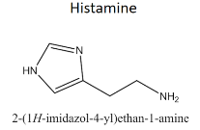
The fate of Biogenic amines (BAs):-
The fate of Biogenic amines (BAs) is appear when they absorbed by intestinal microvilli's to be converted directly into:
1- 2- 3-
Physiological role of amines:-
Biogenic amines BAs play a number of crucial roles in the physiology, and development of eukaryotic Cells, their physiological role is summarized in table 2. The most active example of Biogenic amines (BAs) is Histamine. It is a low molecular weight amine synthesized from L- Histidine, by L- Histidine decarboxylase enzyme only.
Histamine is present in many living tissues as a normal constituent of the body, and has multiple effects in different mammalian, and invertebrate organs. In humans, different concentrations are found in the brain, lung, stomach, small, large intestine, & uterus.
Table2 Example of Biogenic amines (BAs):- Histamine (in human body)
Physiological role of Histamine | Toxicology effect of Histamine
Secretion of Pituitary Hormones, Neurotransmitance in central nervous system. regulation of body Temperature | Headache, swelling, diarrhea, blood pressure disorders.

Slide 28
Histamine Functions :-
Histamine modulates a variety of functions by interacting with specific receptors on target cells, namely H1, H2, H3 and H4, receptors of the G-protein coupled receptor of the cell.
H1 receptors: are found in the brain where they are involved in the control of the circadian rhythm, attention, and they mediate vascular and bronchial muscle responses to histamine in allergic processes in peripheral tissues.
H2 receptors, widely distributed in body tissues, & seem to have a central role only in the regulation of acid secretion. They respond to the presence of histamine, provoking gastric acid secretion, and the contraction of intestinal smooth muscle.
H3 receptors, originally described as auto receptors on brain that controlled histamine synthesis and release.
∆ When histamine binds with these receptors they affect the contraction of smooth muscle cells, the dilation of blood vessels and, therefore, an efflux of blood serum into the surrounding tissues (including the mucous membranes), initiating the inflammatory process.
Table 3:- The G- protein-coupled receptor family.
Receptors | Found in the | Function
H1 | brain. | involved in the control of the peripheral tissues where they mediate vascular and bronchial muscle in responses to histamine in allergic processes .
H2 | body tissues. | They respond to the presence of histamine, provoking gastric acid secretion and the contraction of intestinal smooth muscle.
H3 | brain | controlled histamine synthesis and release.

Slide 29
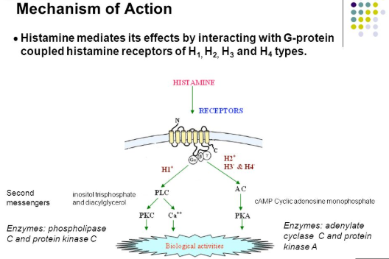
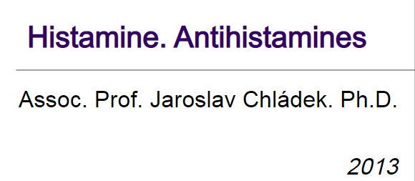
This Figure For Seen Only:
Reference:
https://www.fedup.com.au/factsheets/additive-and-natural-chemical-factsheets/amines.
-

