Slide 1
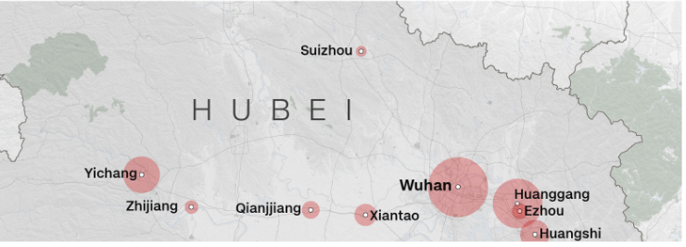
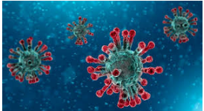
Corona Virus(nCov):
It’s a new type of viruses first identified in Wuhan, Hubei Province, China.

Slide 2
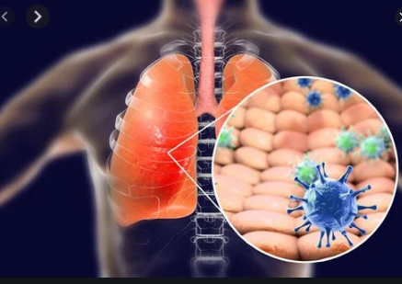
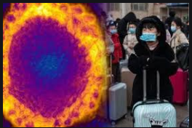
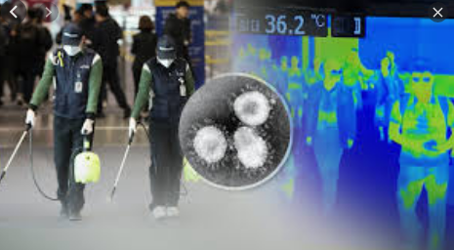
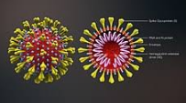
Corona Virus Symptoms may appear 2-14 days after exposure:
- Fever
- Dry Cough
- Shortness of breath.
- Fatigue.
Transmission:
Most often, spread from person-to-person happens among close contacts (about 6 feet). Person-to-person spread is thought to occur mainly via respiratory droplets produced when an infected person coughs or sneezes, similar to how influenza and other respiratory pathogens spread. These droplets can land in the mouths or noses of people who are nearby or possibly be inhaled into the lungs.

Slide 3
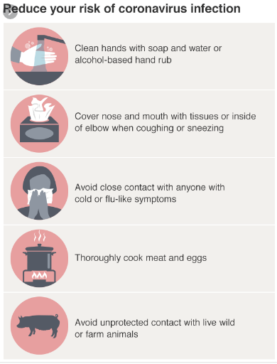
BE SAFE
Prevention of Corona Virus:
Wash your hands.
Avoid touching your eyes.
Stay home when you are sick.
Cover your cough or sneeze with a tissue.
Use gloves.
Reduce your risk of Coronavirus infection:
God Save You

