Slide 1
UPPER LIMB ANATOMY
CUBITAL FOSSA
CUTANEOUS NERVES-DERMATOMES
SUPERFICIAL VEINS

Slide 2
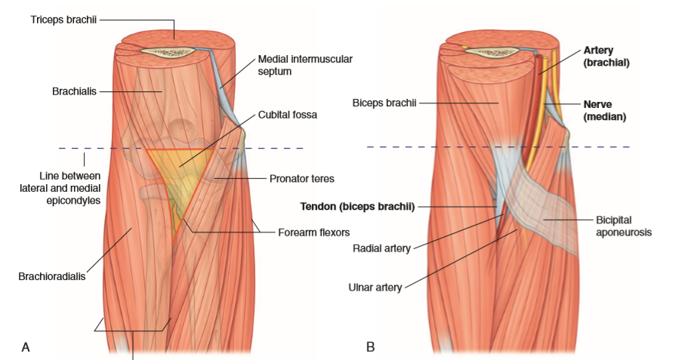

Slide 3
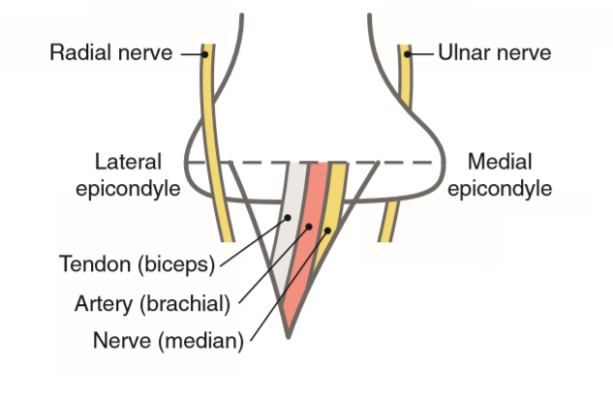

Slide 4
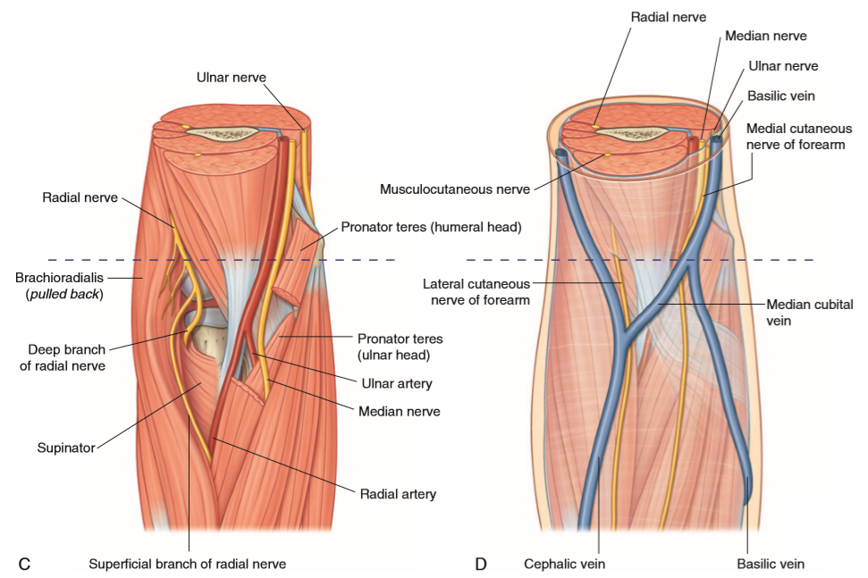

Slide 5
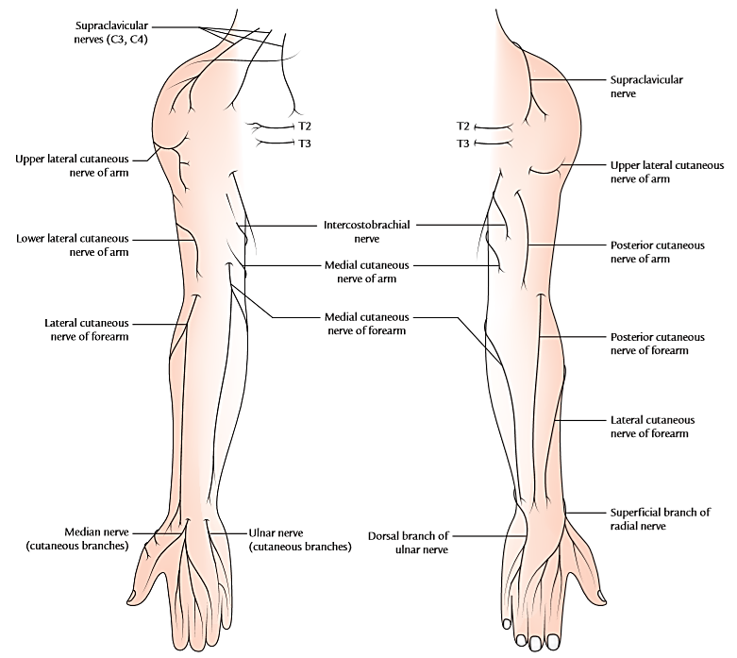
CUTANEOUS NERVES OF THE UPPER LIMB

Slide 6
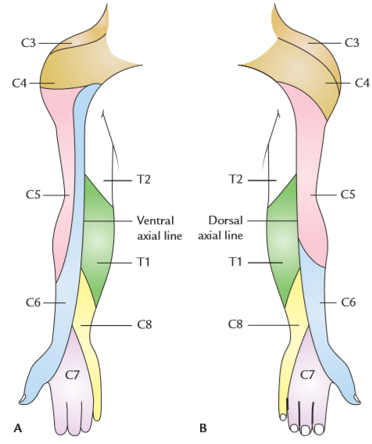
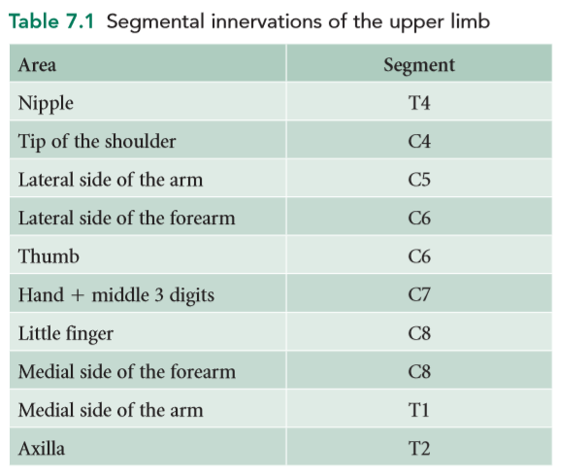
DERMATOMES OF THE UPPER LIMB

Slide 7
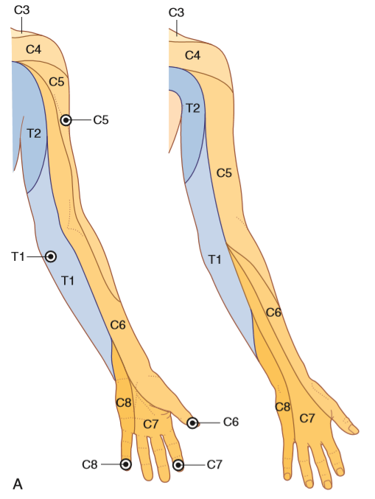
DERMATOMES OF THE UPPER LIMB

Slide 8
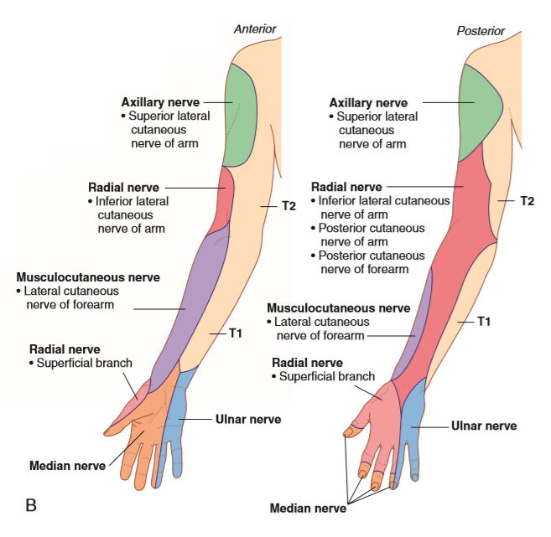
Cutaneous nerves - Dermatomes

Slide 9
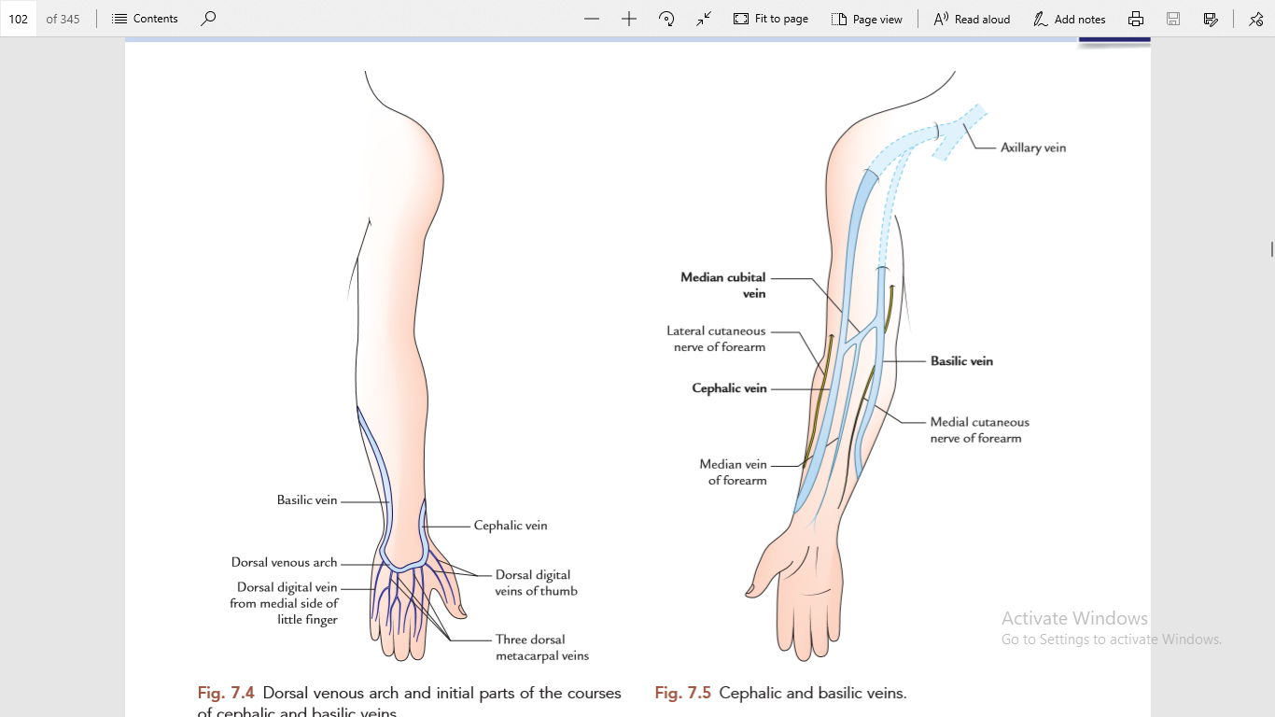
VENOUS DRAINAGE OF THE UPPER LIMB

Slide 10
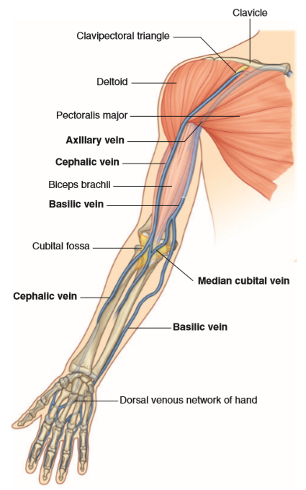

Slide 11
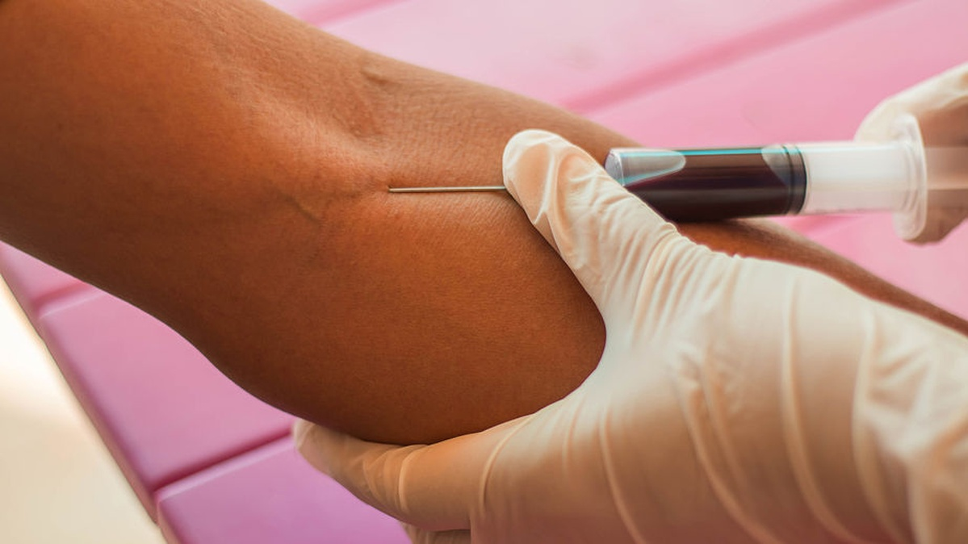
Venipuncture of median cubital vein

Slide 12
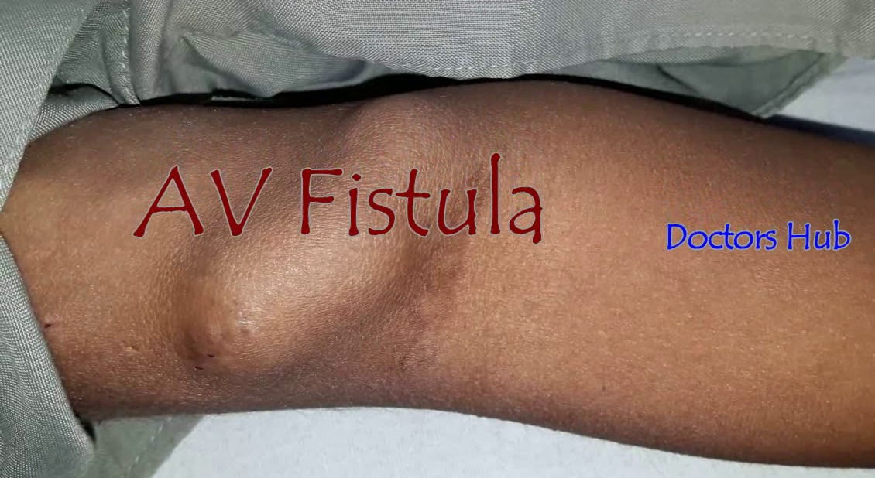
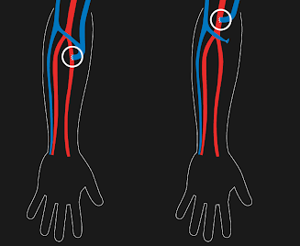
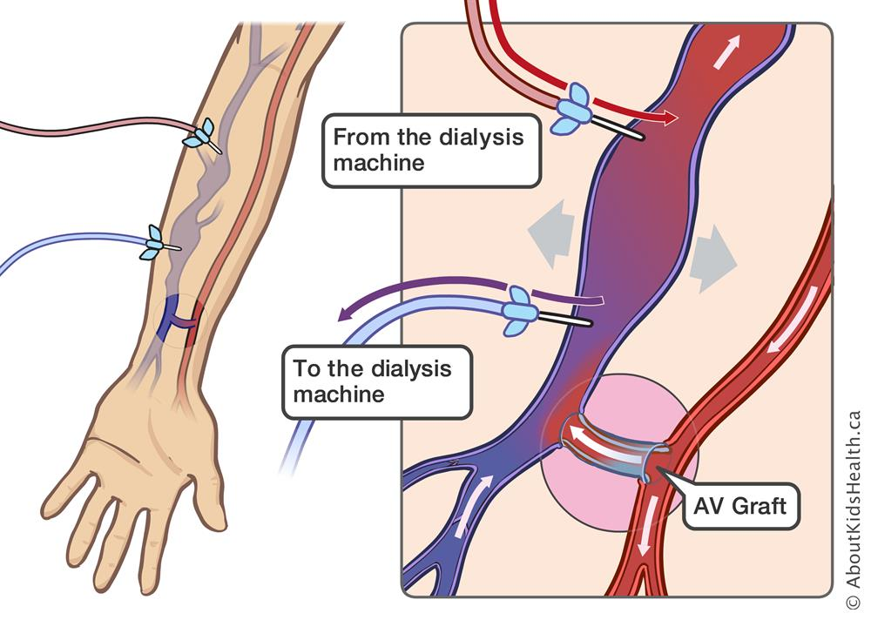
AV Fistula (for hemodialysis)

