Slide 1
UPPER LIMB ANATOMY
THE ARM

Slide 3
ARM

Slide 5
Muscles
ANTERIOR COMPARTMENT (FLEX)
Coracobrachialis
Brachialis
Biceps brachii

Slide 6
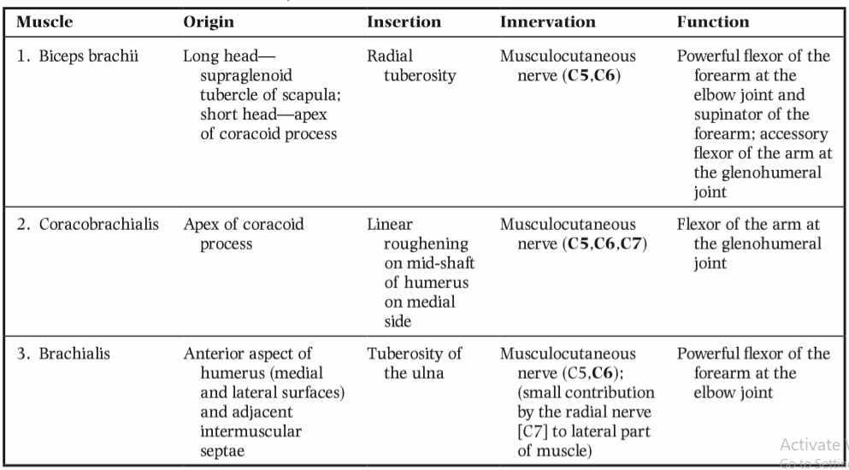

Slide 8
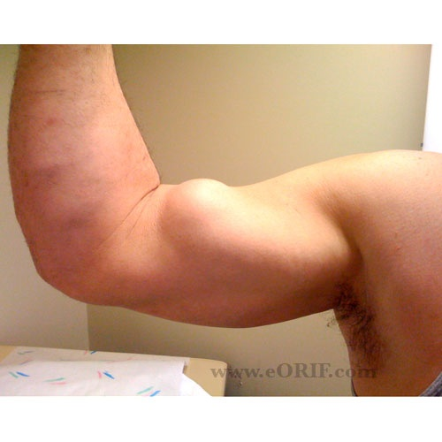
Rupture of biceps tendon
Popeye sign

Slide 9
POSTERIOR COMPARTMENT (EXT)
Triceps (long, lat. & med.)
Triangular interval

Slide 10
Brachial artery

Slide 11
Blood pressure measurement

Slide 12
Branches

Slide 13
Veins

Slide 14
Nerves
MCN (C5,6,7)
Median (C5-T1)
Ulnar (C7-T1)

Slide 15
Radial n. (C5-T1)
Muscular Brs
Triceps, brachioradialis, FCRL
Brachialis (contribution)
Cutaneous Brs
Inf. Lat. Cutaneous of forearm
Post. Cut of forearm

Slide 16
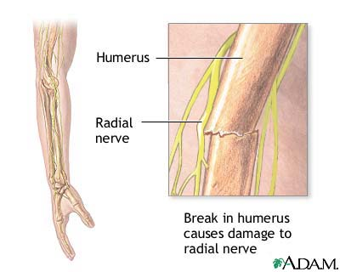
Humerus mid-shaft fracture

Slide 17
THANK YOU

