Slide 2
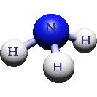
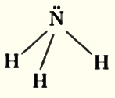
lecture 3عضوية Organic Chemistry
AMINES
Amines:
Amines are a group of organic compounds that are derived from ammonia (NH₃) Figure 1, compounds that has a nitrogen atom connected with two hydrogen atoms (-NH₂), and a single group of some other atoms for example(R), are amines . If hydrogen atoms are replaced by other atoms are also amines.
Figure 1: Formula structure of ammonia (NH₃).
Classification of Amines:
Amines are classified by the number of organic compounds attached with the central nitrogen atom as shown in figure (2), & as follow:
1- Primary amines compounds (RNH₂) consist of one carbon atom attach to NH₂ group, & will be RNH₂ where "R" is an alkyl group. Primary amines are water soluble.
2- Secondary amines compounds (R₂NH) have N–H groups, two of the hydrogen in an ammonia molecule have been replaced by hydrocarbon groups R₂NH.
3- Tertiary amines compounds (R₃N) haven't N–H group (water insoluble). Although the tertiary amines don't have a hydrogen atom attached to the nitrogen, and so can't form hydrogen bonds with themselves, they can form hydrogen bonds with water molecules just using the lone pair on the nitrogen R₃N.
4- Quaternary amines compounds (NR₄⁺) are positively charged polyatomic ions of the structure NR₄⁺ with R being alkyl or aryl groups.

Slide 3
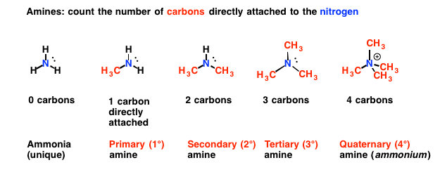
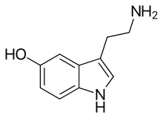
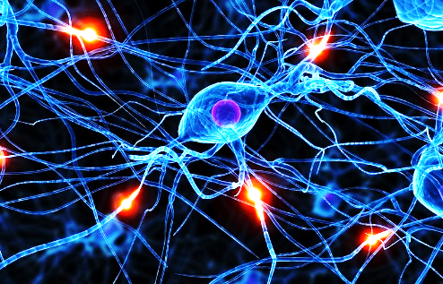
figure (2): Classification of Amines. Amines are classified, by the number of organic compounds attached with the central nitrogen atom as primary, secondary, tertiary , and Quaternary amines.
Reference:
https://www.google.com/url?sa=i&source=images&cd=&ved=2ahUKEwi0r-aP_5fnAhXC3KQKHRTzCMsQjB16BAgBEAM&url=https%3A%2F%2Fwww.masterorganicchemistry.com%2F2010%2F06%2F16%2F1-2-3-4%2F&psig=AOvVaw1lIblnF7dTCL43Y1_FuXWg&ust=1579809451408066
Amines In Our Life:
Amines are present in amino acids the building blocks of proteins, hemoglobin of the blood, and many vitamins & enzymes in living beings.They are built from amino acids.
Serotonin is an important amine, that functions as one of the primary neurotransmitters, for the brain. It controls the feelings,
of happiness, hunger, and helps in regulating the sleeping, and waking-up Cycle, of the brain.
Figure-3: Serotonin chemical formula act as neurotransmitter.

Slide 4
Amines are extremely important functional groups in medicine, and are present, in many drugs (Medicines) Table 1.
Table 1: Amines are present, in many drugs (Medicines).
Manufactured as Medicines & Their Function are: | Amine compounds.
commonly used as analgesics for relieving pain. | Demerol
plays role in the production of some neurotransmitters in the human body that make the brain work properly. | Choline (alkyl ammonium salts).
Use: Emergency disinfection of drinking water. Required dosage: 8 ppm of iodine. | Tetra methyl ammonium Iodide.
Many drugs can contain amines also, including over the counter cold tablets, nasal drops or sprays, some pain relievers, and some antidepressants.
The presence of Amine in foods:
All foods are made up of hundreds of naturally occurring compounds that can have varying effects on us, depending on how much we eat and how sensitive we are Table 2.
The amine content of foods varies greatly due to differences in processing, age, handling, storage and many other factors.

Slide 5
Table 2: Amine present in different foods:
soy sauce | Chocolate | vegetables such as mushrooms | some fruit such as: bananas and avocados | some meats | cheese | Fish
Basically any protein food can contain amines.
The content of amines in foods:-
Amines are present in many forms in human body (Proteins, DNA & others),also in plants (food). Amines are an unavoidable food, that can’t be removed from food. Simply, you can’t buy amine free food. All foods are made up of hundreds of naturally occurring compounds that can have varying effects on us, depending on how much we eat and how sensitive we are (Table -3).
Table -3: Different contents of Amines in foods. FOR SEEN ONLY

Slide 6
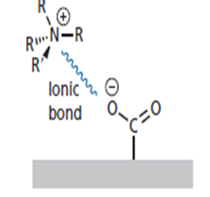
Effect of Amines on Health
The meat distribution in our supermarkets is a problem for amine responders. All meat is now vacuum packed, repacked, and sold as fresh which means, it can be up to ten weeks old when you eat it. Studies show that vacuum packing can inhibit the growth of bacteria but does nothing to retard the development of amines.
Biogenic amines are organic bases with low molecular weight, and are synthesized by microbial vegetable and animal metabolisms. In food and beverages they are formed by the enzymes of raw material or are generated by microbial decarboxylation of amino acids.
Biogenic amines are formed by the breakdown of proteins in foods. They can affect brain functioning, blood pressure, body temperature.
Also amines have been associated with migraines, and headaches, as well as other symptoms of food intolerance, including irritable bowel symptoms, eczema and depression.
Solubility:-
In many cases, the amines can form Hydrogen bonds with water Amines with 6 carbon atoms are water soluble due to this Hydrogen bonding. Water solubility decrease as the length of Hydrocarbon portion of the molecule increase.
Alternatively, a strong ionic interaction may take place with a carboxylate ion in the binding site Figure 4.
Fig.4: Hydrogen bonding of Amines.

Slide 7
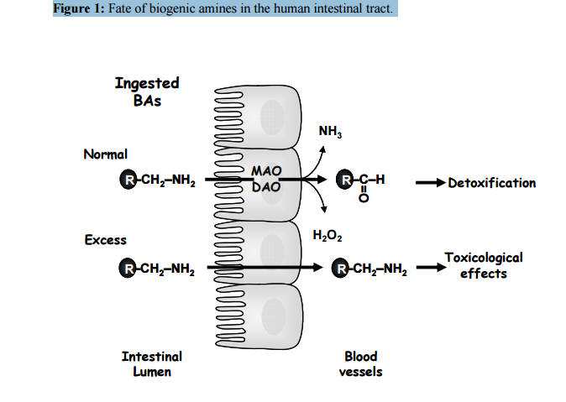
Biogenic amines (BAs):- Biogenic amines (BAs) are formed by the breakdown of proteins (in foods), by metabolism process with the help of enzymes.
Figure (5):- The fate of Biogenic amines (BAs). appear when they absorbed by intestinal microvilli's to be converted directly into RNH₂, H₂O₂, & RCHO.
The fate of Biogenic amines (BAs) are indicated in figure (5).
They can affect blood pressure, and body temperature due to high levels of RCH₂NH₂ in blood.

Slide 8
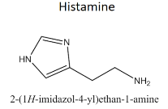
The fate of Biogenic amines (BAs):-
The fate of Biogenic amines (BAs) is appear when they absorbed by intestinal microvilli's to be converted directly into:
1- 2- 3-
Physiological role of amines:-
Biogenic amines BAs play a number of crucial roles in the physiology, and development of eukaryotic Cells, their physiological role is summarized in table 2. The most active example of Biogenic amines (BAs) is Histamine. It is a low molecular weight amine synthesized from L- Histidine, by L- Histidine decarboxylase enzyme only.
Histamine is present in many living tissues as a normal constituent of the body, and has multiple effects in different mammalian, and invertebrate organs. In humans, different concentrations are found in the brain, lung, stomach, small, large intestine, & uterus.
Table2 Example of Biogenic amines (BAs):- Histamine (in human body)
Physiological role of Histamine | Toxicology effect of Histamine
Secretion of Pituitary Hormones, Neurotransmitance in central nervous system. regulation of body Temperature | Headache, swelling, diarrhea, blood pressure disorders.

Slide 9
Histamine Functions :-
Histamine modulates a variety of functions by interacting with specific receptors on target cells, namely H1, H2, H3 and H4, receptors of the G-protein coupled receptor of the cell.
H1 receptors: are found in the brain where they are involved in the control of the circadian rhythm, attention, and they mediate vascular and bronchial muscle responses to histamine in allergic processes in peripheral tissues.
H2 receptors, widely distributed in body tissues, & seem to have a central role only in the regulation of acid secretion. They respond to the presence of histamine, provoking gastric acid secretion, and the contraction of intestinal smooth muscle.
H3 receptors, originally described as auto receptors on brain that controlled histamine synthesis and release.
∆ When histamine binds with these receptors they affect the contraction of smooth muscle cells, the dilation of blood vessels and, therefore, an efflux of blood serum into the surrounding tissues (including the mucous membranes), initiating the inflammatory process.
Table 3:- The G- protein-coupled receptor family.
Receptors | Found in the | Function
H1 | brain. | involved in the control of the peripheral tissues where they mediate vascular and bronchial muscle in responses to histamine in allergic processes .
H2 | body tissues. | They respond to the presence of histamine, provoking gastric acid secretion and the contraction of intestinal smooth muscle.
H3 | brain | controlled histamine synthesis and release.

Slide 10
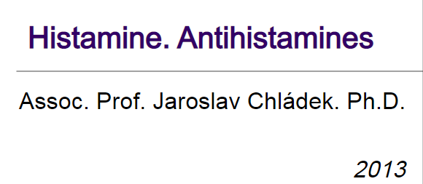
This Figure For Seen Only:
Reference:
https://www.fedup.com.au/factsheets/additive-and-natural-chemical-factsheets/amines.
-

