Slide 1
Lab. 6:
Trematodes
Fasciola hepatica

Slide 2
Adult worm in human & other vertiberates (sexual reproduction)
Eggs in fresh water (3-7 weeks)
Miracidium (swimming free in water )
Sporocyst (soft tissue of the aproprate intermediat host"snail“ (asexual reproduction)
1st & 2nd generation of Redia (snail)
Cercaria free in fresh water
Metacercaria (other trematodes)
Schistosoma

Slide 3
Fasciola hepatica

Slide 4
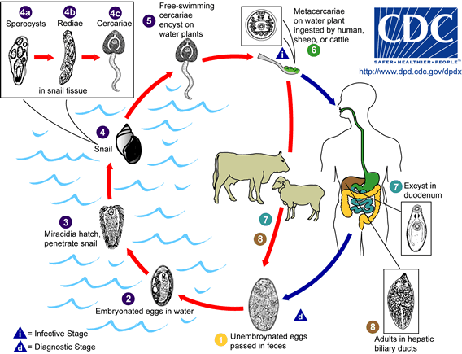

Slide 5
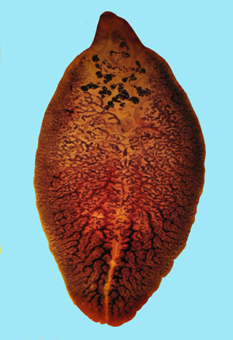
Fasciola hepatica
A. Adult:
large and broadly-
flattened,
measuring up to
30 mm long and 15
mm wide.
The anterior end is
cone-shaped.
Extensive branching
of: intestinal ceca,
testes and vitelline
follicles.

Slide 6
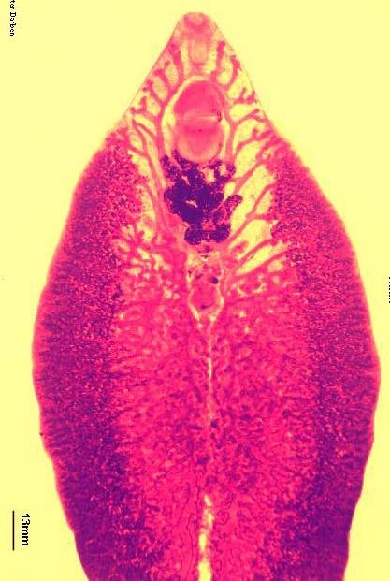
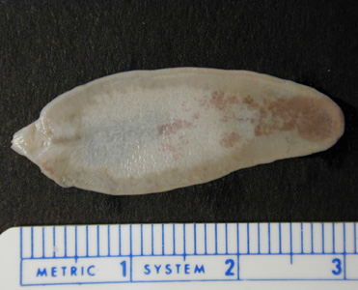

Slide 7
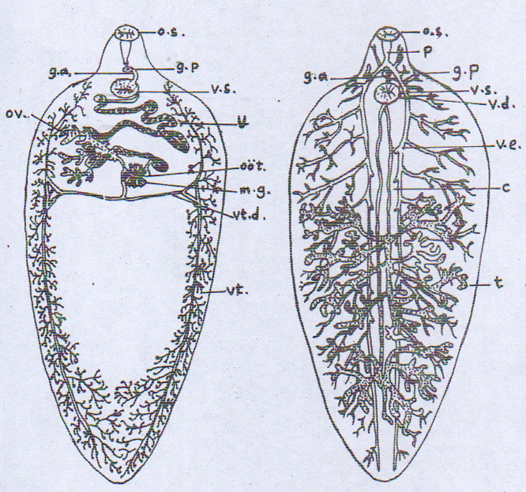
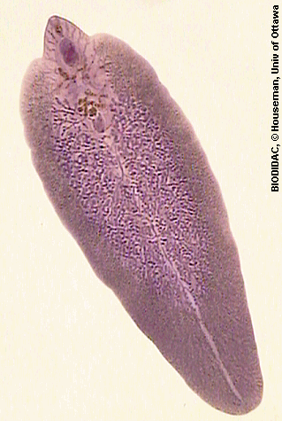
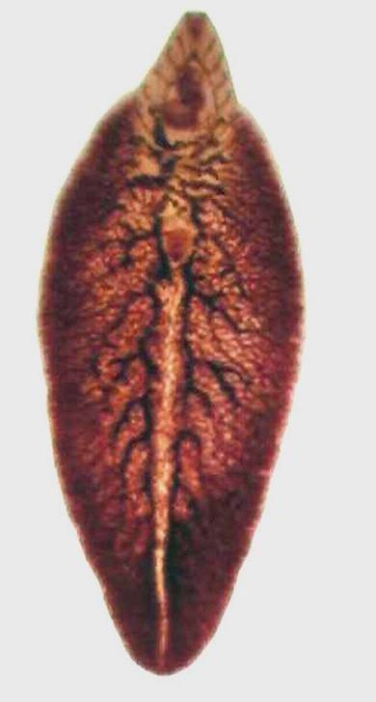
Fasciola hepatica A: Adult
Carmine s.
Fasciola hepatica Adult 20 – 30 mm L. X 8 – 13 mm B, ( grey – brown )

Slide 8
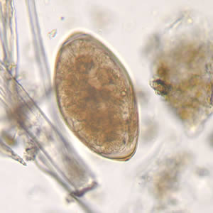
Fasciola hepatica
B-Ovum
Large ,
Single celled Unembryonated
with operculum

Slide 9
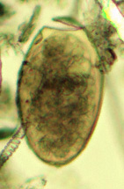
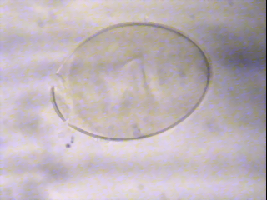
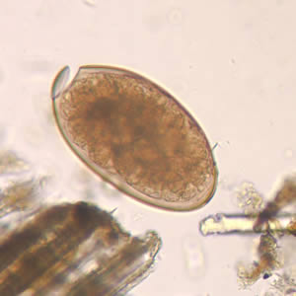

Slide 10
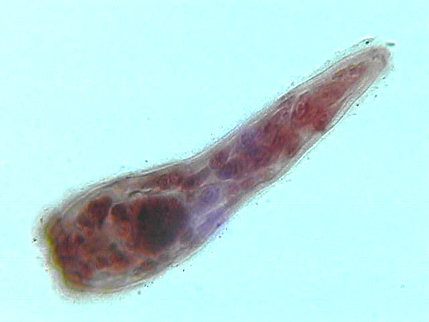
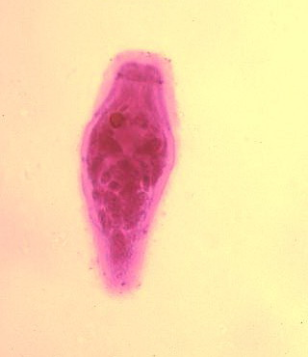
Fasciola hepatica
C-Miracidium
Ciliated,
Swimming in water
Many celled.

Slide 11
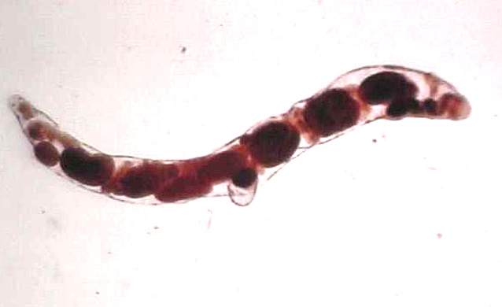
Fasciola hepatica
D-Redia
Sac - like structure with germ cells,
Clusters of germ cells differentiate
into daughter redia or cercaria

Slide 12
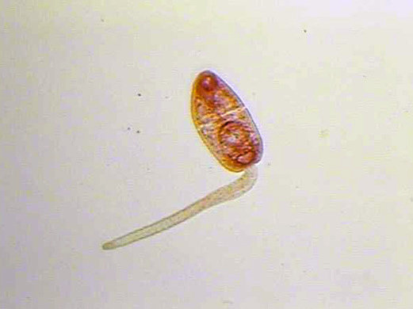
Fasciola hepatica
E. Cercaria:
Anterior trunk
Posterior tail,
Leaving snail to
swim in water.

Slide 13
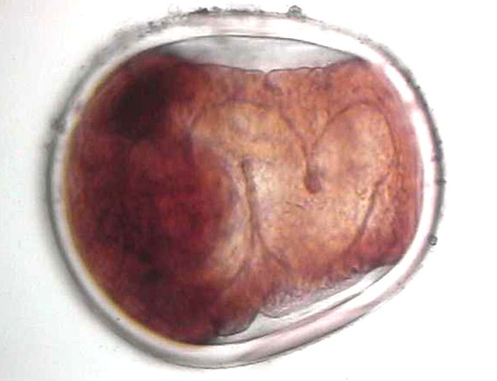
Fasciola hepatica
F. Metacercaria:
Globose structures
Encysted on aquatic vegetation.

Slide 14
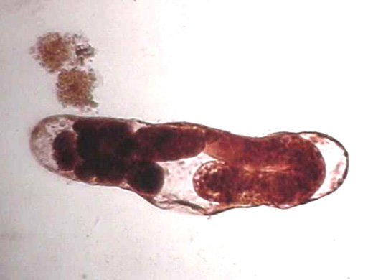
Miracidium
sporocysts
Egg
Rediae
Cercaria
Metacercaria
stages from Fasciola hepatica life cycle

