Slide 1
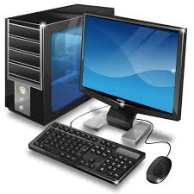
Al Mustansiriyah University / College of Medicine
Computer Science for First Year
Computer Basics

Slide 2
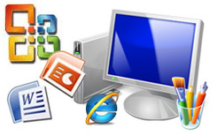
Introduction
Today, almost all of us in the world make use of computers in one way or the other. It finds applications in various fields of engineering, medicine, commercial, research and others.
They are present everywhere, in all the devices that we use daily like cars, games, washing machines, microwaves etc. and in day to day computations like banking, reservations, electronic mails, internet and many more.

Slide 3
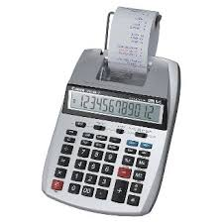
Introduction
The word computer is derived from the word compute, Compute means to calculate.
The computer was originally defined as a super-fast calculator. It had the capacity to solve complex arithmetic and scientific problems at very high speed. But nowadays in addition to handling complex arithmetic computations, computers perform many other tasks like accepting, sorting, selecting, moving, comparing various types of information. They also perform arithmetic and logical operations on alphabetic, numeric and other types of information.

Slide 4
Computer Generations
the generation term was used to distinguish between varying hardware technologies. Nowadays, generation includes both hardware and software, which together make up an entire computer system.

Slide 5
First Generation (1946-1959): This generation relied on machine language to perform operations, and they could only solve one problem at a time. Input was based on punched cards and paper tape, and output was displayed on printouts.

Slide 6
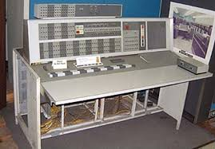
Second Generation (1959-1965): The transistor was far superior to the vacuum tube.
Computers become smaller, faster, cheaper
More energy-efficient and more reliable.
Assembly languages.
High-level programming languages.
It is the first computers that stored their instructions in their memory.

Slide 7
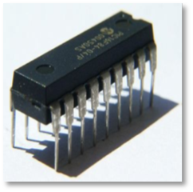
Third Generation (1965-1971): Integrated Circuit based.
Users interacted computers through keyboards and monitors.
Interfaced with an operating system, which allowed the device to run many different applications at one time.

Slide 8
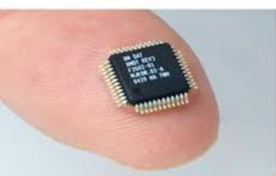
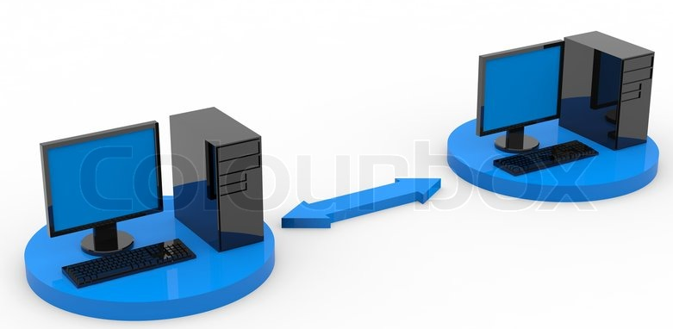
Fourth Generation (1971-1980): VLSI microprocessor based.
First computer for the home user.
Development of Networks led to develop the Internet.
GUIs (Windows OS) .
The mouse and handheld devices.

Slide 9
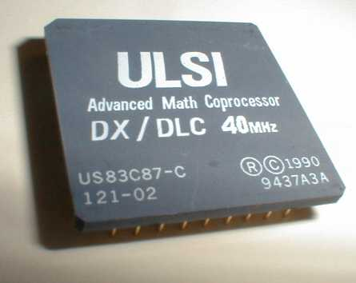
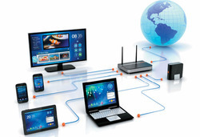
Fifth Generation (1980-onwards):
ULSI microprocessor based.
Develop devices that respond to :
Natural language input.
Capable of learning and self-organization (Artificial Intelligent).

Slide 10
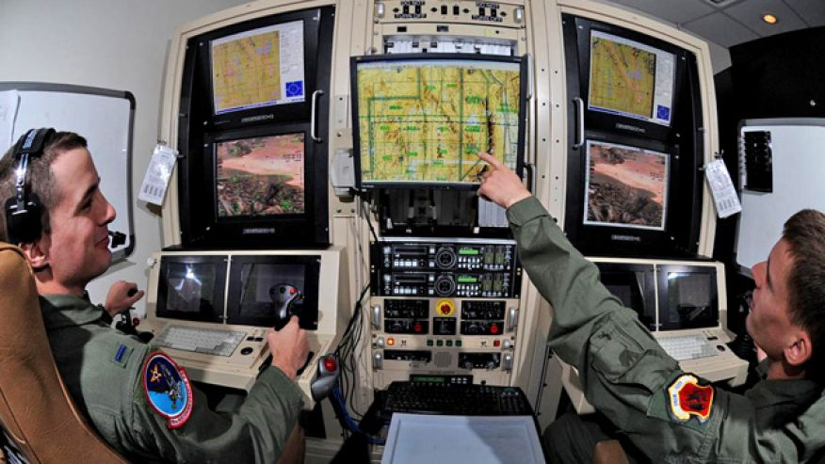

APPLICATIONS OF COMPUTERS
Military.
Scientific, Engineering and Research.
Business.
Healthcare:
Information: Television, Satellite communication, Internet, networks
Education.
Games and Entertainment.
Communication.

Slide 11
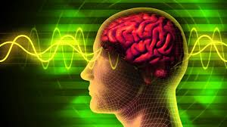
Computer System and the Human Mind
The content of the human mind can be classified into four categories:
Data: symbols.
Information: data that are processed to be useful; provides answers to "who", "what", "where", and "when" questions.
Knowledge: application of data and information; answers "how" questions .
Wisdom: evaluated understanding.

Slide 12
Human Mind
Data
Ex: It is raining.
Information
Ex: The temperature dropped 15 degrees and then it started raining.
If the humidity is very high and the temperature drops substantially the atmospheres is often unlikely to be able to hold the moisture so it rains.
Knowledge
Wisdom
It rains because it rains.

Slide 13
Advantage of Computer:
Speed: Smaller computers can execute thousands of instructions per second, while the more complex machines can execute millions of instructions per second.
Accuracy: They are capable of executing hundreds of instructions without any errors.
Efficiency: The computers can perform repeated tasks with the same efficiency any number of times without exhausting there selves.
Storage Capability: Computers are capable of storing large amounts of data in their storage devices.
Versatility: They are capable of performing no numerical operations fielding like: air-line reservation, electricity bills, data base management etc.

Slide 14
Limitations of Computers:
Although the computers of today are highly intelligent and sophisticated they have their own limitations.
No Intelligence: a computer cannot take any decision on its own.
Dependency: It functions as per the user’s instruction, thus it is fully dependent on humans.
Environment: The operating environment of the computer should be dust free and suitable.
Feeling: It cannot make judgment based on feeling, taste, experience, and knowledge unlike humans.

Slide 15
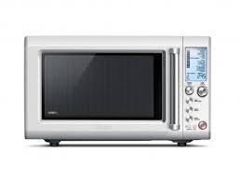
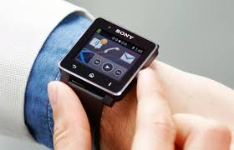
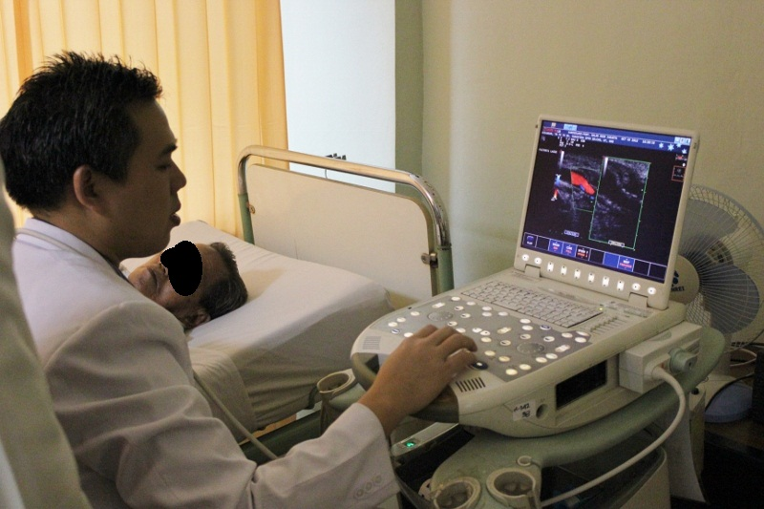
Computers can be generally classified by :
Purpose, Size and Number of users
1) Special-Purpose Computers or dedicated computers, because they are dedicated to perform a single task over and over again.
Games.
Traffic lights control system.
Weather forecasting.
Oil exploration.
Automotive industries.
Keeping time in a digital watch.
Heart monitoring equipment
Global positioning satellite (GPS)
Microwaves and other home appliances
Playing graphic intensive Video

Slide 16
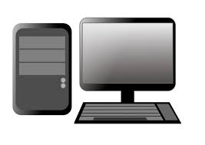
2) Personal computer:
The personal computers are specially designed for general purpose. PC are widely used & the fastest growing computers.
Its small, relatively inexpensive
computer based on the microprocessor technology that enables manufacturers to put an entire CPU on one chip.
Well known manufacturers of PC are Dell, Apple, Samsung, Sony and Toshiba.

Slide 17
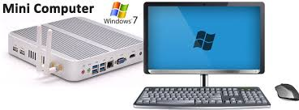
3) Minicomputer:
    May contain one or more processors.
    Support multiprocessing and tasking.
    Generally resilient to high workloads.
    More powerful than personal computers and workstations.

Slide 18
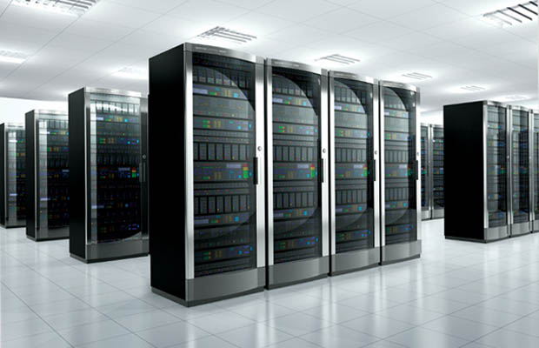
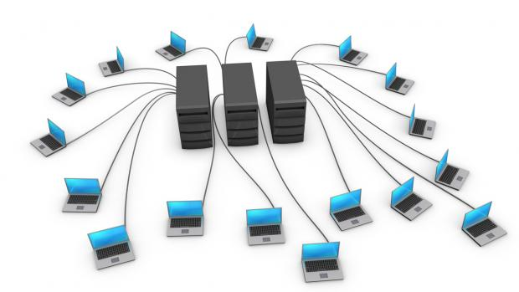
4) Mainframe:
A powerful multi-user computer
Supporting many hundreds or thousands of users simultaneously.
Used in Banks, Educational institutions and Control massive networks.

Slide 19
5) Supercomputer:
    Fast computer that can perform hundreds of millions of instructions per second.
    Very expensive
    Employed for specialized applications that require huge amount of mathematical calculations.
    Used in Weather forecasting, scientific simulations and Nuclear energy research.

Slide 20
Computer System
Computer defined as a fast and accurate data processing system that accepts data, performs various operations on the data, has the capability to store the data and produce the results on the basis of detailed step by step instructions given to it.
A computer system is made up of 4 main types of components:
Hardware
Soft­ware (Software: Bringing the Machine to Life)
Data
People/Users.

Slide 21
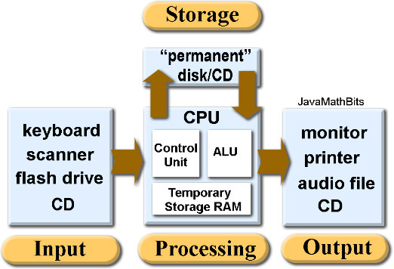
Computer System
The Hardware:

Slide 22
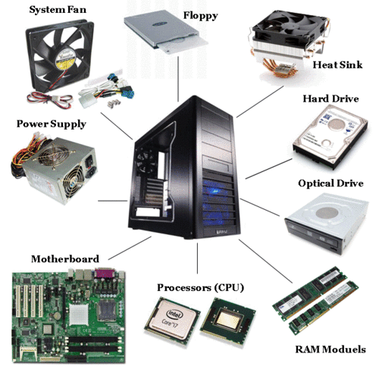
The Hardware:
  Input unit.
  Storage unit.
  Central processing (Arithmetic logic unit and control unit).
  Output unit.

Slide 23
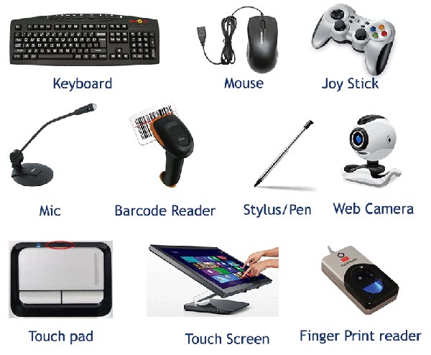
The Hardware
Input Unit: Input unit is any peripheral (piece of computer hardware) equipment which Translate data from form that humans understand to one that the computer can work with. Most common are Keyboard and Mouse

Slide 24
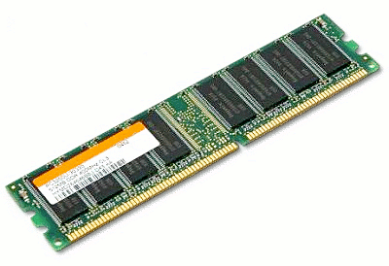
  Storage Unit
Primary Memory:
RAM:
Random Access Memory is a memory structure responsible for storing data on a temporary basis.
It can be quickly accessed by the processor as and when needed.
RAM is generally measured in GB (Gigabytes).
RAM plays a huge part in the number of programs a computer can run simultaneously.
If you’ve ever wondered why your computer may buckle under the pressure if 5 or 6 memory-demanding programs run at the same time, it’s probably because it doesn’t have enough RAM capacity to support them all.
It is volatile memory; that is, what’s held in RAM is only held there as long as the computer is on.
If the data isn’t moved to the hard drive before the computer is turned off, the data stored in RAM is flushed away.

Slide 25
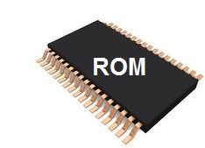
  Storage Unit
Primary Memory:
ROM: Read Only Memory
It's a type of storage medium that permanently stores data on personal computers (PCs) and other electronic devices.
It contains the programming needed to start a PC, which is essential for boot-up; it performs major input/output tasks and holds programs or software instructions.
Because ROM is read-only, it cannot be changed.
It is permanent and non-volatile, meaning it also holds its memory even when power is removed.

Slide 26
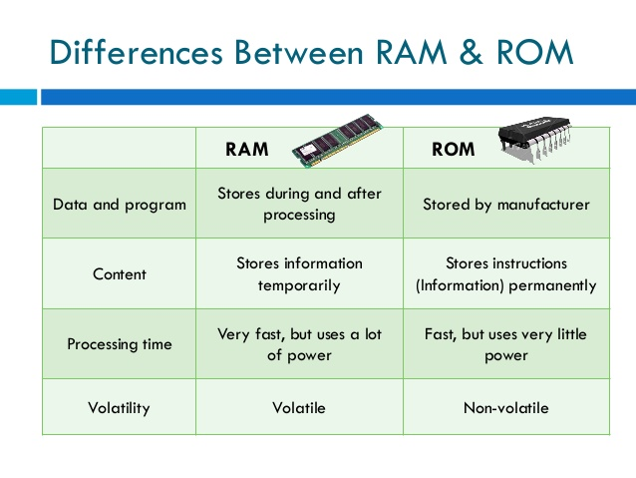

Slide 27
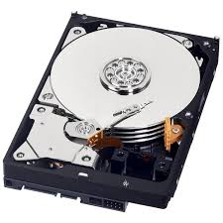
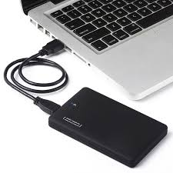
  Storage Unit
Secondary Memory
Stores data and programs permanently, it's retained after the power is turned off.
Hard drive (HD): A hard disk is part of storage unit, often called a "disk drive," "hard drive," or "hard disk drive," that store and provides relatively quick access to large amounts of data on an electromagnetically charged surface or set of surfaces.

Slide 28
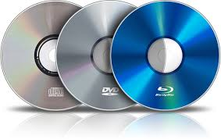
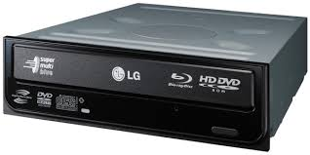
  Storage Unit
Secondary Memory
Optical Disk
An optical disc drive (ODD) is a disk drive that uses laser light as part of the process of reading or writing data to or from optical discs. Recently all drives are both readers and recorders, also called burners or writers.
There are three main types of optical media: CD, DVD, and Blu-ray disc.
CDs can store up to 700 megabytes (MB) of data and DVDs can store up to 8.4 GB of data. Blu-ray discs, which are the newest type of optical media, can store up to 50 GB of data.

Slide 29
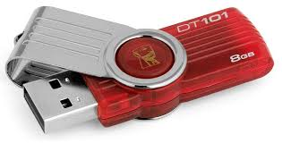
  Storage Unit
Secondary Memory
Flash Disk
Is an electronic (solid-state) non-volatile computer storage medium that can be electrically erased and reprogrammed.
Flash disk from 8 to 256 GB are frequently sold, and less frequently 512 GB and 1 TB units.
Flash memory doesn't usually degrade because of its age, but rather because of the number of write cycles.
USB flash disk are often used for storage, data back-up and transfer of computer files.
They are smaller, faster, have thousands of times more capacity, and are more durable and reliable because they have no moving parts.

Slide 30
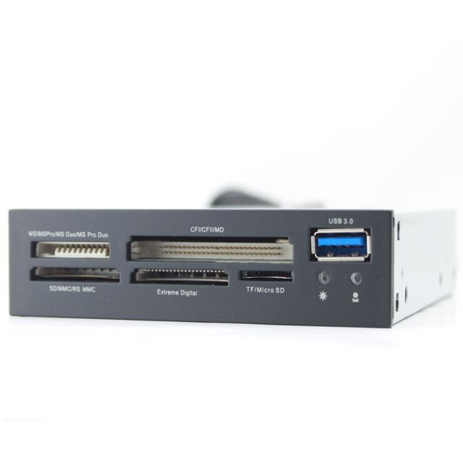
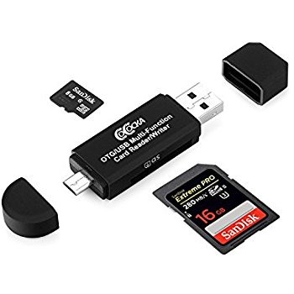
  Storage Unit
Secondary Memory
Flash Disk

Slide 31
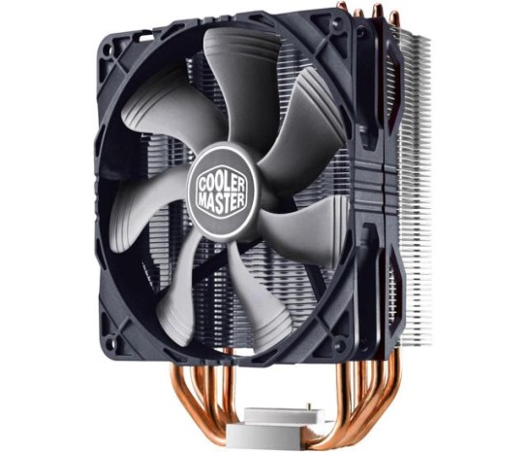
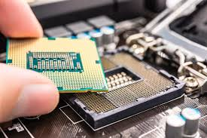
The Hardware
Central Processing Unit (CPU)
  A CPU is brain of a computer. It is responsible for all functions and processes. Regarding computing power, the CPU is the most important element of a computer system.

Slide 32
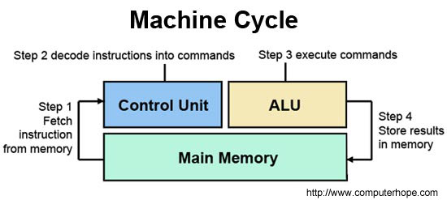
Arithmetic Logic Unit (ALU):
Arithmetic calculations like addition, subtraction, multiplication and division.
Logical operation like compare numbers, letters, or special characters
Control Unit (CU):
Controls and co-ordinates computer components.
Read the code for the next instruction to be executed. Increment the program counter so it points to the next instruction.
Read whatever data the instruction requires from cells in memory.
Provide the necessary data to an ALU or register. If the instruction requires an ALU or specialized hardware to complete, instruct the hardware to perform the requested operation.

Slide 33
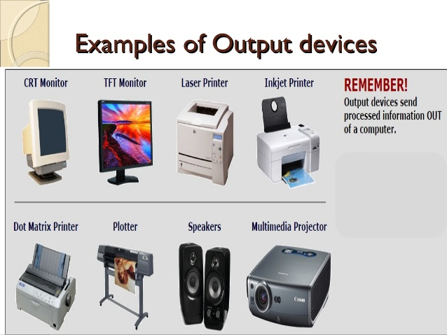
The Hardware
Output Unites
  is any piece of computer hardware equipment used to converts the results of data processing from electronically generated information into human-readable form.

Slide 34
The Software
      The computer hardware itself is not capable of doing anything on its own. It has to be given explicit instructions to perform the specific task.
Software is a collection of programs which utilize and enhance the capability of the hardware.
The computer program is the one which controls the processing activities of the computer.
Software
Application Software
System Software
Operating System
Utilities

Slide 35
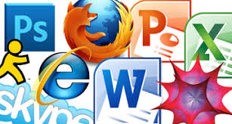
2.1) Application software:
Application software tells the computer how to accomplish tasks the user requires.
Examples:
Word processing programs
Spreadsheets
Database manage­ment software
Presentation programs
Graphics programs
Web browsers
Internet applications.

Slide 36

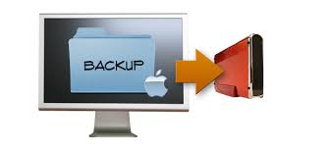
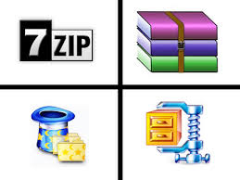
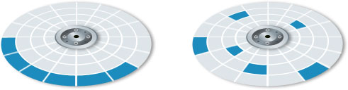
2.2.1) Utility software is designed to help analyze, configure, optimize or maintain a computer.
For Example:
Anti-virus utilities scan for computer viruses.
Backup software can make copies of all information stored on a disk and restore either the entire disk (e.g. in an event of disk failure) or selected files (e.g. in an event of accidental deletion).
Data compression utilities output a shorter stream or a smaller file when provided with a stream or file.
Disk compression utilities can transparently compress/uncompress the contents of a disk, increasing the capacity of the disk.
Disk defragmenters can detect computer files whose contents are scattered across several locations on the hard disk, and move the fragments to one location to increase efficiency.

Slide 37
 | Application Software | Utility Program
Definition | A computer-based program that is designed to perform some tasks grouped together. | A program that aims to perform specific tasks that help in making the device work better.
Access | Always downloaded from the internet. | Either comes pre-installed or downloaded from the web.
Example | VLC Media Player | AVAST Antivirus
Usage | An accessory that may or may not shows any benefit | Always shows some kind of interest towards the device
Size | Big | Small
Price | Free or Paid | Mostly free

Slide 38
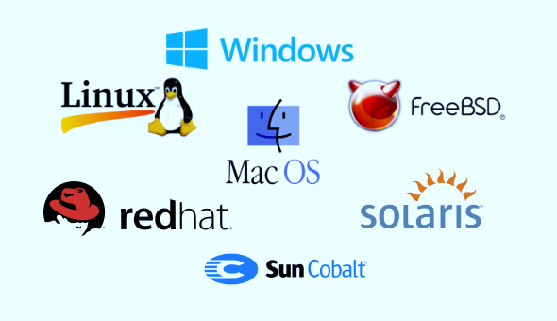
2.2.2) Operating Systems: are the most important programs that run on a computer. Every general-purpose computer must have an operating system to run other programs.
Types of Operating System Interfaces
The way in which users communicate with the computer is called an 'interface'. The interface is what we use to give the computer commands. There are three types of operating system interfaces:

Slide 39
Command Line Interface (CLI)

Slide 40
Graphical User Interface (GUI)

Slide 41
Touchscreen Interface

Slide 42
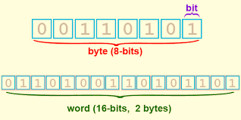
      Data
The basic unit used in computer data storage is called a bit (binary digit).
Computers use these little bits, which are composed of ones and zeros, to do things and talk to other computers.
All your files, for instance, are kept in the computer as binary files and translated into words and pictures by the software (which is also ones and zeros).
This two number system, is called a “binary number system” since it has only two numbers in it.
The decimal number system in contrast has ten unique digits, zero through nine.

Slide 43
      Data
0 or 1 | BIT | Computer Storage units Bit
1024 bytes | KB | Kilobyte
1024 kilobytes | MB | Megabyte
1024 megabytes | GB | Gigabyte
1024 gigabytes | TB | Terabyte
Size example
    1 bit - answer to an yes/no question
    1 byte - a number from 0 to 255.
    90 bytes: enough to store a typical line of text from a book.
    4 KB: about one page of text.
    120 KB: the text of a typical pocket book.
    3 MB - a three minute song (128k bitrate)
    650-900 MB - an CD-ROM
    1 GB -114 minutes of uncompressed CD-quality audio at 1.4 Mbit/s
    8-16 GB - size of a normal flash drive

Slide 44
      Data
Speed measurement: The speed of Central Processing Unit (CPU) is measured by Hertz (Hz), Which represent a CPU cycle. The speed of CPU is known as Computer Speed.
CPU SPEED MEASURES
1 hertz or Hz | 1 cycle per second
1 MHz | 1 million cycles per second or 1000 Hz
1 GHz | 1 billion cycles per second or 1000 MHz

Slide 45

Users
All the persons (users) that use the computer can be considered as live ware.
EX:
Programmers,
Graphic Designer,
Data entry operator,
Hardware technician,
Network engineer,
Data base Administrator,
Web Designer,
System Analyzer.

Slide 46
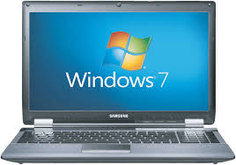
Laptop and Smartphone Computers
1) Laptops
Laptops are portable computers and are small enough to sit on your lap.
They can be used almost anywhere due to their small size and a built-in battery which powers the laptop when there is no access to a plug socket.
Modern laptops are generally almost as powerful as a Desktop PC and are used for similar tasks and purposes.
They have LCD screens (Liquid Crystal Display) which use low-power. This helps increase the run-time of a laptop's battery.

Slide 47
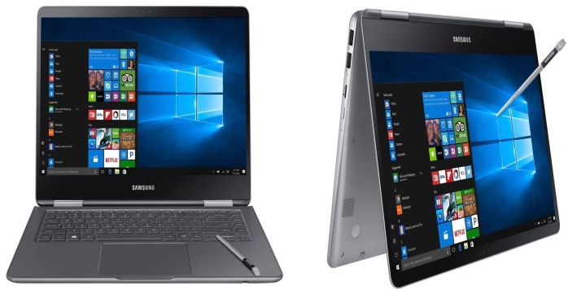
2) Notebook
Computer
It is a battery- or AC-powered personal computer generally smaller than a briefcase that can easily be transported and conveniently used in temporary spaces such as on airplanes, in libraries, temporary offices, and at meetings.

Slide 48
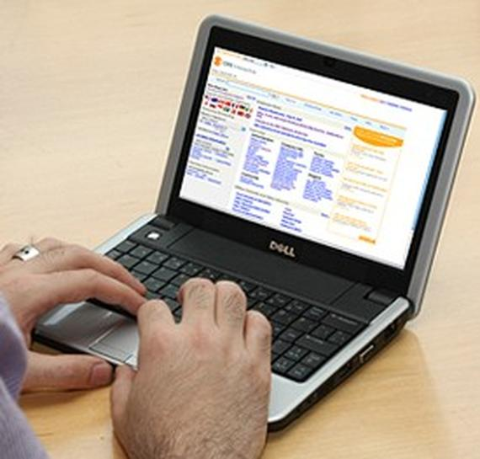
3) Netbook
Netbooks are smaller and lighter than notebook computers, which in turn are smaller and lighter than laptops.
Netbooks can be used for similar tasks to a laptop (word processing, running a Web browser and connecting wirelessly to the Internet)
they are not as powerful and have much smaller screens.
Cheaper because they do not come with certain components (such as CD/DVD drive).
A netbook will have a slimmed-down operating system, a smaller-than-usual keyboard and very little (if any) storage space.

Slide 49
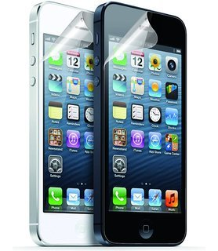
Smart Phone
A mobile phone, known as a is a portable telephone that can make and receive calls over a radio frequency
A smartphone or smart phone is a mobile phone with an advanced mobile operating system which combines features of a personal computer operating system with other features useful for mobile or handheld use.
Most smartphones can access the Internet, have a touchscreen user interface, can run third-party apps, music players and camera phones.
What are Third-party apps: An application that is provided by a vendor other than the manufacturer of the device. For example, the iPhone comes with its own camera app, but there have been camera apps from third parties that offered advanced features such as a self timer and simple editing.

Slide 50
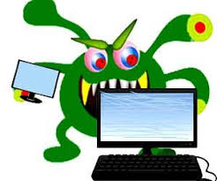
Viruses
A virus is a small piece of software that piggybacks on real programs.
For example, a virus might attach itself to a program such as a spreadsheet program. Each time the spreadsheet program runs, the virus runs, too, and it has the chance to reproduce (by attaching to other programs).

Slide 51

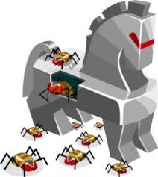
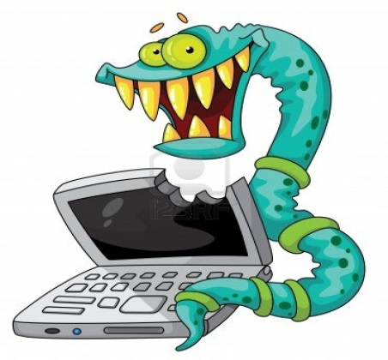
E-mail viruses: An e-mail virus travels as an attachment to e-mail messages, and usually replicates itself by automatically mailing itself to dozens of people in the victim's e-mail address book. Some e-mail viruses don't even require a double-click -- they launch when you view the infected message in the preview pane of your e-mail software .
Trojan horses: A Trojan horse is simply a computer program. The program claims to do one thing (it may claim to be a game) but instead does damage when you run it (it may erase your hard disk). Trojan horses have no way to replicate automatically.
Worms: A worm is a small piece of software that uses computer networks and security holes to replicate itself. A copy of the worm scans the network for another machine that has a specific security hole. It copies itself to the new machine using the security hole, and then starts replicating from there, as well.

Slide 52
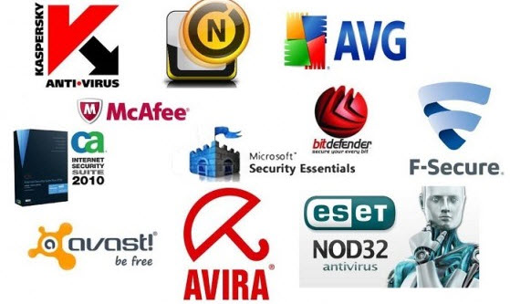
There are some tips to avoid viruses and reduce their impact?
Install anti-virus software from a reputable vendor. Update it and use it regularly.
In addition to scanning for viruses on a regular basis, install an "on access" scanner (included in most anti-virus software packages) and configure it to start each time you start up your computer. This will protect your system by checking for viruses each time you run an executable file.

Slide 53
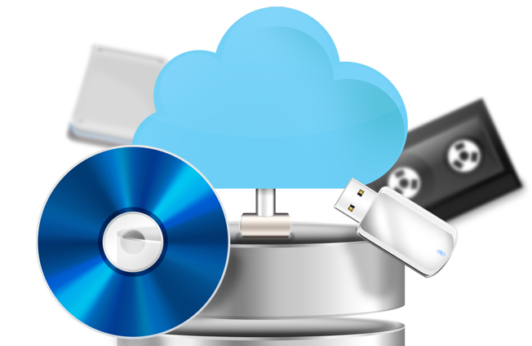
There are some tips to avoid viruses and reduce their impact?
Use a virus scan before you open any new programs or files that may contain executable code. This includes packaged software that you buy from the store as well as any program you might download from the Internet.
If you are a member of an online community or chat room, be very careful about accepting files or clicking links that you find or that people send you within the community.
Make sure you back up your data (documents, bookmark files, important email messages, etc.) on disc so that in the event of a virus infection, you do not lose valuable work.

Slide 54
End
of computer Basic Lecture

