Slide 1
Lab. 5
Strongyloides stercoralis (Threadworm)
Trichinella spiralis
The blood- and tissue dwelling
nematodes:
Filariae
Wuchereria bancrofti

Slide 2
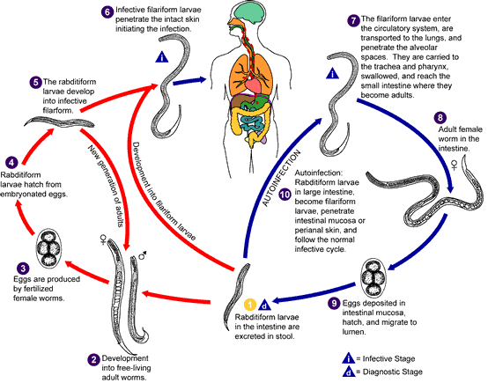
Life cycle Strongyloides stercoralis :

Slide 3
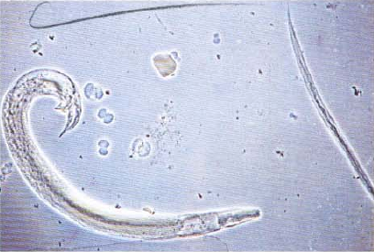
5- Strongyloides stercoralis:
A-Adult male:
free living
curved posterior end with 2 spicules.

Slide 4
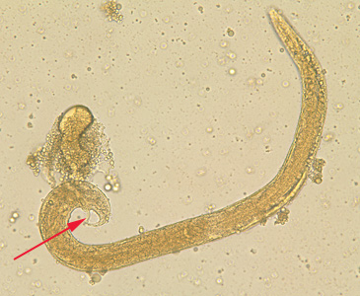
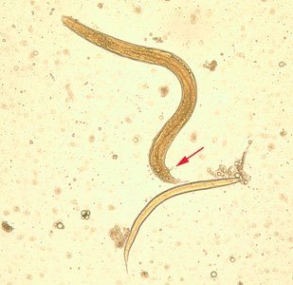
Free living adult male S. stercoralis, showing a spicule (red arrow). A smaller, rhabditiform larva lies adjacent to the adult male.
Free-living adult male S. stercoralis. Notice the presence of the spicule (red arrow).

Slide 5
B-Adult female:
tapering posterior end
parthenogentic
uterus with eggs.

Slide 6
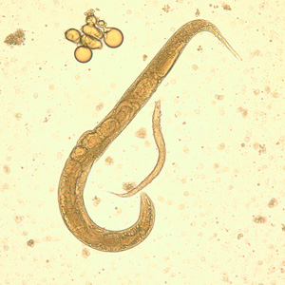
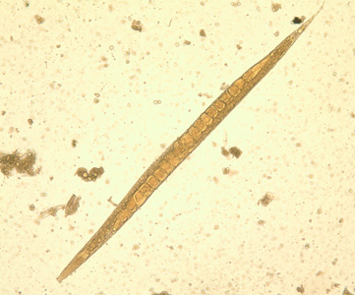
Adult free-living female S. stercoralis alongside a smaller rhabditoid larva. Notice the developing eggs in the adult female.
Adult free-living female S. stercoralis. Notice the row of eggs within the female’s body.

Slide 7
Male
Female
Free living adult of strongyloides stercoralis

Slide 8
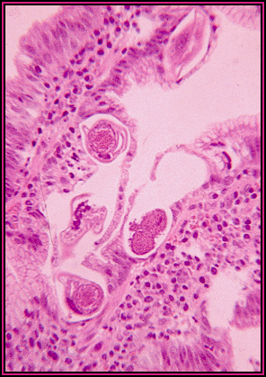
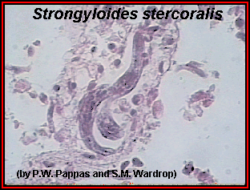
Hematoxylim - eosin s.
Strongyloides stercoralis Adult Parasitic Female Small
Intestine Section

Slide 9
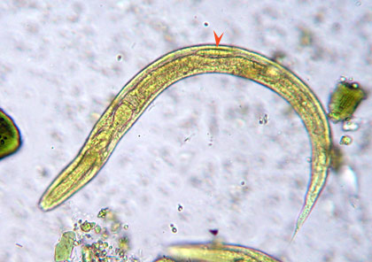
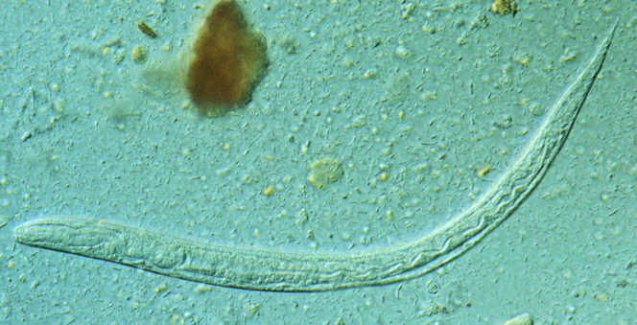
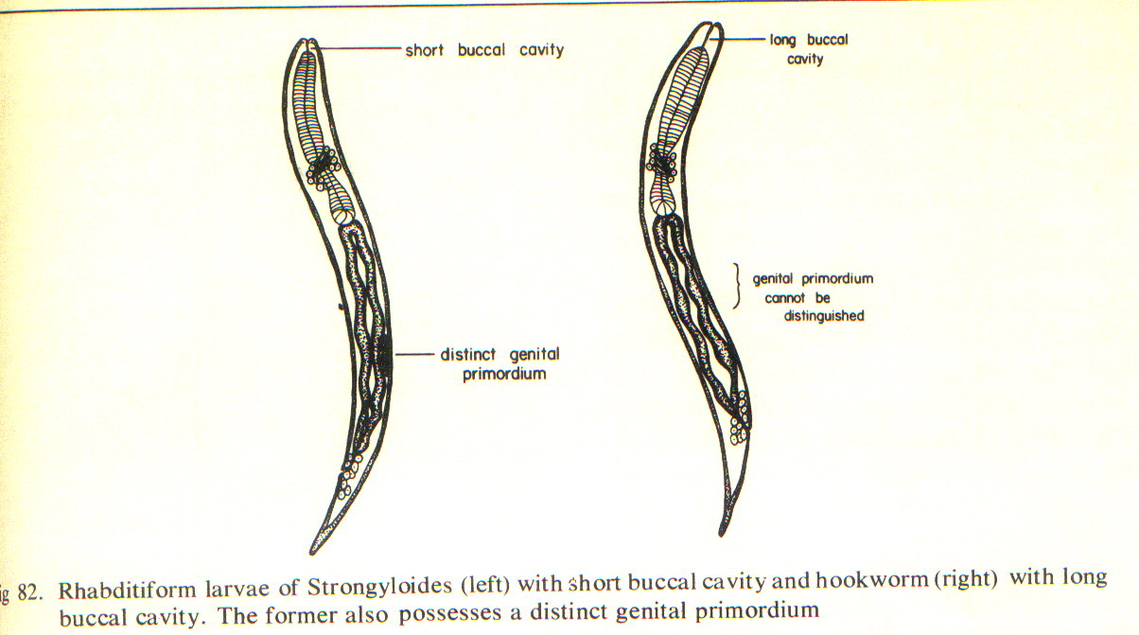
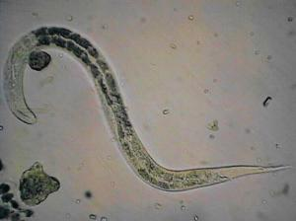
In Iodine s.
Strongyloides stercoralis Rhabditiform Larva in fresh stool smear 200 – 250 X 16 µm note :1- this larvae with short mouth and double – bulb oesophagus
2- in hook worm the rhabdiform larva detected in old stool ( 24 – 48 hr. ) or when we used sugar with concentration method

Slide 10
filarial – form larvae of strongyloides stercoralis, 500µm
Note : more slender than rhabditiform larva have shourt mouth and cylinderical oesophagus about ½ of the body

Slide 11
Trichinella spiralis
Disease: Trichinosis

Slide 12
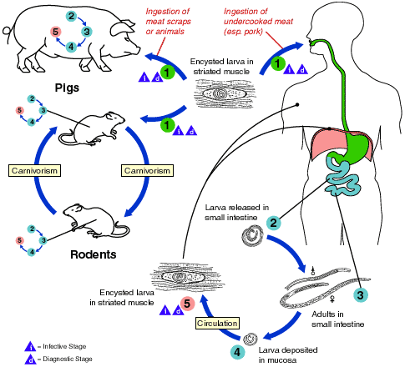
Life cycle

Slide 13
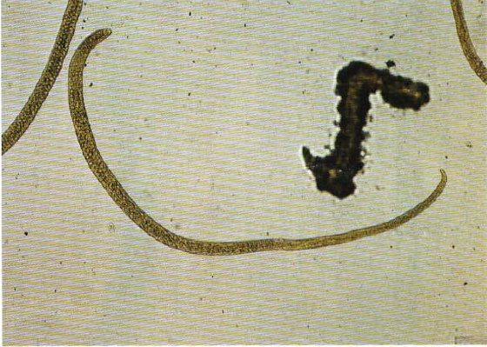
6-Trichinella spiralis:
a- female:
small size
stichocytes
club-shaped posterior end.

Slide 14
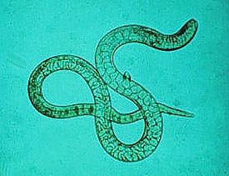

Slide 15
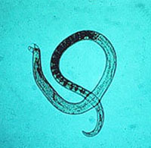
6-Trichinella spiralis:
b- Male:
Small size
Stichocytes
With 2 conical
papillae at
posterior end.

Slide 17
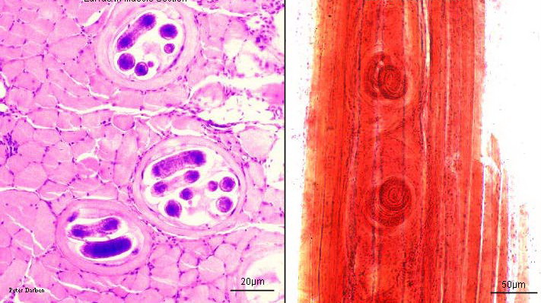
C-larva:
spirally coiled
within muscle fiber.

Slide 18
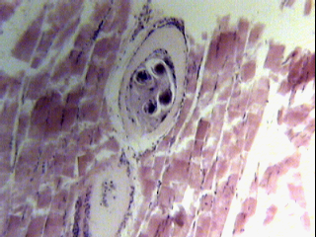
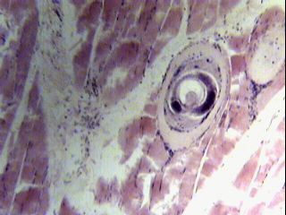
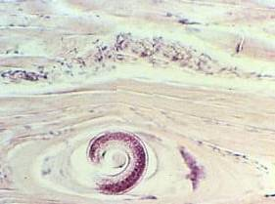
Hematoxylim - eosin s.
Trichinella spiralis Encysted Larva Muscle Section

Slide 19
Wuchereria bancrofti
Disease: Bancroftian filariasis or
Elephantiasis
Mosquito Culex intermediate host
& vector.

Slide 20
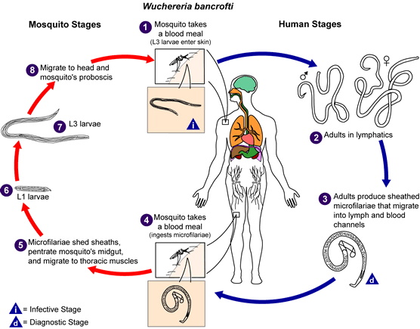
Life cycle:

Slide 21
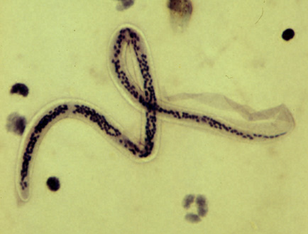
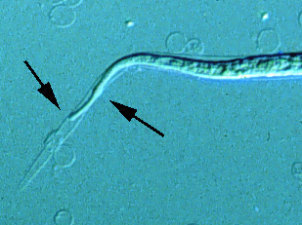
Filariae:
A- Wucheraria bancrofti:
sheathed microfilaria; short cephalic space
long tail; aseptete nuclei.

Slide 22
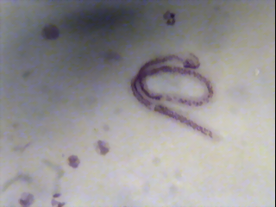
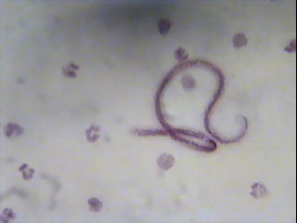
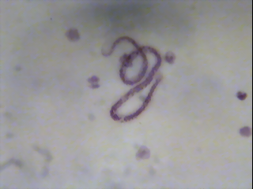
Giemsa s.
Wuchereria bancrofti Microfilaria in blood smear 210 – 320 X 7.5 – 10 µm,
Note : blood collected between the hour 10 – 2 at night, this microfilaria detected in blood after 6 mouth of infection

Slide 23
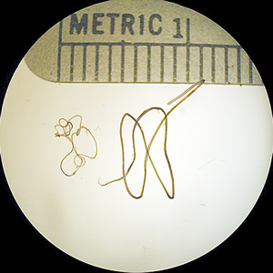
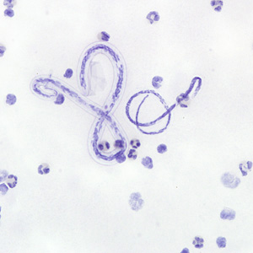
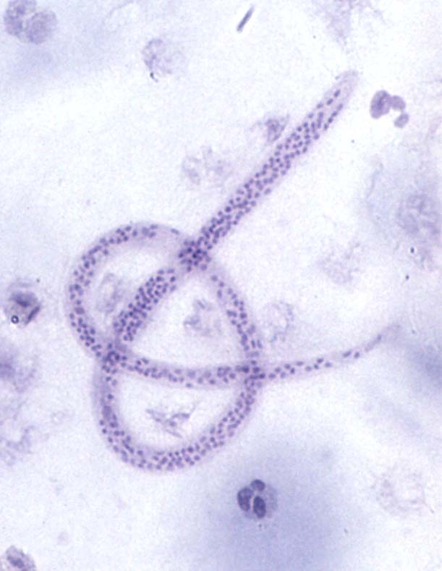
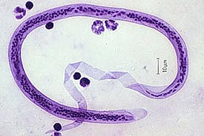
Adults of W. bancrofti. The male worm is on the left; the female is on the right.

Slide 24
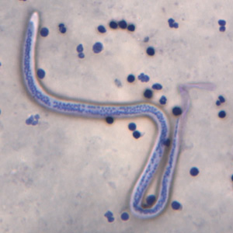
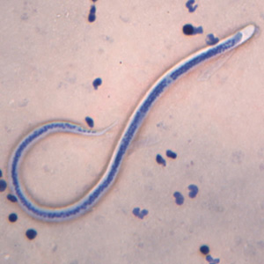
Microfilariae of W. bancrofti in thick blood smears stained with Giemsa. Images courtesy of the Oregon State Public Health Laboratory.

Slide 25
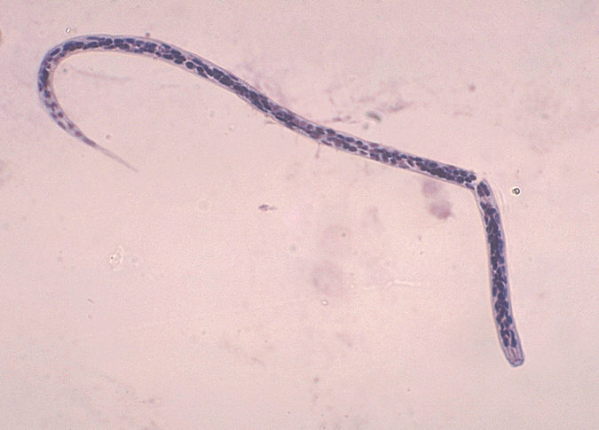
B- Onchocerca volvulus:
unsheathed microfilaria
long cephalic space
short tail
Aseptete nuclei.

Slide 26
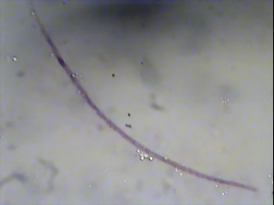
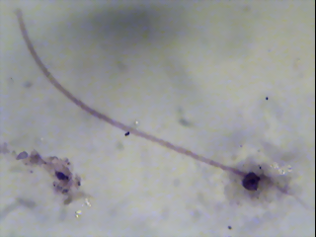
Ciemsa s.
Onchcerca volvulus Microfilaria ( 280 – 330 X 6 – 9 µm )

Slide 27
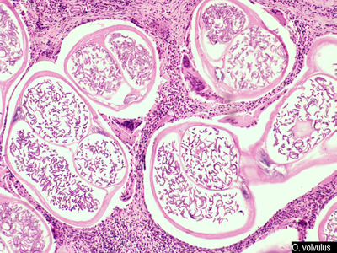
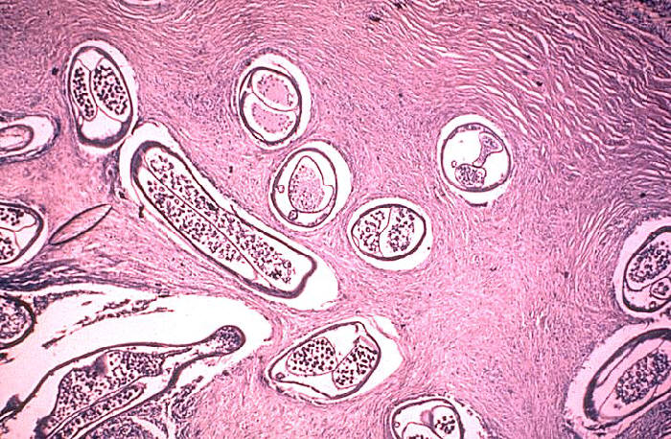
Onchcerca volvulus -Skin Nodule Section with adult female and microfilariae In the surrounding fibrous connective tissues

Slide 28
