Slide 1
Nerves and Muscles Physiology
Lecture 1
Dr. Amar AL-Musawi
MD, PhD
Email: am1363@rutgers.edu
Office hour: Monday 10-11 am
Tuesday 10-11 am

Slide 2
Objectives of this lecture
Explain the genesis of resting membrane potential (RMP).
Describe the action potential of nerves and muscles.

Slide 3
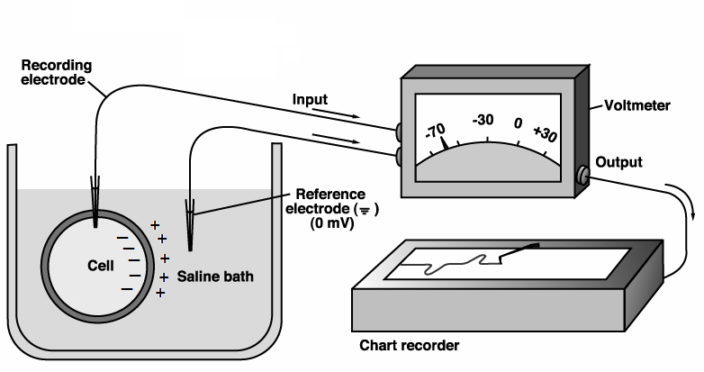
Resting membrane potential (RMP)

Slide 4
Definition:
RMP is the potential difference between the inner and outer surface of a biological membrane during rest or inactivity at which the forces of concentration gradient and electrical gradient balance

Slide 5
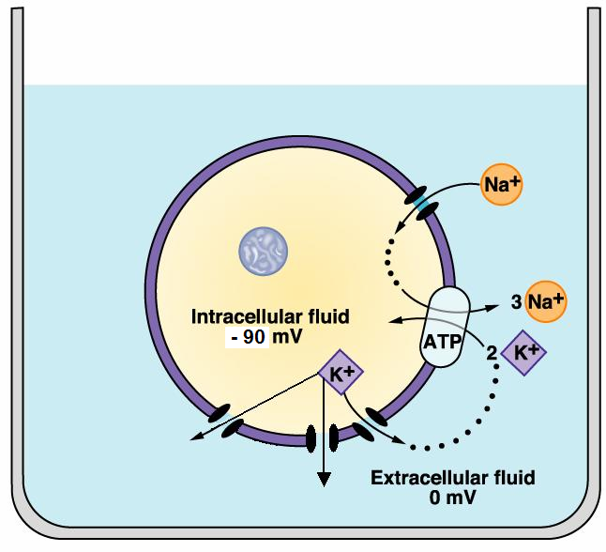
The genesis of resting membrane
potential (RMP)

Slide 6
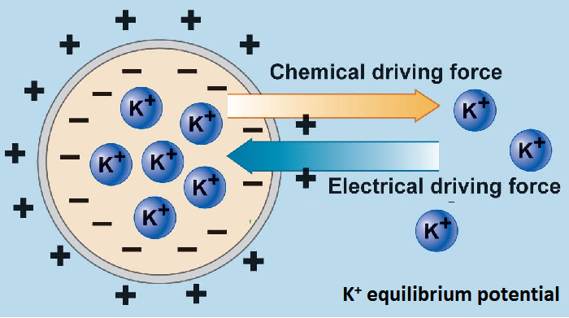

Slide 7
Definition:
The action potential of the nerve and skeletal muscle fiber is a rapid and transient change in the membrane potential that can be transmitted across the surface of an excitable cells.
The excitable cell: define as those cells that have two essential properties:
[1] Excitability: They are able to respond to certain stimuli by generating electrical impulses called action potentials.
[2] Conductivity: They and able to transmit action potential over the surface of cell membrane.

Slide 8
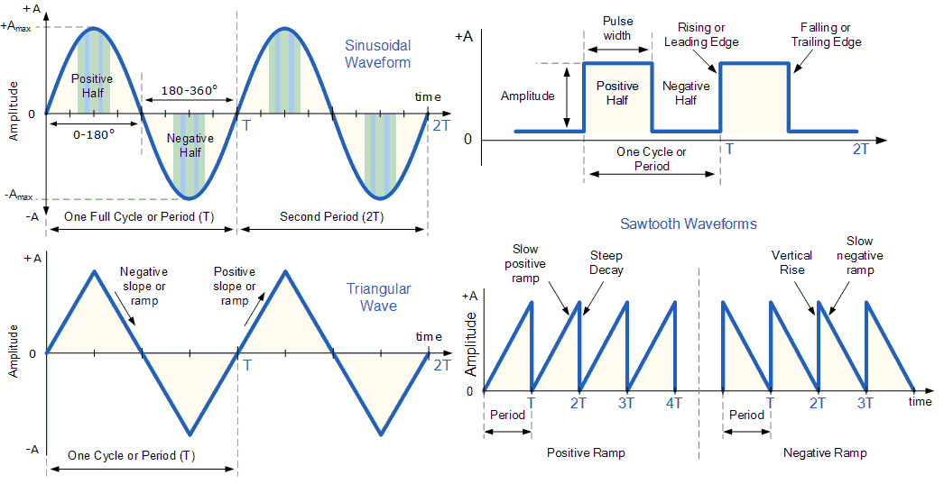
Varieties of electrical waves

Slide 9
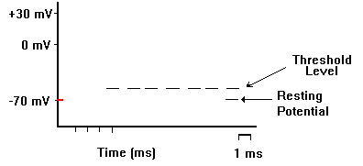

Slide 13
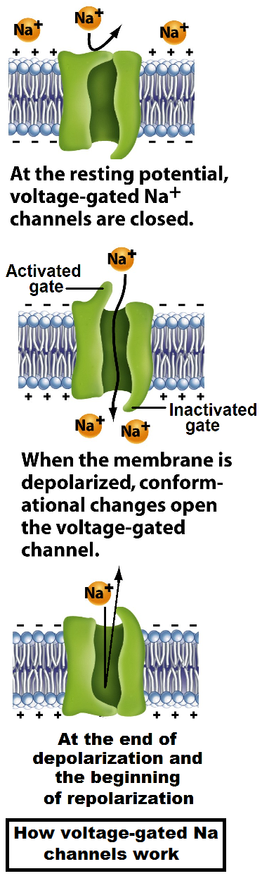

Slide 16
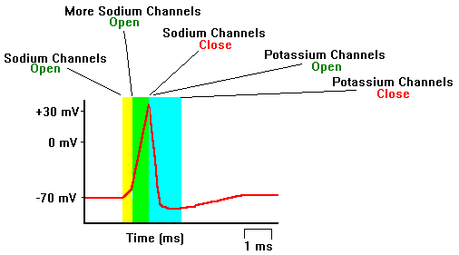
Na influx
K efflux

Slide 17
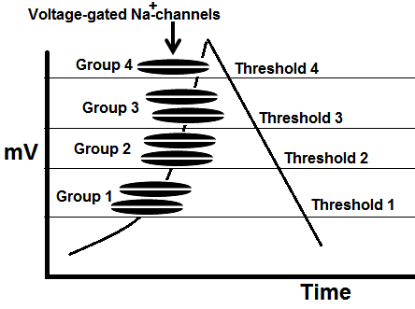

Slide 18
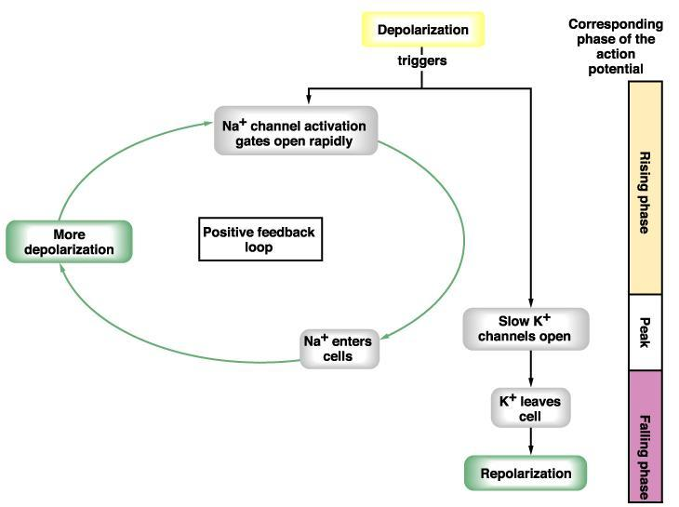
a positive-feedback vicious circle of voltage-gated Na channels opening during depolarization phase

Slide 19
Table 4.1: Differences of graded potential versus action potential.
Graded potentials | Action potentials
Depending on the stimulus, graded potentials can be depolarizing or hyperpolarizing. | Action potentials always lead to depolarization of membrane and reversal of the membrane potential.
Amplitude is proportional to the strength of the stimulus. | Amplitude is all-or-none; strength of the stimulus determines the frequency of all-or-none action potentials generated.
Amplitude is generally small (a few mV to tens of mV). | Large amplitude of ~100 mV.
Duration of graded potentials may be a few milliseconds to seconds. | Action potential duration is relatively short; 3-5 ms.
Ion channels responsible for graded potentials may be chemical, mechanical, or electrical –gated channels | Voltage-gated Na^{+,} Voltage-gated Ca⁺⁺ and voltage-gated K⁺ channels are responsible for the action potential.
The ions involved are usually Na⁺, K⁺, or Cl⁻. | The ions involved are Na^{+,} Ca⁺⁺ and K⁺ (for action potentials).

Slide 20
Table 4.1: Differences of graded potential versus action potential.
Graded potentials | Action potentials
No refractory period is associated with graded potentials. | Absolute and relative refractory periods are important aspects of action potentials.
Graded potentials can be summed over time (temporal summation) and across space (spatial summation). | Summation is not possible with action potentials (due to the all-or-none nature, and the presence of refractory periods).
Graded potentials travel by passive spread (electrotonic spread) to neighboring membrane regions. | Action potential propagation to neighboring membrane regions is characterized by regeneration of a new action potential at every point along the way.
Amplitude diminishes as graded potentials travel away from the initial site (decremental). | Amplitude does not diminish as action potentials propagate along neuronal projections (non decremental).
In principle, graded potentials can occur in any region of the cell plasma membrane | Occur in plasma membrane regions where voltage-gated Na⁺ and K⁺ channels are highly concentrated.

Slide 21
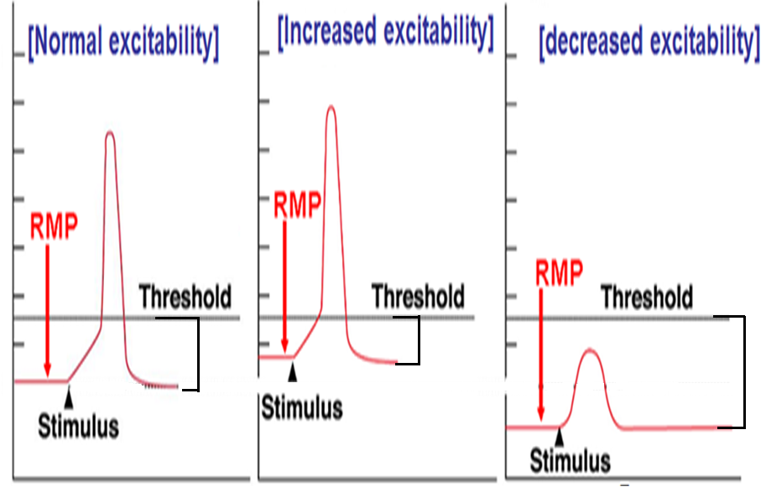

Slide 22
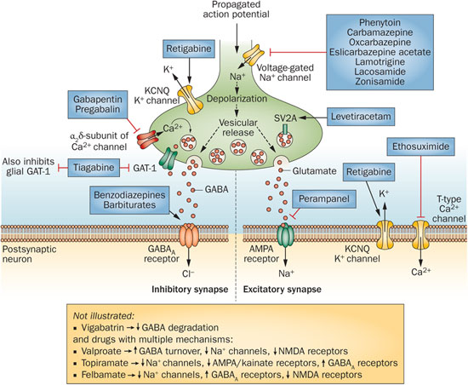
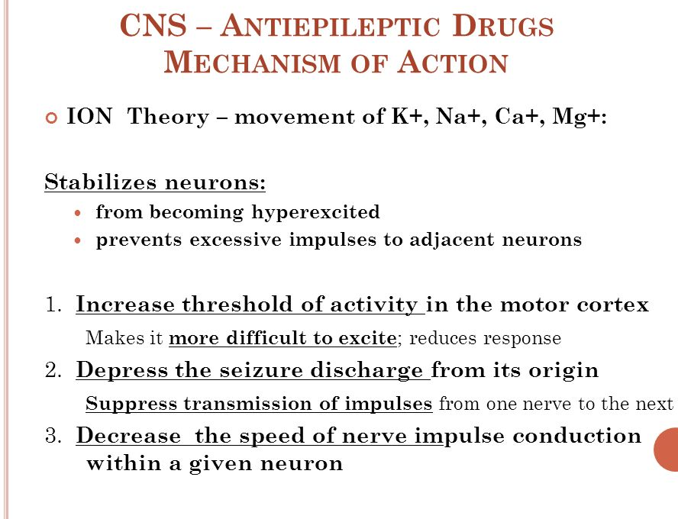
Some clinical relevant:
Anti epileptic drugs
Anti arrhythmic drugs
Analgesic drugs
Anesthetic drugs

Slide 23
Some practice questions:
1. In the resting state the conductance of membrane is more for which of the ions?
A. Na+
B. Ca++
C. K+
D. Cl-
2. Hyperpolarization in the action potential is caused by:
A. Increased exit of K+ from the cell
B. Entry of Cl- into the cell
C. Delay in sodium pump
D. Increased exit of Na+ from the cell

Slide 24
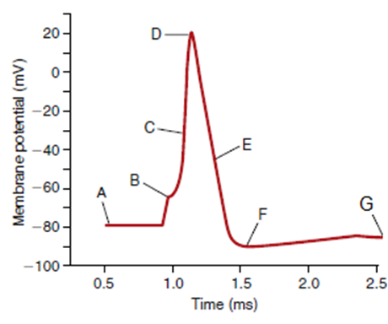
3. Repolarization of the membrane begins when:
A. Sodium channels are inactivated
B. Potassium channels close
C. Sodium entry slows down
D. Sodium channels are activated
4. The figure shows the change in membrane potential during an action potential in a giant squid axon. Which of the following is primarily responsible for the change in membrane potential between points B and D?
A. Inhibition of the Na+- K+-ATPase
B. Movement of K+ into the cell
C. Movement of K+ out of the cell
D. Movement of Na+ into the cell
E. Movement of Na+ out of the cell

