Slide 1
Lab. 3:
Ascaris lumbricoides

Slide 2
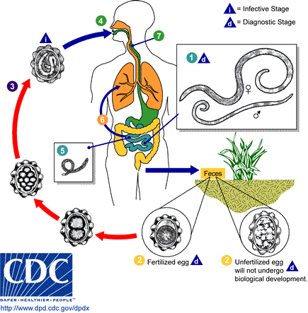
Life cycle of Ascaris lumbricoides

Slide 3
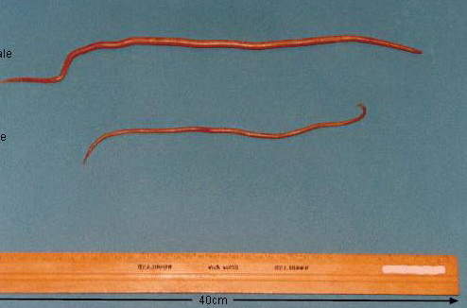
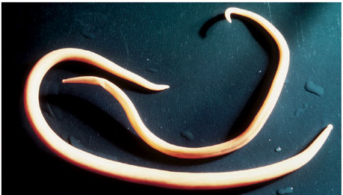
Ascaris lumbricoides:
A-Gross specimens:
large size of worm
Female: cylindrical in shape, straight posterior end.
Male: smaller than female with curved posterior end.
Female
Male

Slide 4
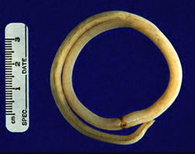
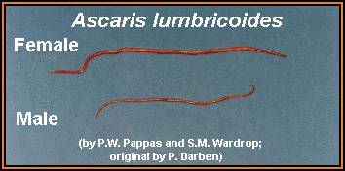
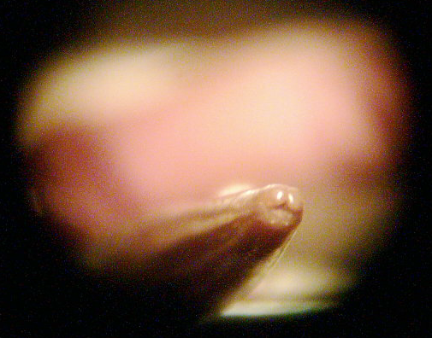
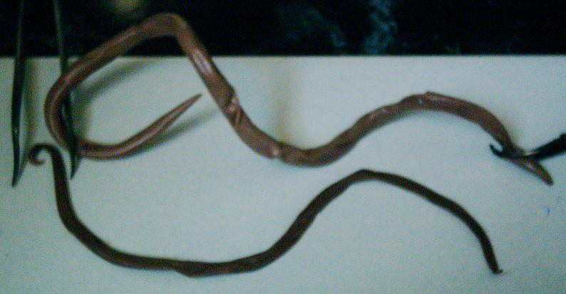
281
Male and female anterior end, with three lips
Ascaris lumbricoides adult worm
Note: white, brown redish or light brown or pink the posterior end of the male, curved with 2 spicules, the female with straight end

Slide 5
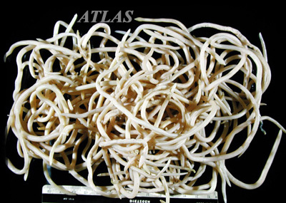

Slide 6
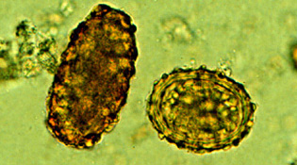
B-Egg:
Fertilized:
round in shape
with outer mammillated coat
thick transparent middle coat
thin membranous inner coat
single unembryonated egg.
Unfertilized:
elongated cylindrical in shape
with all other characters
mentioned above.

Slide 7
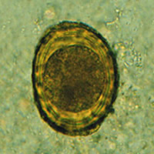
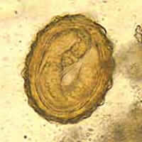
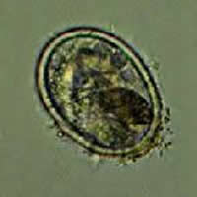
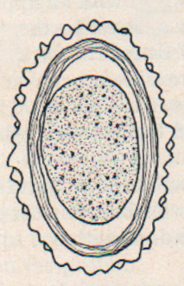
Iodine s.
Fertile, with larvae
Semilunar space
Vitelline layer (1st)
One cell stage
2nd layer (thick)
Decorticated egg: Its fertile ovum, but the outer coat is sometime lost
3rd layer outer coarse albuminous layer (regular)
Ascaris lumbricoides-Fertilized Egg In Iodine s. stool smear ( golden brown in colour ) 60 – 75 X 40 – 50 µm, is spherical or oval with semilunar space and regular albuminous layer

Slide 8
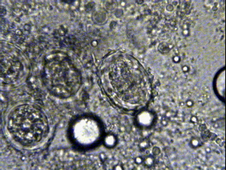
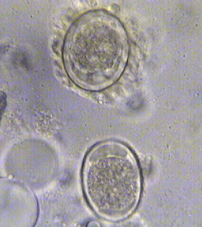
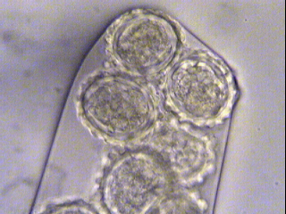
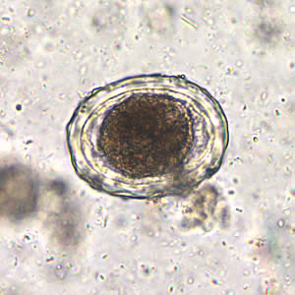
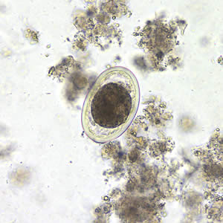
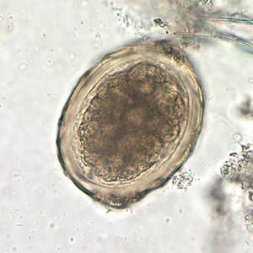
Ascaris lumbricoides- Fertilized Egg In Saline s.
Decorticated egg: Its fertile ovum, but the outer coat is sometime lost

Slide 9
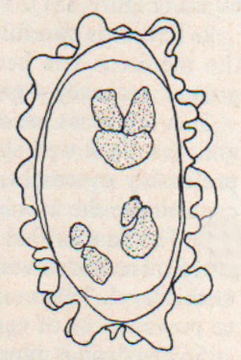
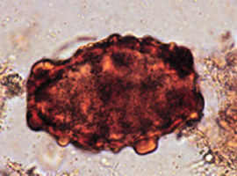
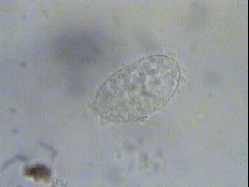
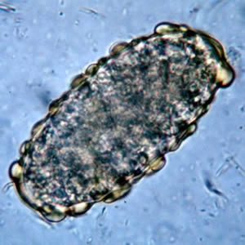
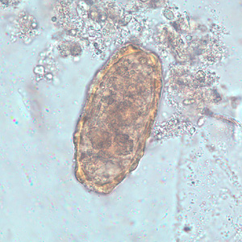
In Iodine s.
In Saline s.
elongated oval, no semilunar space with irrregular albuminous layer 88 – 94 X 40 – 50 µm
Ascaris lumbricoides- Unfertilized Egg stool smear

Slide 10
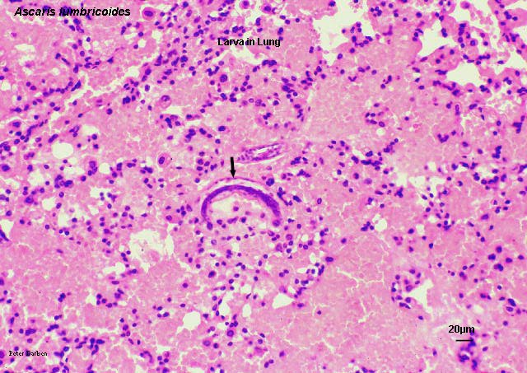
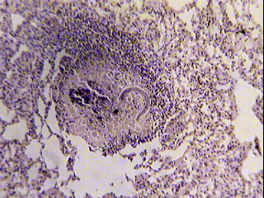
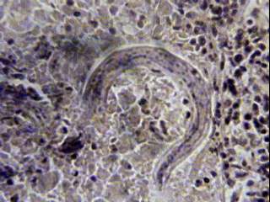
Ascaris lumbricoides Larva in Lung Section
Note : the larva also detected in sputum
Hematoxylim - eosin s.

Slide 11
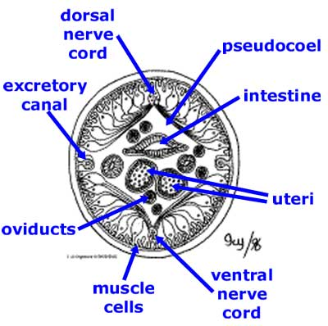
C. Cross section of worm:
Outer cuticular covering layer
Middle syncetial cellular layer with dorsal & ventral thickenings or cords in which dorsal ventral nerve cords pass.
lateral thickenings or cords in which lateral excretory vessels pass.

Slide 12
Inner musculer layer:
divided by the Dorsal,
ventral & lateral cords
into 4 sector.
Section through the
intestine in the middle
Coelomic cavity between
muscles intestine,
with male or female
reproductive organs.

Slide 13
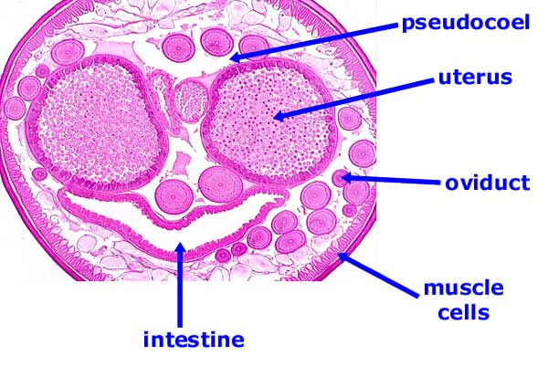
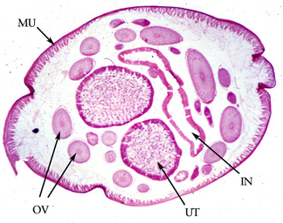
ovary
Ascaris lumbreioides : cross section in female

Slide 14
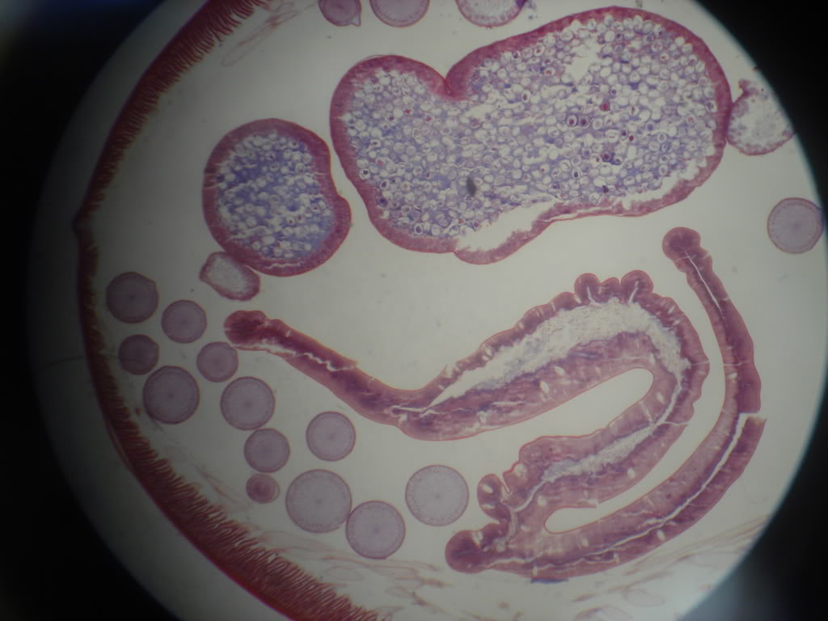
Ascaris lumbreioides : cross section in female

Slide 15
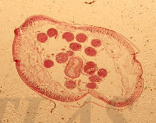
Ascaris lumbreioides : cross section in male

Slide 16
Lab. 4:
Hook worms
A. Old world hook worm:
Ancylostoma duodenale
B. New world hook worms:
Necator americanus

Slide 17
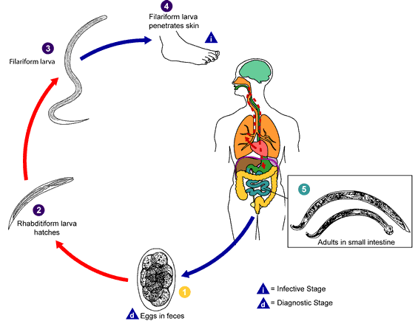
Life cycle of Hookworms

Slide 18
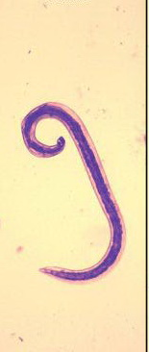
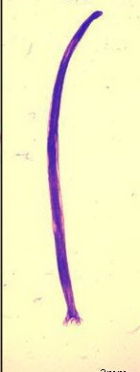
Ancylostoma duodenale:
Female & Male

Slide 19
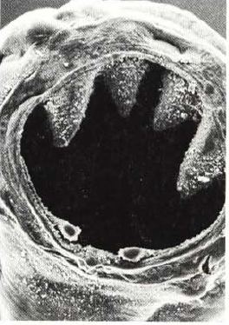
Ancylostoma duodenale:
1-Buccal capsule:
in male & female
anterior end, enlarged,
chitinized with:
2 pairs of subequal ventral teeth-like thickenings,
1 pair of dorsal small
tooth-like thickenings.

Slide 20
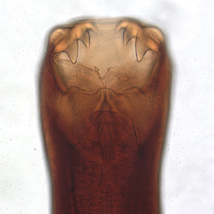
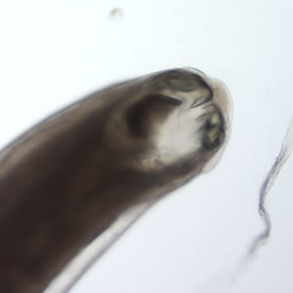
Ancylostoma duodenale: buccal capsule

Slide 21
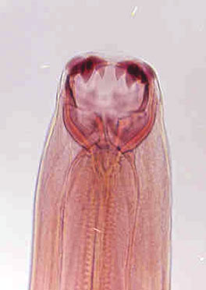
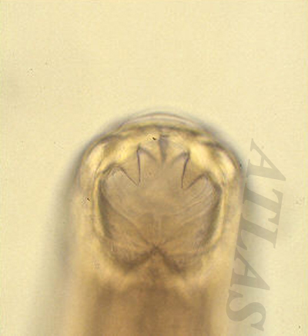

Slide 22
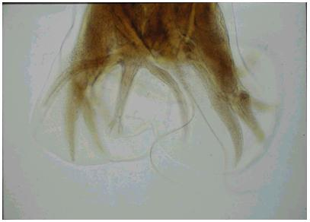
2-Capulatory bursa in male:
Fan-like expansion of posterior part of cuticula,
With rib-like thickenings & 2 thin separated copulatory bursa.
2 separated spicules

Slide 23
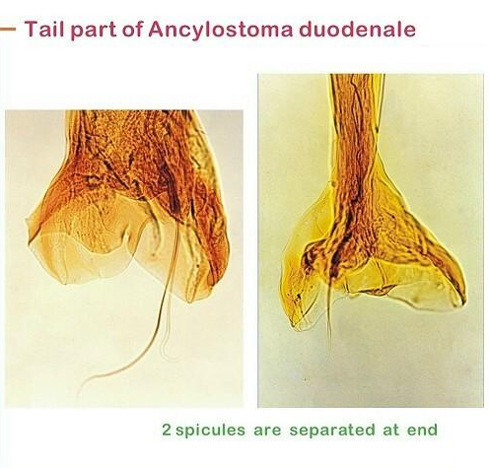
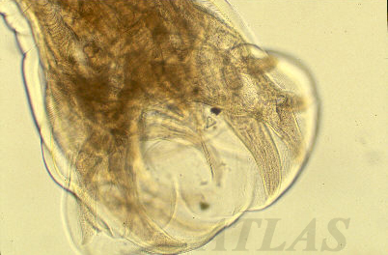
posterior end in male (Bursa) of A. duodenale

Slide 24
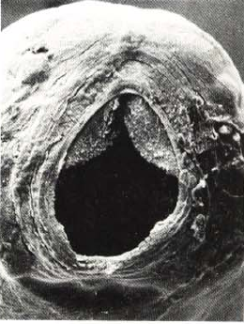
Necator americanus:
1-Buccal capsule: in male & female
anterior end, enlarged,
chitinized with 2 cutting plates on the ventral side.

Slide 25
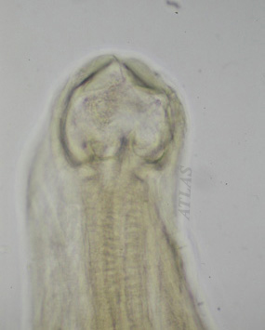
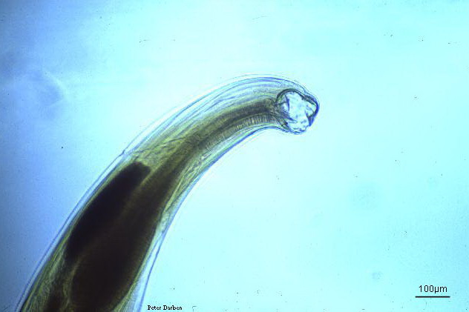

Slide 26
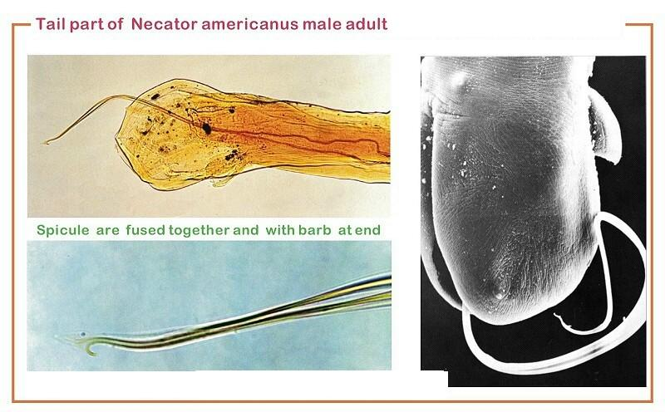
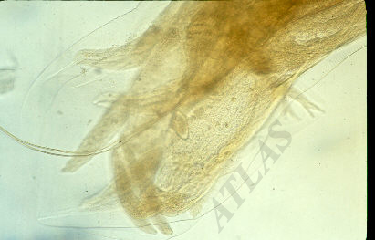
Capulatory bursa in male:
Fan-like expansion of posterior part of cuticula,
with rib-like thickenings & 2 thin fused copulatory barbs.

Slide 27
posterior end in male (Bursa) of N. americanus

Slide 29
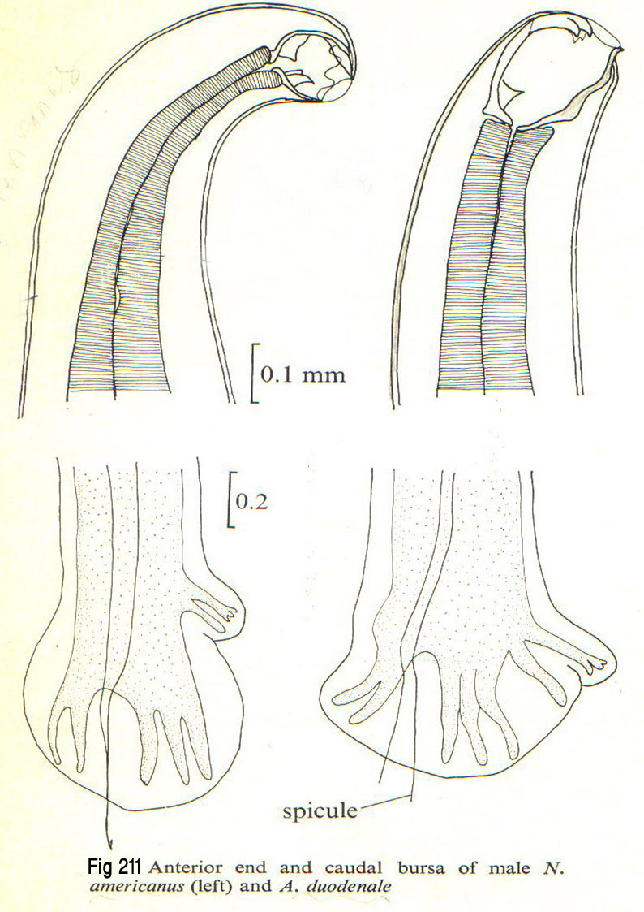

Slide 30
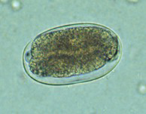

Egg:
Thin shelled transparent, ovoid & measures 64-76 µm in early stages(4-celled) of cleavage when laid in several hours may reach the early larval stage, then hatching in 24-48 hrs. to L1.
1- celled
4- celled

Slide 31




Eggs of hookworms in unstained wet mount

Slide 32

C- Rhabditoid larva:
Mouth open
Esophagus short with bulb.

Slide 33


Open mouth
Bulb
Rhabditoid larvae of hookworms

Slide 34

D- Filariform larva:
more delicate
closed mouth
long esophagous

Slide 35


Bulb
Closed mouth
Filariform larvae of hookworms

Slide 36



Ancylostoma duodenale Filariform Larva in sputum

