Slide 1
Lab. 2:
Trichuris trichiura

Slide 2
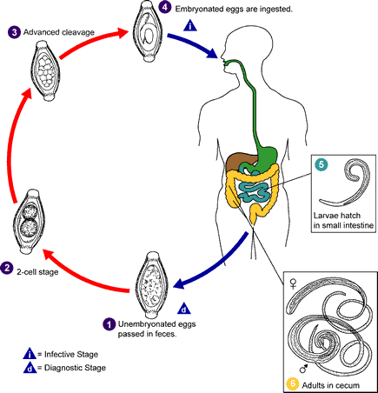
Trichuris trichiura
Life cycle

Slide 3
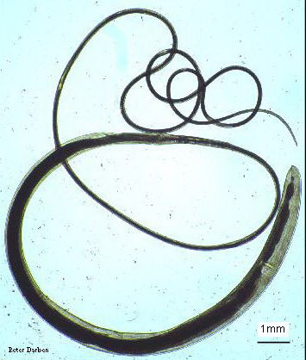
Trichuris trichiura:
A-Female:
whip-like body
with thin anterior 2/3body
thick posterior 1/3 body.
bead-like cells surrounding intestinal tract in the anterior end, called stichocytes.

Slide 4
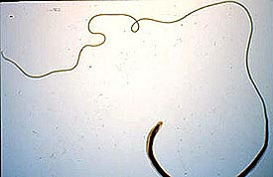

Slide 5
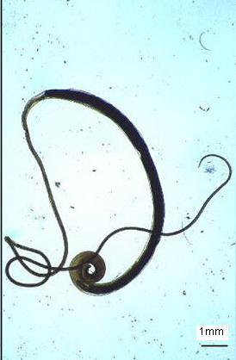
B-Male:
body same as in female.
posterior end strongly curved with
one spicule.

Slide 6
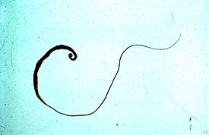

Slide 7
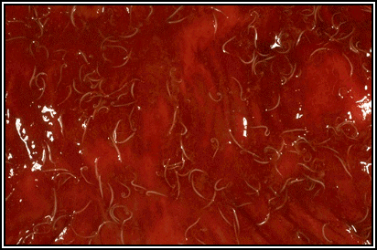
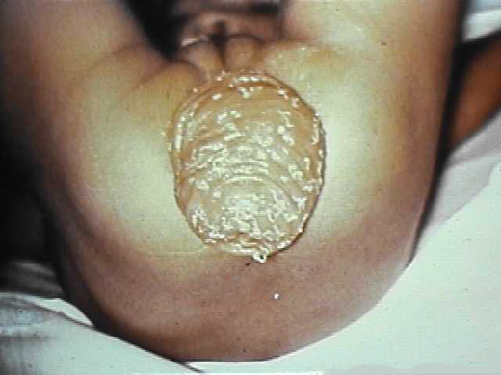
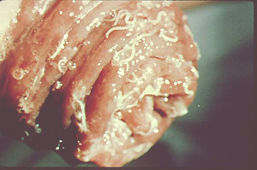
Trichuris trichiura in the large intestine. Many worms are present, each with its anterior end embedded in the intestinal mucosa, resulting in the erythema.
symptum, with havey infection ( prolapse of the rectum )
Notes:
http://www.biosci.ohio-state.edu/~parasite/trichuris.html
Erythema /eri’thi:ma/ 红斑

Slide 8
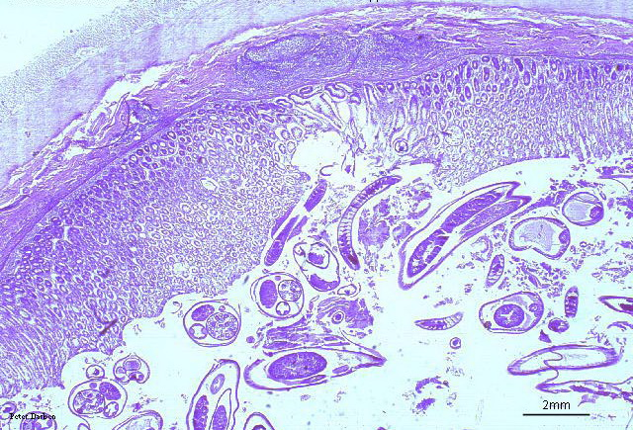
c. section in mucosa:
small round section in anterior part of worm,
in columnar epithelial cells of mucosa.
larger rounded sections in posterior part of worm, in lumen of intestine.

Slide 9
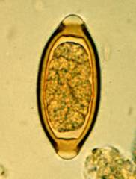
D-Eggs:
Barrel-shaped or
lemon-shaped eggs
With lateral plug like
thickining.
Egg single-celled,
unembryonated.

Slide 10
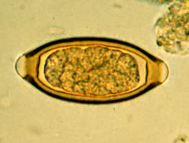
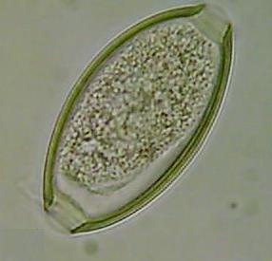
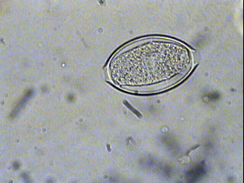
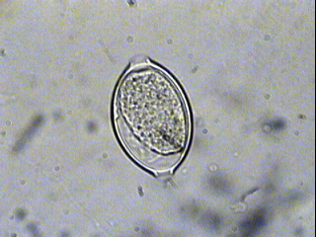
Plug
Plug
In Iodine s.
In saline s.
Trichuris trichiura Egg 50 X 25 µm
Note : the egg barrel – shaped, with two polar plugs yellowish brown in colour
( bile – stained ) has a double shell, the outer one is bile – stained

