Slide 1
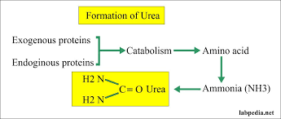
Urea Formation
(Krebs-Henseleit cycle)
Ammonia is highly toxic to the central nervous system
It is converted to urea, which is much less toxic, water soluble and easily excreted in urine.

Slide 2
The liver is the site of urea biosynthesis.
Urea biosynthesis occurs by urea cycle (Krebs Hensleit cycle) in five steps by five enzymes.
Any defect in one of these enzymes leads to ammonia intoxication
The first 2 steps occur in mitochondria, while the last 3 steps occur in cytoplasm

Slide 3
Note
Other Organs
• Kidneys: Urea cycle operates in a limited extent. Kidney can form up to arginine but cannot form urea,
as enzyme arginase is absent in kidney tissues.
• Brain: Brain can synthesis urea from citrulline, but lacks the enzyme for forming citrulline from ornithine.
Thus, neither the kidneys nor the brain can form urea in significant amounts.
• Location of enzymes: It is partly mitochondrial and partly cytosolic.
• One mol. of NH3 and one mol. of CO2 are converted to one mol. of urea for each turn of the cycle and orinithine is regenerated at the end, which acts as a catalytic agent.
• The overall process in each turn of cycle requires 3 mols of ATP.

Slide 4
Steps of Urea Biosynthesis
Biosynthesis of carbamoyl phosphate
One molecule of ammonia condenses with CO2 in the presence of two molecules of ATP to form carbamoyl phosphate. The reaction is catalyzed by the mitochondrial enzyme carbamoyl phosphate synthetase-I

Slide 5
  2-Formation of citrulline
This step occurs in mitochondria. It is catalyzed by ornithine transcarbamoylase

Slide 6
3-Formation of argininosuccinate
This step occurs in cytoplasm. It is catalyzed by agininosuccinate synthetase . It utilizes one ATP

Slide 7
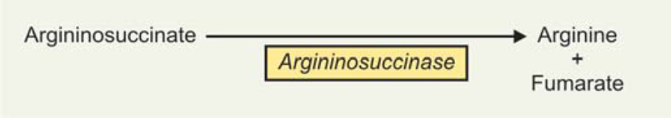
  4- Cleavage of argininosuccinate
This step occurs in cytoplasm. It is catalyzed by argininosuccinase enzyme Argininosuccinate is cleaved into arginine and fumarate Fumarate produced is used to regenerate aspartic acid again

Slide 8
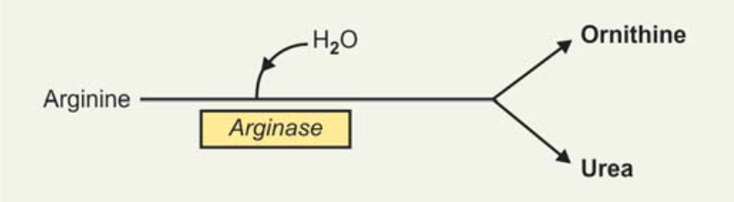
  5-Cleavage of arginine
This step occurs in cytoplasm
It is catalyzed by arginase enzyme Arginine is cleaved to urea and ornithine

Slide 10
Regulation of urea cycle
The major regulatory step is catalyzed by CPS-I where the positive effector is N-acetyl glutamate (NAG). It is formed from glutamate and acetyl CoA . Arginine is an activator of NAG synthase.

Slide 11
Disorders of Urea Cycle
Deficiency of any of the urea cycle enzymes would result in hyperammonemia. When the block is in one of the earlier steps, the condition is more severe, since ammonia itself accumulates. Deficiencies of later enzymes result in the accumulation of other intermediates, which are less toxic and hence symptoms are less. As a general description, disorders of urea cycle is characterized by hyperammonemia,encephalopathy and respiratory alkalosis. Clinical symptoms include vomiting, irritability, lethargy and severe mental retardation. Infants appear normal at birth, but within days progressive lethargy.

Slide 12
Clinical significance of urea
1-Normal level: the normal concentration of blood plasma in healthy adult ranges from 20-40 mg/dl
2- Increase levels Increases in blood urea may occur in a number of diseases in addition to those in which the kidneys are primarily involved. The causes can be classified as:
• Prerenal,
• Renal, and
• Postrenal

Slide 13
Prerenal
Most important are conditions in which plasma vol / body-fluid are reduced:
• Salt and water depletion,
• Severe and protracted vomiting as in pyloric and intestinal obstruction,
• Severe and prolonged diarrhea,
• Haematemesis,
• Haemorrhage and shock; shock due to severe burns,
• Ulcerative colitis with severe chloride loss,
• In crisis of Addison’s disease (hypoadrenalism).

Slide 14
(b) Renal
The blood urea can be increased in all forms of kidney diseases like:
• In acute glomerulonephritis.
• In early stages of type II nephritis (nephrosis) the blood urea may not be increased, but in later stages with renal failure, blood urea rises.
• Other conditions are malignant nephrosclerosis, chronic pyelonephritis and mercurial poisoning.
• In diseases such as hydronephrosis, renal tuberculosis; small increases are seen but depends on extent of kidney damage.

Slide 15
c) Postrenal Diseases
These lead to increase in blood urea, when there is obstruction to urine flow.
Causes:
• Enlargement of prostate,
• Stones in urinary tract,
• Stricture of the urethra,
• Tumors of the bladder affecting urinary flow.
Note
Increase in blood urea above normal is called uraemia.

Slide 16
3- Decreased levels: are rare, but may be seen in:
• some cases of severe liver damage.
• physiological condition: blood urea is lower in pregnancy than in normal non pregnant women.

