Slide 1
Dissimilation of Amino Acid
(N-Catabolisim of Amino Acid)
*transamination
*Deamination(oxidative or nonoxidative deamination)
*Transdeamination
* NH₃ transport
*formation of urea.

Slide 2
Transamination
*Transamination means transfer of amino group from α-amino acid to α-keto acid with formation of a new α-amino acid and a new α-keto acid.
*The liver is the main site for transamination.
*All amino acids can be transaminated except lysine, threonine, proline and hydroxy proline.
*All transamination reactions are reversible.
*It is catalyzed by transaminases.
It needs pyridoxal phosphate as a coenzyme.

Slide 4
Role of pyridoxal phosphate in transamination
Pyridoxal phosphate acts as an intermediate carrier for amino group.
Pyridoxal phosphate accepts the amino group from amino acid to form. pyridoxamine phosphate, which in turn gives the amino group to a-keto acid.
Examples of transaminases
Alanine transaminase
Aspartate transaminase
Glutamate transaminase

Slide 5
Clinical significance of serum transaminases
Transaminases are intracellular enzymes.
Their levels in blood plasma are low under normal conditions.
ALT (GPT) is present mainly in the cytoplasm of liver cells.
AST (GOT) is present in both cytoplasm and mitochondria in liver, heart and skeletal muscles.
-Any damage to these organs will increase the level of transaminases in blood

Slide 6
-In liver diseases, there is an increase in both serum ALT (SGPT) and AST (SGOT) levels.
In acute liver diseases, e.g. acute viral hepatitis, the increase is more in SGPT
-In chronic liver diseases, e.g. liver cirrhosis the increase is more in SGOT.
-In heart diseases, e.g. myocardial infarction, there is an increase in SGOT only.
-In skeletal muscle diseases, e.g. myasthenia gravis, there is an increase in SGOT only.

Slide 7
Deamination
Deamination means the removal of amino group from a-amino acid in the form of ammonia with formation of a-keto acid
The liver and kidney are the main sites for deamination
Deamination may be oxidative or non oxidative

Slide 9
B-Non-oxidative deamination
It is catalyzed by one of the following enzymes:
1-Dehydrases
This enzyme deaminates amino acids containing hydroxyl group e.g. serine, homoserine and threonine.It needs pyridoxal phosphate as coenzyme.

Slide 11
2-Desulfhydrases
This enzyme deaminates sulpher containing amino acids e.g. cysteine and cystine. It needs pyridoxal phosphate as a coenzyme.

Slide 12
3-Deamination of Histidine

Slide 13
Transdeamination
(Deamination of L-Glutamic Acid)
transdeamination, that is transamination followed by oxidative deamination.
Transamination takes place in the cytoplasm of all the cells of the body; the amino group is transported to liver as glutamic acid, which is finally oxidatively deaminated in the mitochondria of hepatocytes.
The enzyme L-glutamate dehydrogenase catalyzes the deamination of L-glutamate to forms NH3 and α-keto glutarate.

Slide 15
First Line of Defense (Trapping of Ammonia)
ammonia should be eliminated or detoxified. Even very minute quantity of ammonia may produce toxicity in central nervous system.
ammonia is always produced by almost all cells, including neurons. The intracellular ammonia is immediately trapped by glutamic acid to form glutamine, especially in brain cells. glutamine is then transported to liver.

Slide 16
Transportation of Ammonia
Inside the cells of almost all tissues, the transamination of amino acids produce glutamic acid.
However, glutamate dehydrogenase is available only in the liver. Therefore, the final deamination and production of ammonia is taking place in the liver.
Thus, glutamic acid acts as the link between amino groups of amino acids and ammonia.

Slide 17
Final Disposal
The ammonia from all over the body thus reaches liver. It is then detoxified to urea by liver cells, and then excreted through kidneys. Urea is the end product of protein metabolism.

Slide 18
Why NH₃ is toxic?
• Increased NH₃ concentration enhances amination of α-ketoglutarate, an intermediate in TCA cycle to form glutamate in brain. This reduces mitochondrial pool of α-ketoglutarate consequently depressing the TCA cycle, affecting the cellular respiration.
• Increased NH₃ concentration enhances "glutamine" formation from glutamate and thus reduces" brain-cell" pool of Glutamic acid. Hence there is decreased formation of inhibitory neurotransmitter "GABA"( γ- amino butyric acid)

Slide 19
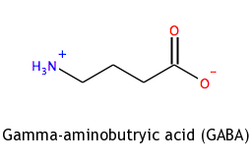
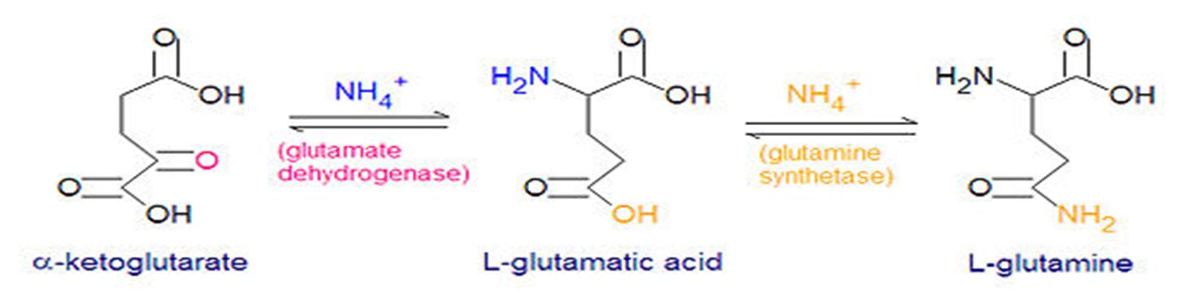

Slide 20
• Rise in brain glutamine level enhances the outflow of glutamine from brain cells.
Glutamine is carried "out" by the same "transporter" which allows the entry of "tryptophan" into brain cells. Hence "tryptophan" concentration in brain cells increases which leads to abnormal increases in synthesis of " serotonin", a neurotransmitter.

Slide 22
Hyperammonaemia
Two type:
1- Acquired hyperammonaemia: the result of Cirrhosis of the liver.
2-Inherited hyperammonaemia: results from genetic defects in the urea cycle enzyme
.

Slide 23
Features of NH₃ intoxication:
The symptoms of NH₃ intoxication include:
- a peculiar flapping tremor
- slurring of speech
- blurring of vision
- and in severe cases follows to coma and death.
These resemble those of syndrome of hepatic coma, where blood and brain NH₃ levels are elevated

