Slide 1
Protein Metabolism

Slide 2
The main role of amino acids is in the synthesis of structural and functional proteins.

Slide 3
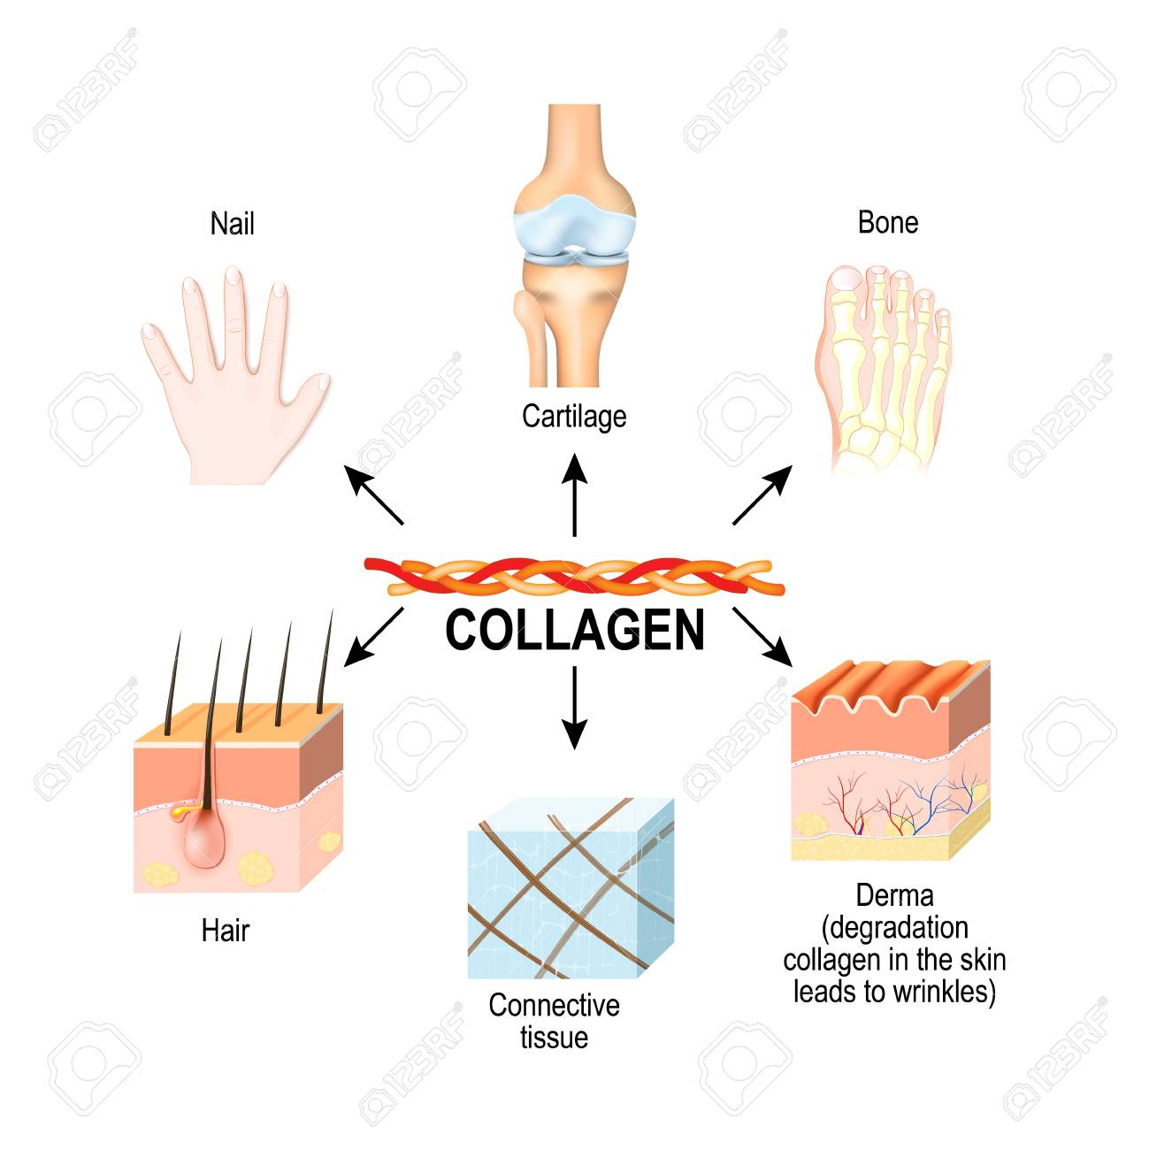

Slide 4
The non-essential amino acids are either derived from the diet or synthesized in the body.
The essential amino acids are obtained from the diet.
Even if one is deficient, protein synthesis cannot take place.

Slide 5
Unlike carbohydrates and fats, there is no storage form of proteins in the body. (same amount synthesized and same amount broken down).

Slide 6
The body amino acid pool is always in a dynamic steady state.
In an adult, the rate of synthesis of proteins balances the rate of degradation, so that nitrogen balance is maintained

Slide 7
Digestion of Protein
Dietary proteins (from animal source or vegetable source) are very large complex molecules that cannot be absorbed from the intestine. To be absorbed, dietary proteins must be digested to small simple molecules (amino acids), which are easily absorbed from the intestine.

Slide 8
The dietary proteins are denatured on cooking and therefore more easily digested by proteolytic enzymes secreted as inactive zymogens which are converted to their active form .

Slide 9
The digestion of protein is effected by enzymes in:
A. Stomach
B. Pancreas
C. Intestinal cells

Slide 10
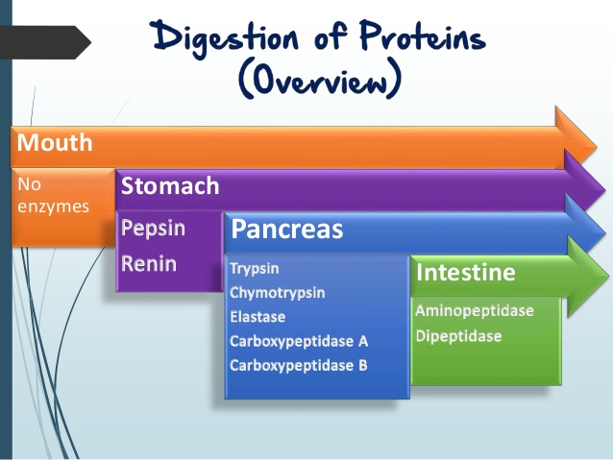

Slide 11
Endopeptidases: They act on peptide bonds inside the protein molecule, so that the protein becomes successively smaller and smaller units. This group includes Pepsin, Trypsin, Chymotrypsin and Elastase

Slide 12
Exopeptidases: Which act only on the peptide bond located at the ends of the polypeptide chain. This group includes:
a. Carboxypeptidase, which acts only on the peptide bond at the carboxyl terminal end of the chain.
b. Aminopeptidase, which acts only on the peptide bond at the amino terminal end of the chain.

Slide 13
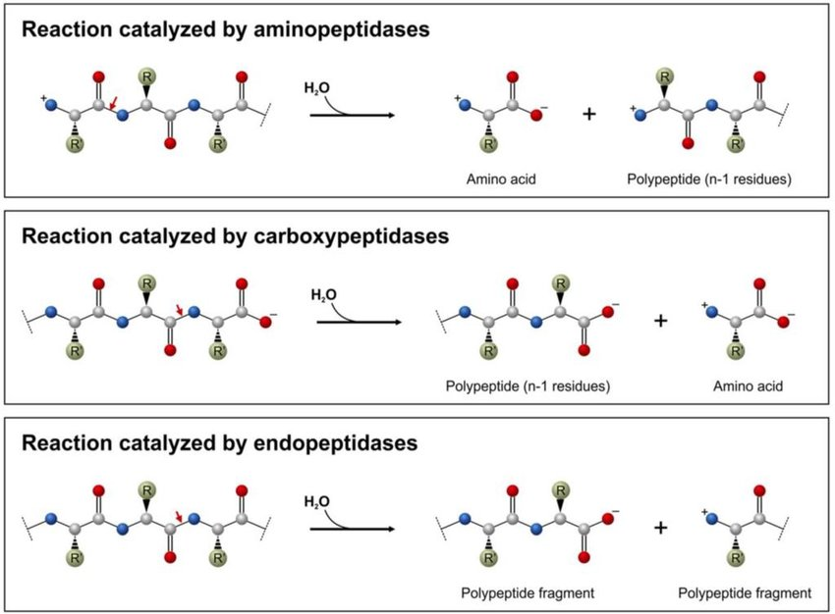

Slide 14
Gastric Digestion of Proteins
In the stomach, hydrochloric acid is secreted. It makes the pH optimum for the action of pepsin and also activates pepsin. The acid also denatures the proteins

Slide 15
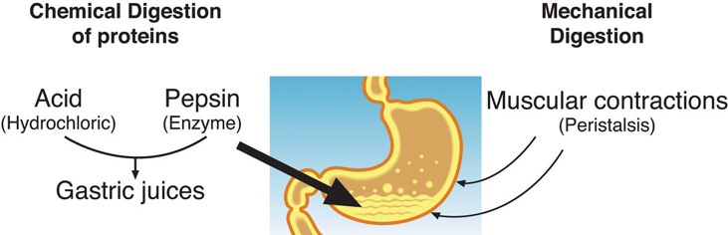

Slide 16
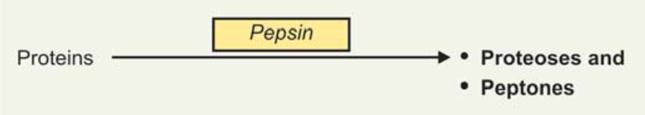
Pepsin
*Its endopeptidase ,secreted in an inactive zymogen form called pepsinogen.
*Its hydrolyzes protein molecule and produces proteoses and peptones.

Slide 17
Rennin
Rennin otherwise called Chymosin, is active in infants and absent in adults.
It is secreted as prorennin, which is activated in the stomach to form active rennin.
Milk protein, casein is converted to paracasein by the action of rennin. This denatured protein is easily digested further by pepsin.

Slide 18
Pancreatic Digestion of Proteins
The optimum pH for the activity of pancreatic enzymes (pH 8) is provided by the alkaline bile and pancreatic juice.
The secretion of pancreatic juice is stimulated by the peptide hormones, Cholecystokinin also called Pancreozymin

Slide 19
Pancreatic juice contains the important enzymes, namely
Carboxypeptidase.
Trypsin,
Chymotrypsin
Elastase

Slide 20
Trypsin
Trypsin is activated by the removal of a hexapeptide from N-terminal end.
Trypsin catalyzes hydrolysis of the bonds formed by carboxyl groups belongs to basic amino acids e.g. arginine, lysine and histidine.

Slide 21
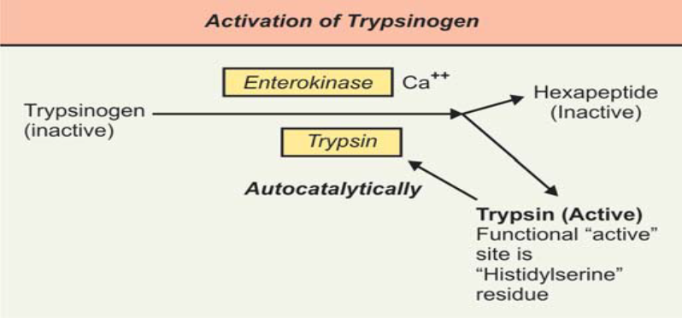

Slide 22
Acute pancreatitis : Premature activation of trypsinogen inside the pancreas itself, will result in the autodigestion of pancreatic cells. The result is acute pancreatitis.

Slide 23
Chymotrypsin
*It is an endopeptidase that hydrolyzes central peptide bond in which the carboxyl group belongs to aromatic amino acids.
*It is secreted in an inactive form called chymotrypsinogen.
*It is activated by trypsin, and completed by chymotrypsinogen, which acts autocatalytically.

Slide 24
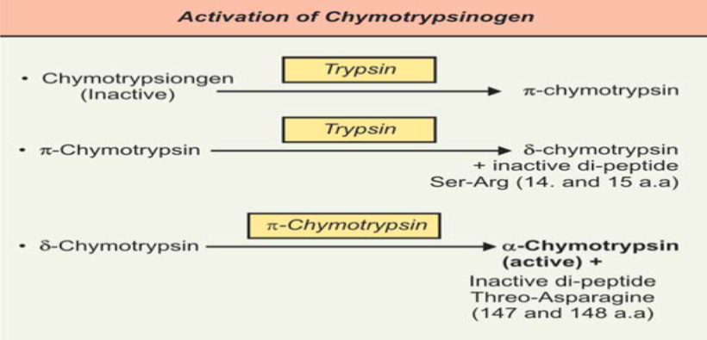

Slide 25
* α-Chotrypsin is the active form, optimum pH(7-8), it converts the proteoymses, peptones and peptides to smaller peptides and amino acids.

Slide 26
Elastase
It is an endopeptidase acting in pH= 8 on peptide bonds formed by glycine, alanine and serine .It is secreted in an inactive form called proelatase, and activated by trypsin. It digests elastin and collagen.

Slide 27
Carboxypeptidase
It is an exopeptidase that hydrolyzes the terminal (peripheral) peptide bond at the carboxyl terminus (end) of the polypeptide chain. It is secreted in an inactive form called procarboxypeptidase which is activated by trypsin
Carboxypeptidase A: it is an exopeptidase that cleaves aromatic amino acids from the C-terminal end of peptides.
Carboxypeptidase B : is also an exopeptidase cleaves the basic amino acids, lysine and arginine, from the C- terminal end of peptides

Slide 29
Intestinal Digestion of Proteins
Complete digestion of the small peptides to the level of amino acids is brought about by enzymes present in intestinal juice .The luminal surface of intestinal epithelial cells contains the following enzymes:

Slide 30
Aminopeptidase
*It is an exopeptidase that acts on the terminal peptide bond at the amino terminus of the polypeptide chain.
*It releases a single amino acid
* can't hydrolyze a dipeptide
*it requires presence of Zn⁺⁺,Mn⁺⁺ and Mg⁺⁺.

Slide 31
Prolidase
*Its an exopeptidase and can hydrolyze a proline peptide of collagen molecule, liberating a proline molecule.
Tri and Dipeptidase
* Tri-peptidase acts on tri-peptide and produces a di-peptide and free a. a.
*Di-peptidase hydrolyzes a di-peptide to produce two molecules of a. a.
* They requires the presence of Zn⁺⁺, Mn⁺⁺ and Co⁺⁺ as cofactors for their activity.

Slide 32
Food Allergy
Dipeptides and tripeptides can enter the brush border of mucosal cells; they are immediately hydrolyzed into single amino acids. They are then transported into portal vein.
Rarely, larger molecules may pass paracellularly (between epithelial cells) and enter blood stream. These are immunogenic, causing antibody reaction, leading to food allergy.

Slide 33
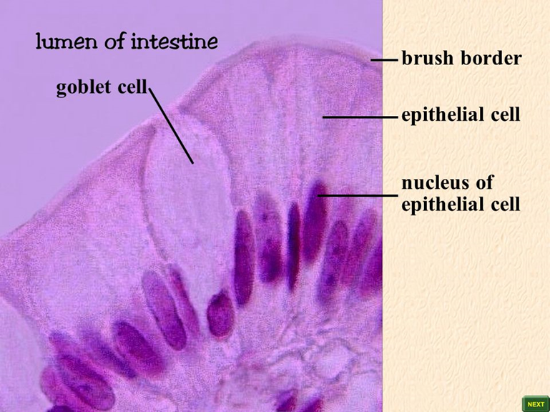

Slide 34
