Slide 1
OTITIS EXTRENA
ا.م.د. محمد رديف

Slide 2
Definition: Its inflammatory conditions of the external meatal skin, it may arise primarily in the meatus or be a manifestation of a generalized skin condition.
Predisposing factors:
1- Genetic: as narrow canal, excessive wax, inherited tendency to eczema.
2- Environmental: as heat, humidity, swimming.
3- Traumatic: as scratching the ear by matchsticks, etc.
4- Infective: as viral, bacterial, fungal.
5- Reactive: as eczematic dermatitis, seborrhoeic dermatitis, neurodermatitis.

Slide 3
Classifications (types):

Slide 4
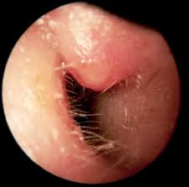

Slide 5
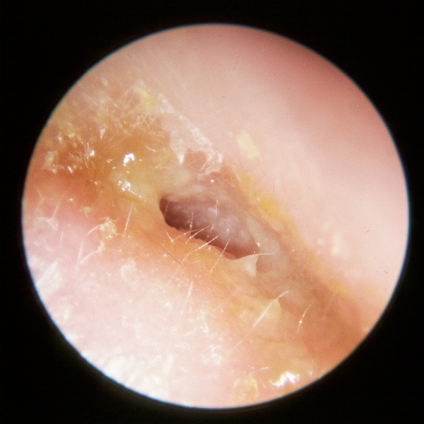

Slide 6
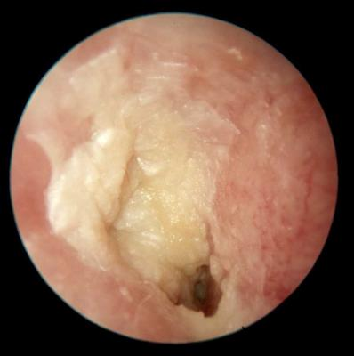
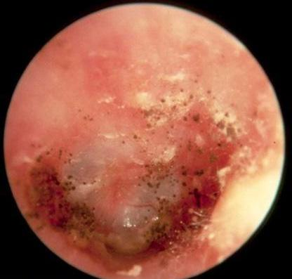
Otomycosis (candida Albicans) Otomycosis (Aspergillus Niger)

Slide 7
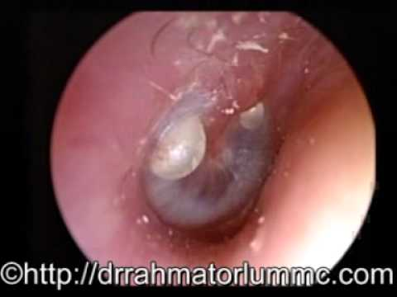

Slide 8
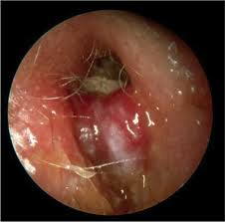

Slide 9
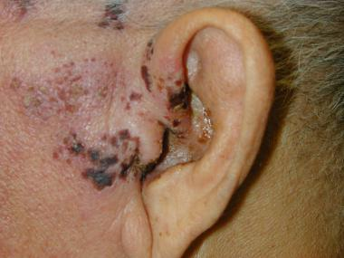

Slide 11
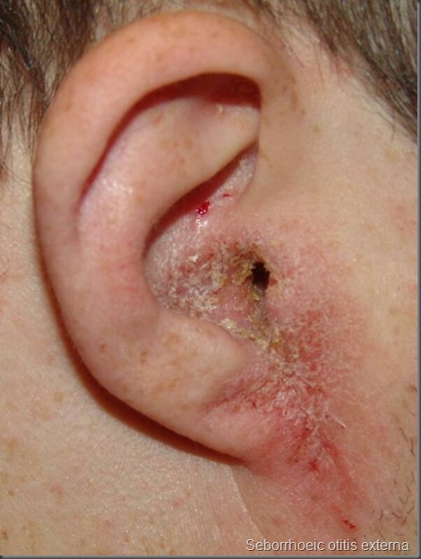

Slide 12
9- Neurodermatitis:
There is constant scratching of the ears due to psychosomatic disturbance results into irritation of the external meatus which may lead to secondary infection, the management include attention must be paid to the psychosomatic aspect of the problem, also local application of steroid preparation, and in severe cases it may necessary to bandage the ears to prevent scratching.

