Slide 1
TUBERCULOUS PERITONITIS
By Dr Mustafa Usama
General and laparoscopic surgeon

Slide 2
Origin of the infection
Infection originates from:
• tuberculous mesenteric lymph nodes;
• tuberculosis of the ileocaecal region;
• a tuberculous pyosalpinx;
• blood-borne infection from pulmonary tuberculosis, usually the ‘miliary’ but occasionally the ‘cavitating’ form.

Slide 3
Acute tuberculous peritonitis
Tuberculous peritonitis sometimes has an onset that so closely resembles acute peritonitis that the abdomen is opened. Straw coloured fluid escapes and tubercles are seen scattered over the peritoneum and greater omentum.
Early tubercles are greyish and translucent. They soon undergo caseation and appear white or yellow and are then less difficult to distinguish from carcinoma.

Slide 4
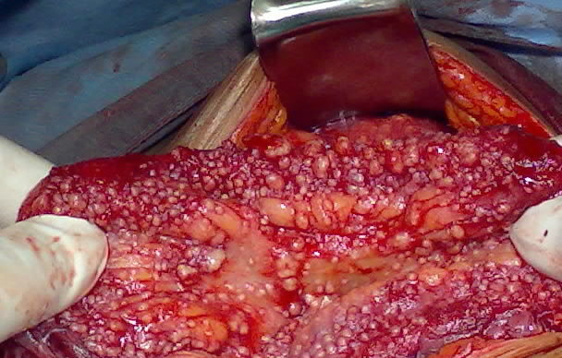

Slide 5
Chronic tuberculous peritonitis
The condition presents with abdominal pain (90% of cases), fever, loss of weight ,ascites (60%), night sweats and abdominal mass (26%)

Slide 6
Varieties of tuberculous peritonitis
1-Ascitic form
The peritoneum is studded with tubercles and the peritoneal cavity becomes filled with pale, straw-coloured fluid.
The onset is insidious. There is loss of energy, facial pallor and some loss of weight.
The patient is usually brought for advice because of distension of the abdomen.

Slide 7
2-Encysted form
The encysted (loculated) form is similar to the ascitic form except that one part of the abdominal cavity alone is involved. Thus, a localised intra-abdominal swelling is produced.

Slide 8
3-Fibrous form
The fibrous (synonym: plastic) form is characterised by the production of widespread adhesions, which cause coils of intestine, especially the ileum, to become matted together and distended

Slide 9
4-Purulent form
The purulent form is rare. When it occurs, usually it is secondary to tuberculous salpingitis. Amidst a mass of adherent intestine and omentum, tuberculous pus is present. Sizeable cold abscesses often form and point on the surface,

