Slide 1
Yersinia
Dr . Salma

Slide 2

Yersinia pestis
Black death

Slide 3
taxonomy
Member of the Enterobacteriaceae family yersinia is gram nagative coccobacilli

Slide 4
Yersinia
General characteristics:
- Yersinia pestis is the causative agents of plague (the Black Death), and another two less important species: Yersinia enterocoltitica & Y. pseudo tuberculosis.
- It is a small Gram –ve bacilli, with bipolar staining with clear central area.
- Freshly isolated organisms possess a capsule composed of polysaccharide-protein complex, where it is considered as virulence factor, where its loss leads to loss virulence.
- It is considered as the virulent most bacteria known, where only 1-10 bacteria are capable of causing the disease.
- Wild rodents are the animal reservoir, where it is endemic now in western U.S.A and in South East Asia.

Slide 5
Pathogenesis:
- The vector is the wild rodent’s fleas.
Dogs could as the main reservoir, and human is the accidental host.
- The organisms inoculated by the flea bite are spread to the regional lymph nodes which become swollen and tender (buboes), bubonic plague.
- Organisms reach high concentration in the blood lead to abscesses in different organs, and the endotoxins relayed symptoms, such as disseminated intravascular coagulation, and Cutaneous hemorrhage gives the name of Black Death.

Slide 6
The virulence factors include:
* The capsular antigens F-1
* The cell wall endotoxic
* An exotoxin (its action is unknown)
* V & W antigens (protect organisms from intracellular killing and digestion)
* Yops (Yersinia Outer Proteins), experimentally shown to inhibit phagocytosis and
cytokine production, as well as inhibit tumor necrosis factor production.
Laboratory diagnosis:
* Smear and culture from the blood or bubo is the best diagnostic test.
* Great care must be taken during samplings.
* Giemsa stain shows safety pin cell appearance.
* For further diagnosis, fluorescent-antibody staining is used.
Treatment:
Combination of erythromycin and tetracycline is used without waiting the result to appear.

Slide 7
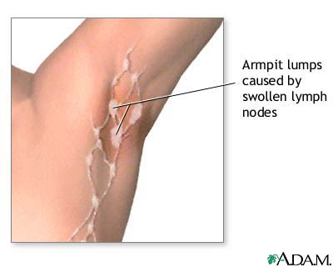
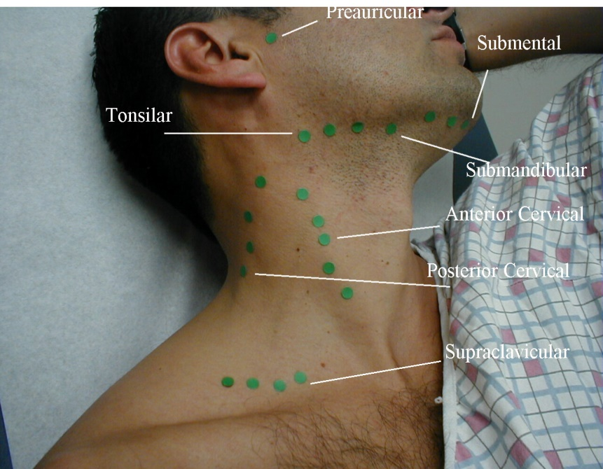
Target tissues
This disease direct effects the lymph node which can be found in the groin , neck , and armpits cause them to enlarge and suppurate

Slide 8
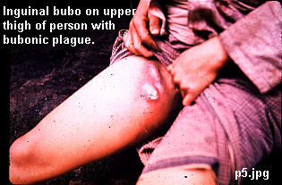
Symptoms
Bubonic Plague
bacteria infect lymph nodes
Bubos
Fever
Headache
Vomiting Blood

Slide 9
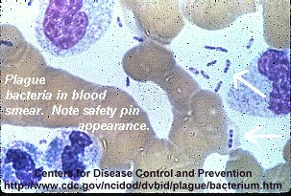
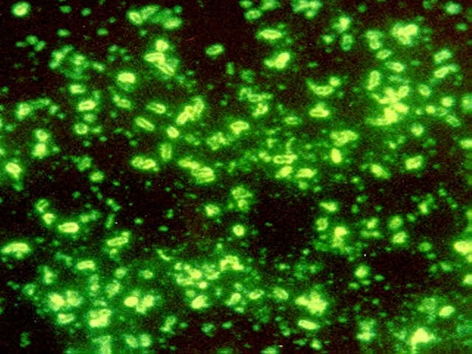
Diagnostic Tests
Take smear from blood or feces for bubonic plague
> bacteria has “safety pin” appearance
Can also use FA (fluorescent-antibody) test
All plague bacilli have unique diagnostic envelope glycoprotein called
the Fraction 1 (F1) antigen

Slide 10
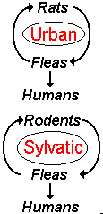
Epidemiology: Transmission
Bubonic
Infected Rodent → Fleas → Humans
Can also enter through breaks in skin when handling infected animal

Slide 11
Other Yersinia cause disease.
Yersinia enterocolitica
Typically, only a small number of human cases of Yersiniosis are recognized. Symptoms are like that of appendicitis and out breaks are often detected by a sudden increase in appendectomies in a particular region.
The Center for Disease Control & Prevention estimates that about 17,000 cases occur each year in the United States.

Slide 12
Mortality
Bubonic Plague
Untreated 50- 60% mortality rate
Treated 5 – 20% mortality rate
Killed one third of the world’s population during the 14th century
Latest reports
As of 15 March 2001, World Health Organization has reported a total of 436 suspected cases, including 11 deaths in Nyanje area in Zambia.
As of 27 May 2002, the Malawian Ministry of Health has reported a total of 71 cases of bubonic plague in Malawi.

Slide 13
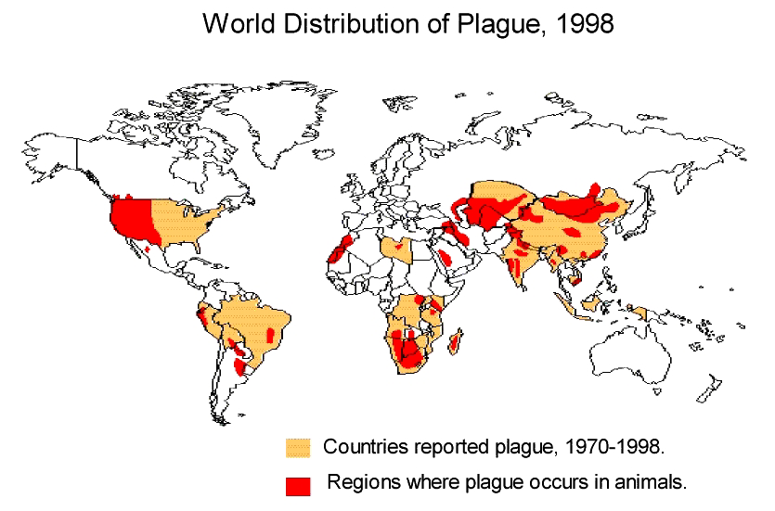
WHO reports 1,000 to 3,000 cases of plague every year!

Slide 14
EVOLUTION: A single gene change in a relatively benign recent ancestor of the bacterium that causes bubonic plague played a key role in the evolution of the deadly disease from a germ that causes a mild human stomach illness acquired via contaminated food or water to the flea-borne agent of the "Black Death.”
GENETICS: Research on three genes, hemin storage (hms) genes, in Y. pestis that change it from a harmless, long-term inhabitant in the flea midgut to one that amasses in its foregut.
PREVENTION: Current prevention measures include dusting family pets with insecticides to prevent the spread of the Yersinia pestis organism from the native prairie dog populations

Slide 15
Francisella
Francisella tularensis, the causative agent of Tularemia.
Small Gram –ve bacilli with a single serologic type.
Pathogenesis:
- It is enzootic, isolated from more than 100 different species of wild animals, mainly rabbits, deer, and a variety of rodents.
- The vectors are: ticks, mites and lice, where ticks can pass it to their offspring.
- Human acquire the infection by a tick bite or due a direct contact with the animal during removal of the hide.
- No person to person transmission.
- Rarely transmitted by ingestion or inhalation causing gastrointestinal or pneumonic tularemia respectively.
- Clinical findings, vary from sudden influenza- like syndrome to prolonged onset of a low grade fever and adenopathy, and may be other gastrointestinal and typhoid symptoms.
Disease usually confers a lifelong immunity.

Slide 16
Laboratory diagnosis:
It is very risky dealing with this organism.
Media should contain cystcine.
The best diagnostic tests are:
1-agglutination test and
2-fluorescent- antibody staining test of the infected tissues.

Slide 17
Pasteurella
*Pasteurella multocida causes wound infections associated with cat and dogs bites.
* It is short Gram –ve, encapsulated with bipolar staining.
* 25% of these animal bites will transmit these organisms with other anaerobic and facultative anaerobes present in the mouth.
* The capsule and the endotoxins are considered as the virulence factors
* The incubation period is less than 24 hrs.
* Rapidly spreading cellulites at the site of the animal bite is an indicative of the P.multocida.
* Osteomyelitis may complicate cat bite.
* Laboratory diagnosis is binding the organism in culture of wound sample.
* Penicillin G is the drug of choice.

Slide 18
Thank you

