Slide 2
Shoulder dystocia
Dr ban hadi

Slide 3
Normal delivery
When the fetal shoulders delivered with gentle traction after the fetal head.

Slide 4
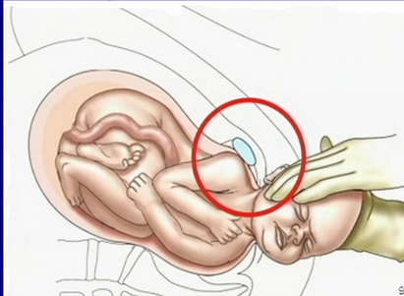
Shoulder dystocia
When the fetal shoulders cannot be delivered with gentle traction after the fetal head.

Slide 5
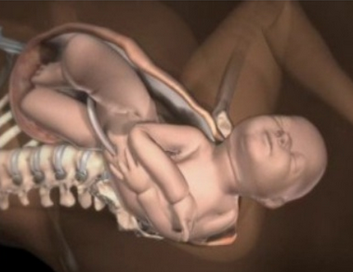
Shoulder dystocia
The incidence varies from 0.2 to 1.2%

Slide 6
Risk factors:
1. Large baby
2. Small mother
3. Maternal obesity
4. Diabetes mellitus
5. Postmaturity
6. Previous shoulder dystocia
7. Prolonged first and second stage of labour
8. Assisted vaginal delivery

Slide 7
Complications : fetal
1.hypoxia and cerebral damage: due to occlusion of the vessels in the fetal neck after 5 minutes, if the baby is already compromised, this may occur earlier
2.nerve and brachial plexus damage (Erb's palsy): due to inappropriate traction on the head causing lateral flexion of the head on the neck..
3.Fetal death

Slide 8
Complications : Maternal:
Postpartum hemorrhage, usually from uterine atony, but also from vaginal and cervical lacerations, is the major maternal risk from shoulder dystocia
trauma to the genital tract, uterine rupture
Puerperal infection

Slide 9
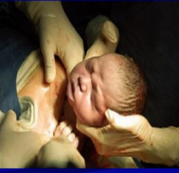
Diagnosis:
The head recoils against perineum ( Turtle sign)
Restitution does not occur

Slide 10
management:
Aim: safe delivery before fetal asphyxia and cortical damage

Slide 11
Preophylactic caesarean?
Not recommended by ACOG
Consider if:
EFW > 5 kg in women without DM
EFW >4.5 kg in women with DM

Slide 13
Ask for help
Senior Obstetrician, anaesthesiologist and paediatrician
Prepare blood
Avoid : fundal pressure, turning the patient into left lateral position and inappropriate traction on the fetal head.

Slide 16
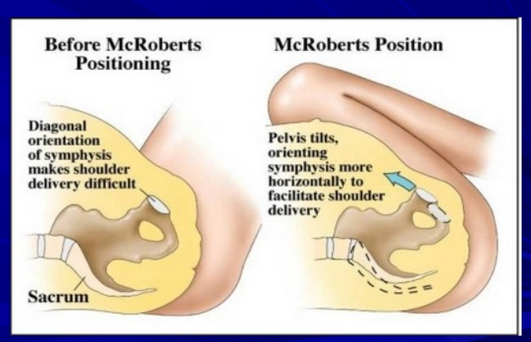

Slide 24
More dramatic techniques:
. as fracture of the fetal clavicle, symphysiotomy, replacement of the fetal head and delivery by caesarean section ( Zavanelli maneuver) are traumatic and rarely necessary

Slide 25
Thank you

