Slide 1

بسم الله الرحمن الرحيم
الرحمن (١) علم القران (٢) خلق الإنسان (٣) علمه البيان (٤)
صدق الله العظيم
سورة الرحمن (١-٤)

Slide 2

Postmenopausal bleeding
Dr. Zainab Abdul Ameer
M.B.CH.B - F.I.C.O.G.

Slide 3
Postmenopausal bleeding
definition
bleeding that occurs after 12 months of amenorrhea in a woman aged 45 years or over.

Slide 4
But some prefer to reduce the period to 6 months

Slide 5
Even without amenorrhea or irregularity, menstruation continuing after the age of 55 years should be investigated.

Slide 6
It affects as 30% of postmenopausal women.

Slide 7
As many as one-third of the cases are due to malignancy.

Slide 8
What are the causes of postmenopausal bleeding?

Slide 9
The main differential diagnosis of PMB :
1.HRT.( 30% )
2. atrophic endometritis / vaginitis (30%)
3. endometrial cancer (15%)
4. endometrial polyps or cervical polyps (10%)
5. endometrial hyperplasia (simple, complex, and atypical) (5% )
6.other 10%

Slide 10

HRT.( 30% )

Slide 11

atrophic endometritis / vaginitis (30%)

Slide 12
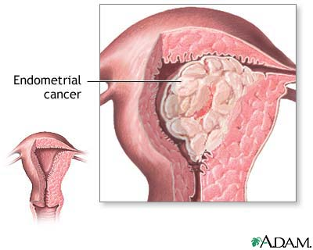
endometrial cancer (15%)

Slide 13
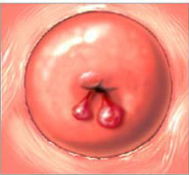
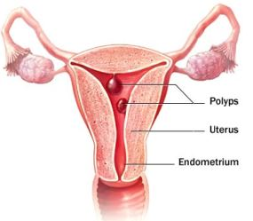
Cervical polyp
*It compose 10% of post menopausal bleeding
endometrial polyp

Slide 14
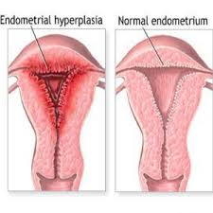
endometrial hyperplasia (simple, complex, and atypical) (5% )

Slide 15
other uncommon causes include:
Benign and malignant neoplasms of the vulva, vagina, cervix, fallopian tubes
Ovarian tumours: oestrogen-producing tumours(theca cell, granulose cell tumors(

Slide 16
Infections
Vaginitis — Trichomonas, Candida, Chlamydia
Senile endometritis - tuberculous, senile pyometra and haematometra

Slide 17
Injuries
Direct trauma
Decubital ulceration
Foreign bodies such as supporting pessaries
Postradiation ulceration

Slide 18
Over use of anticoagulant medications such as aspirin, heparin, and warfarin.
Abnormalities of the hematologic system e.g. leukemia or a blood dyscrasia.

Slide 19
Bleeding from the urethra, bladder and rectum (mistaken for vaginal bleeding)
Urethral caruncle
Papilloma and carcinoma of the bladder
Haemorrhoids and fissure-in-ano
Carcinoma of the rectum

Slide 20
diagnosis:

Slide 21

History

Slide 22
A detailed history
confirm menopausal, when was your last period?
Frequency
Length
quantity of bleeding
(The woman may report individual episodes of spotting, or she may report days or months of profuse bleeding).
3.Associated symptoms like Pain

Slide 23


4.Medications taken, especially estrogens or steroids, should be asked
Hormone use
Tamoxifen

Slide 24
post-coital bleeding? (i.e. think cervical polyp/ cervical malignancy)
ensure that the bleeding is coming from the vagina and not the urinary tract or bowel.

Slide 25
Date of last smear done? Have they always been normal? (i.e. think cervical malignancy)
A history of thyroid, kidney or liver conditions. She may report a history of bleeding or easy bruising.

Slide 26
Risk factors for uterine cancer can be sought in the history
Probability of having endometrial cancer associated with PMB in women (Risk factors):
Early menarche(< 10 years).
Late menopause(>55 years).
Null parity.
history of chronic anovulation.
tamoxifen use.
Unopposed estrogen therapy.

Slide 27
7.Bleeding moderate or severe.
8.Obesity.
9.Hypertension.
10.diabetes mellitus
11.Persistent/ recurrent bleeding.
12.A family history of Lynch type II syndrome (hereditary nonpolyposis colorectal, ovarian, or endometrial cancer).

Slide 28

Clinical examination

Slide 29
Physical exam:
General examination: for
Pallor
Cachexia
Enlarged groin or supraclavicular lymph nodes may be palpated
The breast for possible tumor
Ex. of the chest for possible metastasis.
Hypertension, cardiac and respiratory signs must be excluded. The presence of all these may influence treatment, e.g. the patient’s suitability for surgery

Slide 30
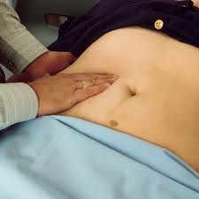
Abdominal and pelvic examination

Slide 31
Abdominal examinations:
lump in the lower abdomen
A uterus that is larger than normal may in case of(the presence of fibroids or polyps or cancer ). (Classically patient with endometrial carcinoma do not have an abdominally palpable uterus).
abdominal masses and ascites(Patient with advanced cancer: evidence of metastases)
The presence of ovarian masses may suggest the possibility of a functioning ovarian tumor.

Slide 32
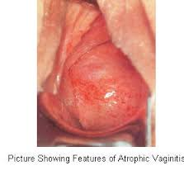
vaginal examination
Direct inspection: of the vulva and vagina for any signs or lesion suggests of:
atrophy
areas of bleeding
Ulcers
tumors( malignancy )

Slide 33
Palpation:
To separate the labia for better inspection of the urethral meatus to find out any
Caruncle
polyp
mucosal prolapse

Slide 34
A speculum Examination
of the vagina &cervix look for
polyp
atrophic changes in the vagina
infection
Lesion suggestive of malignancy
Any visible cervical growth → biopsy is to be taken for histology.
2.Then before removal of the speculum A Pap smear is taken.
3.Aspiration cytology — for endometrial carcinoma

Slide 35
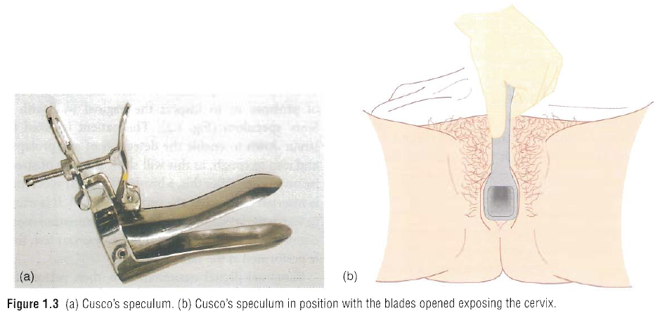
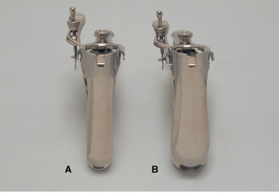

Slide 36
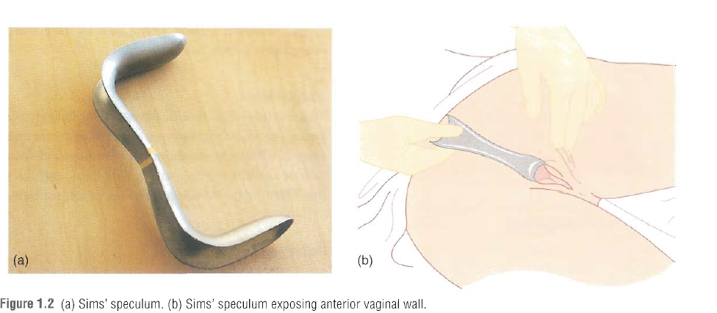

Slide 37
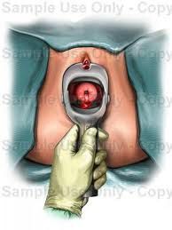
Speculum examination of the cervix

Slide 38
A bimanual examination
I. Assess the uterus for
Uterus may be normal, atrophic or enlarged
position
Mobility
(An enlarged, fixed uterus may indicate advanced malignant disease)
II.Palpable adnexal mass

Slide 39
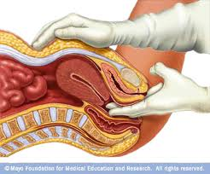
Bimanual examination

Slide 40
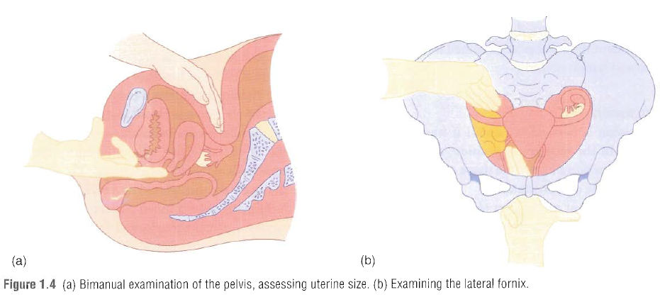

Slide 41
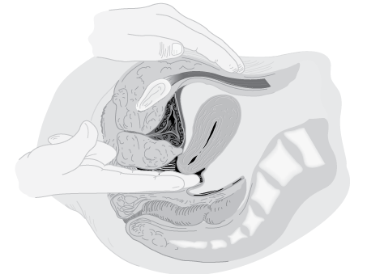
bimanual examination of an anteverted uterus.

Slide 42
All postmenopausal bleeding is suspected endometrial carcinoma until proven otherwise.

Slide 43
Investigations:
General investigation:
  Complete blood count (CBC) , platelet count
  blood sugar (fasting and postprandial)
  blood urea
  urine microscopy
  chest x-ray
  ECG

Slide 44
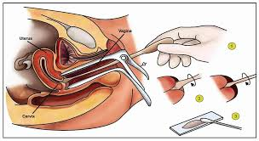
Cytological smears from the vagina may be obtained.
Pap smear and biopsy of the cervix will be obtained.

Slide 45
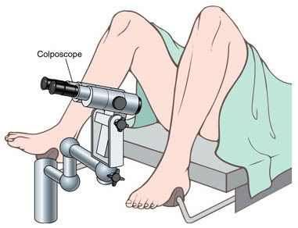
Colposcopy

Slide 46
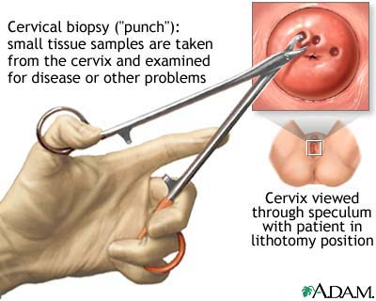
Biopsy

Slide 47
Tests performed to identify abnormalities of the uterus, the main aim of these investigations are to exclude both endometrial cancer &atypical hyperplasia.

Slide 48
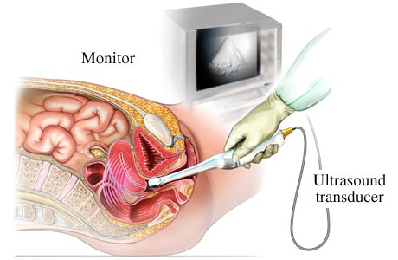
Transvaginal solography (TVS) should be done:
to exclude any pelvic pathology
For endometrial thickness

Slide 49
In the postmenopausal woman, the endometrial thickness is 3 mm or less (or 5 mm or less for women on HRT)
patients can be reassured that the likelihood of endometrial carcinoma is extremely low and no further investigation is required

Slide 50
For those with an endometrial thickness greater than 3 mm (5 mm for those on HRT), further endometrial assessment is warranted in the form of an endometrial biopsy.

Slide 51
The exception to this rule is women on tamoxifen as ultrasound will not assist with a diagnosis ,Most women on tamoxifen will have a thickened, irregular and cystic endometrium

Slide 52
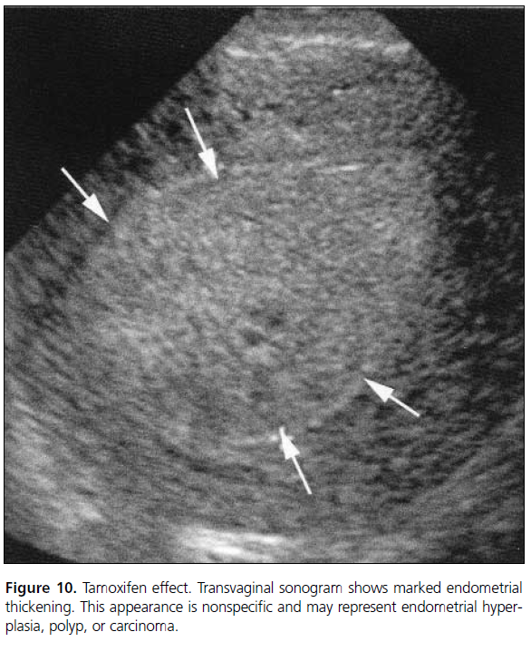

Slide 53
Findings that require further investigation by EB(Indications of Endometrial sampling)
Endometrial thickness is >5 mm
An irregular endometrial outline
Fluid in the uterine cavity
Focal endometrial abnormality(thick polypoid endometrium) (9–10 mm)
ET not visualized, e.g. fibroids
Recurrent PMB, regardless of ET

Slide 54
  The injection of liquid into the uterus prior to inserting a vaginal probe (saline infusion sonogram – SIS).

Slide 55
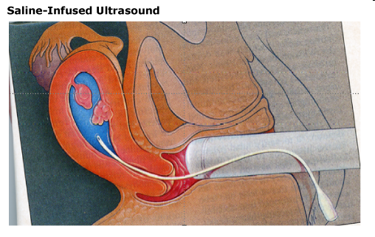
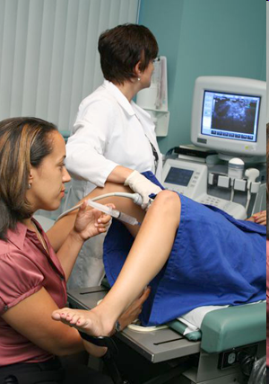
procedure

Slide 56
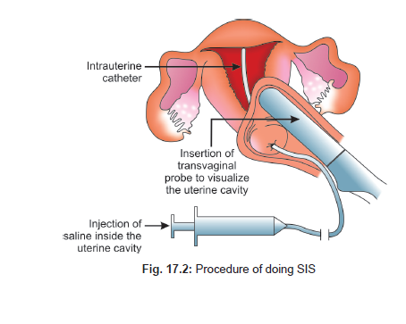

Slide 57
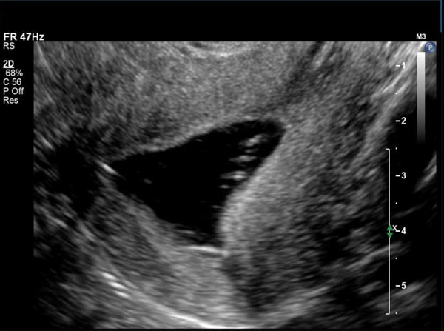
normal cavity

Slide 58
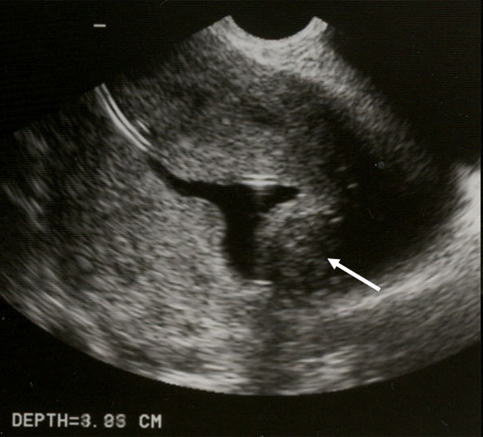

Slide 59
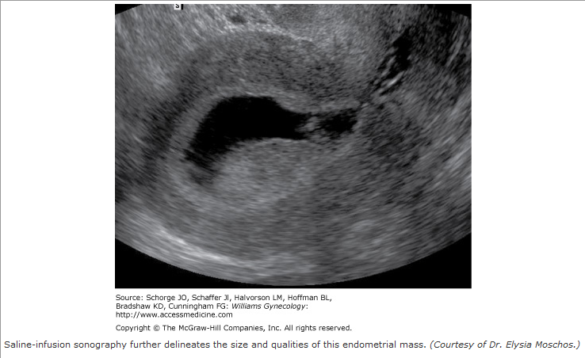

Slide 60
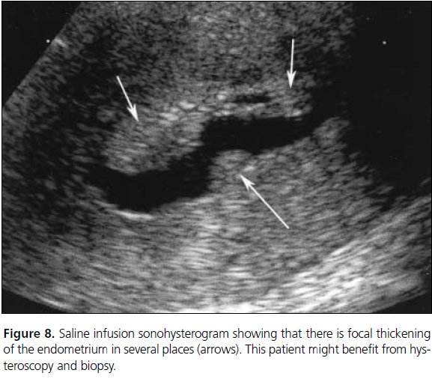

Slide 61
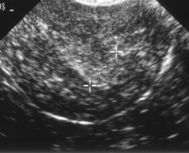
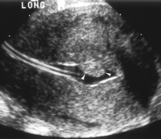
The Thickened endometrium may be a polyp
catheter
POLYP
With polyps the endometrial-myometrial interface is preserved

Slide 62
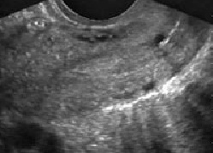
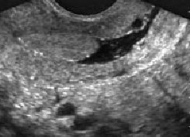
The Thickened endometrium may be a polyp
CYST
POLYP
With polyps the endometrial-myometrial interface is preserved
well-defined, homogeneous, isoechoic to the endometrium

Slide 63
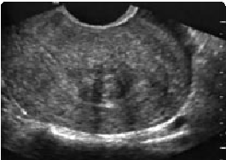
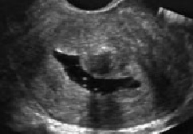
The Thickened endometrium may be a Submucosal leiomyomas
With myomas the endometrial-myometrial interface is distorted
broad-based, hypoechoic,

Slide 64
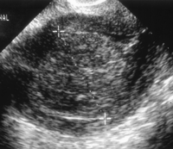
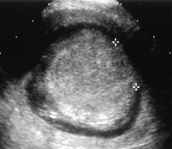
Endometrial cancer
Endometrial cancer is typically a diffuse process, but early cases can appear as a polypoid mass

Slide 65
Endometrial sampling
Outpatient endometrial biopsy.
Pipelle
Vabra
sharman curatte
Outpatient hysteroscopy
B. In patient endometrial biopsy
Dilatation& curettage
Hysteroscopy directed endometrial biopsy.

Slide 66
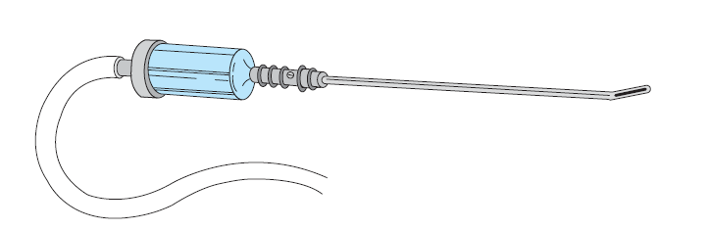

Slide 68
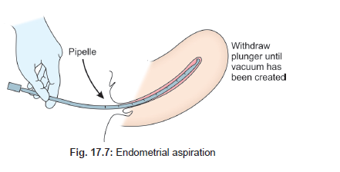

Slide 69
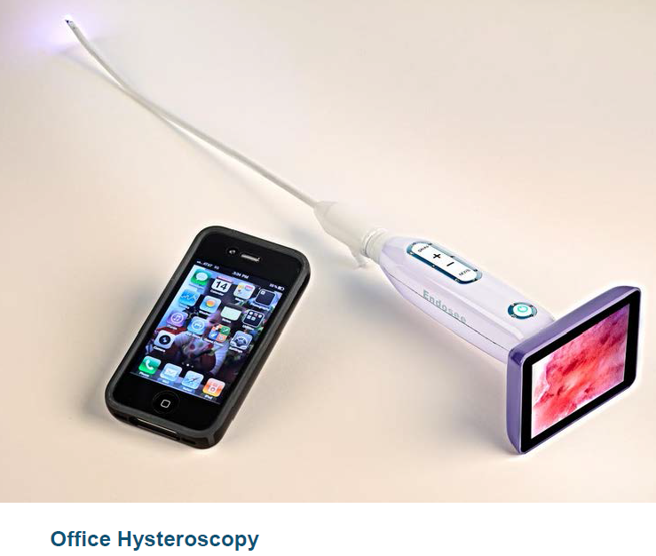
Office outpatient sonohysteroscopy directed endometrial biopsy .

Slide 70
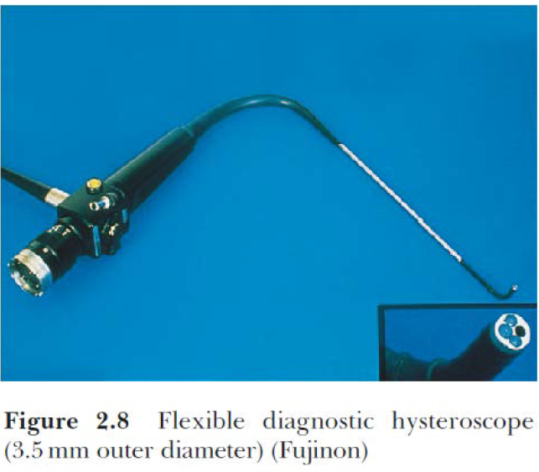

Slide 71
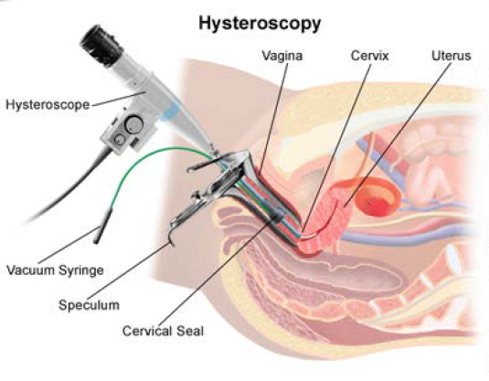

Slide 72
Current recommendation:
hysteroscopy &endometrial sampling as the gold standard for evaluation of women with PMB.

Slide 73
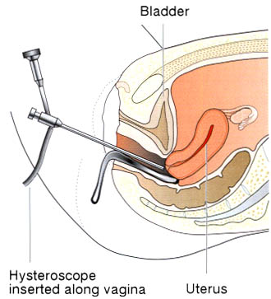

Slide 74
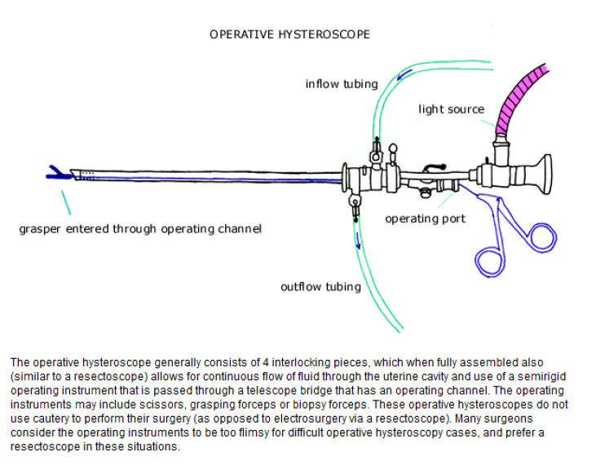

Slide 75
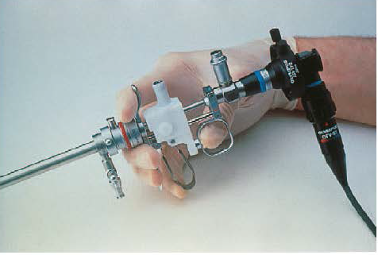


Slide 76
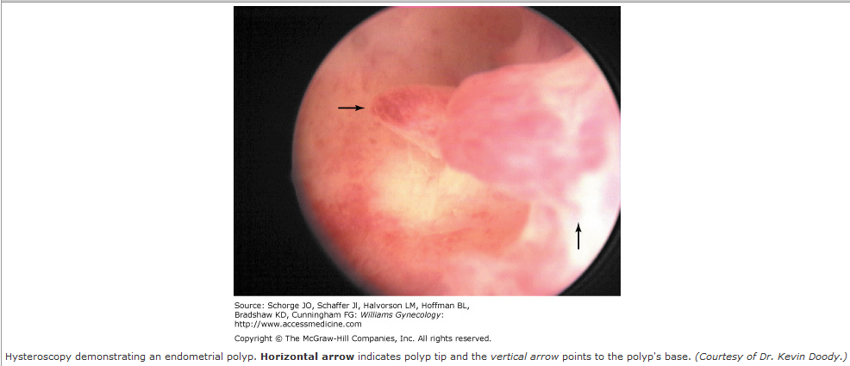

Slide 77
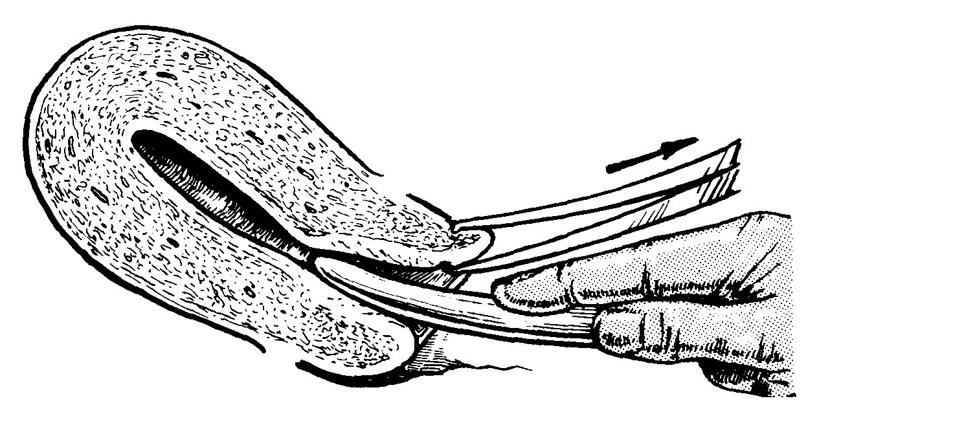


Slide 78
CT and MRI:
may also use to predict myometrial invasion.

Slide 79
in suspected cases of ovarian or adnexal mass: tumor markers (Ca-125, LDH, hCG, AFP,CEA, inhibin, and estradiol)
Cystoscopy and proctoscopy in order to rule out urinary tract and rectal lesions respectively must be done
Laparoscopy: in selected cases

Slide 80
Treatment
Treatment of postmenopausal bleeding depends on the cause.
Lesions of the vulva and vagina should be biopsied and treated accordingly.

Slide 81
2.Lacerations of the vaginal mucosa should be repaired With:
vaginal estrogen preparations in the form of (creams, pill, & rings)

Slide 82
Systemic treatment :with
hormone replacement therapy (HRT) if the uterus is in situ
with estrogen replacement therapy (ERT) if the uterus has been removed

Slide 83
3. Removal of tissue from the inside of uterus (curettage) may be all that is necessary to relieve postmenopausal bleeding.
4. Endometrial polyps may be removed (polypectomy) by hysteroscopic resection or D&C ; will correct bleeding associated with their presence.

Slide 84
5. Endometrial hyperplasia can be treated with progestin therapy or hysterectomy
Cyclic progestin may be administered for treatment of overgrowth of the endometrium (simple endometrial hyperplasia), for up to 3 months.

Slide 85
At completion of progestin therapy
a repeat D&C or endometrial biopsy will be performed to verify absence of hyperplasia
Then oral HRT with progestin may be given.

Slide 86
6. endometrial cancer is usually treated by TAHBSO performed in conjunction with possible
lymph node dissection, radiation, or chemotherapy (less common).

Slide 87
7.Hysterectomy
may be necessary to treat the following condition.
Endometrial hyperplasia with atypical cells.
Bleeding does not resolve with treatment ,causing anemia due to chronic blood loss.
endometrial cancer
cervix cancer

Slide 88

Thank you

