Slide 1
د.زينب عبد الأمير
Instruments in gynecology

Slide 2
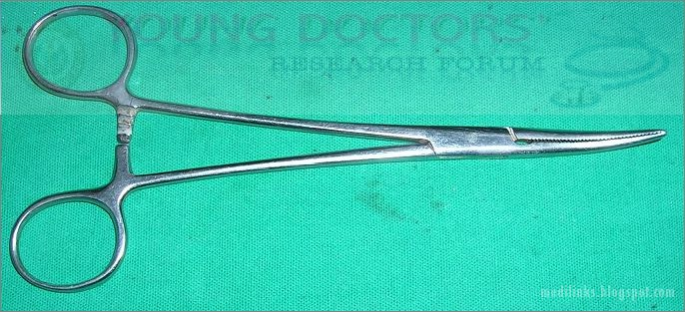
Artery Forceps
used for
clamping bleeding vessels
grasping tissue at the time of operation( Opening and closing peritoneum)
hold stay sutures.

Slide 3
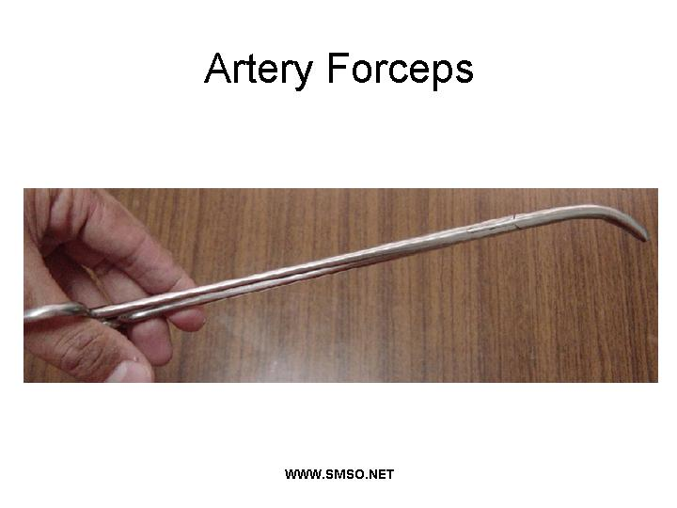

Slide 4
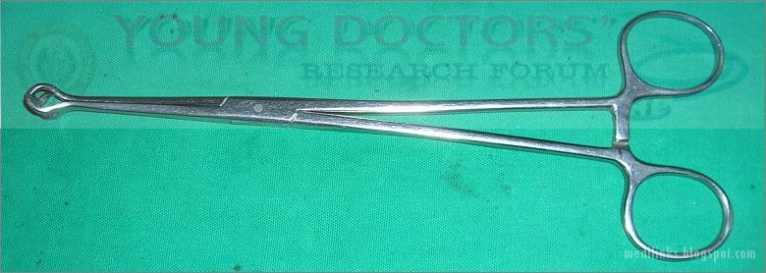
Babcock's Forceps
The tip is atraumatic as there are no sharp tooth.
it used for grasping tubular structures like:
fallopian tube in tubectomy in modified Pomeroy's operation
Ureter
appendix

Slide 5
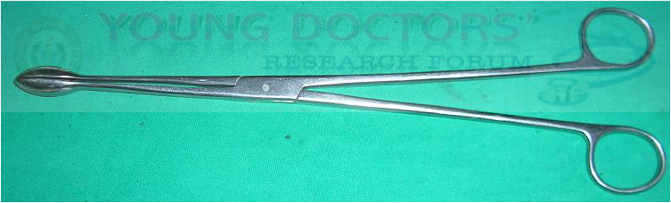
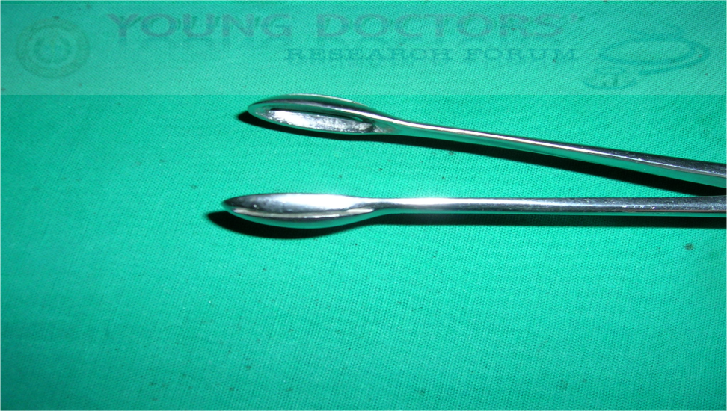
ovum holding forceps
The tip of this instrument is rounded cup like to avoid perforation and to hold large tissue.
used for removing the products of conception in
inevitable
incomplete abortion
in termination of pregnancy operations.

Slide 6
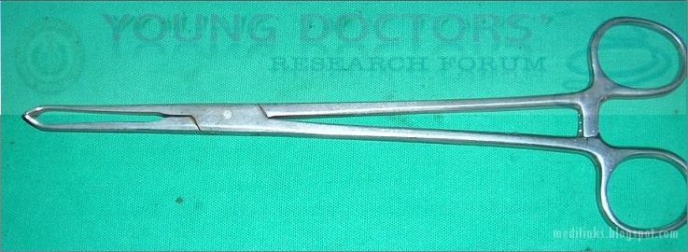

Allis' Forceps
used for grasping tough structures like
Rectus sheath
fascia
in operations like :
Tubectomy
LSCS
abdominal hysterectomy.

Slide 7
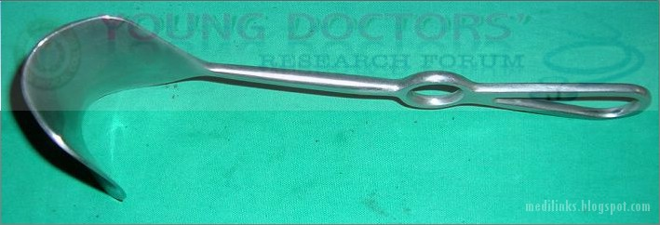
doyen's retractor
used for retracting bladder downwards during abdominal operations like
.LSCS
abdominal hysterectomy
laparotomy

Slide 8
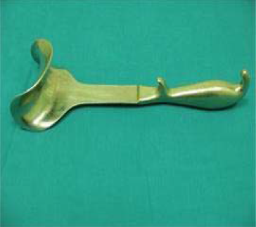
Doyen's retractor

Slide 9
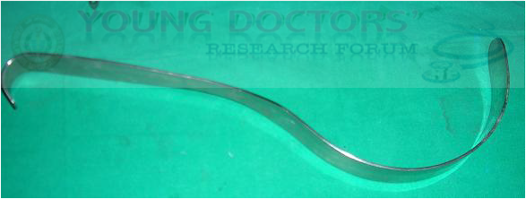
deaver's retractor for retraction of deep structures

Slide 10
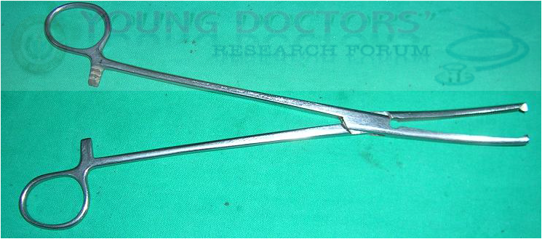
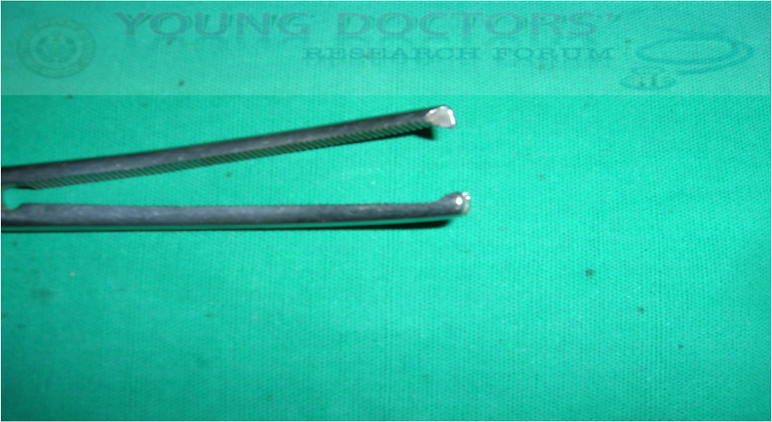
kocher's forceps (clamp)
The tips of the blades have teeth so that the tissue does not slip.
The blades can either be straight or curved.

Slide 11
This instrument is used in
holding pedicles in hysterectomy
salpingectomy in ectopic
oophorectomy in ovarian mass.
This can also be used for clamping umbilical cord of new born at the time of delivery
artificial low rupture of membranes ( ARM).

Slide 12
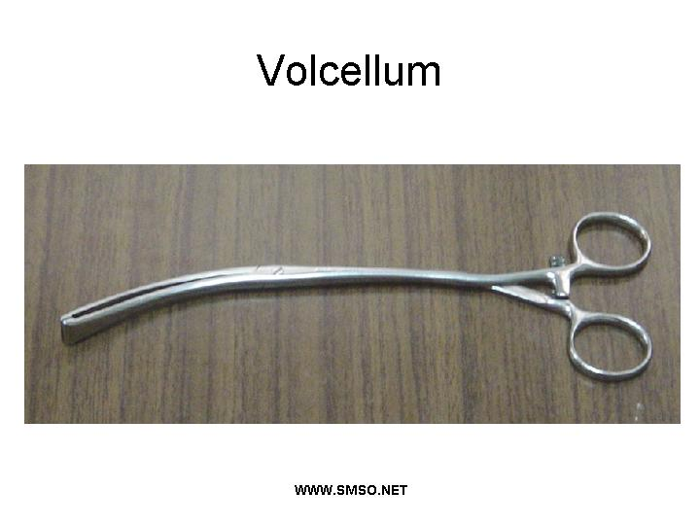

Slide 13
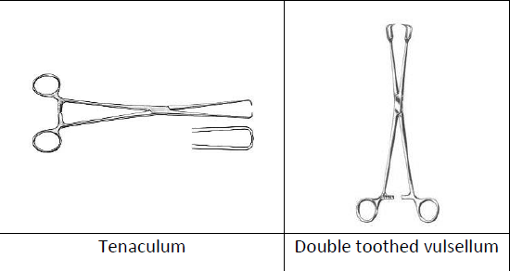

Slide 14
Vulsellum Forceps
Types:
1. Single toothed (bullet forceps) Tenaculum
2. Double toothed (Fenton’s bull-dog vulsellum or the lion’s forceps)
3. Multiple toothed vulsellum (Tenaculum)

Slide 15
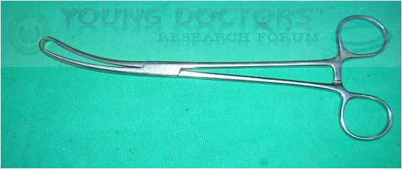
vulsellum
This instrument is used for grasping the cervix ( Usually anterior lip of the cervix is grasped)
Its a long instrument with gentle curve so that the line of vision is not obstructed

Slide 16
The tip of the blades have 3-4 teeth to hold and steady the cervix in procedures like
Insertion of IUCD
Cx Biopsy
D&C
First trimester TOP with Suction Evacuation
Vaginal Hysterectomy

Slide 17
Posterior lip of the cervix is grasped for post. colpotomy .
Since the teeth are sharp it is not used in pregnancy as it may cause cervical tears and lacerations. Instead sponge holding forceps is used to grasp the cervix.

Slide 18
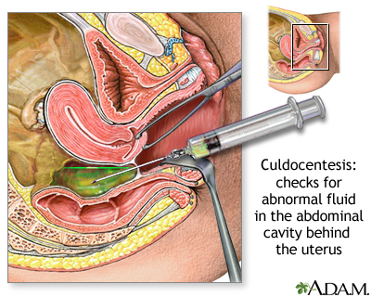
PROCEDURE
Patient-lithotomy position
Posterior lip of cervix-downwards and forwards with vulsellum forceps
Speculum-retracts posterior vaginal wall
Area disinfected
Aspiration syringe inserted into the pouch and aspirated
Done best in OT under full asceptic precautions and to proceed laproscopy/laprotomy if indicated

Slide 19
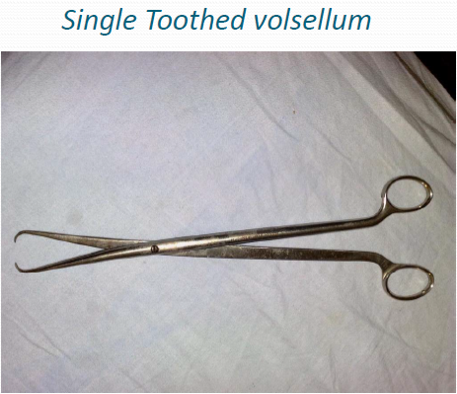

Slide 20
Indications:
1. Grasping of the cervix

Slide 21
2. To grasp a prolapsed submucous myoma during a vaginal myomectomy.
3. During operation of hysterectomy it can be used to hold the cercal stump
after the removal of the uterine body in subtotal hysterectomy.

Slide 22
Contraindications:
The soft pregnant cervix,
Infections,
Suspicious malignancy of the cervix.

Slide 23
Complications:
1. Lacerations of the cervix.
2. Infections
3. Bleeding from the site of the bite of the teeth of the vulsellum

Slide 25
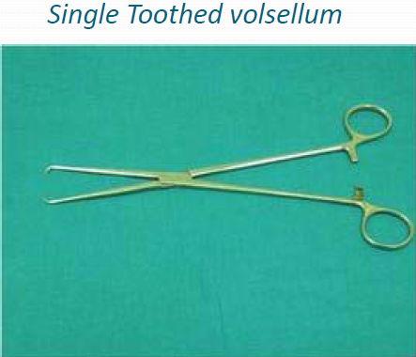

Slide 26

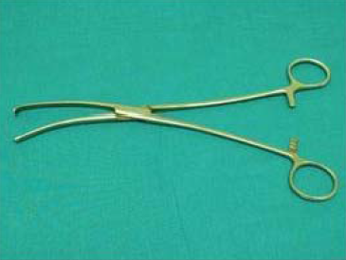

Slide 27

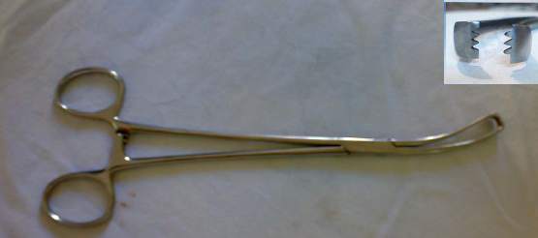

Slide 28
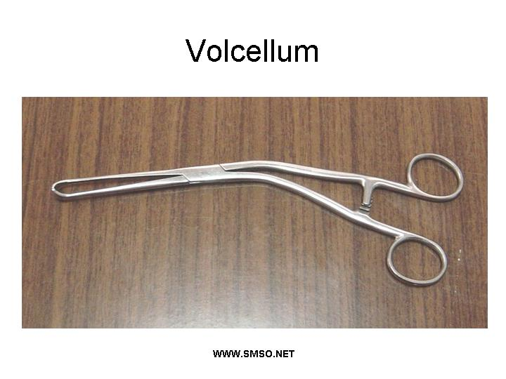

Slide 29
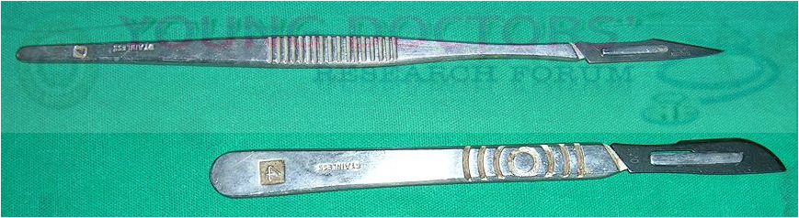
surgical blades/ scalpel

Slide 30
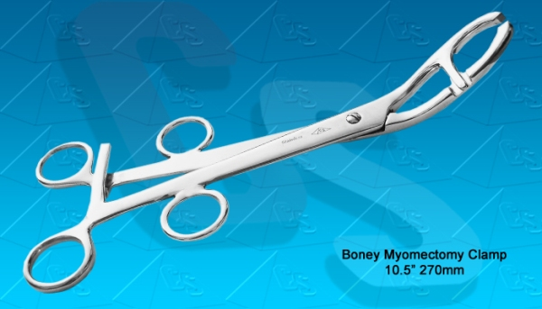
Bonney's myomectomy clamp

Slide 31
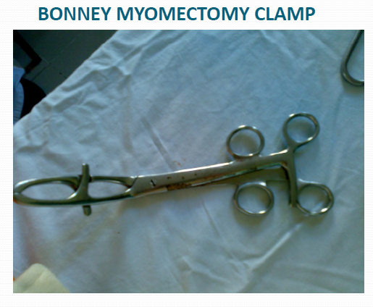

Slide 32
BONNEY MYOMECTOMY CLAMP
It is applied on the lower part of the uterus just above the cervix to compress the uterine arteries to minimize blood loss during abdominal myomectomy.
The blades may cause crushing of the uterine wall.
Instead a rubber catheter is preferred because it is less traumatic and both uterine and ovarian arteries are occlude

Slide 33
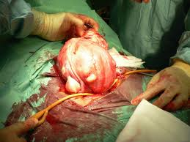

Slide 34
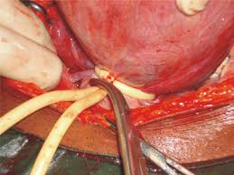

Slide 35
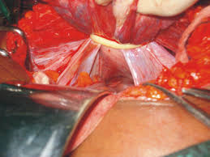

Slide 36
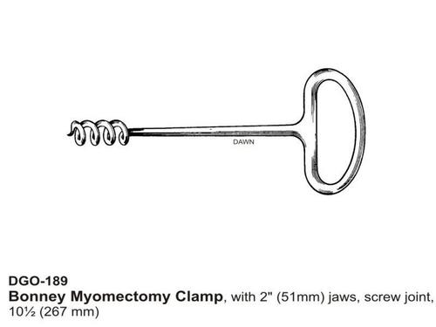

Slide 37
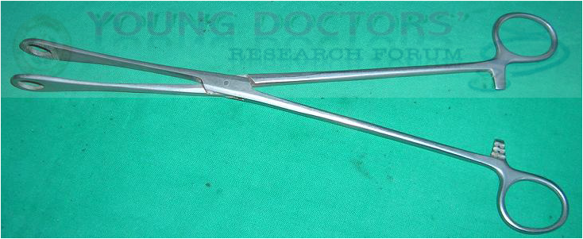
Sponge Holder / Sponge holding forceps
this is used for
holding sponge or a gauze piece for painting the area before operation.
for grasping the cervix in obstetrics in exploring cervix after forceps delivery ( three sponge holding forceps are used)

Slide 38
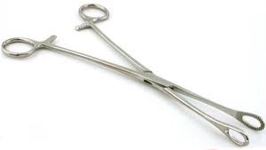

Slide 39
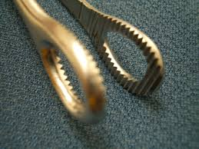
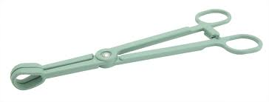

Slide 40
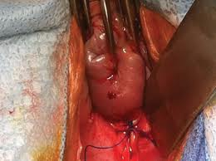

Slide 41
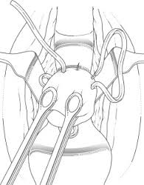

Slide 42
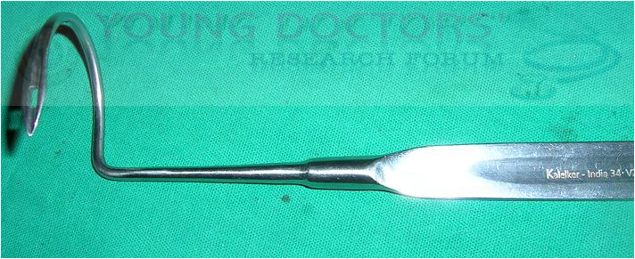
shirodkars cerclage needle
This is specially designed needle for putting stitch around the cervix.

Slide 43
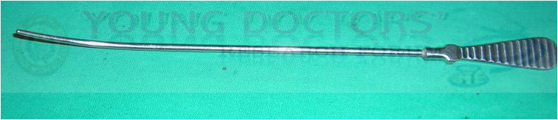
Bladder Sound
It is long instrument with
gentle curve ( not angled like uterine sound)
has no markings on it.

Slide 44
It is used to
define extension of bladder cystocele
vaginal hysterectomy.

Slide 45
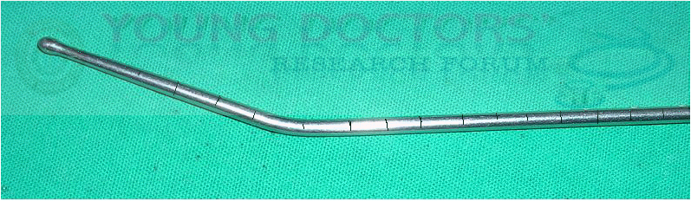
Uterine sound
Its a long instrument with blunt tip ( To avoid perforation) About 5 cms from the tip its bend to make angle of 30 degrees.
It has marking on it for measurements. ( Bladder sound has no markings )

Slide 46

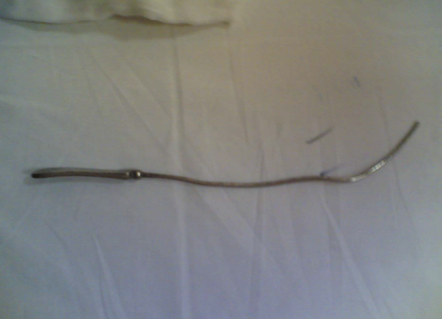

Slide 47
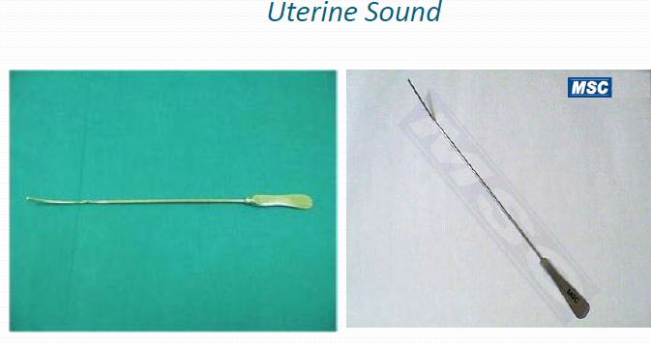

Slide 48
Uterine Sound
indicatlons
Diagnosis of cervical stenosis
it cannot be introduced through the cervical
(2) measure the length of the cervix by feeling resistance at the internal os.
This is of value in
diagnose supravaginal elongation in case of uterine prolapse
during Fothergill’s operation to estimate the length to be amputated

Slide 49
(3) diagnosis of incompetent cervix. When internal os is wide the sound rocks
freely inside it

Slide 50
4) measure the length of uterine cavity
This is done before dilatation of the cervix to avoide perforation of uterus
diagnose uterine hypoplasia

Slide 51
(5) to know the position and direction of uterus as in Retroversion

Slide 52
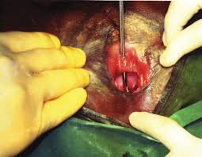
(6)Elicit the click sign in vesicovaginal fistula

Slide 53
Contraindications:
1. Genital infections
2. Suspicion of pregnancy
3. Soft uterus (malignancy, infection, molar pregnancy).

Slide 54
COMPLICATIONS
(1) Ascending infection
(2) Perforation of uterus
(3)Shock (Neurogenic shock) due to pain may occur in sensitive women
(4) Abortion may occur if introduced into a pregnant uterus
.

