Slide 1
Vaginal pessary for prolapse
د-زينب عبد الأمير

Slide 2
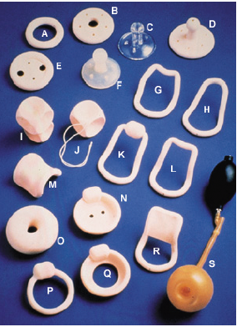

Slide 3
What is a vaginal pessary?
It is a removable device that fits into vagina to help support a pelvic
organ prolapse. It does this by adding support to the walls of the vagina.
It may ease the symptoms of prolapse but it will not cure the condition

Slide 4
the pessary put in at an outpatient clinic

Slide 5
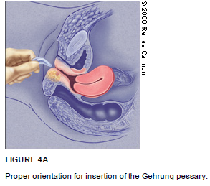

Slide 6
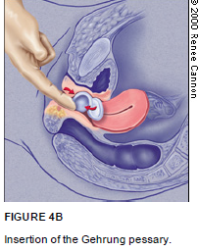

Slide 7
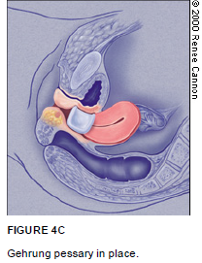

Slide 8
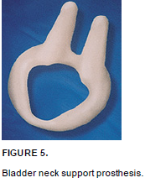

Slide 9
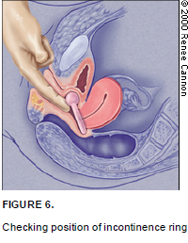

Slide 10
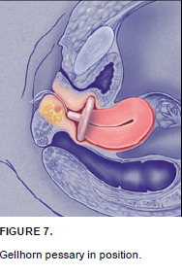

Slide 11

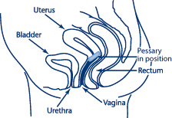
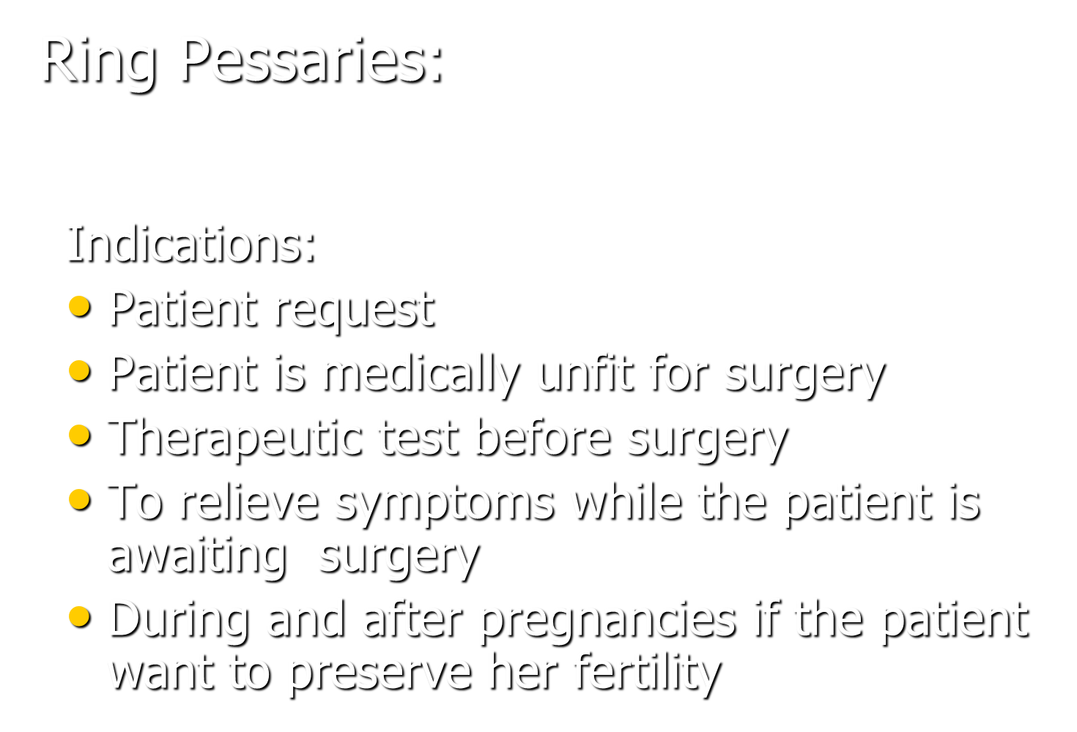

Slide 12
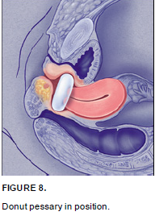

Slide 13
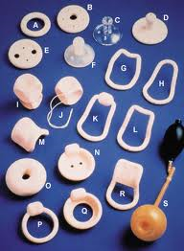
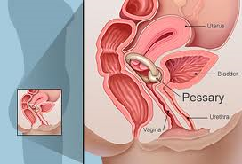
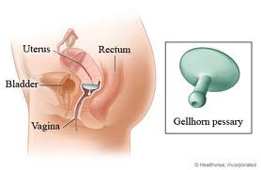
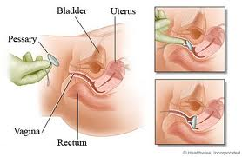

Slide 14
How to apply it in this lady:
Privacy
take permission
explination of the procedure
gloves
place her in the lithotomy position and examine her at rest
apply lubricant
squeeze & introduce it & fix it against bony element
Begin by inserting your middle finger behind the cervix in the posterior fornix and placing your index finger against the pubic notch
If the ring does not fit properly, try a smaller or larger size

Slide 15
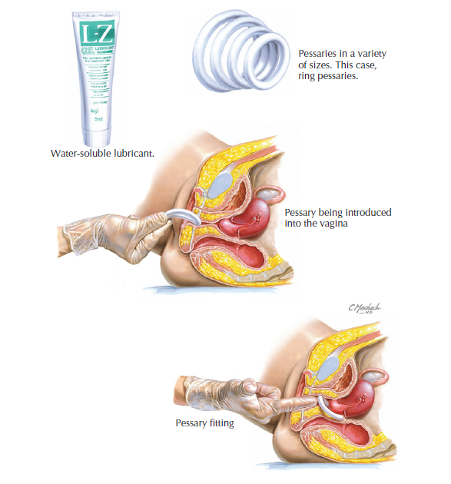

Slide 16
Postmenopausal women require 2 to 3 months of topical estrogen applied 2 or 3 times weekly before a pessary is fitted in order to be fitted comfortably.

Slide 17
Possible complications from wearing a pessary include
vaginal infection
Erosions
discharge
Odour
Pain
bleeding
Open sores in the vaginal wall.
Bleeding.
(fistula): wearing away of the vaginal wall. In severe cases, an opening can form between the vagina and the rectum

Slide 18
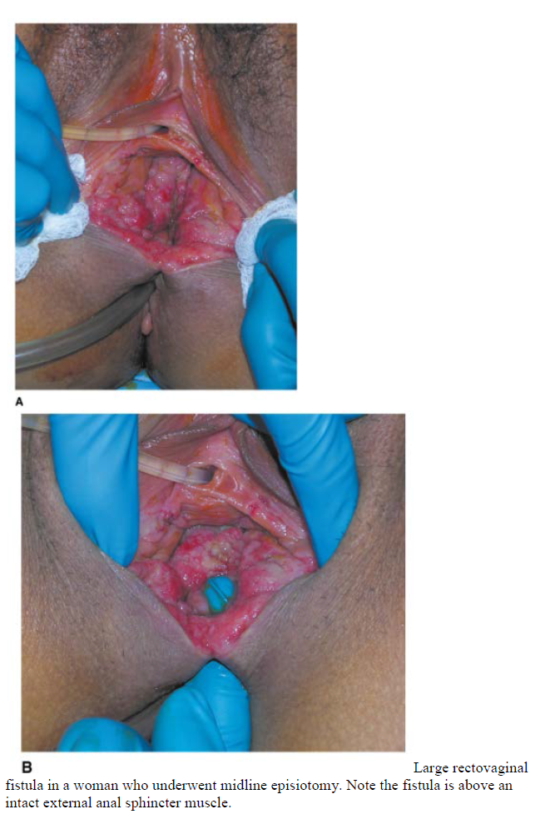

Slide 19
The average pessary size is 4 or 5, the range being from 2 to 7.
The patient should then spend about an hour walking around and trying to void. When she returns, remove the fitting ring and select the appropriate pessary.

Slide 20
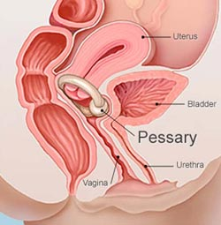
Maintenance
Pessaries can be removed daily, weekly, or monthly, at patients’ discretion, for washing with regular soap and water.
Ring pessaries can be removed or left in place for intercourse.
to remove, wash, and re-insert them every 3 to 6 months. To prevent infections and odours, an acidifier (usually supplied with the pessary) or estrogen must be applied vaginally 2 or 3 times weekly. Oral or transdermal estrogen or an estradiol-17 ring (placed behind the pessary) are also options.

Slide 21
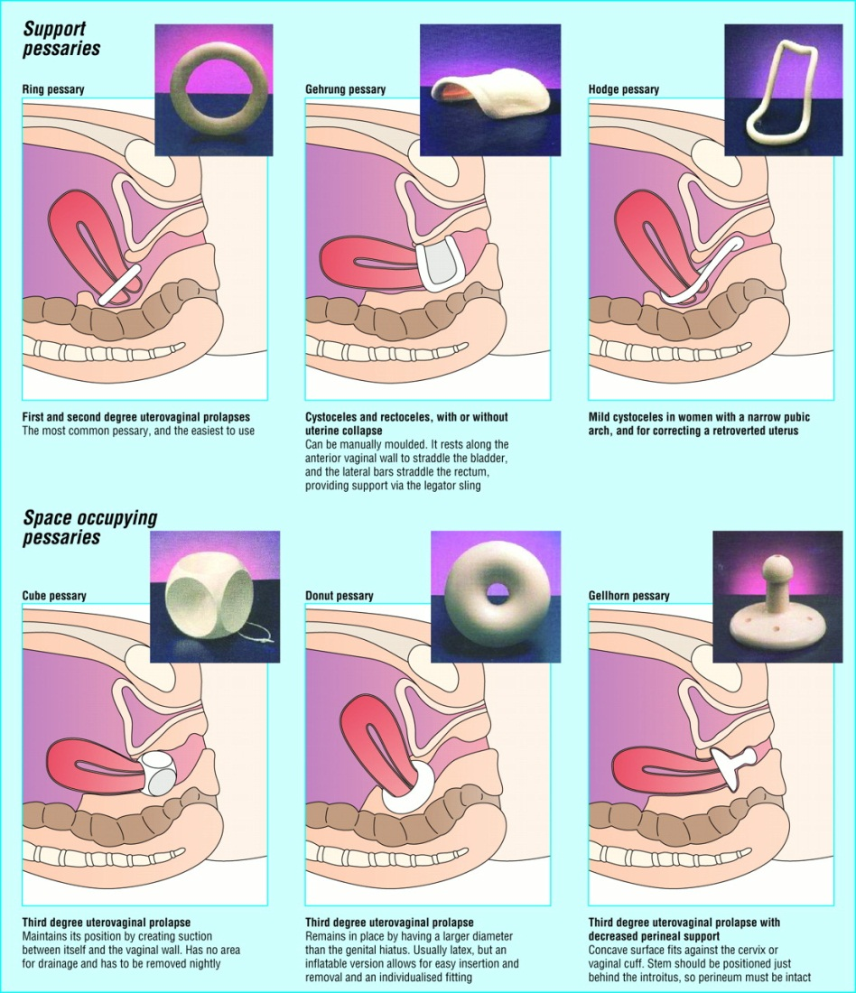
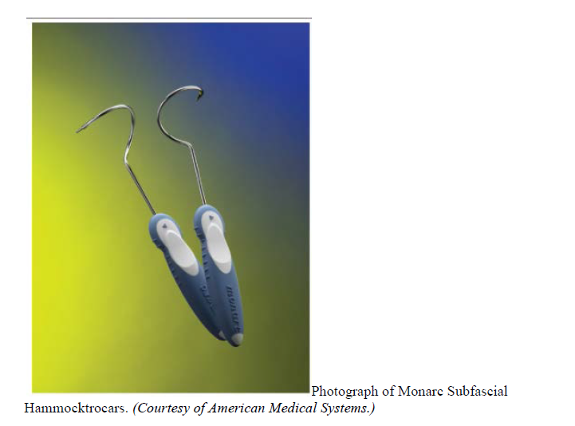

Slide 22
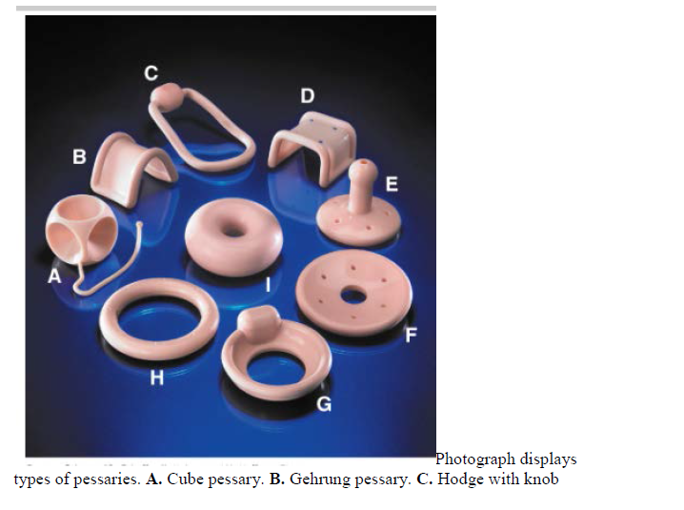

Slide 23
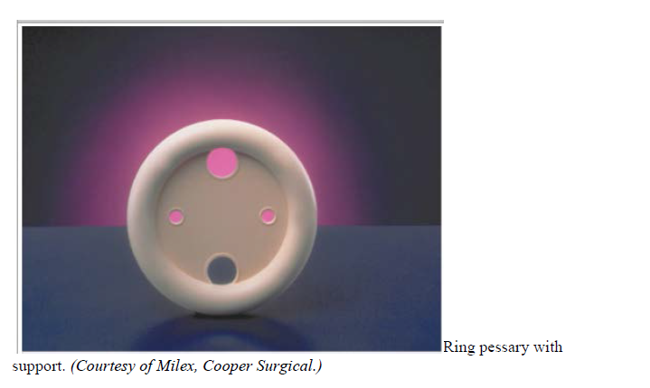

Slide 24
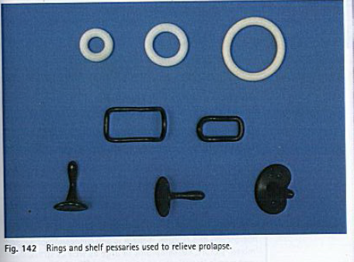

Slide 25
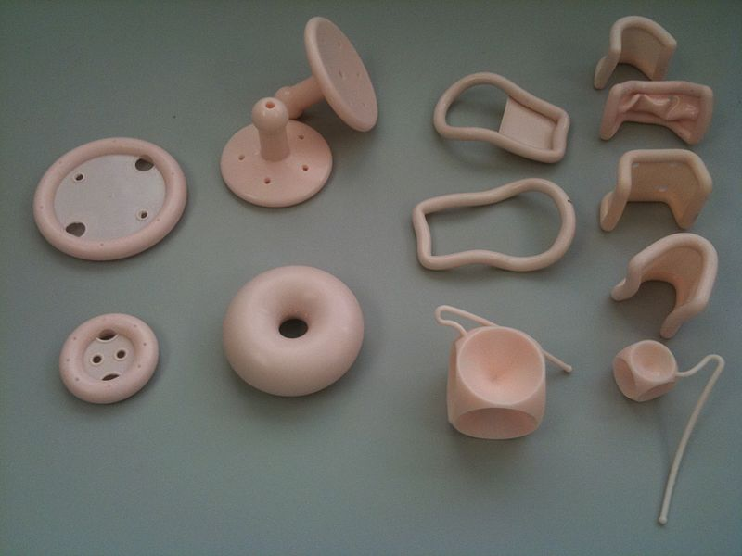
PESSARIES (ALTERNATIVE TO SURGERY)

Slide 26
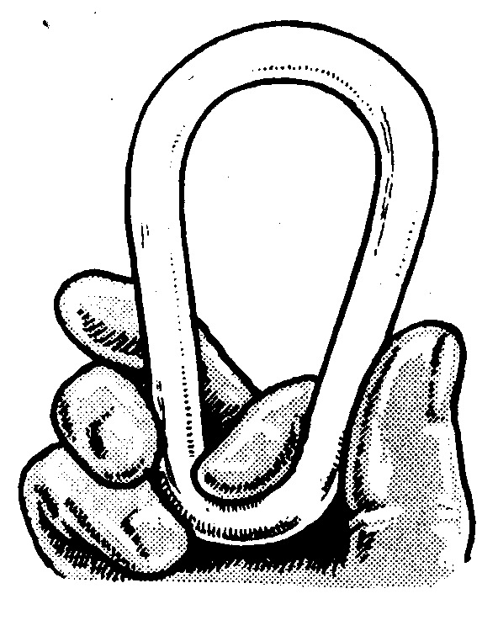

Slide 27
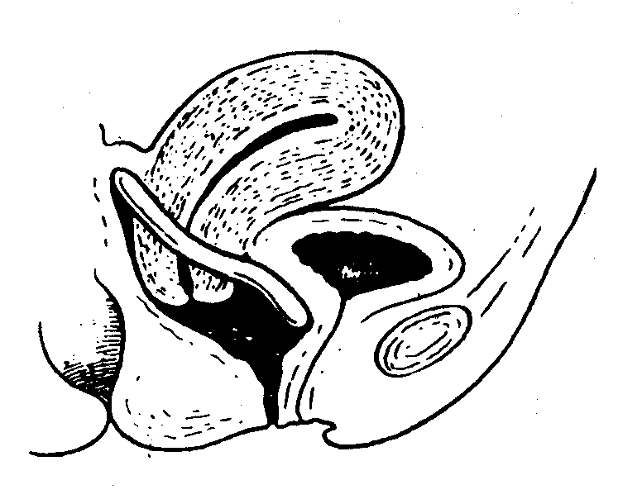

Slide 28
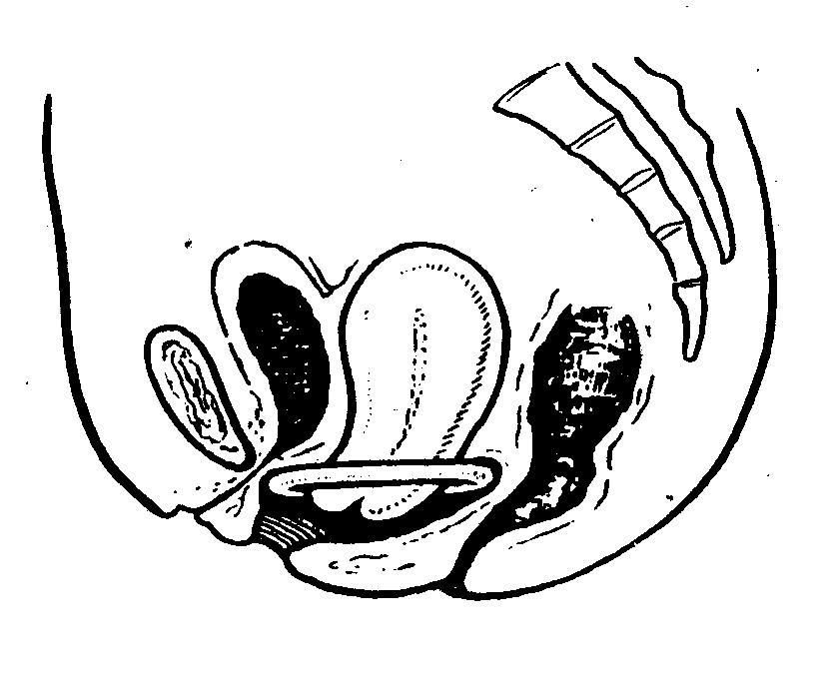

Slide 29
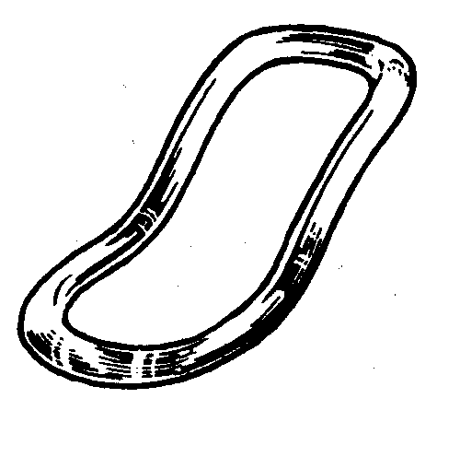

Slide 30
Precautions during wearing a pessary:
The patient is instructed to have a daily vaginal douche
every month the pessary is removed, cleaned
If the pessary is made of rubber it should be changed every three months.
All patients wearing pessaries should be examined by health care professionals every 3 to 6 months to check for vaginal erosions or ulcers
If lesions are found, pessaries should be removed until the lesions have healed, and affected areas should be treated with topical estrogen.

Slide 31
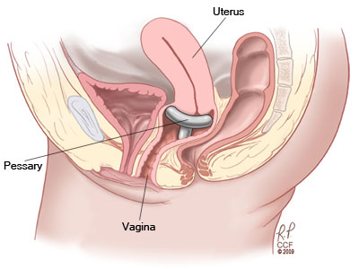

Slide 32
How often do I need to change my pessary?
If you have a ring or gellhorn pessary fitted, your pessary is changed every
four – six months

