Slide 1
المحاضرة الاولى الانزيمات

Slide 2
Enzymes
Enzyme Definition.
Important characteristics of enzyme.
Some Types of Enzymes & Substrates.
Enzymes naming.
Enzyme Terminology.
Factors Affect The Enzyme Activity.
Enzymes are important in clinical diagnosis.
Enzyme classes.
Types Of Enzymes
Enzymes kinetics and mechanism of action
The Michaels- Mentone equation
Factors affecting enzymatic reactions
Enzymes inhibition
Types of inhibitors
Enzymes specificity
Control of metabolic pathways
Enzymes inhibition
Enzymes in clinical diagnosis
Enzymes and genetic diseases

Slide 3
Enzymes
Enzyme Definition

Slide 4
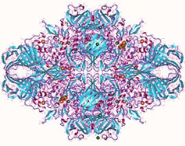
المحاضرة الاولى \ الكيمياء الطبية
Enzymes
Enzyme:
In all living organisms the biochemical reactions are necessary for obtaining energy, growth, and repairing damaged tissues. These reactions are called ‘metabolism’ happen all the time, but if they stop working, this leads to death. The reactions of living organisms require high activation energy to take place. So to reduce the cell’s consumption of energy, there is a catalyst to induce the chemical reactions occur rapidly, and reduce the activation energy. This catalyst called the enzymes.
Table (1): Examples of specific enzymes (Enzymes specificity).
 | enzymes | Source | Structures
1 | Acetyl cholinesterase | breaks down the neurotransmitter acetylcholine in nerves and muscles.
3 | DNA polymerase | synthesize DNA from deoxyribonucleotides
2 | Lactase | found in the small intestine, breaks lactose, the sugar in milk, into glucose and galactose.
 | Trypsin | - found in the small intestine, breaks proteins down into amino acids.

Slide 5
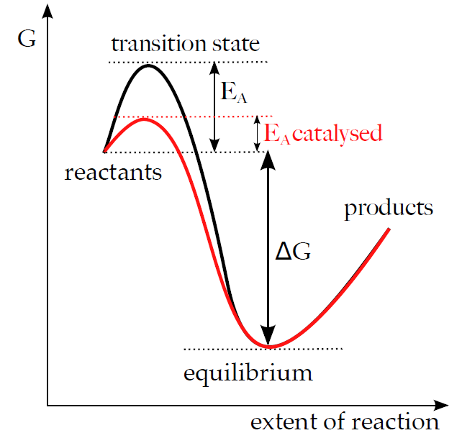
Enzymes are proteins catalysts, that increase the biochemical reactions rate, it lowers the activation energy figure (1), and they are not consumed during the reaction but may undergo physical changes.
Enzymes
activation energy
Enzymes naming:
Enzymes often are known by common names obtained by the suffix “-ase” to the name of substrate or to the reaction they catalyze, Table (1) indicate some enzyme examples.
Table (1):- Enzyme Examples
Enzyme | Role
Amylase | A family of enzymes which assist in the breakdown of carbohydrates.
Glucose oxidase | Is an enzyme catalyze the oxidation of Glucose.
Lipases | A family of enzymes which breakdown Lipids.
Proteases | Digestive enzymes which act on proteins in the digestive system.

Slide 6
Enzyme Terminology:
1-Catalyst or Enzyme ( E ):- A substance that increase the rate of the reaction without being changed the overall process (reaction).
2-Substrates ( S ):- The materials that enzymes act upon.
3-Active site (catalytic site):-
Enzymes have a specific areas (special pocket) on an enzyme where a substrate binds and catalysis takes place. This is called Active site formed by folding of the protein contains amino acid side chains which bind Substrate and form Enzyme-Substrate complex (ES). This binding thought to cause a conformational change in the enzyme to allows catalysis. (ES) complex is then converted to Enzyme and Product (P) as below:
The enzymes are usually highly specific binding for their substrates:-
a-Many enzymes recognized only single compound as a substrate Figure(2).
E + S → ES → E + P
Figure(2): Active site of Enzyme & General enzymatic reaction for one
enzyme and substrate. E = Enzyme, S = Substrate, and
ES = Enzyme- Substrate complex.
Enzymes
Figure(2): Active site of Enzyme
Active site of Enzyme
← amino acids side chain

Slide 7
Enzymes
b-Some enzymes like those involved in digestion are less specific have more than one substrate Figure(4).
E + S₁ + S₂ → E S₁ S₂ → E + P
Figure(3): Active site of Enzyme & General enzymatic reaction for
one enzyme and two substrate. E = Enzyme, S₁ = Substrate ₁,
S₂ = Substrate ₂, and ES = Enzyme-Substrate complex.
5-Coenzymes: are a helper molecule for a biochemical reaction (coenzymes bind loosely). Coenzymes are small, nonproteinaceous molecules that provide a transfer site to form an intermediate bind enzyme loosely, and carriers of an atom or group of atoms, allowing a reaction to occur. Coenzymes are not considered part of an enzyme's structure.
Coenzyme Examples TABLE(2) :
The B vitamins serve as coenzymes essential for enzymes to form fats, carbohydrates and proteins.
TABLE(2) of some enzymes which indicate the effect of coenzyme on an enzyme activity.
Effect on enzyme activity | Vitamin | Hepatic transaminase Enzymes
→ Active Enzyme | → B6 | GOT
→ Active Enzyme | → B6 | GPT
Loss of enzyme activity. | No vitamin B6 | (GOT, GPT)

Slide 8
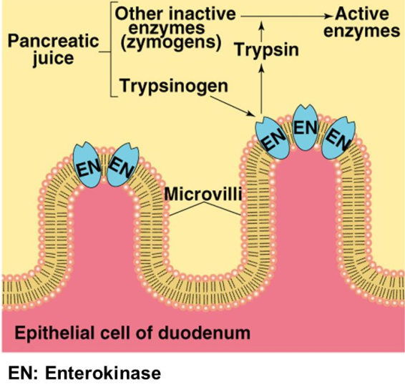
Enzymes
4- Isoenzymes:-
Some of the enzymes are present in more than one form having the same molecular weight and differ in conformational structures called isoenzymes. Trypsinogen isoenzymes are present in three conformational structures:-
1- cationic Trypsinogen.
2- anionic Trypsinogen.
3- mesotrypsinogen.
These conformational structures of isoenzymes are capable of digesting the cell and causing significant damage. But there are mechanisms to prevent these enzymes from potentially digesting the pancreas including:
The storage and packing in acidic media to inhibit enzyme activity synthesis, and storage as inactive precursor forms.
Some of the enzymes that are stored in the pancreas before secretion as inactive precursor forms, then activated when they enter the duodenum. Activation takes place in the surface of the duodenal lumen, microvilli where Enterokinase, activates Trypsinogen by removing (by hydrolysis) an N-terminal hexapeptide fragment of the molecule (Val–Asp–Asp–Asp–Asp–Lys). To the active form, Trypsin Figure (4), then catalyzes the activation of the other inactive enzymes for digestion.
Of note, many key digestive enzymes, such as α-amylase and lipase, are present in the pancreas in their active forms. Presumably, these enzymes would not cause pancreatic cellular damage if released into the pancreatic cell / tissue because there is no starch, glycogen or triglyceride substrate for these enzymes in pancreatic tissue.

Slide 9
Enzymes
5- Prosthetic groups (organic compounds) are enzyme partner molecules, that bind tightly or covalently to the enzyme (remember, coenzymes bind loosely). It help proteins to bind other molecules, act as structural elements, and act as charge carriers.
An example of a prosthetic group is heme in hemoglobin. The iron (Fe) found at the center of the heme prosthetic group allows it to bind and release oxygen in the lung and tissues, respectively. Figure (5):
Figure (5):
Enzymes are important in clinical diagnosis:-
Enzymes are present in different cellular materials or tissues, in each the cell enzymes are attached to the cell walls, and membranes. Then dissolve in the cytoplasm, or sequestered in the nucleus, and other sub cellular organelles including mitochondria, lysosomes, and microsomes.
From this any change in enzyme activity indicate a specific disease state or reflected tissue damage in a certain organ
Formation of blood clots within the vessels. Ischemic necrosis leads to infarction (death of surrounding tissue). When cells of the myocardium die as a result of severe ischemia, the lesion is known as a myocardial infarct.
The amounts of enzymes released depend on the degree of cellular damage, the intracellular concentrations of the enzymes, and the mass of affected tissue. The subcellular source of the enzymes released reflects the severity and the nature of the damage. Mild inflammatory conditions are likely to release cytoplasmic enzymes, whereas necrotic conditions also yield mitochondrial enzymes. Thus, in severe liver damage (e.g., hepatitis), the serum aspartate aminotransferase (AST) level is extremely high in serum.
The normal range is affected by a variety of factors: age; sex; race; degree of obesity; pregnancy; alcohol or other drug consumption; and malnutrition. Drugs can alter enzyme levels in vivo and interfere with their measurement in vitro.
hemoglobin structure
Human Hemoglobin α chain β chain & O2 .

Slide 10
المحاضرة الثانية انزيمات 21-4-2019

Slide 11
Enzyme classes :
Your body contains around 3,000 unique enzymes, and are classified into six categories: Oxidoreductases, transferases, hydrolases, Lyases, ligases, and Isomerases. As in table (3).
Table (3): Enzyme classes.
Factors Affecting The Enzyme Activity
1-Enzyme concentration
2- substrate concentration
3- Product concentration
4-Tempreture
5- pH
6- UV light & Radiation
7- Activators
8-Inhibitors
9- Anti enzymes
10- Time
Class | Enzyme Function
Oxidoredo-reductases | Catalyze oxidation-reduction reactions Glucose Dehydrogenase, oxidizes Glucose to ATP in animals.
Transferases | Catalyze the transfer of functional groups among molecules, Transaminase Kinases.
Hydrolases | Add water across a bond, Lipases.
Lyases | Catalyze a formation of double bonds (or a ring structure), Decarboxylases.
Ligases | Catalyze bond formation, Citric acid synthetase.
Isomerases | Catalyze isomerization (changing of a molecule into its isomer), Phospho hexo isomerase: glucose-6-phosphate ↔ fructose-6-phosphate.

Slide 12
Factors Affecting The Enzyme Activity:
1-Enzyme concentration:
If the concentration of the enzyme is increased, the velocity of the reaction proportionately increases, in clinical application determination of enzyme concentration & for diagnosis of inborn error in metabolism.
as bellow. Figure(6).
2- The substrate concentration:
the rate of enzymatic reaction increases as the substrate concentration increases until a limiting rate is reached, after which further increase in the substrate concentration produces no significant change in the reaction rate. At this point, all of the enzyme active sites have saturated with substrate, Figure(7).
3- Product concentration:
With increase in product concentration the velocity rate decrease causing feed-back inhibition of enzyme.
enzyme concentration X2
Product concentration
enzyme concentration X1
No enzyme
Time
Figure(6): The effect of increasing the enzyme concentration upon the reaction. X1,X2 are increasing concentration.
The reaction rate.
The reaction rate.
Substrate concentration.
The enzyme concentration.
Figure(7): The effect of substrate concentration on Enzyme action.

Slide 13
4-The effect of Temperature on Enzyme activity: Each enzyme has a temperature that it works optimally in, which in humans is around 37⁰ the normal body temperature for humans. Temperature is speed up all reactions. Figure(8) indicate enzyme activity stops completely at 0C°, but if the temperature rises again, then the enzyme gets reactivated once more, besides If the temperature gets too hot, the enzyme denatures.
Figure(8): The effect of Temperature on
Enzyme action.
5-The effect of pH (H⁺ concentration) on Enzyme action:
substances that contain acidic carboxylic groups (COOH–) and basic amino groups (NH₂). So, the enzymes are affected by changing the pH value. Each enzyme has a pH value that it works at with maximum efficiency called the optimal pH. If the pH is lower or higher than the optimal pH, the enzyme activity decreases until it stops working. Pepsin works at a low pH, it is highly acidic, while trypsin works at a high pH, it is basic. Most enzymes work at neutral pH 7.4, Fig(9).
6-UV light & Radiation:
Radiation of high energy rays [X-ray] activate peroxides to react with enzyme producing oxidized enzyme but losing of enzyme activity.
In turn this cause loss of gene expression.
Enzyme activity
Trypsin
Enzyme activity
Pepsin
Enzyme pH (H⁺ concentration)
Fig(9): The effect of pH (H⁺ concentration) on Enzyme action.

Slide 14
7-The Effect Of Activators and Inhibitors on Enzyme activity
Effects of Activators on Enzyme Activity:
Enzyme activators are molecules that bind to enzymes and increase their activity.
A cofactor: is a non-protein chemical compound or metallic ion (Ca⁺², Fe⁺², Mg ⁺²,Mn ⁺², Zn ⁺², and K⁺), that must bind to particular enzymes before a reaction occurs, Cofactors can be sub classified as either inorganic ions binding cofactors, or complex organic molecules(prosthetic group) binding cofactors called coenzymes. Cofactors can be considered "helper molecules" that assist in biochemical transformations.
Effects of Inhibitors on Enzyme Activity:
An enzyme inhibitor is a molecule, which bind to enzyme, & decreases their activity during biochemical reaction. Drug products are most manufactured with enzyme inhibitors by blocking an enzyme’s activity known as pathogen or correct a metabolic imbalance. Enzyme Inhibitors may act combining directly with the enzyme and so effectively remove it from the substrate (like Drugs), the optimum temperature for most human enzymes start between 35⁰C and 40⁰C. Human enzymes start to denature above 40⁰C and stop its catalytic activity.
Enzyme inhibition can be categorized in three types:
1-Competative Inhibitor.
2-Un Competative(Reversbile) Inhibitor.
3-No Competative (Irreversbile) Inhibitor.
Some enzymes containing or requiring metal ions as
Fe⁺² or Fe⁺ᵌ : Peroxidase
Zn⁺² : Alcohol dehydrogenase.
Table 4:-metal ions as cofactors.

Slide 15
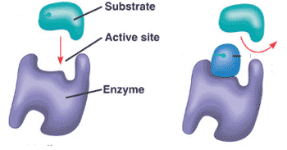
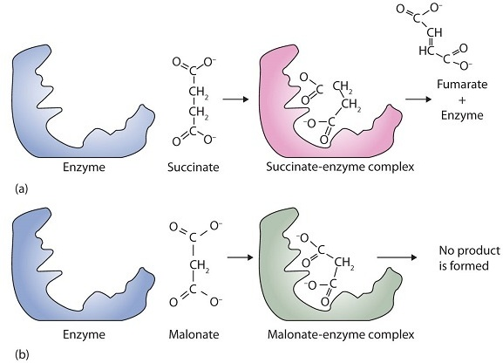
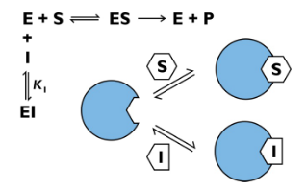
The Effect Of Activators and Inhibitors on Enzyme activity
Effects of Inhibitors on Enzyme Activity:
An enzyme inhibitor is a molecule which bind to enzyme, & decreases their activity during biochemical reaction as in fig-11 below:-
Enzyme inhibition can be categorized in three types:
1-Competative Inhibitor:
Substances [I] that compete with the substrate [S] for the same active site of enzyme molecule and form new enzyme- substrate complex [ES]. Malonate and succinate are the anions of dicarboxylic acids and contain three and four carbon atoms, respectively. The malonate molecule binds to the active site because the spacing of its carboxyl groups is not greatly different from that of succinate. However, no catalytic reaction occurs because malonate does not have a CH₂CH₂ group to convert to CH=CH. This reaction will also be discussed in connection with the Krebs cycle, and energy production.
inhibitor
fig-11
Fig. (12)Competitive Inhibition. (a) Succinate binds to the enzyme succinate dehydrogenase.
A dehydrogenation reaction occurs, and the product— fumarate —is released from the enzyme. (b) Malonate also binds to the active site of succinate dehydrogenase. In this case, however, no subsequent reaction occurs while malonate remains bound to the enzyme.
Competitive inhibition

Slide 16
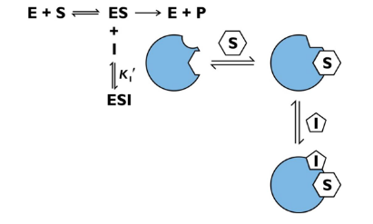
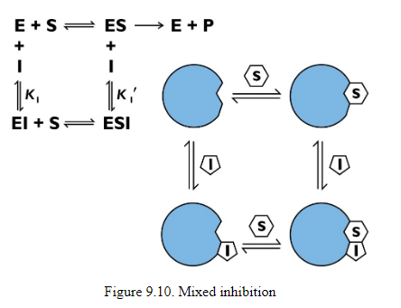
2-Uncompetitive inhibition:
Decrease enzyme activity and full activity return when inhibitor [I] is removed.
3-No - competitive Irreversible Inhibitor:
An irreversible inhibitor inactivates an enzyme by bonding covalently to a particular group at the active site. The inhibitor-enzyme bond is so strong that the inhibition cannot be reversed, by the addition of excess substrate. The nerve gases, especially Diisopropyl Fluorophosphate (DIFP), irreversibly inhibit biological systems by forming an enzyme-inhibitor complex with a specific OH group of serine situated at the active sites of certain enzymes. The peptidase enzymes trypsin, and chymotrypsin contain serine groups at the active site, and are inhibited by DIFP (Glaucoma Drug).
Uncompetitive inhibition
serine DIFP serine-DIFP complex nerve gas
No - competitive inhibition

Slide 17
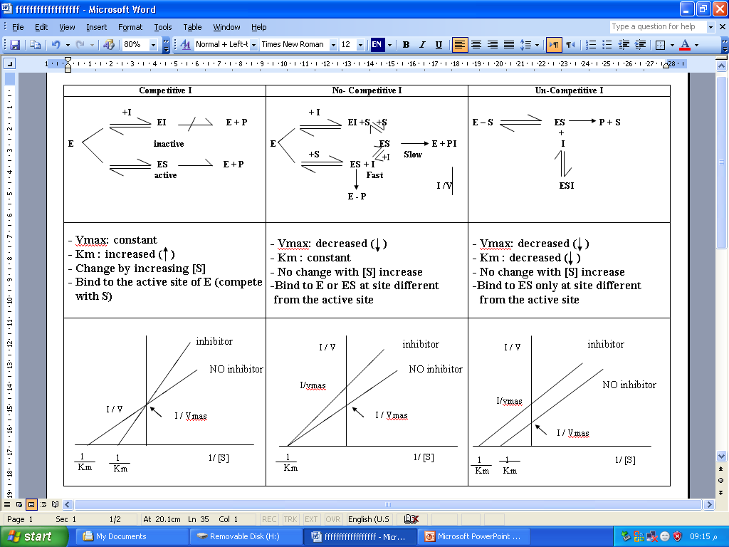
Table (4): Enzyme Inhibitors.

