Slide 1

المحاضرة الاولى الانزيمات

Slide 2
Enzymes
Enzyme Definition.
Important characteristics of enzyme.
Some Types of Enzymes & Substrates.
Enzymes naming.
Enzyme Terminology.
Factors Affect The Enzyme Activity.
Enzymes are important in clinical diagnosis.
Enzyme classes.
Types Of Enzymes
Enzymes kinetics and mechanism of action
The Michaels- Mentone equation
Factors affecting enzymatic reactions
Enzymes inhibition
Types of inhibitors
Enzymes specificity
Control of metabolic pathways
Enzymes inhibition
Enzymes in clinical diagnosis
Enzymes and genetic diseases

Slide 3
Enzymes
Enzyme Definition

Slide 4





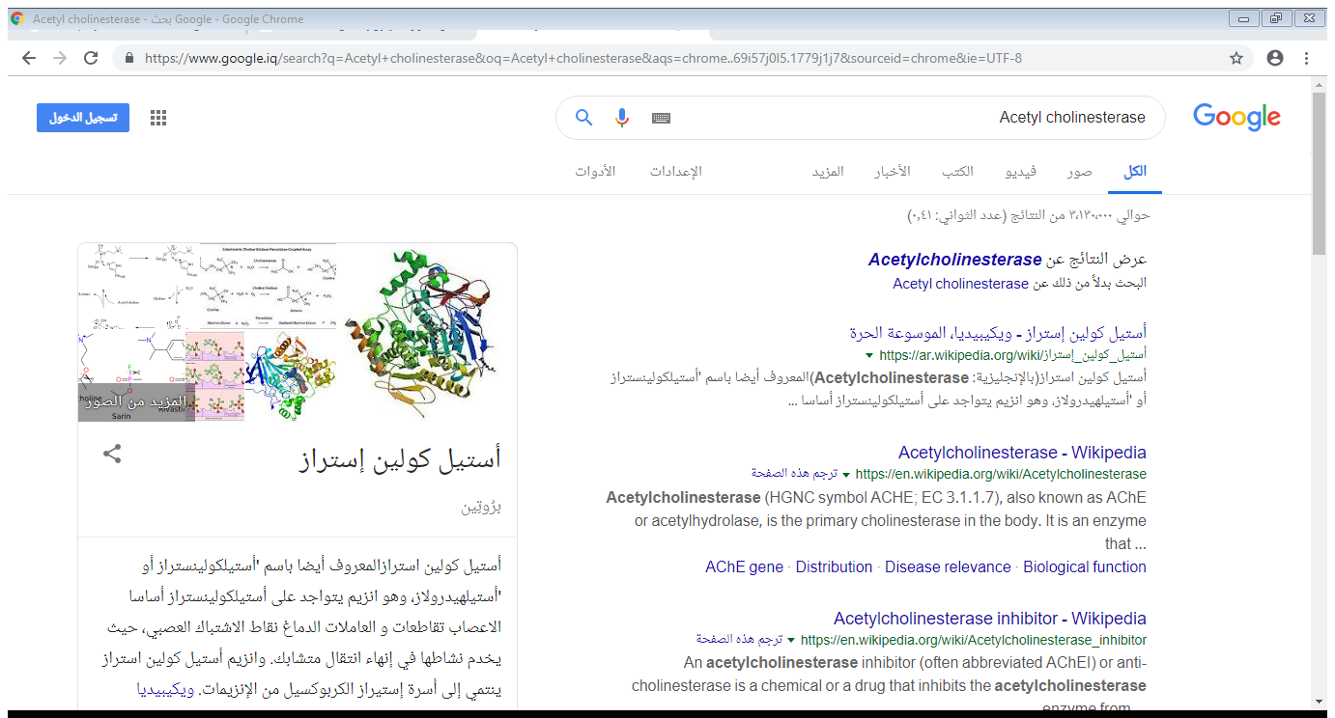
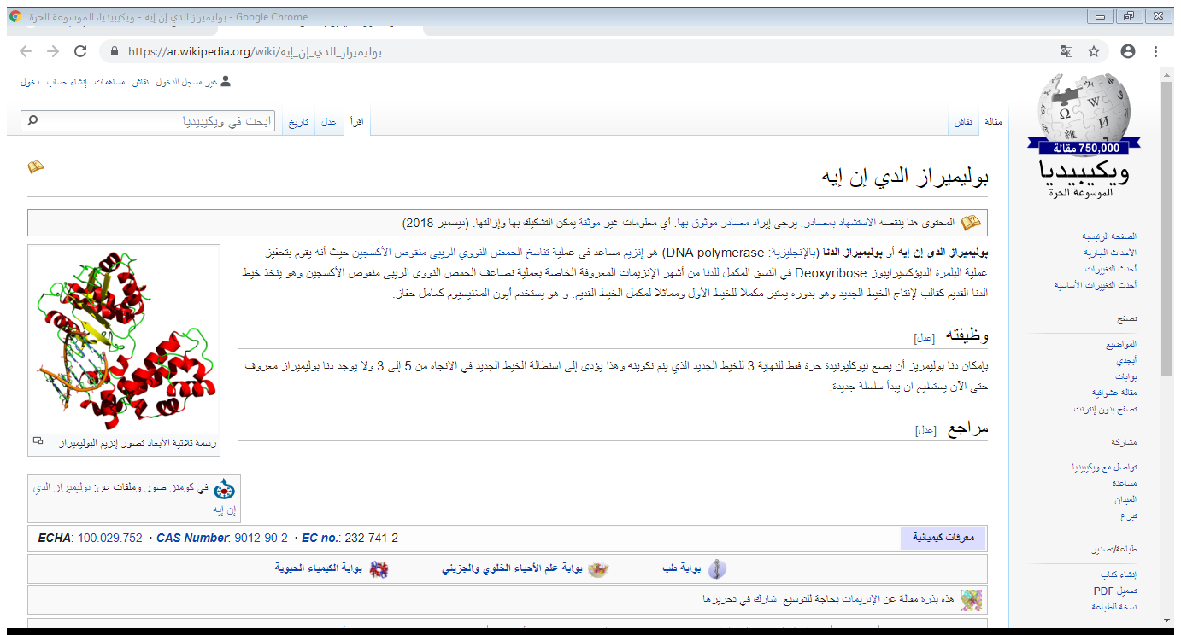
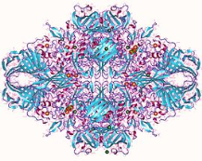
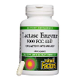
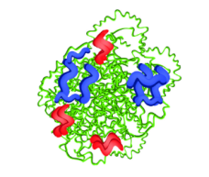
المحاضرة الاولى \ الكيمياء الطبية
Enzymes
Enzyme:
In all living organisms the biochemical reactions are necessary for obtaining energy, growth, and repairing damaged tissues. These reactions are called ‘metabolism’ happen all the time, but if they stop working, this leads to death. The reactions of living organisms require high activation energy to take place. So to reduce the cell’s consumption of energy, there is a catalyst to induce the chemical reactions occur rapidly, and reduce the activation energy. This catalyst called the enzymes.
Table (1): Examples of specific enzymes (Enzymes specificity).
 | enzymes | Source | Structures
1 | Acetyl cholinesterase | breaks down the neurotransmitter acetylcholine in nerves and muscles.
3 | DNA polymerase | synthesize DNA from deoxyribonucleotides
2 | Lactase | found in the small intestine, breaks lactose, the sugar in milk, into glucose and galactose.
 | Trypsin | - found in the small intestine, breaks proteins down into amino acids.

Slide 5
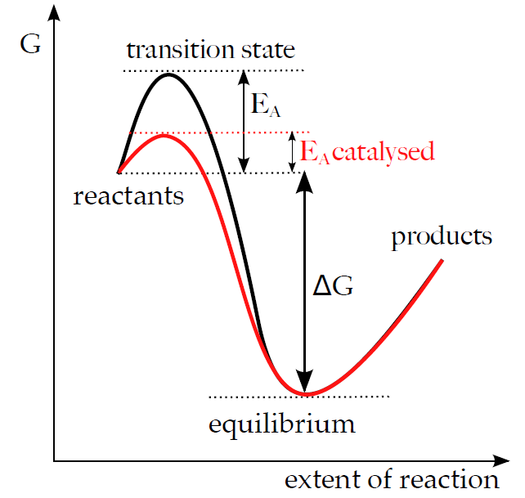
Enzymes are proteins catalysts, that increase the biochemical reactions rate, it lowers the activation energy figure (1), and they are not consumed during the reaction, but may undergo physical changes.
Enzymes
activation energy
Enzymes naming:
Enzymes often are known by common names obtained by the suffix “-ase” to the name of substrate or to the reaction they catalyze, Table (1) indicate some enzyme examples.
Table (1):- Enzyme Examples
Enzyme | Role
Amylase | A family of enzymes which assist in the breakdown of carbohydrates.
Glucose oxidase | Is an enzyme catalyze the oxidation of Glucose.
Lipases | A family of enzymes which breakdown Lipids.
Proteases | Digestive enzymes which act on proteins in the digestive system.

Slide 6
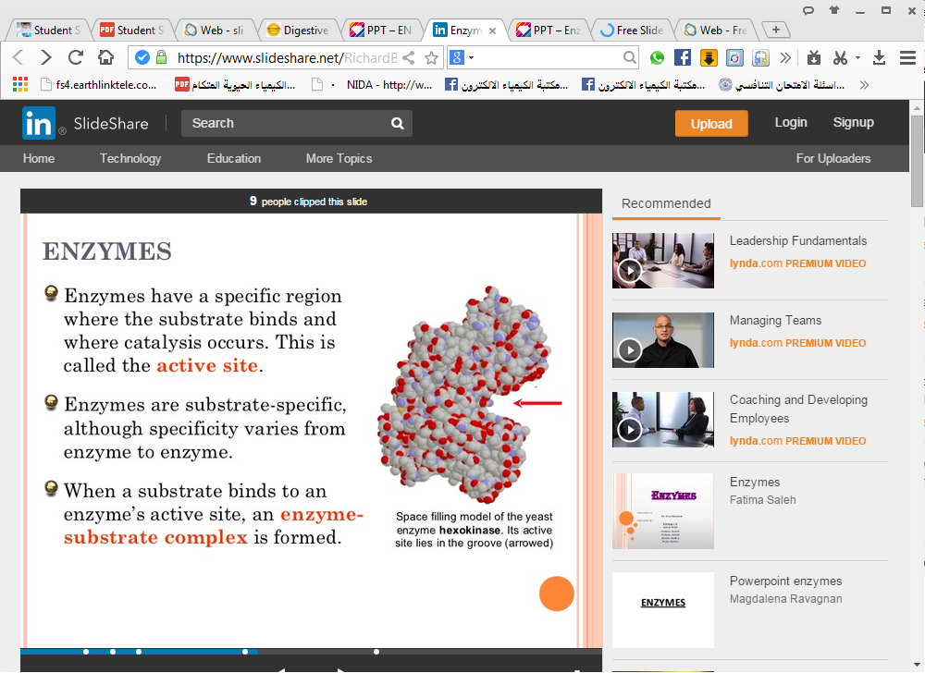
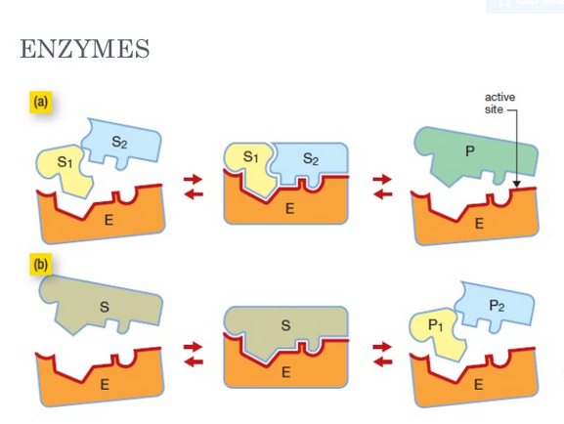
Enzyme Terminology:
1-Catalyst or Enzyme ( E ):- A substance that increase the rate of the reaction without being changed the overall process (reaction).
2-Substrates ( S ):- The materials that enzymes act upon.
3-Active site (catalytic site):-
Enzymes have a specific areas (special pocket) on an enzyme where a substrate binds and catalysis takes place. This is called Active site formed by folding of the protein contains amino acid side chains which bind Substrate and form Enzyme-Substrate complex (ES). This binding thought to cause a conformational change in the enzyme to allows catalysis. (ES) complex is then converted to Enzyme and Product (P) as below:
The enzymes are usually highly specific binding for their substrates:-
a-Many enzymes recognized only single compound as a substrate Figure(2).
E + S → ES → E + P
Figure(2): Active site of Enzyme & General enzymatic reaction for one
enzyme and substrate. E = Enzyme, S = Substrate, and
ES = Enzyme- Substrate complex.
Enzymes
Figure(2): Active site of Enzyme
Active site of Enzyme
← amino acids side chain

Slide 7
Enzymes
b-Some enzymes like those involved in digestion are less specific have more than one substrate Figure(4).
E + S₁ + S₂ → E S₁ S₂ → E + P
Figure(3): Active site of Enzyme & General enzymatic reaction for
one enzyme and two substrate. E = Enzyme, S₁ = Substrate ₁,
S₂ = Substrate ₂, and ES = Enzyme-Substrate complex.
5-Coenzymes: are a helper molecule for a biochemical reaction (coenzymes bind loosely). Coenzymes are small, nonproteinaceous molecules that provide a transfer site to form an intermediate bind enzyme loosely, and carriers of an atom or group of atoms, allowing a reaction to occur. Coenzymes are not considered part of an enzyme's structure.
Coenzyme Examples TABLE(2) :
The B vitamins serve as coenzymes essential for enzymes to form fats, carbohydrates and proteins.
TABLE(2) of some enzymes which indicate the effect of coenzyme on an enzyme activity.
Effect on enzyme activity | Vitamin | Hepatic transaminase Enzymes
→ Active Enzyme | → B6 | GOT
→ Active Enzyme | → B6 | GPT
Loss of enzyme activity. | No vitamin B6 | (GOT, GPT)

Slide 8
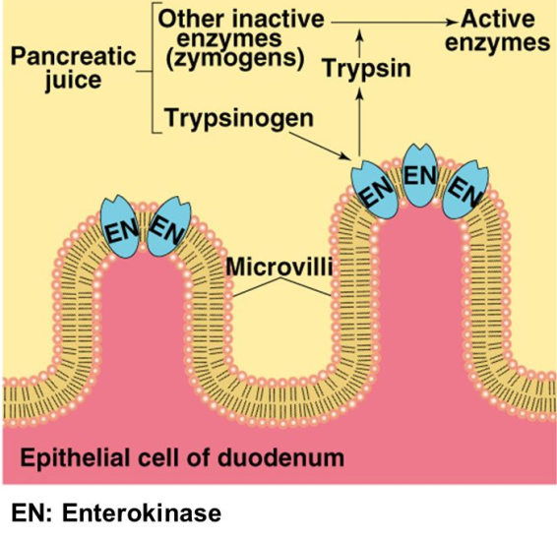
Enzymes
4- Isoenzymes:-
Some of the enzymes are present in more than one form having the same molecular weight and differ in conformational structures called isoenzymes. Trypsinogen isoenzymes are present in three conformational structures:-
1- cationic Trypsinogen.
2- anionic Trypsinogen.
3- mesotrypsinogen.
These conformational structures of isoenzymes are capable of digesting the cell and causing significant damage. But there are mechanisms to prevent these enzymes from potentially digesting the pancreas including:
The storage and packing in acidic media to inhibit enzyme activity synthesis, and storage as inactive precursor forms.
Some of the enzymes that are stored in the pancreas before secretion as inactive precursor forms, then activated when they enter the duodenum. Activation takes place in the surface of the duodenal lumen, microvilli where Enterokinase, activates Trypsinogen by removing (by hydrolysis) an N-terminal hexapeptide fragment of the molecule (Val–Asp–Asp–Asp–Asp–Lys). To the active form, Trypsin Figure (4), then catalyzes the activation of the other inactive enzymes for digestion.
Of note, many key digestive enzymes, such as α-amylase and lipase, are present in the pancreas in their active forms. Presumably, these enzymes would not cause pancreatic cellular damage if released into the pancreatic cell / tissue because there is no starch, glycogen or triglyceride substrate for these enzymes in pancreatic tissue.

Slide 9
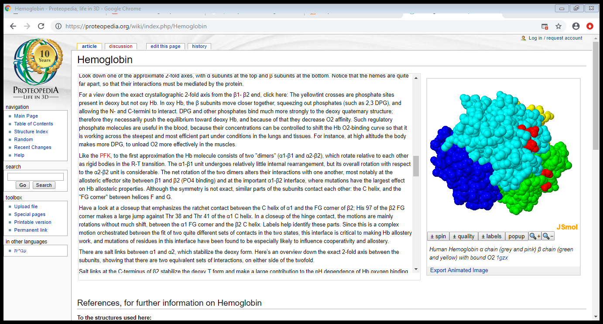
Enzymes
5- Prosthetic groups (organic compounds) are enzyme partner molecules, that bind tightly or covalently to the enzyme (remember, coenzymes bind loosely). It help proteins to bind other molecules, act as structural elements, and act as charge carriers.
An example of a prosthetic group is heme in hemoglobin. The iron (Fe) found at the center of the heme prosthetic group allows it to bind and release oxygen in the lung and tissues, respectively. Figure (5):
Figure (5):
Enzymes are important in clinical diagnosis:-
Enzymes are present in different cellular materials or tissues, in each the cell enzymes are attached to the cell walls, and membranes. Then dissolve in the cytoplasm, or sequestered in the nucleus, and other sub cellular organelles including mitochondria, lysosomes, and microsomes.
From this any change in enzyme activity indicate a specific disease state or reflected tissue damage in a certain organ
Formation of blood clots within the vessels. Ischemic necrosis leads to infarction (death of surrounding tissue). When cells of the myocardium die as a result of severe ischemia, the lesion is known as a myocardial infarct.
The amounts of enzymes released depend on the degree of cellular damage, the intracellular concentrations of the enzymes, and the mass of affected tissue. The subcellular source of the enzymes released reflects the severity and the nature of the damage. Mild inflammatory conditions are likely to release cytoplasmic enzymes, whereas necrotic conditions also yield mitochondrial enzymes. Thus, in severe liver damage (e.g., hepatitis), the serum aspartate aminotransferase (AST) level is extremely high in serum.
The normal range is affected by a variety of factors: age; sex; race; degree of obesity; pregnancy; alcohol or other drug consumption; and malnutrition. Drugs can alter enzyme levels in vivo and interfere with their measurement in vitro.
hemoglobin structure
Human Hemoglobin α chain β chain & O2 .

