Slide 1

Practical No.16
SALMONELLA & SHIGELLA

Slide 2
Salmonella is a genus of rod-shaped, Gram-negative, non-spore-forming, predominantly motile enterobacteria with diameters around 0.7 to 1.5 µm, lengths from 2 to 5 µm, and flagella which grade in all directions (i.e.peritrichous).
Salmonella is closely related to the Escherichia genus and are found worldwide in cold- and warm-blooded animals (including humans), and in the environment. They cause illnesses like typhoid fever, paratyphoid fever, and foodborne illness.

Slide 3
Salmonellae are often pathogenic for humans or animals when acquired by the oral route. They are transmitted from animals and animal products to humans, where they cause enteritis, systemic infection, and enteric fever.
Salmonella Typhi causes typhoid fever
S choleraesuis cause bacteremia
Salmonella Typhimurium causes enterocolitis

Slide 4
Genus: Salmonella
Clinically important serotypes
S.typhi &S. paratyphi
Enteric fever(typhoid) only in human but not part of normal flora
S.choleraesuis
Bacteremia & extraintestinal
S.typhimurium
Salmonellosis

Slide 5
Diagnostic Laboratory Tests:
A. SPECIMENS
Blood
Bone marrow
Stool

Slide 6
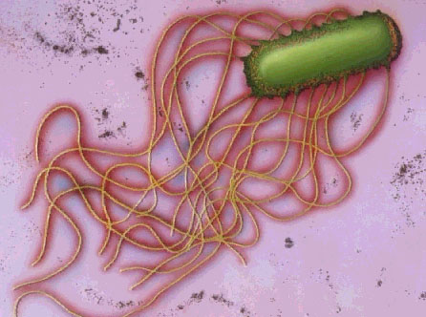
Laboratory diagnosis
Staining:
By Grams stain short bacilli or coccobacilli.

Slide 7
B. BACTERIOLOGIC METHODS FOR ISOLATION OF SALMONELLAE
1. Differential medium cultures— EMB, MacConkey's, or deoxycholate medium permits rapid detection of lactose nonfermenters. Bismuth sulfite medium permits rapid detection of salmonellae which form black colonies because of H2S production. Many salmonellae produce H2S.
2. Selective medium cultures— The specimen is plated on salmonella-shigella (SS) agar, Hektoen enteric agar, XLD, or deoxycholate-citrate agar, which favor growth of salmonellae and shigellae over other Enterobacteriaceae.

Slide 8
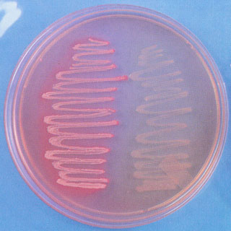
Laboratory diagnosis
Culture : at 37C for 24-48h. On differential & selective media.
MacConkey's agar non-lactose fermentor.

Slide 9
Laboratory diagnosis
Hektoen enteric (HE) agar.
Salmonella spp. on HE
(black precipitate)

Slide 10
3. Enrichment cultures— The specimen (usually stool) also is put into selenite F or tetrathionate broth, both of which inhibit replication of normal intestinal bacteria and permit multiplication of salmonellae. After incubation for 1–2 days, this is plated on differential and selective media.
4. Final identification— Suspect colonies from solid media are identified by biochemical reaction patterns and slide agglutination tests with specific sera.

Slide 11
C. BIOCHEMICAL TESTS
1- TSI agar (triple sugar iron) results are read as follow: Slant/ butt - or + gas , - or + H2S
Salmonella typhimurium alk /acid +gas, + H2S
Salmonella typhi alk /acid - gas, +H2S
The black color in the tube indicates the production of H2S.
2- IMViC TEST for salmonella is - + - +

Slide 12
D. SEROLOGIC METHODS
Serologic techniques are used to identify unknown cultures with known sera and may also be used to determine antibody titers in patients with unknown illness, although the latter is not very useful in diagnosis of salmonella infections.
1. Agglutination test— In this test, known sera and unknown culture are mixed on a slide. Clumping, when it occurs, can be observed within a few minutes. This test is particularly useful for rapid preliminary identification of cultures. There are commercial kits available to agglutinate and serogroup salmonellaeby their O antigens: A, B, C1, C2, D, and E

Slide 13
2. Tube dilution agglutination test (Widal test)— Serum agglutinins rise sharply during the second and third weeks of salmonella infection. At least two serum specimens, obtained at intervals of 7–10 days, are needed to prove a rise in antibody titer. Serial (twofold) dilutions of unknown serum are tested against antigens from representative salmonellae. The results are interpreted as follows:
(1) High or rising titer of O (= 1:160) suggests that active infection is present.
(2) High titer of H (= 1:160) suggests past immunization or past infection.
(3) High titer of antibody to the Vi antigen occurs in some carriers.
Results of serologic tests for salmonella infection must be interpreted cautiously. The possible presence of cross-reactive antibodies limits the use of serology in the diagnosis of salmonella infections.

Slide 14
Shigella:
Shigella species are classified by four serogroups:
Serogroup A: Shigella dysenteriae (12 serotypes)
Serogroup B: Shigella flexneri (6 serotypes)
Serogroup C: Shigella boydii (23 serotypes)
Serogroup D: Shigella sonnei (1 serotype)

Slide 15
The natural habitat of shigellae is limited to the intestinal tracts of humans and other primates, where they produce bacillary dysentery. Shigellae are slender gram-negative, non motile rods; facultative anaerobes All shigellae ferment glucose. With the exception of Shigella sonnei , they do not ferment lactose. The inability to ferment lactose distinguishes shigellae on differential media. Shigellae form acid from carbohydrates but rarely produce gas.

Slide 16
Diagnostic Laboratory Tests
A. SPECIMENS
Fresh stool, mucus flecks, and rectal swabs for culture.
B. CULTURE
differential media (eg, MacConkey's or EMB agar) and selective media (Hektoen enteric agar or salmonella-shigella agar),. Colorless (lactose-negative) colonies are seen on MacConkey's . these organisms fail to produce H2S, that produce acid but not gas in the butt and an alkaline slant in triple sugar iron agar medium, and that are nonmotile.

Slide 17
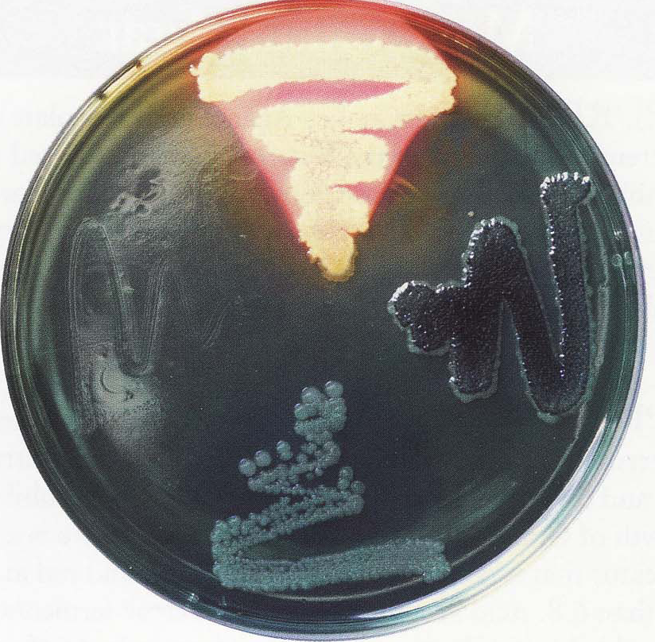
Shigella spp. on HE
(blue - green)

Slide 18
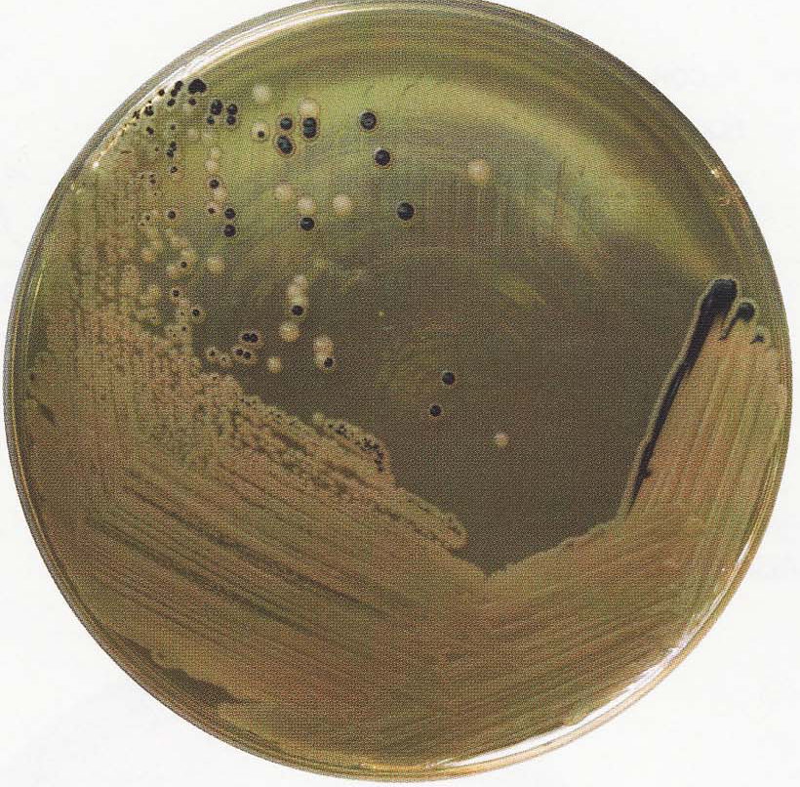
Laboratory diagnosis
Salmonella & Shigella agar.
SS agar with both Salmonella & Shigella spp. growth

Slide 19
C. BIOCHEMICAL
1- TSI alk / butt –gas –H2S
2- IMViC ± + - -
D. SEROLOGY
Normal persons often have agglutinins against several shigella species. However, serial determinations of antibody titers may show a rise in specific antibody. Serology is not used to diagnose shigella infections.

Slide 20
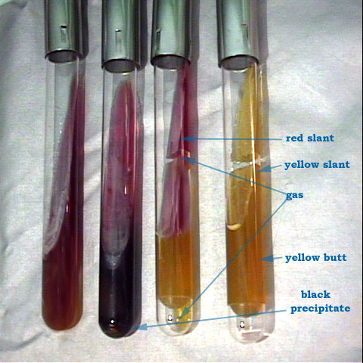
1
2
3
4
Tube | Lactose | Glucose | Gas | H2S
1 | control
2 | -ve | +ve |  | +ve
3 | -ve | +ve | +ve
4 | +ve | +ve | +ve

Slide 21
Thank You

