Slide 1
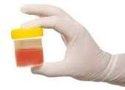
An Approach to a Patient with
Assistant prof. Dr. Mayasah A. Sadiq F.I.B.M.S.-FM

Slide 5
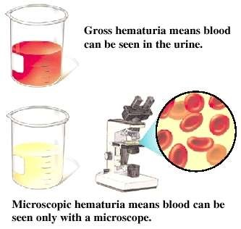

Slide 10
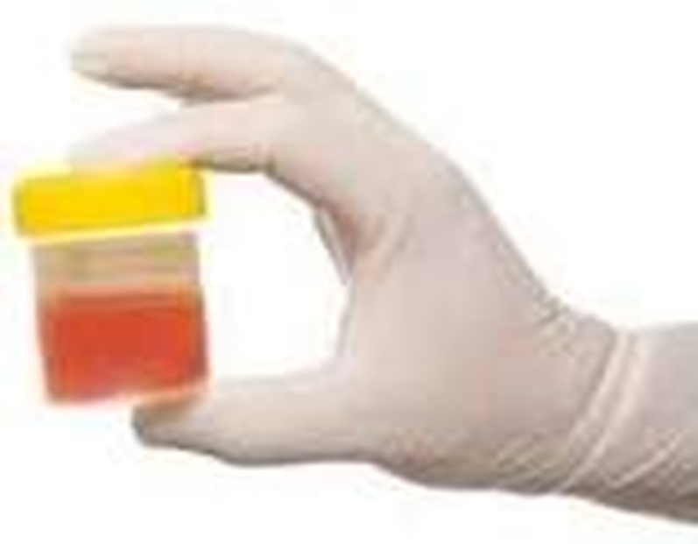
Approach to Patient with blood in urine
History taking
§Physical examination
§Investigation, Lab , Radiology

Slide 15
History Taking
Associated symptoms :
  Fever, back pain, dysuria, urgency, frequency (UTI)
  renal colic or previous nephrolithiasis (renal stone disease)
  weight loss, especially with abdominal pain (RCC)
  weight loss with a significant smoking history, or exposure to industrial dyes (bladder carcinoma)
  Symptoms of prostatic obstruction in older men such as hesitancy and dribbling (BPE)
  recent sore throat or skin infection, edema, hypertension (glomerulonephritis)

Slide 16
History Taking
Associated symptoms(continued) :
  recent back, abdominal, or urethral injury or vigorous exercise (trauma)
  history of heart murmur with recent dental or genitourinary manipulation (endocarditis)
  or a history of bleeding from other sites, a previous bleeding disorder, or family history of a bleeding disorder (systemic coagulopathy).
  Cyclic hematuria in women that is most prominent during and shortly after menstruation, suggesting endometriosis of the urinary tract.
  Sterile pyuria with hematuria, which may occur with renal tuberculosis, analgesic nephropathy and other interstitial diseases
  Loin pain-hematuria syndrome (LPHS): (rare) recurrent episodes of severe unilateral or bilateral loin (flank) pain that were accompanied by gross or microscopic hematuria, associated with use of OCPs,pregnancy,MC.

Slide 17
History taking
Urine Color, pattern:
What color is your urine?
Are you taking rifampicin? Have you eaten beetroot (Beeturia)?
Is it pure blood or mixed with urine?
Are there any clots? (lower urinary tract source) – Does it happen all the time when you pass water?
Is it near the beginning, end or during the entire urine stream?
Post operative , recent urological surgery ?

Slide 18
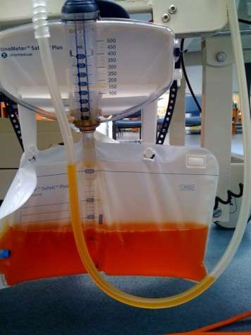

Rifampicin Vs beetroot

Slide 19


Red flags
Painless gross hematuria in an elderly, in the absence of infection, is caused by malignancy unless proved otherwise
Hematuria in elderly, which may be transient, intermittent, or asymptomatic, always warrants a comprehensive evaluation to exclude malignancy
Persistent hematuria warrants thorough evaluation when found in patients of any age
Hematuria associated with sterile pyuria is genitourinary TB or interstitial nephritis until proved otherwise

Slide 24
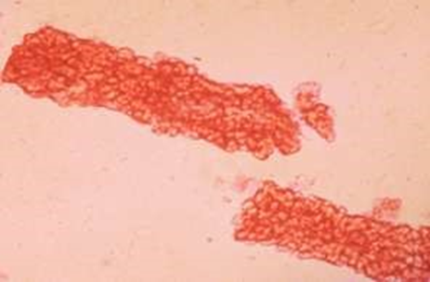
▪ It is difficult to localize the site of bleeding by routine examination of the patient with hematuria.
▪ However, certain findings may be very helpful depend on size & shape of RBCs.
▪For example, casts form in the lumina of renal tubules.
▪Therefore, the presence of RBCs casts localizes the site of bleeding to the renal parenchyma.

Slide 25
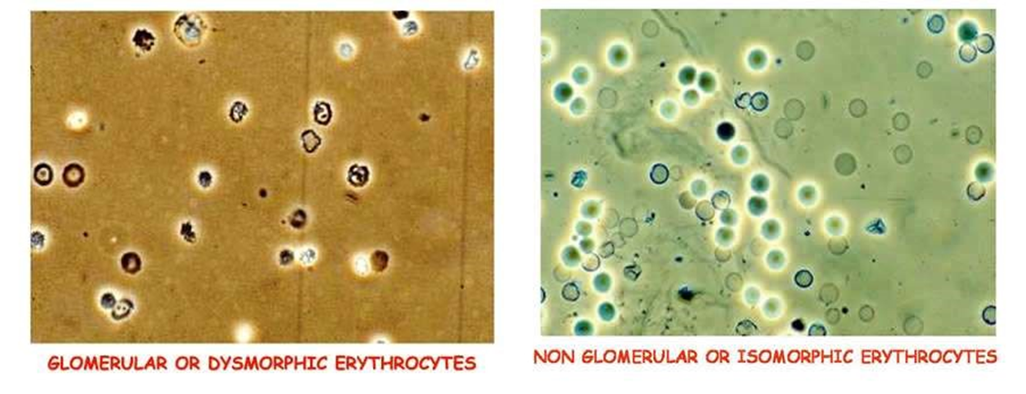

Slide 26


