Slide 1
Popliteal fossa and superficial veins

Slide 2
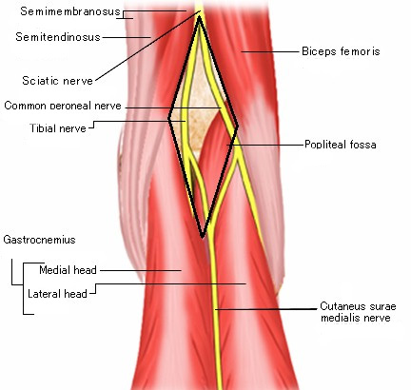
The Right Popliteal fossa

Slide 3
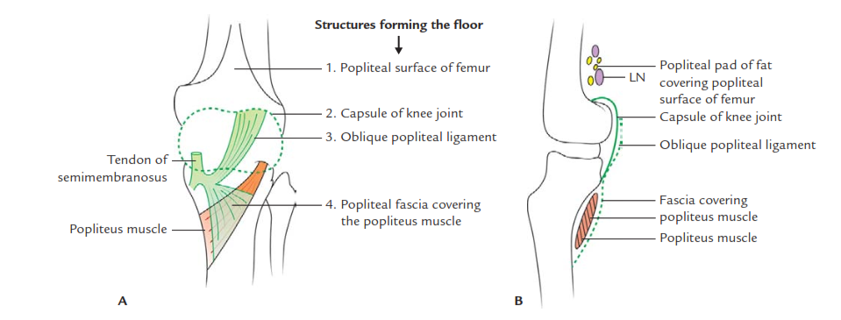
Boundaries

Slide 4
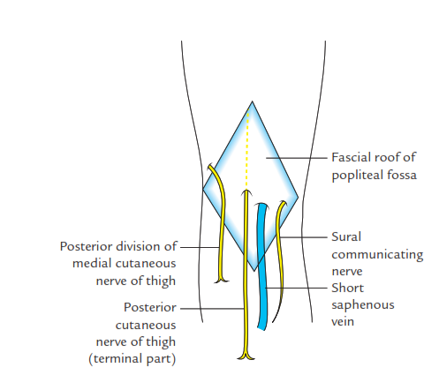

Slide 5
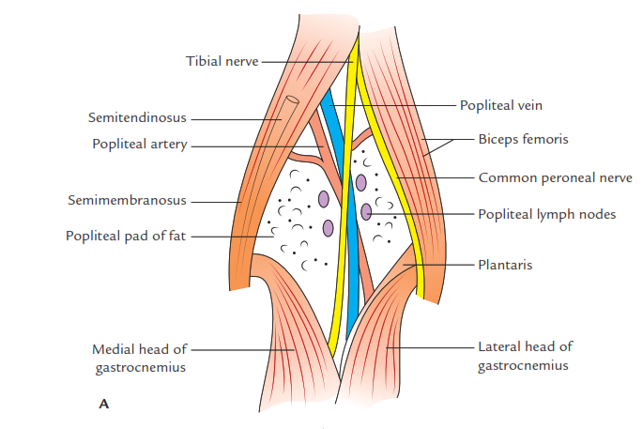

Slide 6
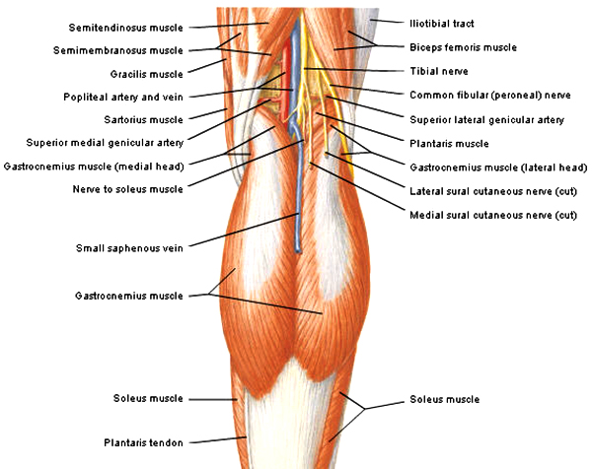

Slide 7
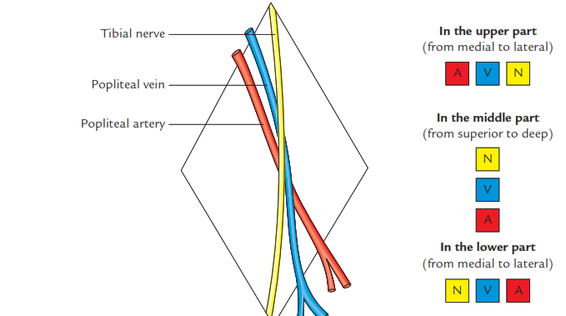

Slide 8
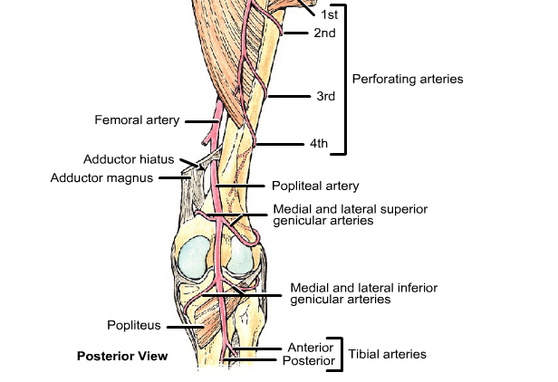

Slide 9
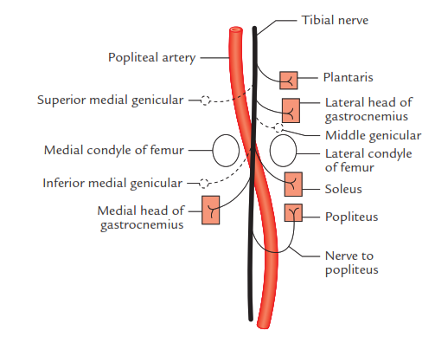

Slide 11
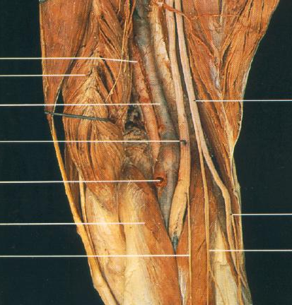
Right Popliteal Fossa
Popliteal artery
Semimembranosus
Popliteal vein
Common peroneal nerve
Tibial nerve
Small saphenous vein
Lateral cutaneous nerve of the calf
Gastrocnemius (medial head)
Sural nerve
Peroneal communicating nerve
MEDIAL
LATERAL

Slide 12
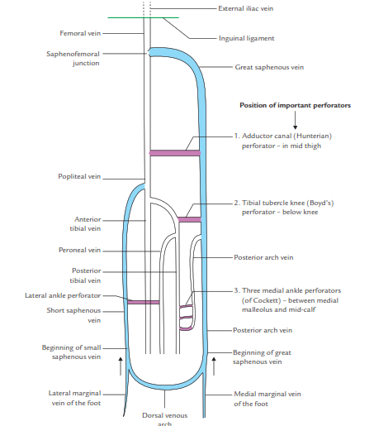
Venous drainage

Slide 13
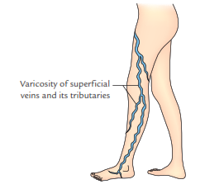
Stagnation – varicose vein

Slide 14
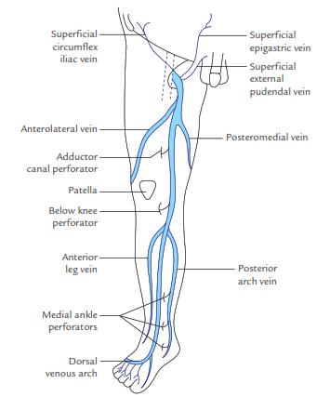

Slide 15
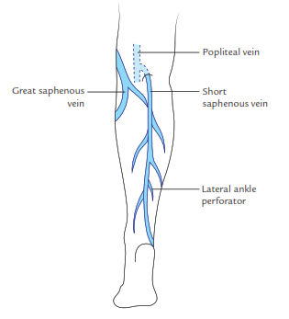

Slide 16
