Slide 1
Proteus species

Slide 2
Proteus is a genus of Gram-negative Proteobacteria. Proteus bacilli are widely distributed in nature as saprophytes, being found in decomposing animal matter, sewage, manure soil, and human and animal feces. They are opportunistic pathogens, commonly responsible for urinary and septic infections, often nosocomial.

Slide 7
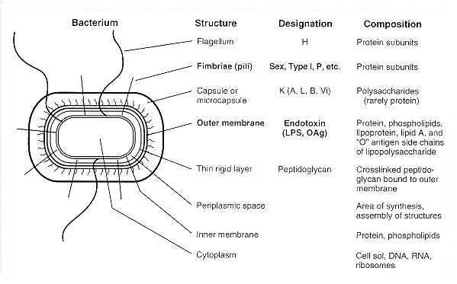

Slide 12
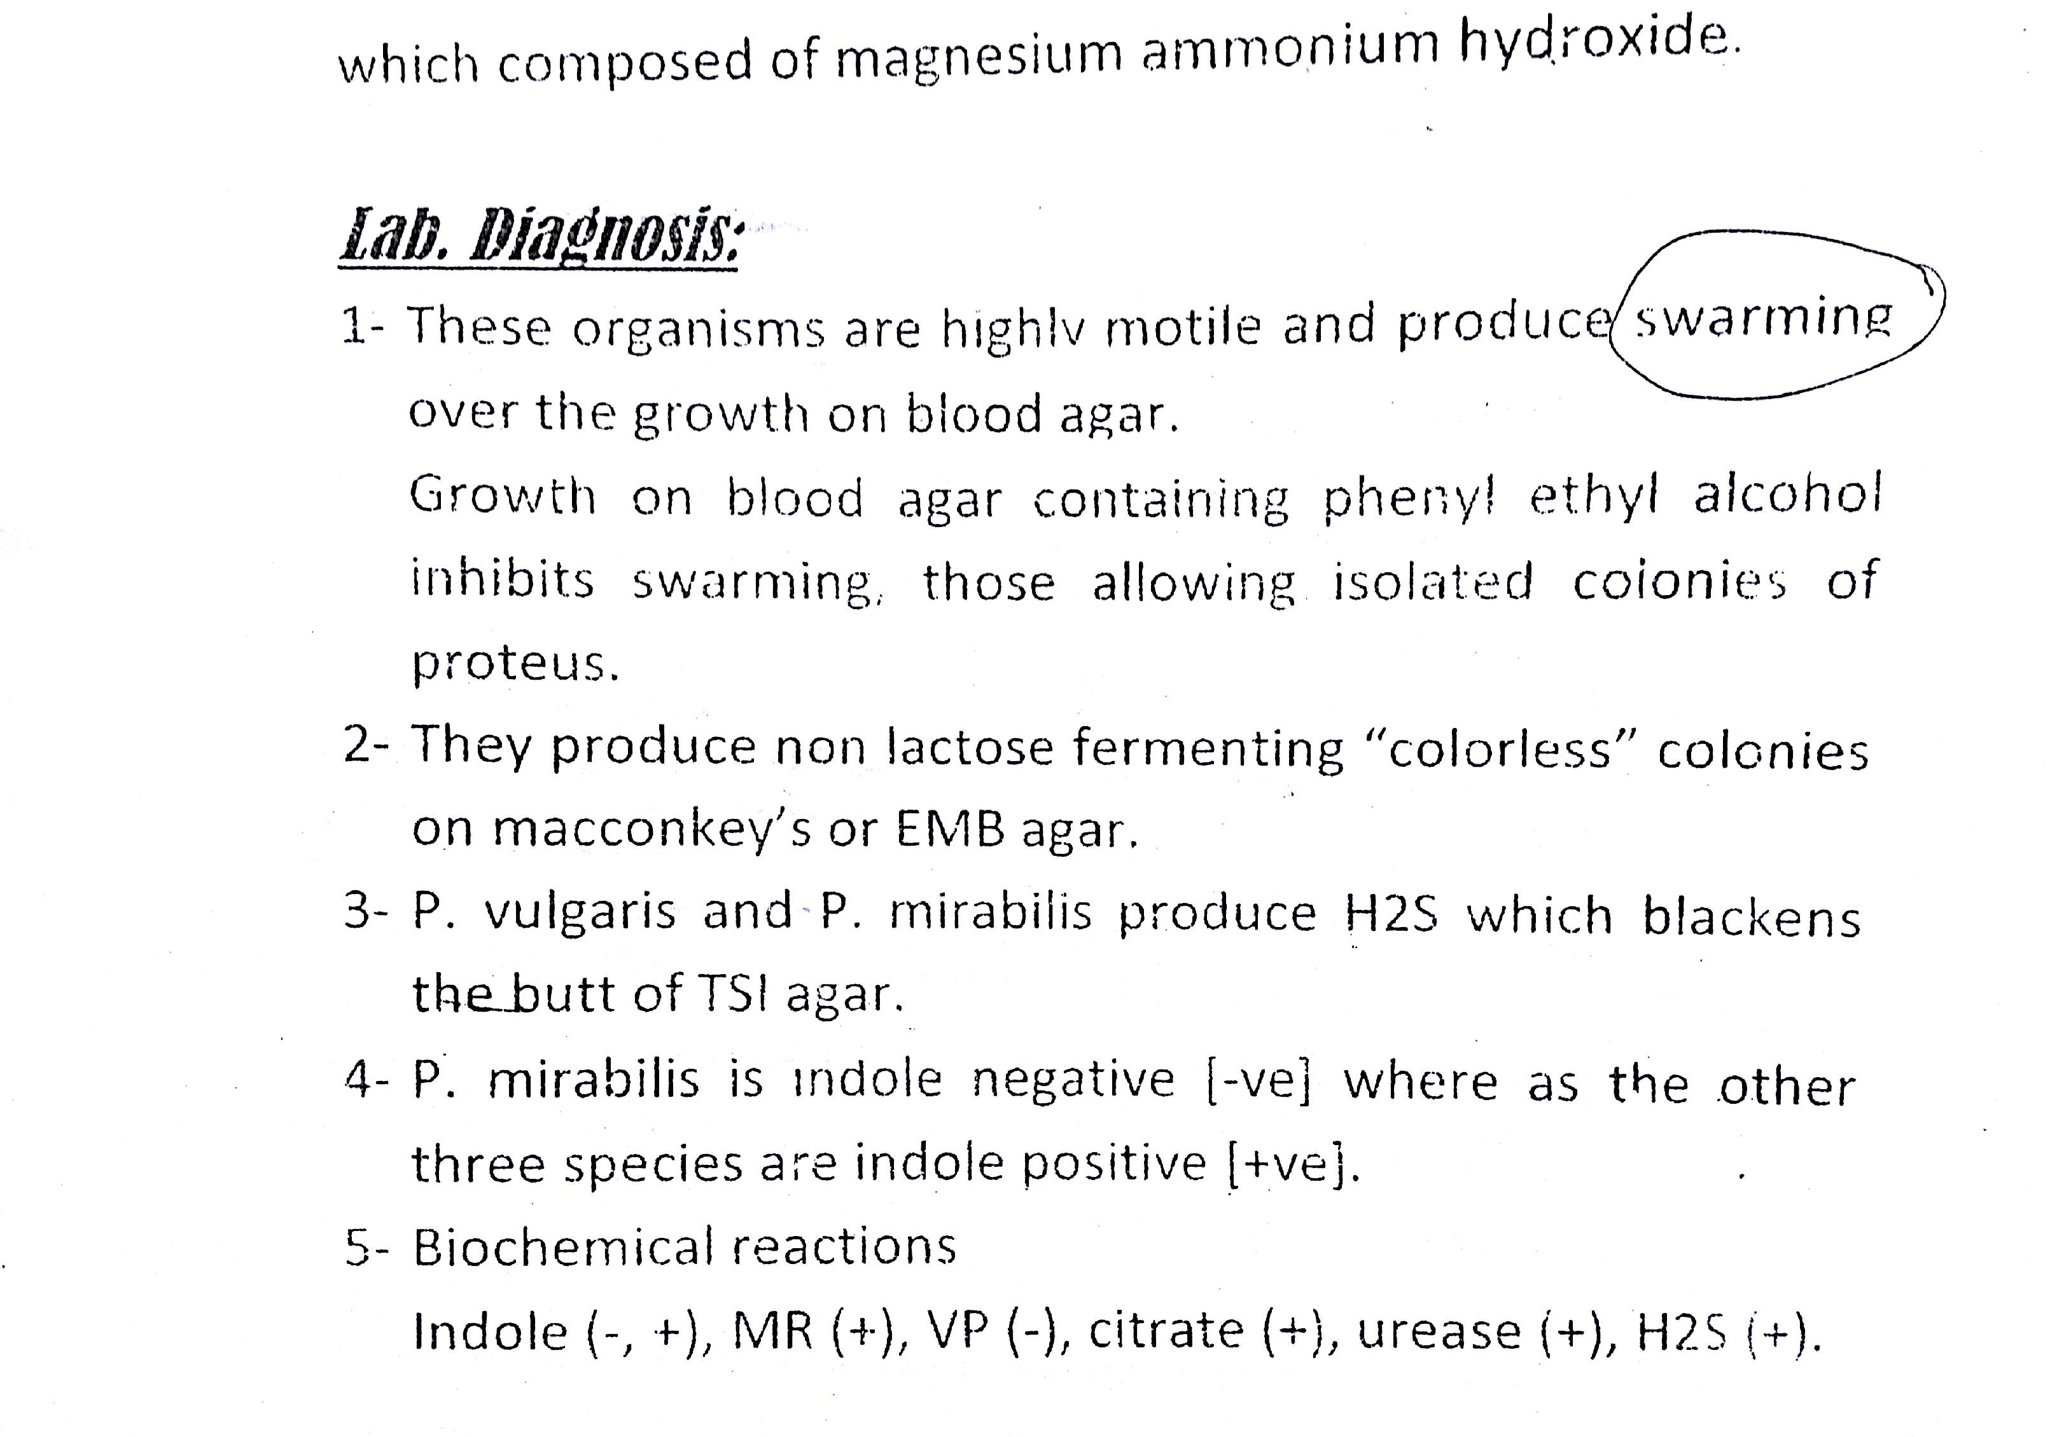

Slide 29
Thank you

