Slide 1
Shigella
Dr. Salma

Slide 2
Shigella-Epidemiology
Humans are only reservoir for these bacteria
Disease spread person to person by fecal-oral route
Patients at highest risk for disease are young children in daycare centers, nurseries, male homosexuals
Relatively few organisms can produce disease (highly infectious)
Disease occurs worldwide with no seasonal incidence

Slide 5
Shigella
 | O antigen | Ornithin decarboxylase | Lactose
S.dysentariae | A | - | -
S.flexneri | B | -- | -
S.boydii | C | - | -
S.sonnei | D | + | - Late+

Slide 8
Shigella 10-100
C.jejuni 10²-10⁶
Salmonella 10⁵
E.coli 10⁸
V.cholerae 10⁸
G.lamblia 10-100 cysts
E.histolytica 10-100 cysts
C.parvum 1-1000 cysts

Slide 11
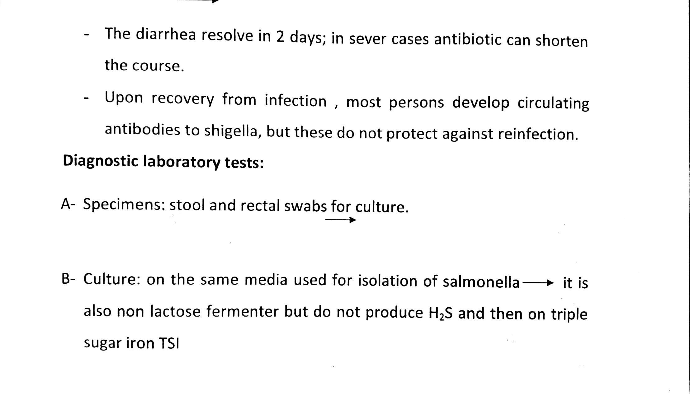

Slide 12
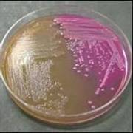
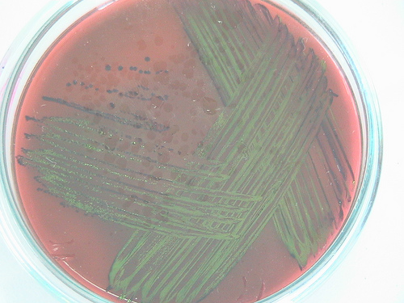
metalic green on ( EMB )
MacConkey Agar
Differential Media:
left: no lactose fermentation
right: lactose fermentation

Slide 13
Shigella spp. on HE
(blue - green)

Slide 14
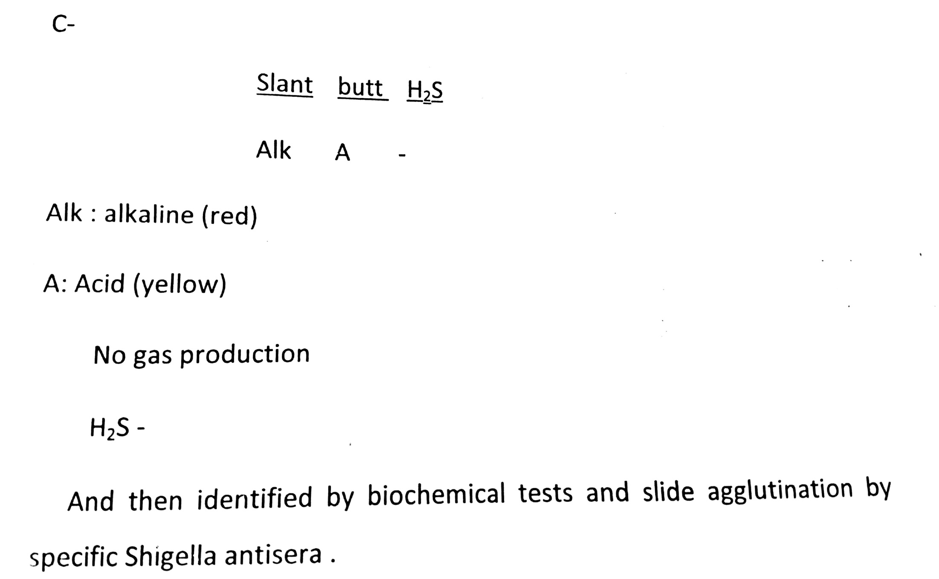

Slide 15
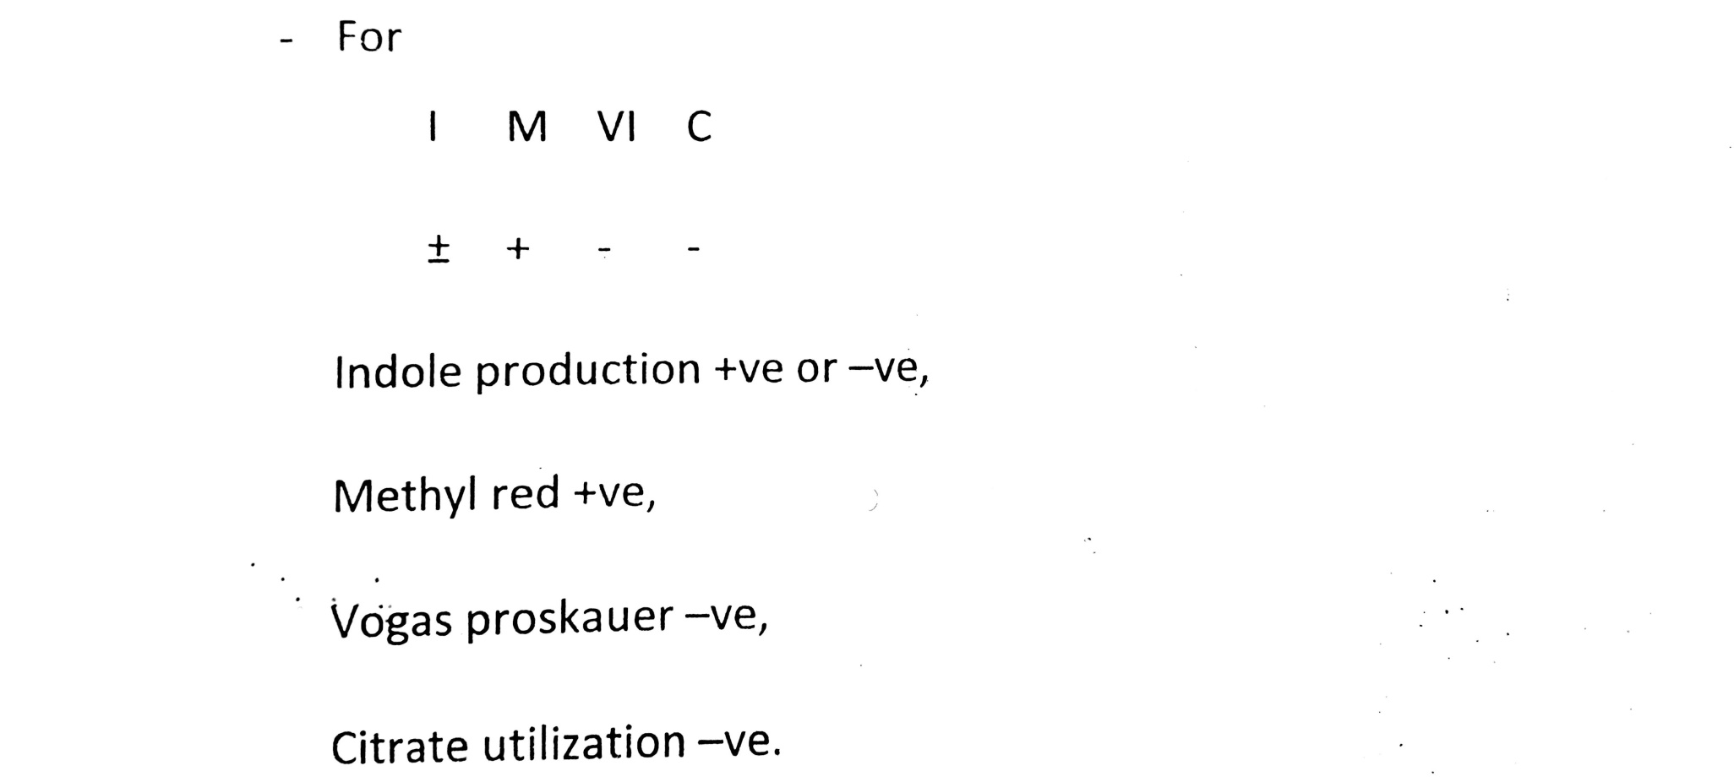

Slide 16
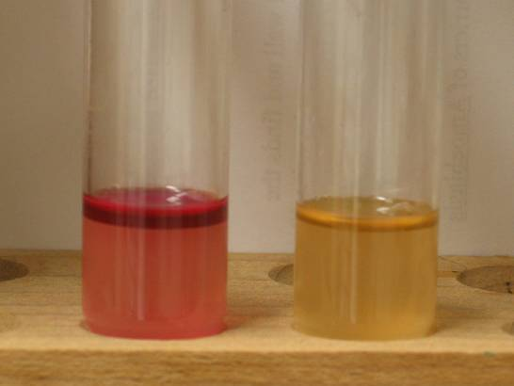
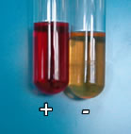
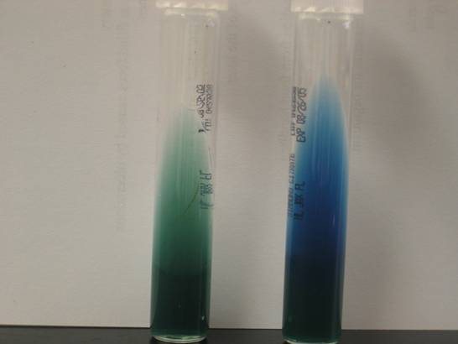

Slide 17
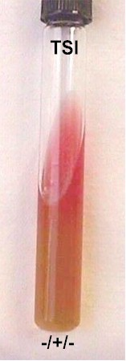
Biochemical test
(TSI) test : Alk slant (-) ve *
Acid butt (+) ve
No gas production , no H2S produced .
IMVC : v + - -
Urease : (-) ve
Nitrate reduction : (+) ve

Slide 18
Shigella-Diseases
Bloody diarrhae containing mucus,
Shigatoxin-an exotoxin B unit binds to host cell glycolipids and A cleaves the 28S rRNA , preventing the protein synthesis
Shigatoxin can mediate the damage to the glomeruşar endothelial calls, resulting in renal failure (HUS).

Slide 20
Shigella, Prevention, and Control
Antibiotic therapy shortens the course of symptomatic disease and fecal shedding
Treatment should be guided by in vitro susceptibility tests
Empiric therapy can be initiated with a fluoroquinolone or trimethoprim-sulfamethoxazole
Appropriate infection control measures should be instituted to prevent spread of the organism

Slide 21
Thank you

