Slide 1
Salmonella
Dr. Salma

Slide 2
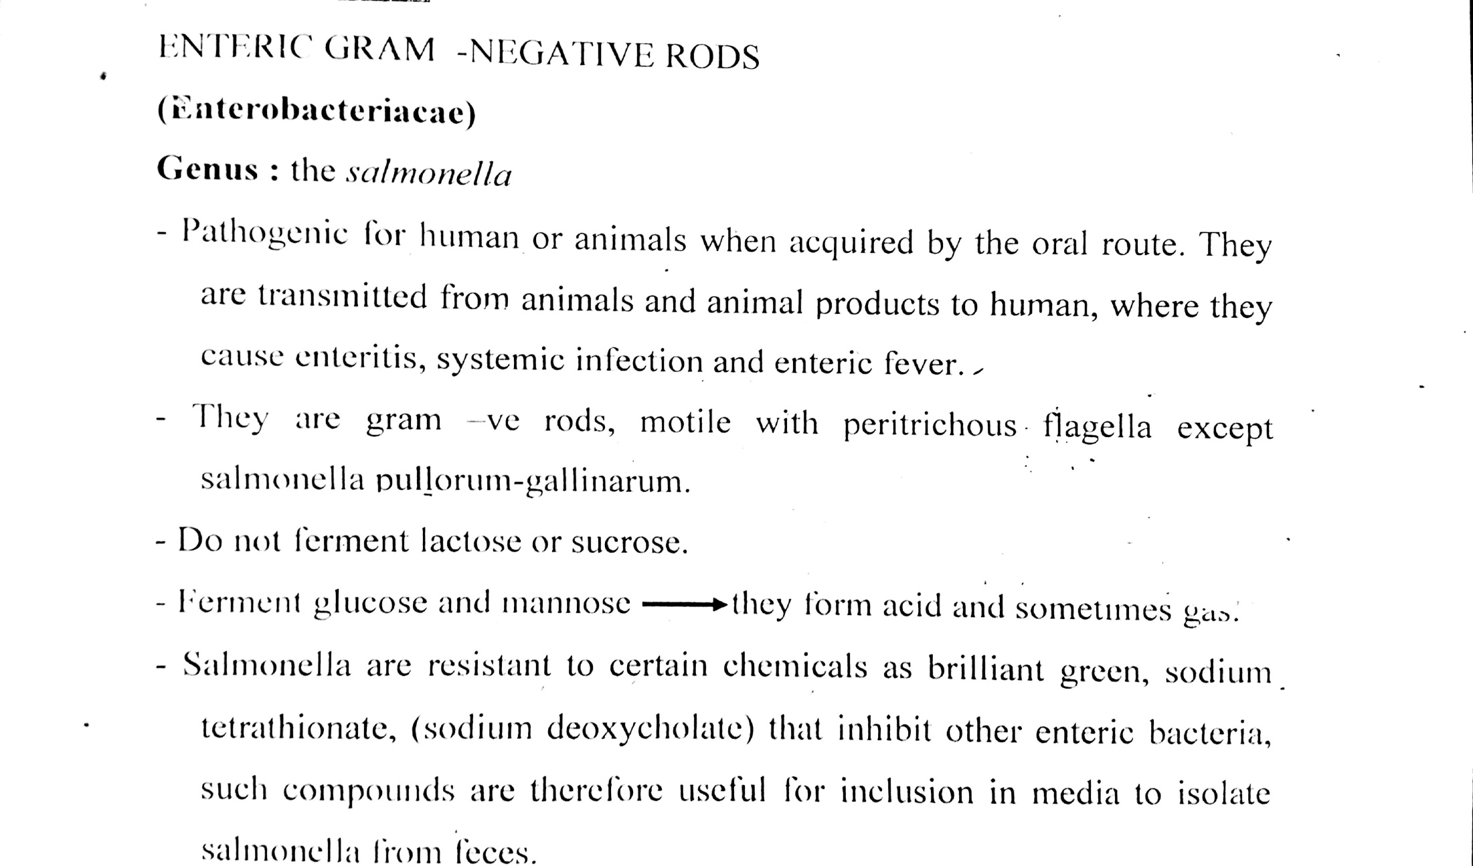

Slide 3
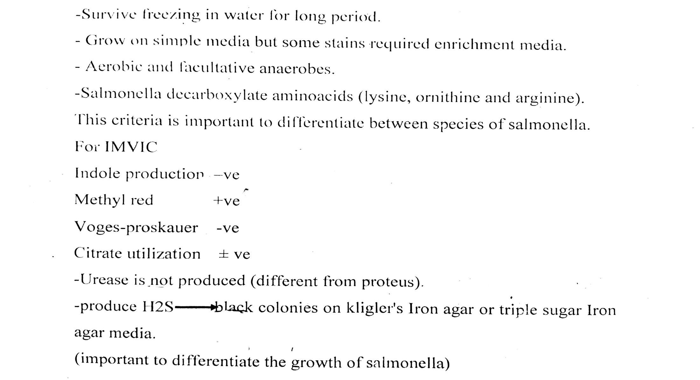

Slide 4
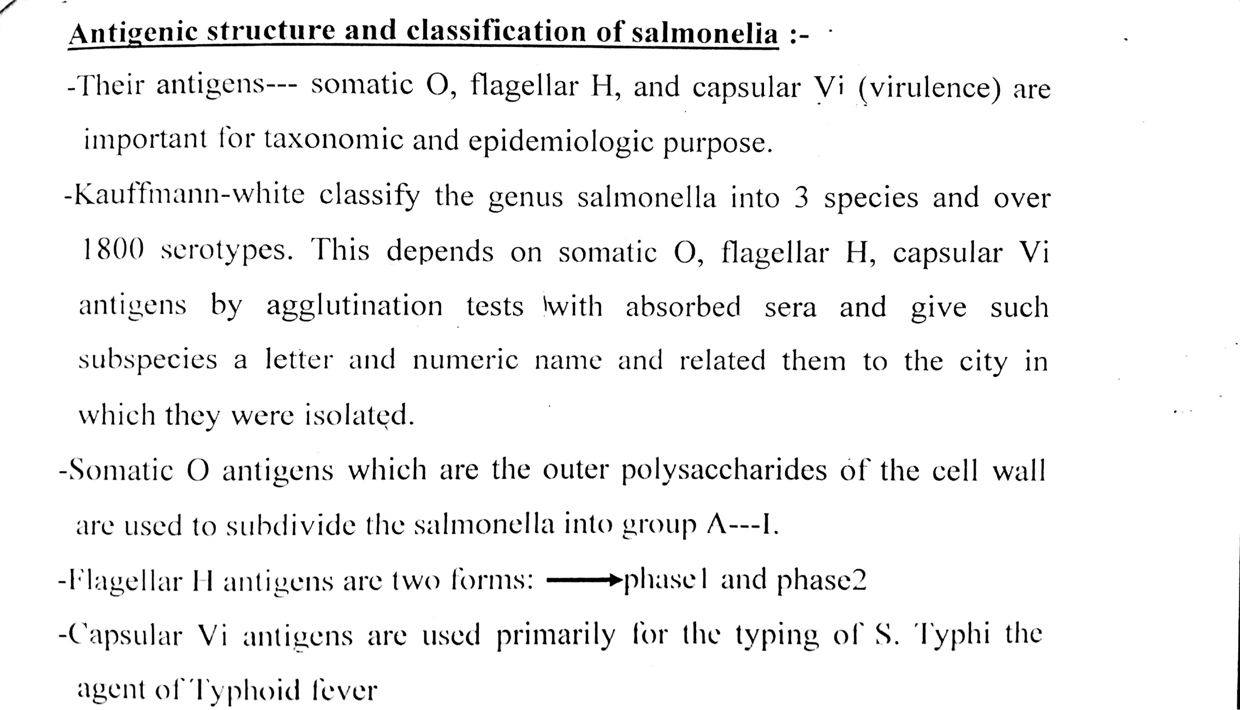

Slide 5
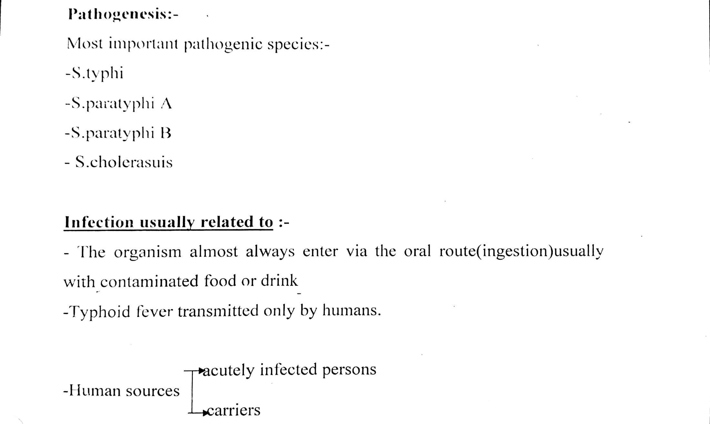

Slide 6
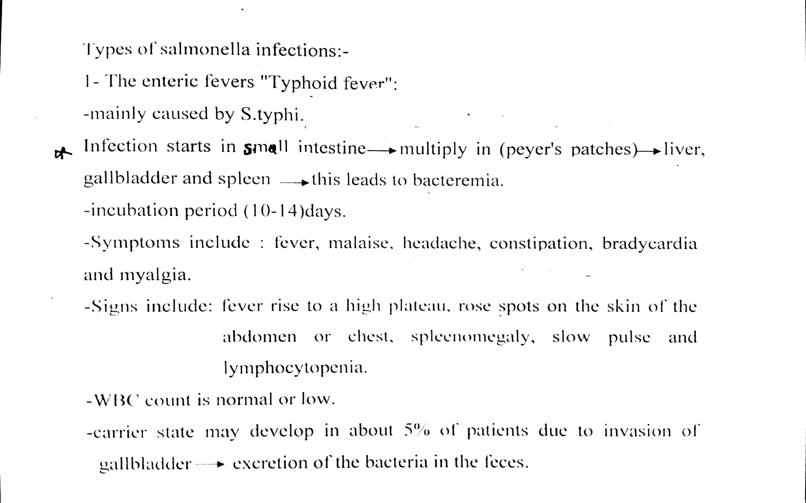

Slide 7
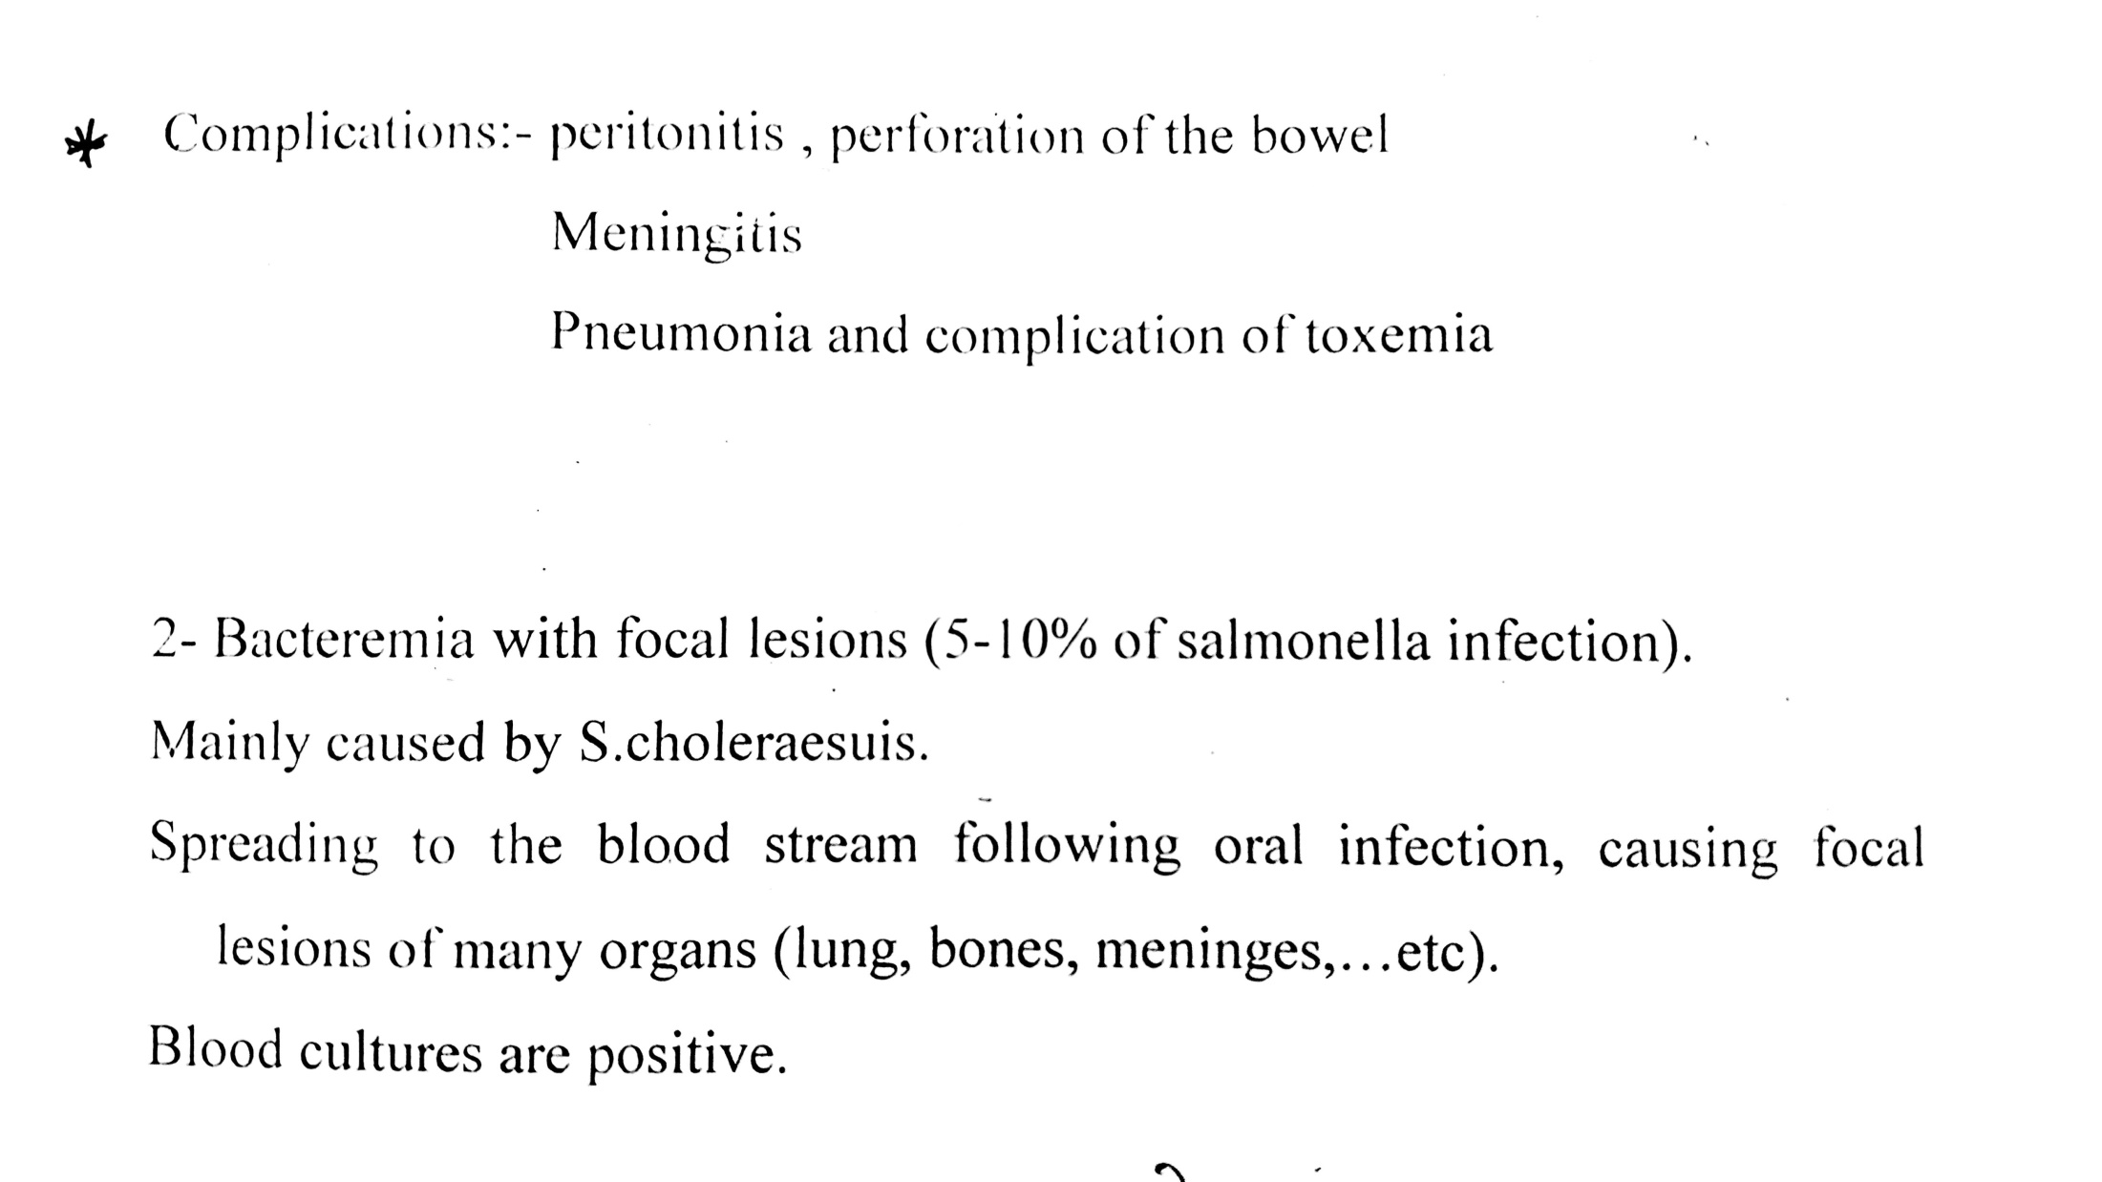

Slide 8
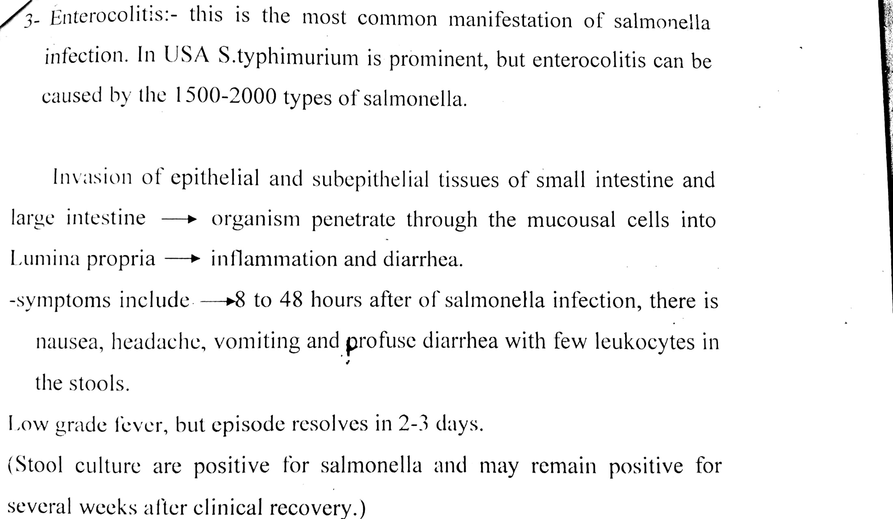

Slide 9
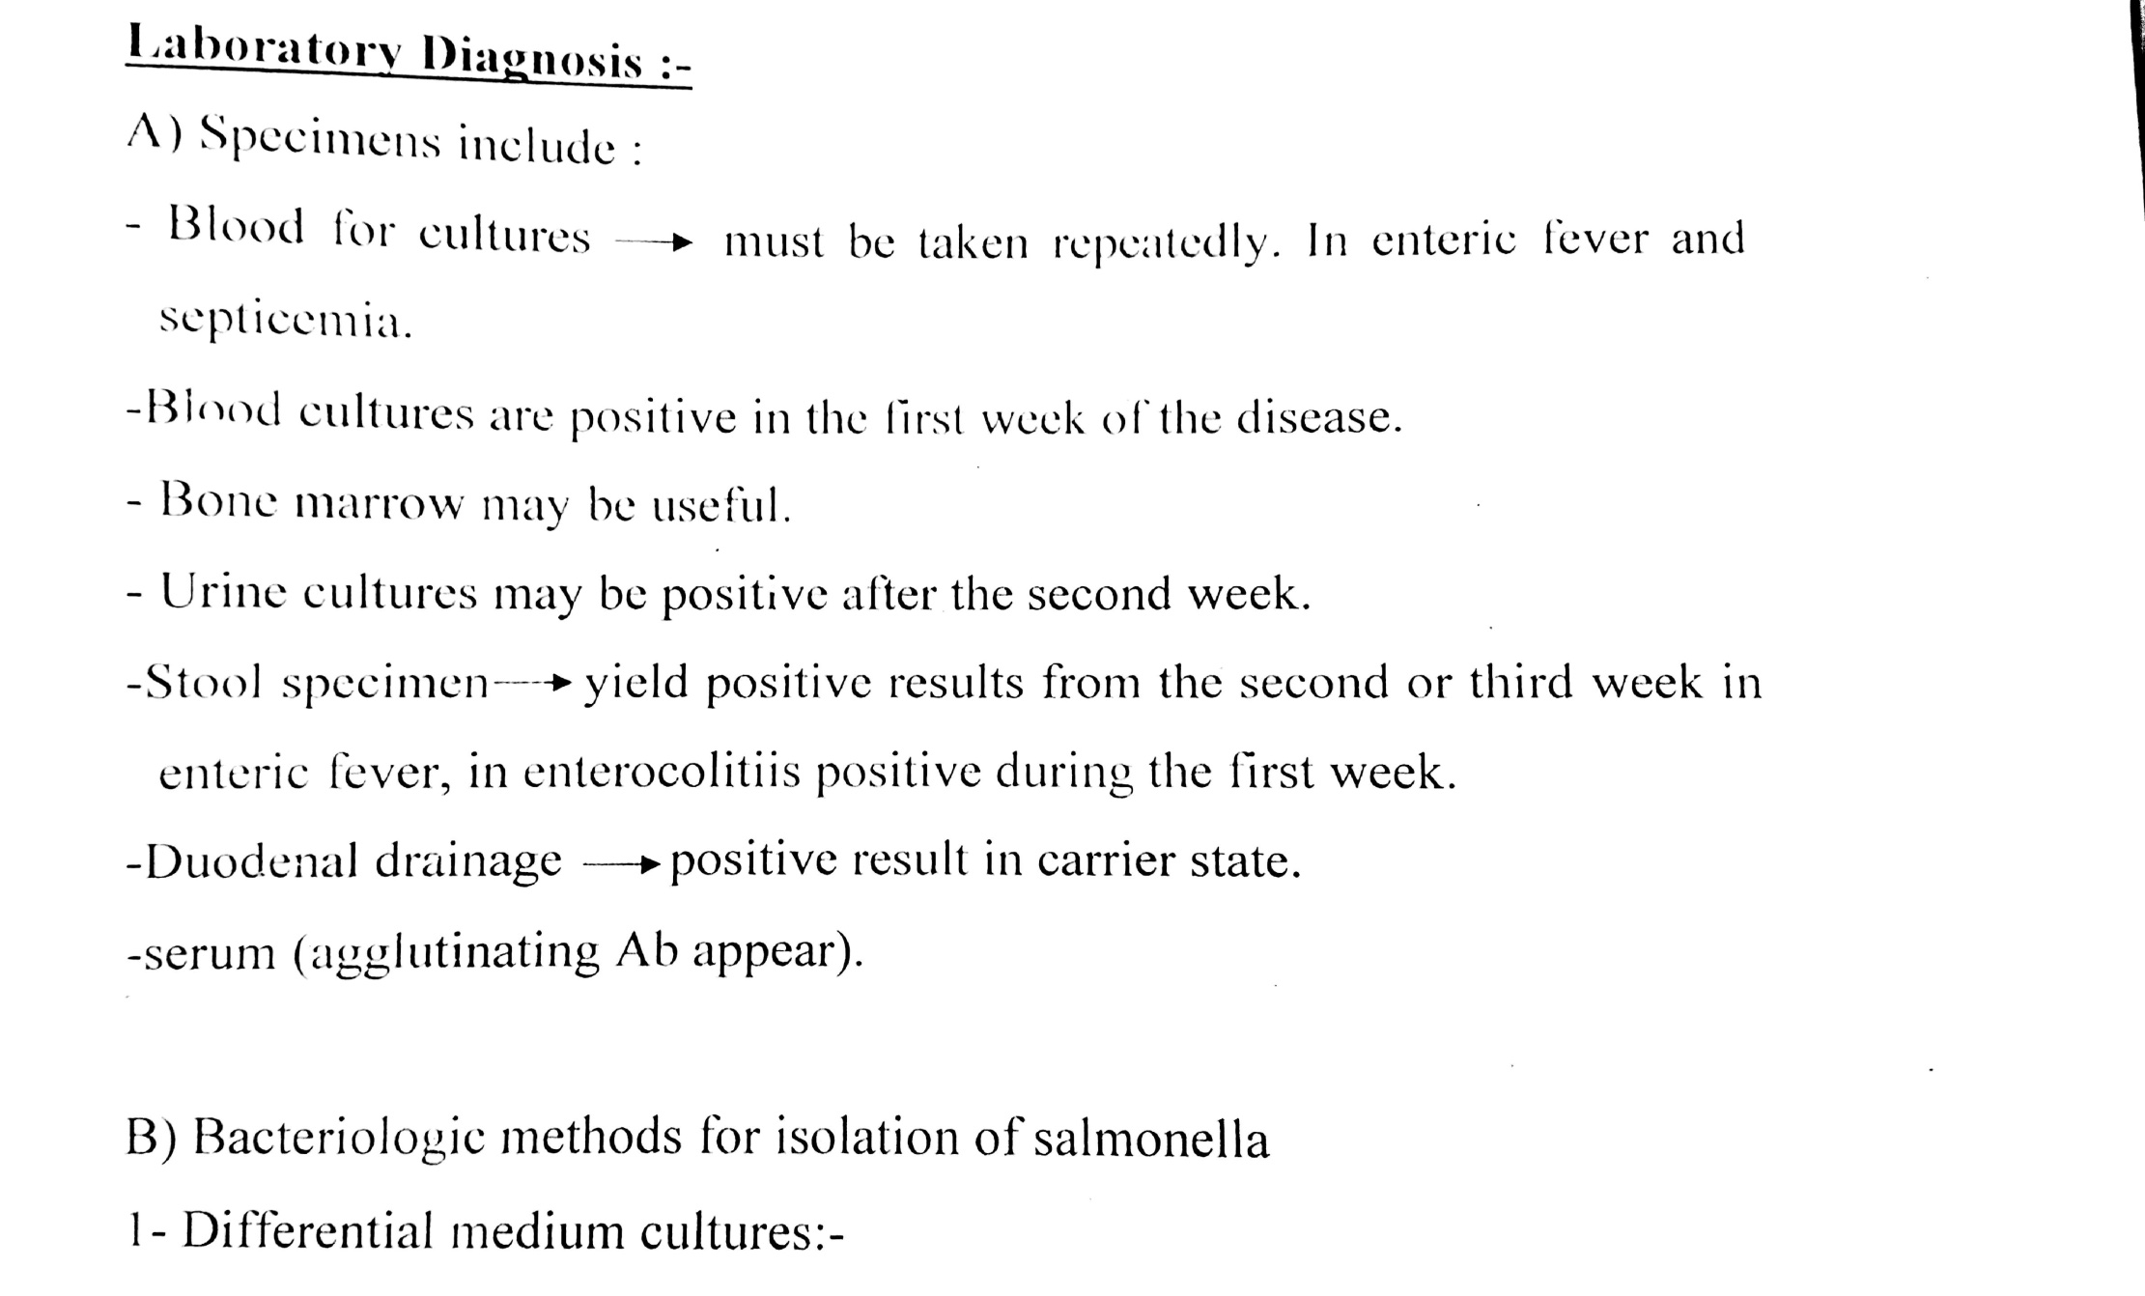

Slide 10
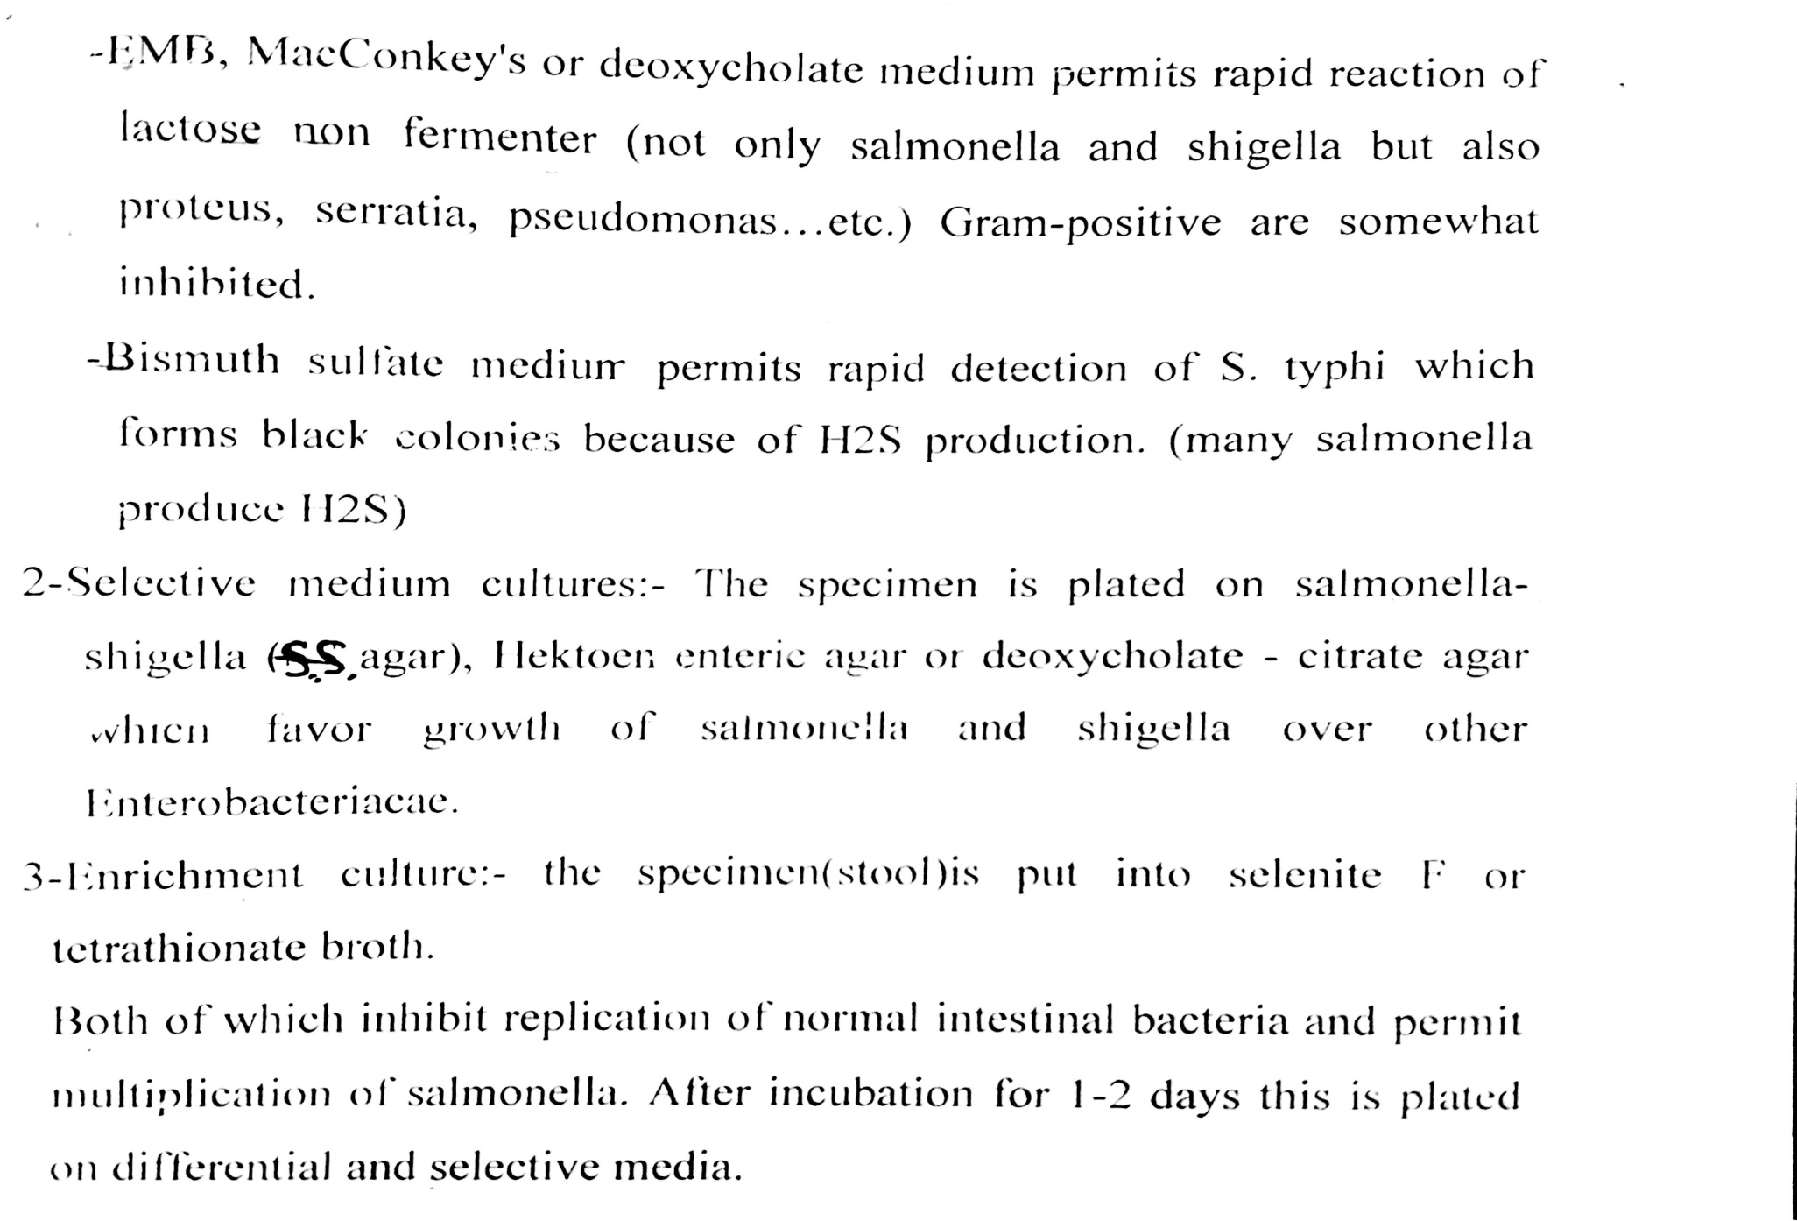

Slide 11
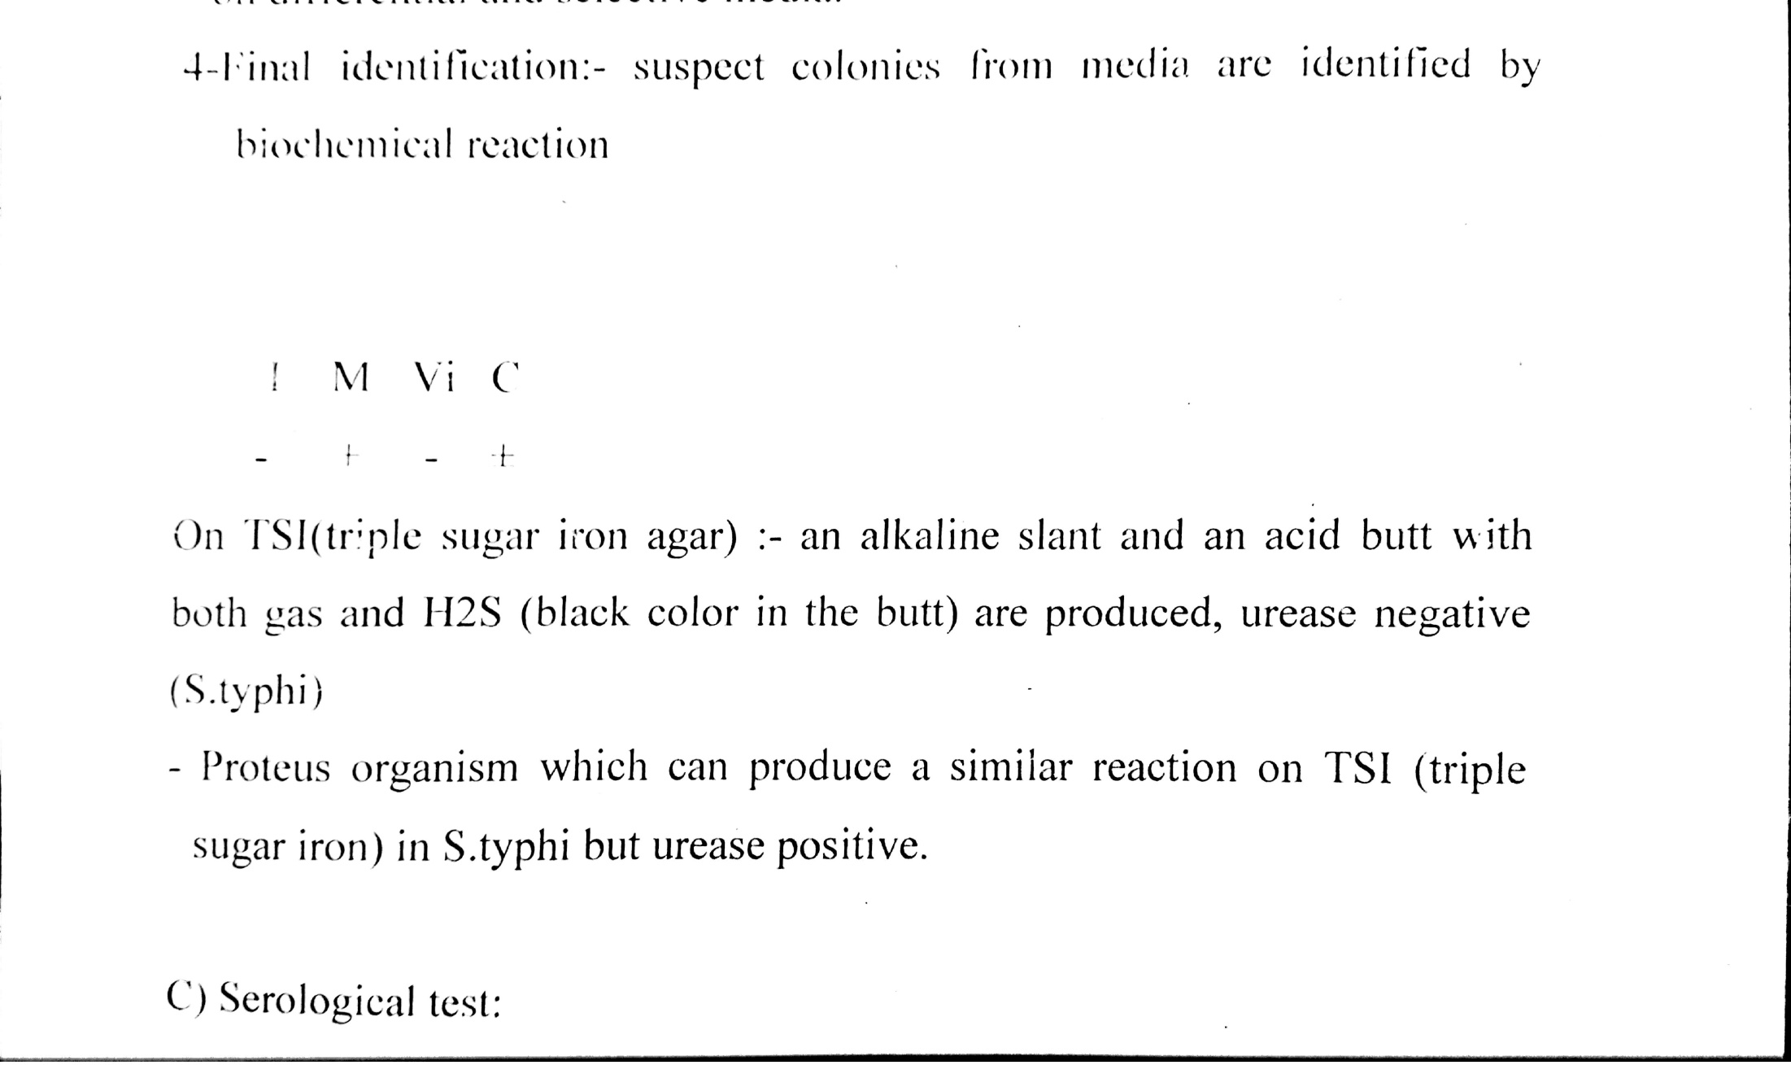

Slide 12
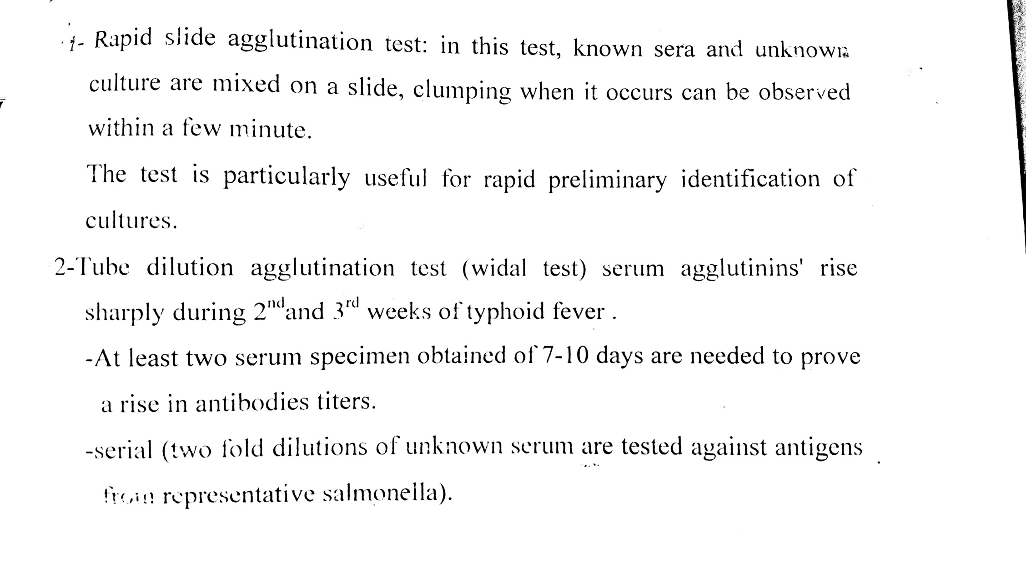

Slide 13
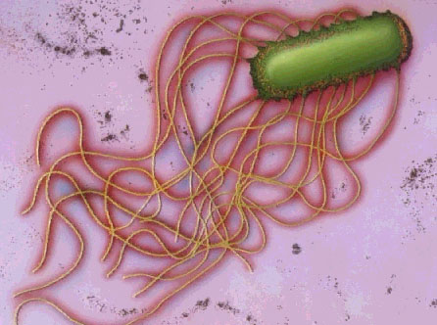
Laboratory diagnosis
2-Staining:
By Grams stain short bacilli or coccobacilli.

Slide 14
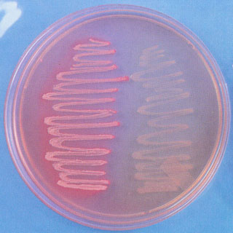
Laboratory diagnosis
3-Culture : at 37C for 24-48h. On differential & selective media.
MacConkey's agar non-lactose fermentor.

Slide 15
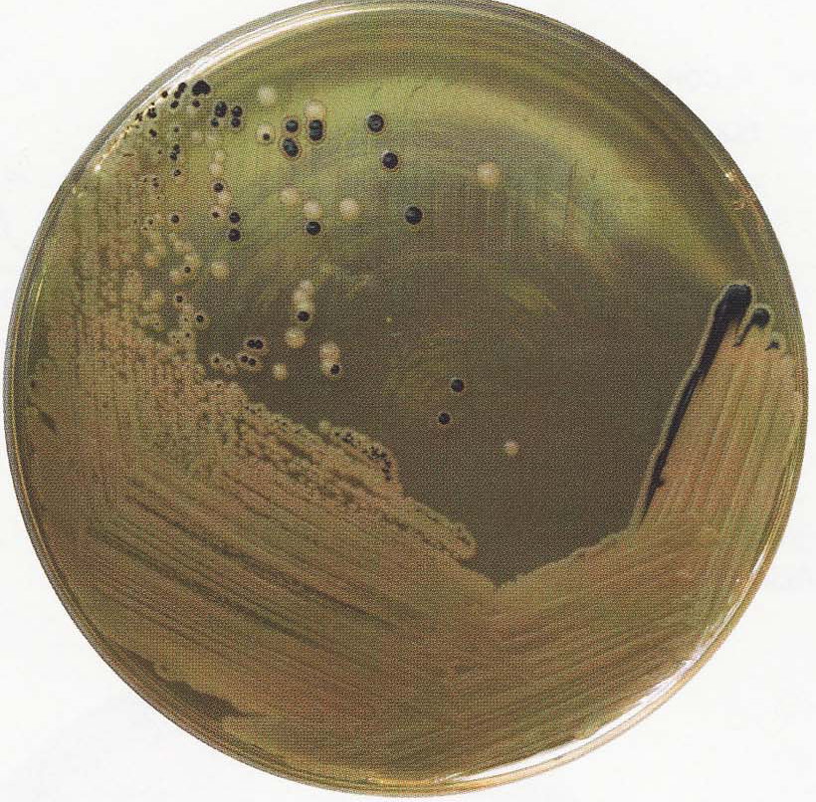
Laboratory diagnosis
Salmonella & Shigella agar.
SS agar with both Salmonella & Shigella spp. growth

Slide 16
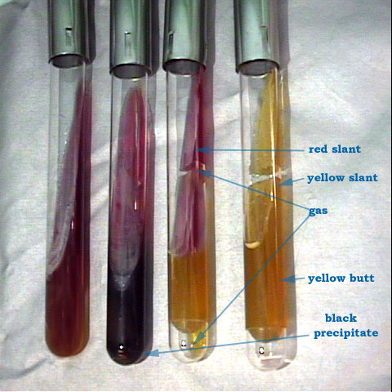
1
2
3
4
Tube | Lactose | Glucose | Gas | H2S
1 | control
2 | -ve | +ve |  | +ve
3 | -ve | +ve | +ve
4 | +ve | +ve | +ve

Slide 17
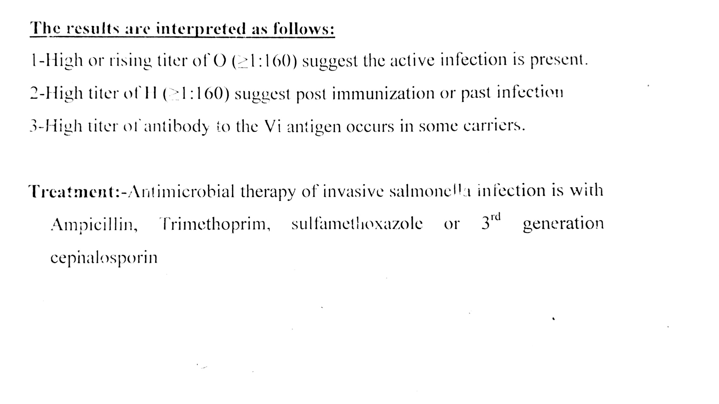

Slide 18
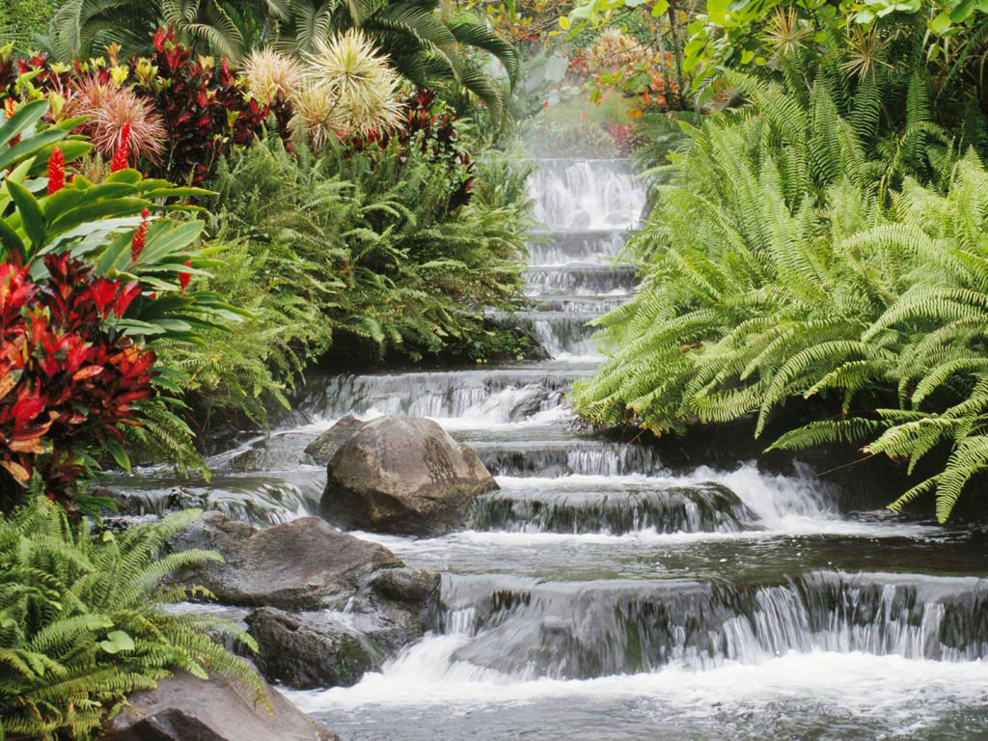
Thank you

