Slide 1
Escherichia coli
&
Klebsiella
Dr. Salma

Slide 2
Escherichia coli: The Most Prevalent Enteric Bacillus
Most common aerobic and non-fastidious bacterium in gut
150 strains
Some have developed virulence through plasmid transfer, others are opportunists.

Slide 3
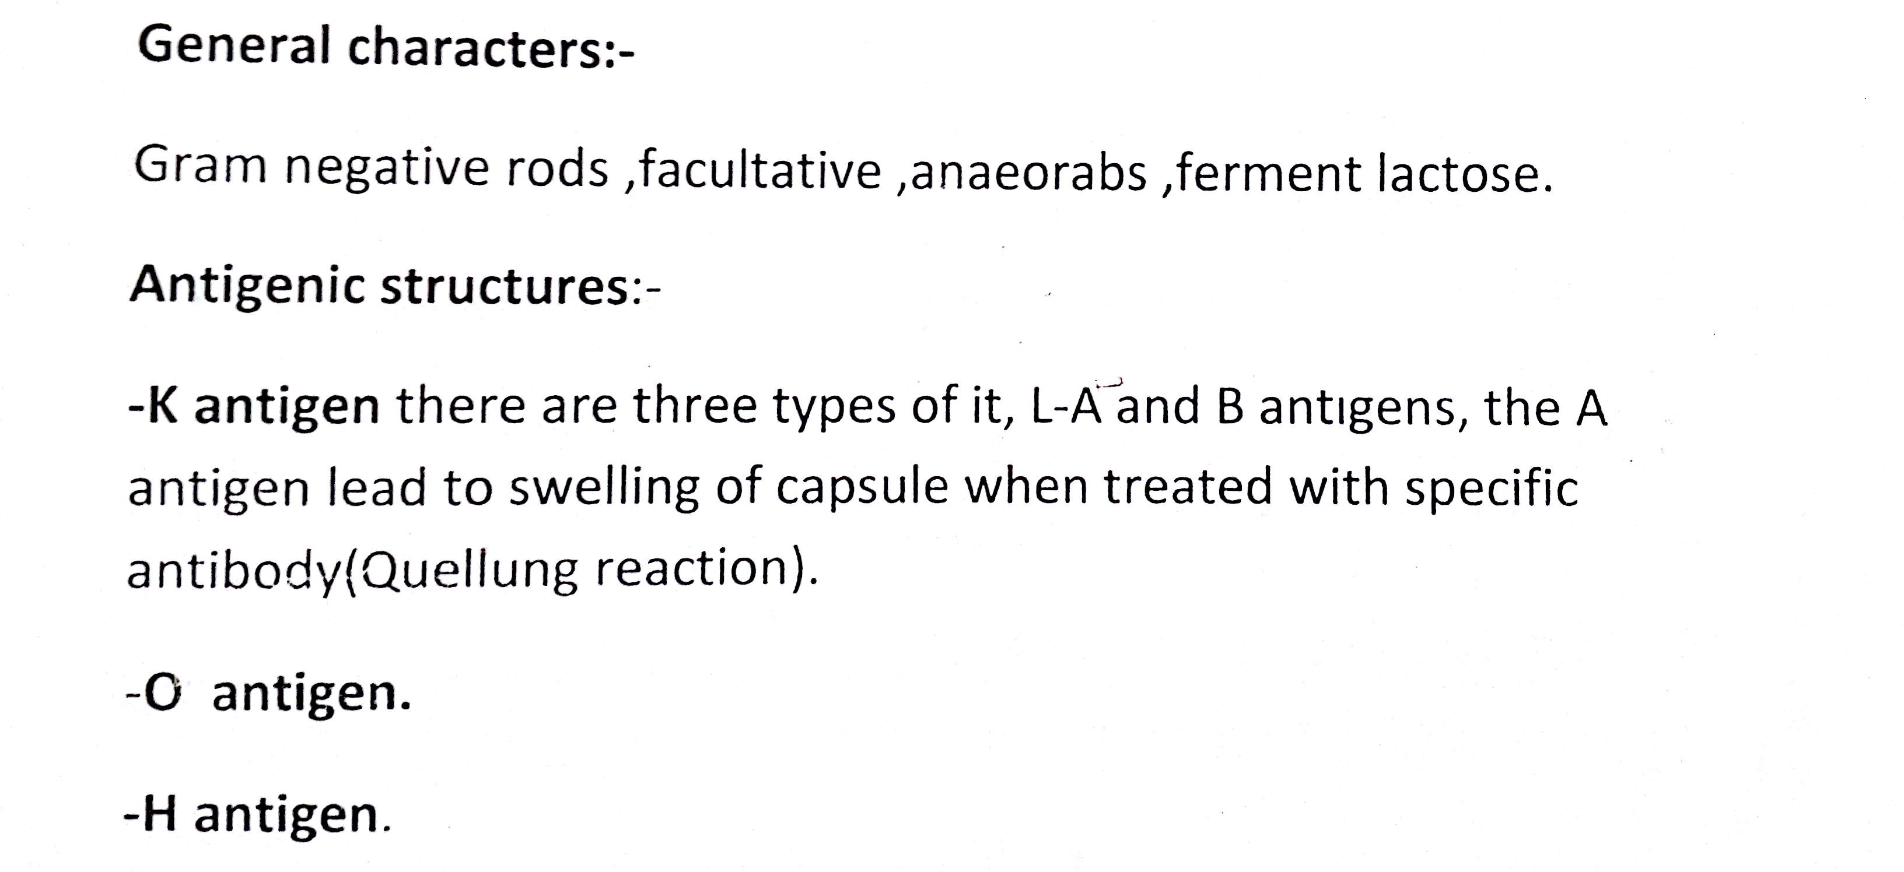

Slide 4
History
First description of E. coli O157:H7
1982
Four patients with bloody diarrhea
Linked to undercooked hamburgers at a fast food chain
Other sources identified over time
Now a major problem
Physicians, public health, food industry

Slide 5
Geographic Distribution
E. coli O157:H7
Found worldwide
Exception: Antarctica
Other EHEC
Wide distribution
Prominent serotypes may vary by geographic area

Slide 6
Morbidity and Mortality: Humans
Seasonal variation
North America
Most infections in summer, autumn
Due to seasonal shedding in animals or increase in summer barbecues?
Incidence
U.S. 1996-2010: 0.9 cases/100,000
Mortality
HUS: 3-10% (children), 50% (elderly)

Slide 7
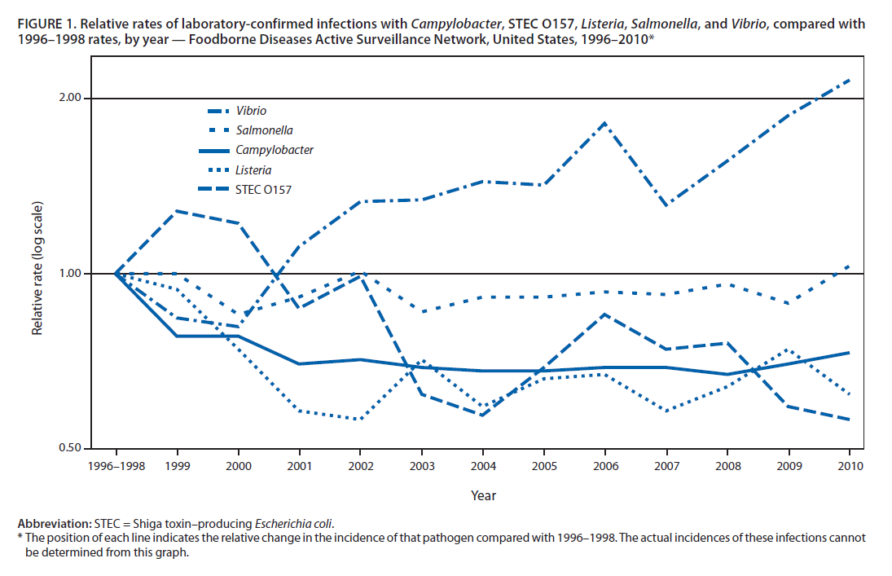
O157 Incidence: 1996-2010

Slide 9
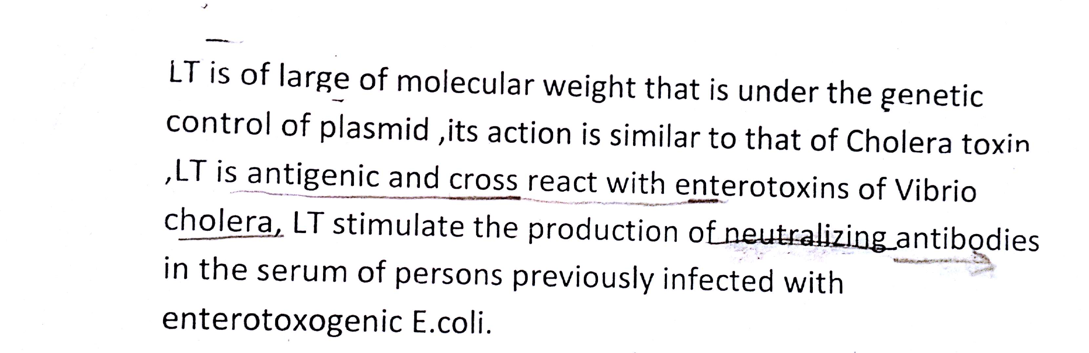

Slide 12
Escherichia coli
five species
sepsis, UTIs, meningitis, gastroenteritis
Gram-negative, facultative anaerobic rods
Fermenter; oxidase negative
Outer membrane makes the organisms susceptible to drying
Lipopolysaccharide consists of outer somatic O polysaccharide, core polysaccharide (common antigen), and lipid A (endotoxin)

Slide 13
Specialized Virulence Factors Associated with Escherichia coli Adhesins and Exotoxins

Slide 14
Escherichia coli
the most common gram-negative rods isolated from patients with sepsis
responsible for causing more than 80% of all community-acquired UTIs
gastroenteritis in developing countries
Most infections are endogenous

Slide 15
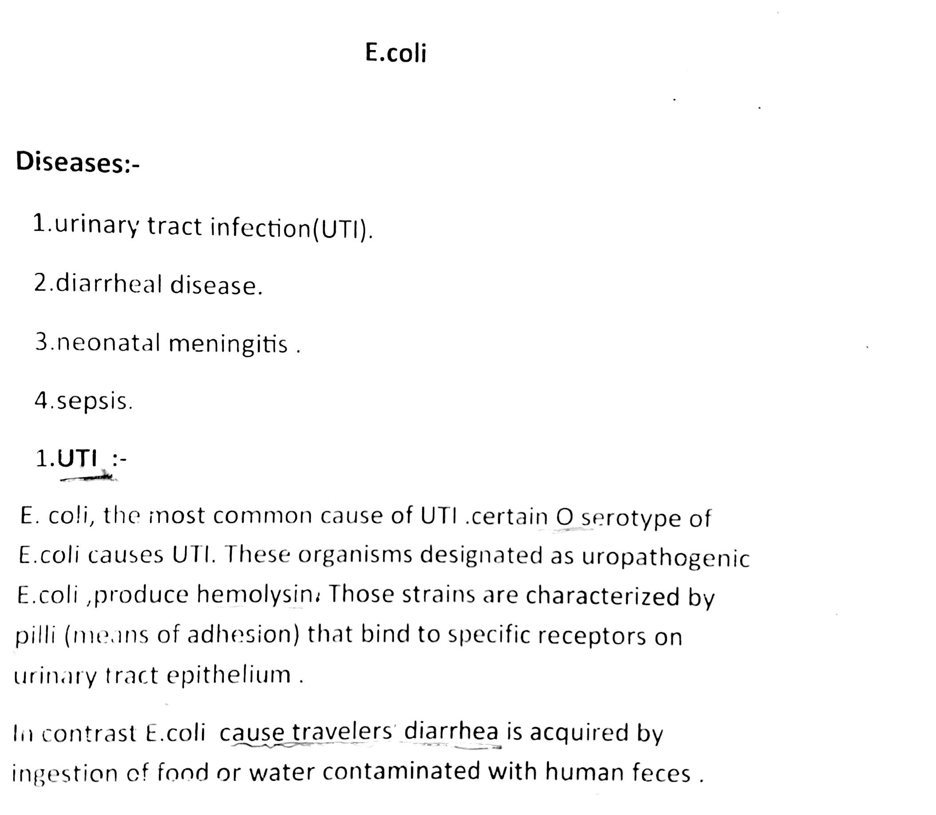

Slide 20
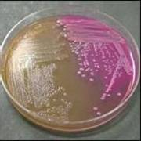
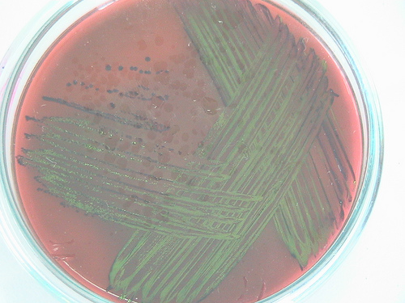
metalic green on ( EMB )
MacConkey Agar
Differential Media:
left: no lactose fermentation
right: lactose fermentation

Slide 21
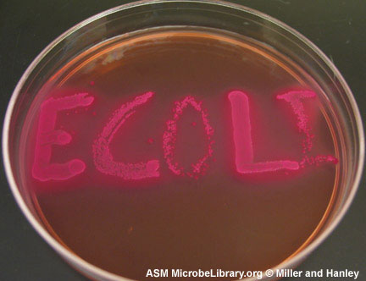
Dry, discreet pink colonies
E.coli on MacConkey’s agar
(pink colony due to lactose fermentation

Slide 22
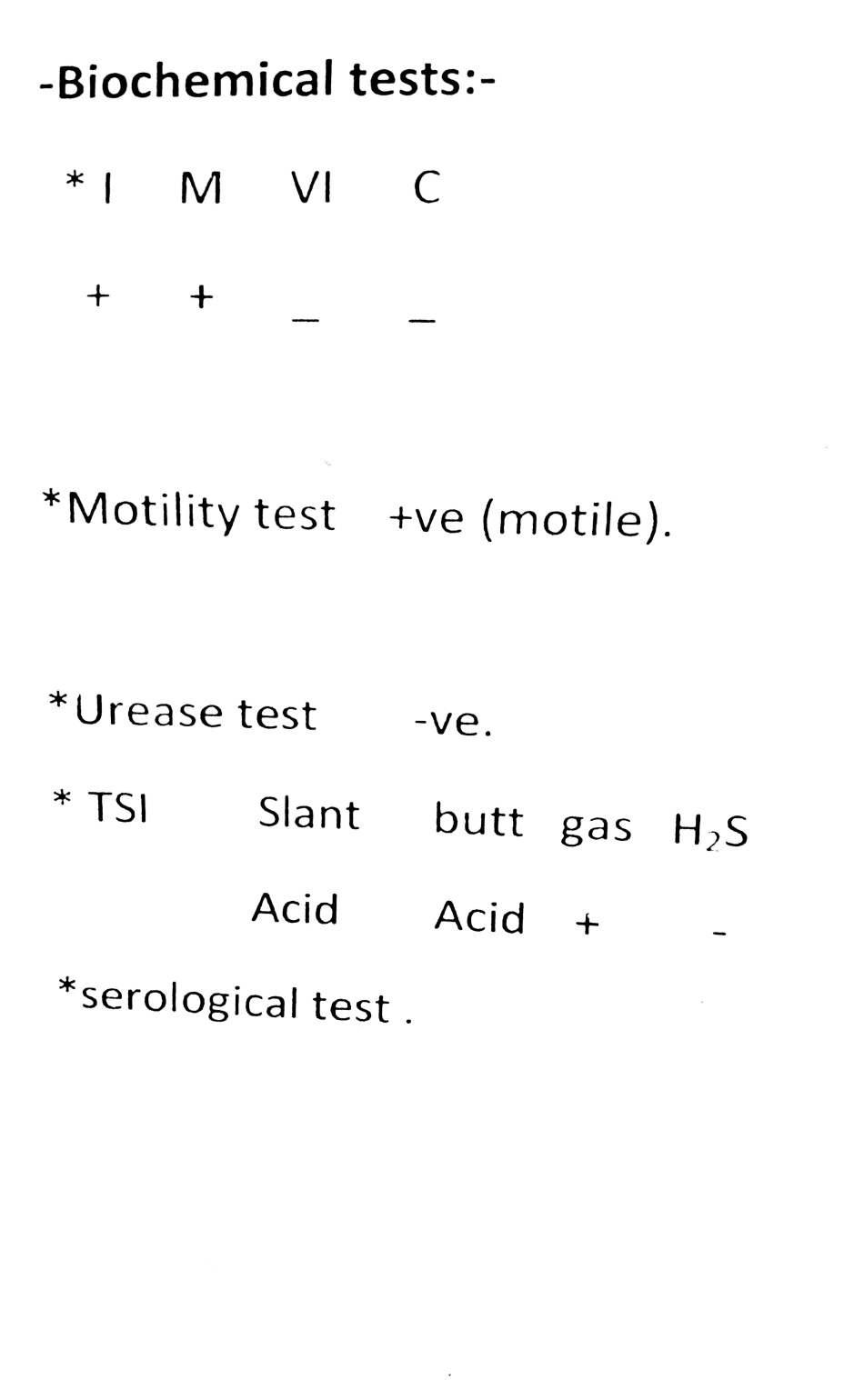

Slide 23
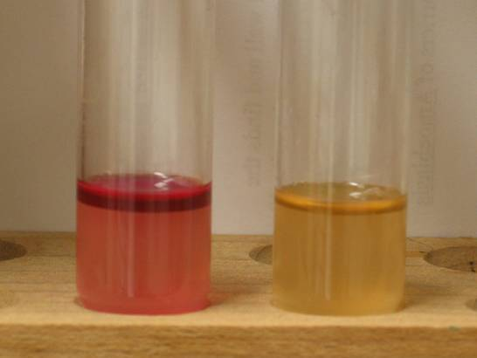
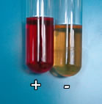
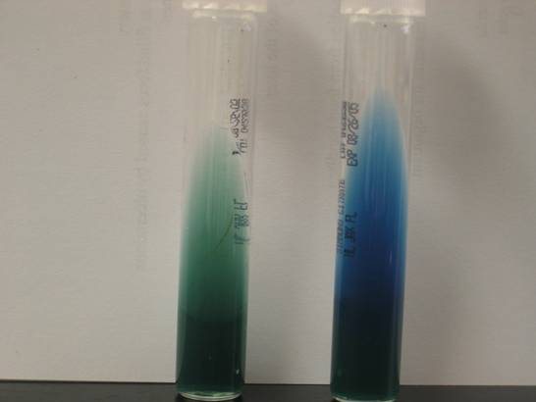

Slide 24
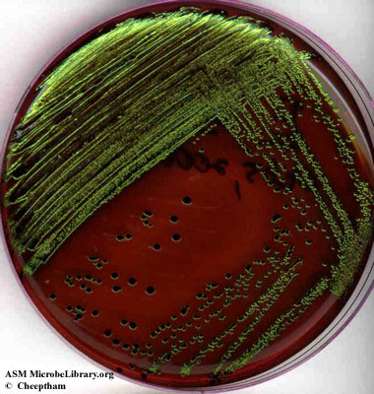

Slide 28
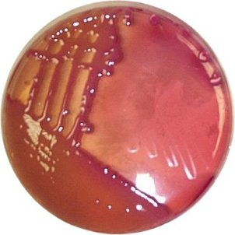
Klebsiella on MacConkey’s agar
(pink mucoid colony due to lactose fermentation

Slide 30
Thank you

