Slide 1
Growth monitoring
Assistant prof. Mayasah A. Sadiq FICMS-FM

Slide 5
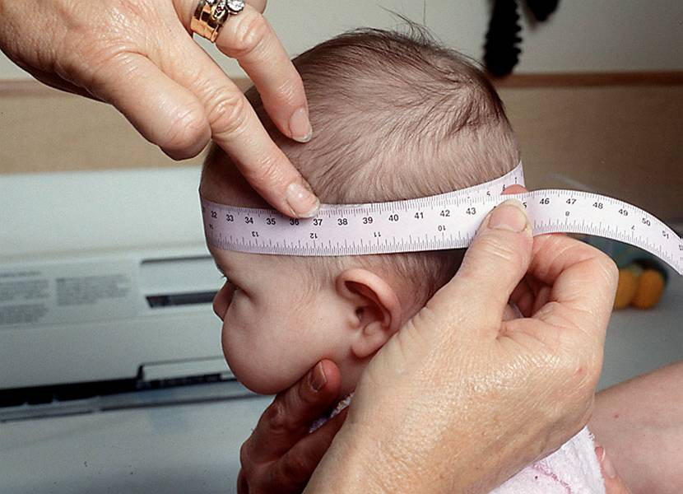
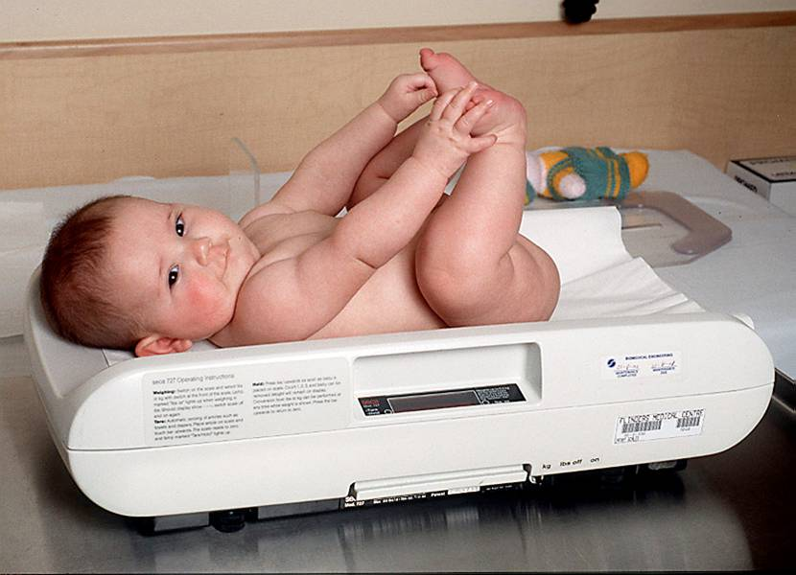
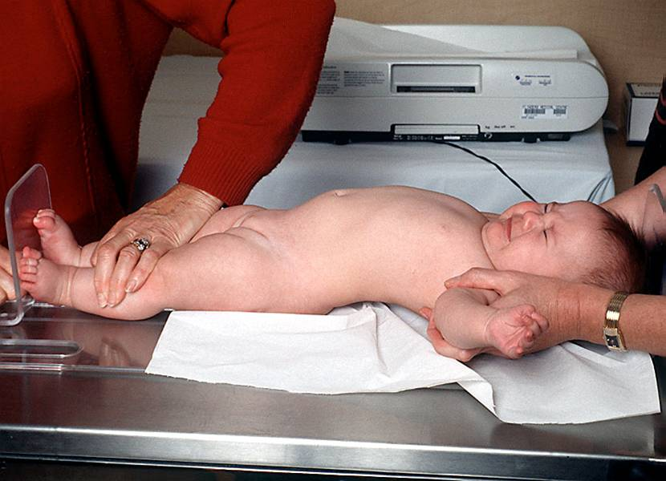
Birth to 2 years
Weight to nearest 10g
To nearest 0.1cm
purpose‘infantometer’ to nearest 0.1cm

Slide 6
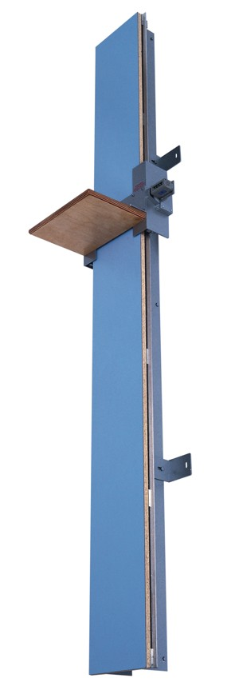
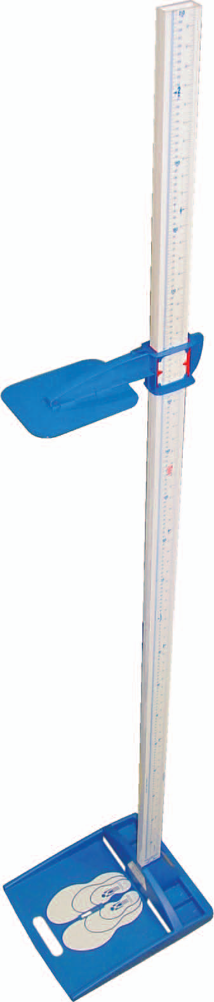
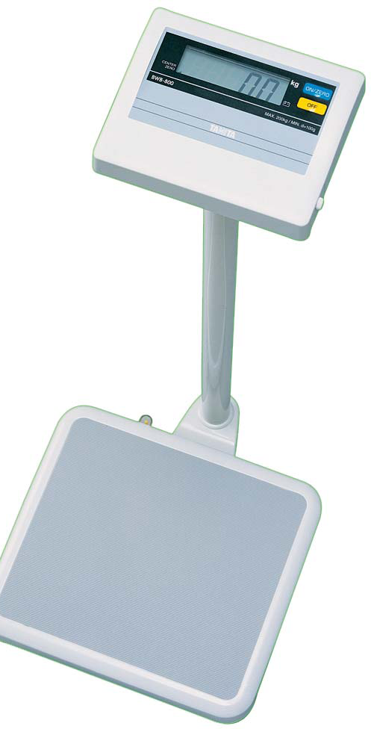
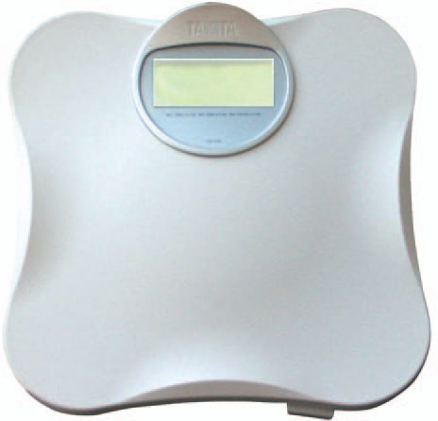
2 & 3 ½ years
Portable or fixed
‘for purpose’
To 100g / 0.1cm

Slide 7

Child Growth = marker of health and development
Quick, non-invasive techniques
Plotting serial measurements on charts
Abnormal growth can indicate underlying health or developmental problems

Slide 8
NCHS(National Center for Health Statistics USA) or WHO charts
•Growth charts are established on large populations of normal children living under near-optimal conditions and therefore representing the range of normal growth for children at different ages.
•NCHS : USA population, cross-sectional
•New growth standards have been developed by the World Health Organization (WHO) based on the growth of normal breast fed infants in various regions of the world. International growth reference standard

Slide 9
In response WHO undertook the Multicentre Growth Reference Study
(MGRS) between 1997 and 2003 to generate new curves for assessing the growth and development of children the world over.

Slide 10
For the assessment WHO has provided
charts for both boys and girls.
to assess growth considering a child‘s age and measurements together.
length/height-for-age
weight-for-age
weight-for-length/height
BMI (body mass index)-for-age

Slide 11
What are growth charts?
Growth charts are a series of percentile curves that show the distribution of body measurements in children over time.
The WHO growth standards to monitor growth for infants up to one year of age.
Growth charts are not diagnostic instruments. They are screening tools that help you form an overall clinical impression for the child being measured.
The positions of the individual points on the graph are less important than the overall trajectory of the growth curve over time.
Notes:
The positions of the individual points on the graph are less important than the overall trajectory of the growth curve over time. This is the key point. Growth charts are to be used as a visual aid. We can get distracted in MTN-016 by the individual percentile numbers because these are what we report on the CRF. However, these individual percentile numbers are less important than what we can discern about the child’s growth when we “eyeball” the overall growth chart over time.

Slide 12
How to use a growth chart
Accurately determine age .
Accurately measure weight and recumbent length
Plot measurements on appropriate chart
Use the percentile lines to assess body size and growth, and monitor growth over time
Gather additional history, exam as needed
Discuss growth pattern with parent and agree on subsequent action if required

Slide 13
USES OF GROWTH CHART
Diagnostic tool-To identify high risk children.
• Planning and policy making
• Education tool for educating mothers
• Tool for action helps in type of intervention that is needed
• Evaluation of effectiveness of corrective measure and impact of a programme of special interventions for improving Childs growth and development

Slide 20
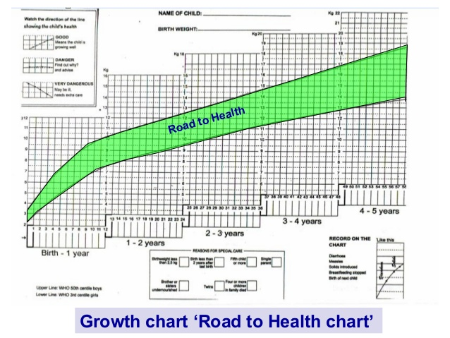

Slide 22
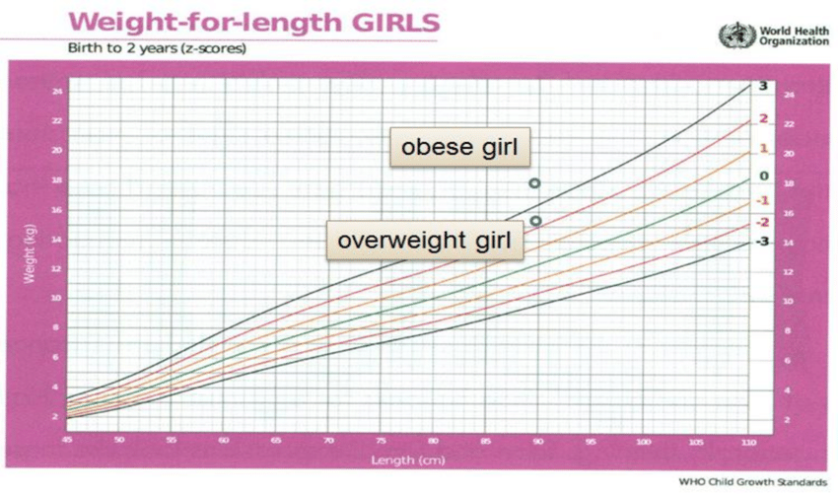

Slide 23
Z-score graphs
•0 correspond to the mean and median
•Z-scores or SD scores are used to describe mathematically how far a measurement is from the median (average).
Z score=x` ± SD
•The mean (median) is the same in both types of graph

Slide 30
After measurement, what next?
•Measurement does not improve growth
•Interpret the graph
•Action must follow:
Any child with Z score < -3
Any child crossing the lines
Weight/height discrepancy
Consider wasting

Slide 31
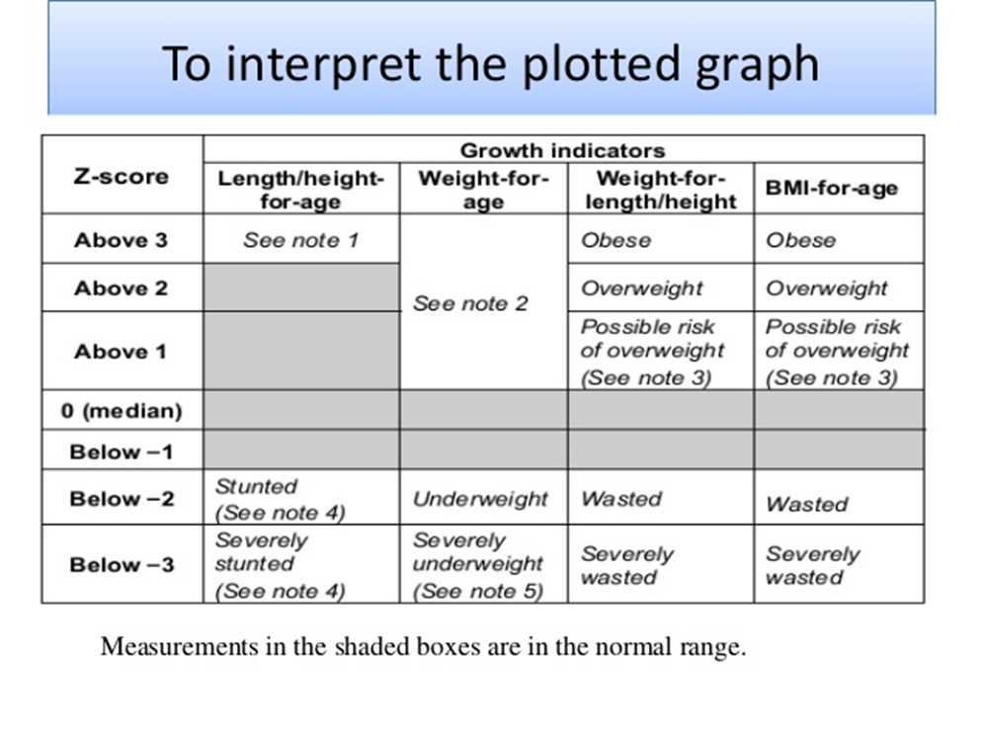

Slide 32
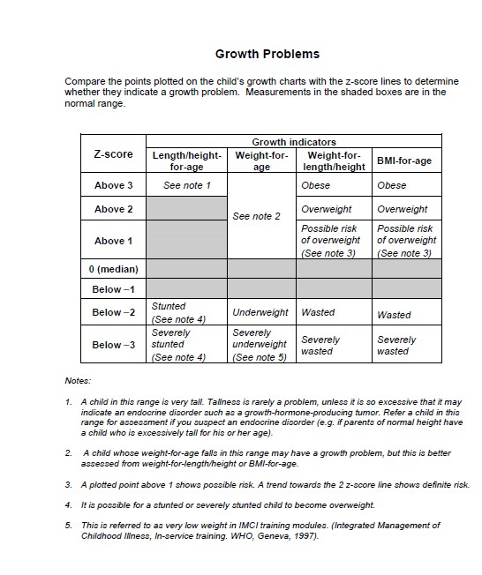

Slide 33
High concern :
Any sharp decline in growth line:
  This is a very significant change in the child’s growth.
  A sharp decline in a normal or undernourished child indicates a growth disturbance.
  Changes in weight or length should be investigated before a child crosses two major percentile lines.

Slide 34
High concern :
A flat growth line:
  Child is not growing consistently.
  When growth rate is rapid during first six months of life, even a one month flat line in growth represents a possible concern.

Slide 35
High concern :
Any sharp incline in the growth line:
  This is a very significant change in the child’s growth.
  Changes in weight or length should be investigated before a child crosses two major percentile lines.
  An unexplained sharp incline may signal a change in feeding practices - may lead to overweight/obesity.
  A sharp incline in a previously ill or undernourished child may be “catch-up” growth expected in the re-feeding period.

Slide 36
Practice Scenario - Birth
Omar is a 3 month old breastfed male infant:
  Birth date: 15 APR 2018
  Birth weight: 3.41 kg
  Gestational age: 38 weeks
Plot the point and describe his weight-for-age percentile
Notes:
For the purpose of this scenario, we are just looking at weight. Assume Omar’s length is normal throughout, which would be expected given that weight typically reveals a growth disturbance before length is affected.

Slide 37
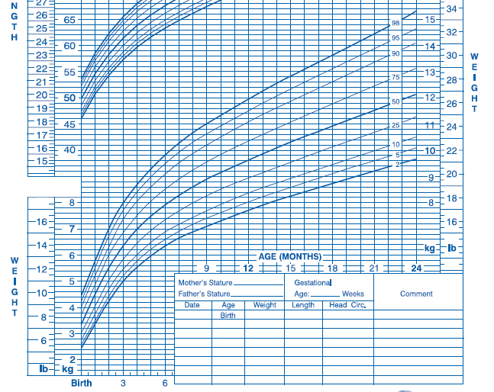
Description: “weight-for-age is at the 50th percentile”=0 Z score

Slide 38
Practice Scenario – Week 1 Visit
At Omar's first study visit his mother is concerned that she does not have enough breast milk.
  Visit date: 24 APR 2018
  Visit weight: 3.21 kg
  Age: 9 days
Plot the point and describe his weight-for-age percentile
Is this expected?
What else would you do at this visit?
Notes:
Is this expected? Yes and no. Omar is not yet two weeks of age, so would not necessarily have re-gained his birth weight by this visit. However, given the mother’s concern, further history and exam is appropriate.
What else would you do at this visit? Perform a lactation assessment in the clinic, i.e. observe positioning, latch, nipple condition, expressed breast milk. Assess infant hydration status, frequency of urine and stool output. Reassure and counsel the mother as appropriate. Provide guidance/treatment (or refer) for cracked nipples or any other concerning findings.

Slide 39
Z score between -1 &-2

Slide 40
Practice Scenario – Month 1 visit
At the Month 1 visit, Omar has not yet regained his birth weight:
  Visit date: 15 May 2018
  Visit weight: 3.35 kg
  Age: 1 month
Plot the point and describe his weight-for-age percentile
Is this expected?
What else would you do at this visit?
Notes:
Is this expected? No, this is not expected. Omar has not yet regained his birth weight, suggesting the need for more follow-up and feeding assistance, and possibly evaluation by (or referral to) a pediatrician.
What else would you do at this visit? In order to determine the cause of Omar's poor weight gain, evaluate feeding for position, latch, and milk transfer. Interview Omar's mother about intervals between feeds, the number of feeds per 24 hours, any supplementary feeding practices, and Omar's elimination patterns (how many urine and soiled diapers each day). Based on this information, provide (or refer) mother for further breastfeeding support and possible supplemental feeding with formula. Depending on your level of concern, arrange for Omar to be seen by a pediatrician and schedule him to return for an interim visit weight check in one to two weeks.

Slide 41
Description: “weight-for-age is at the -3 z score

Slide 42
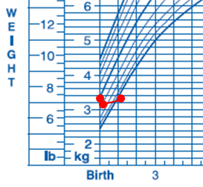

Slide 43
Practice Scenario – Interim visit 1
Omar returns for an interim weight check two weeks after his Month 1 visit:
  Visit date: 30 May 2018
  Visit weight: 4.21 kg
  Age: 1.5 months
Plot the point and describe his weight-for-age percentile
Is this expected?
What else would you do at this visit?
Notes:
Is this expected? Yes, with appropriate breastfeeding counseling and support, Omar has gained 860 grams in 15 days (57 grams/day), moving him from the 2nd to the 10th percentile. While this is more than the typical 30 grams a day, it is expected for undernourished infants to gain weight rapidly during the re-feeding period.
What else would you do at this visit? Repeat history and physical exam to ensure feeding practices and elimination patterns are going well. Ask about any other concerns that may have arisen since the last visit. Review any recommendations from pediatrician, if available. Because the next scheduled visit for EMBRACE is not for another 4 months, schedule a second interim weight check visit in one month to ensure that Omar’s weight continues to improve.

Slide 44
Description: “weight-for-age is at the -1 Zscore

Slide 45
Practice Scenario – Interim visit 2
Omar returns for an interim weight check one month after his last interim visit:
  Visit date: 01 July 2018
  Visit weight: 5.23 kg
  Age: 2.5 months
Plot the point and describe his weight-for-age percentile
Is this expected?
What else would you do at this visit?
Notes:
Is this expected? Yes, now that breastfeeding is going well, Omar's weight continues to improve and shows an upward trend.
What else would you do at this visit? Repeat history and exam, ask about any additional concerns. Schedule Omar to return for his normal Month 6 EMBRACE visit, while also counseling the mother to return earlier if she has any concerns about Omar’s feeding or weight gain.

Slide 46
Description: “weight-for-age is between the -1 Z score

Slide 47
Practice Scenario – Month 6 visit
Omar returns for his Month 6 visit:
  Visit date: 12 OCT 2018
  Visit weight: 7.26 kg
  Age: 6 months
Plot the point and describe his weight-for-age percentile
Is this expected?
What else would you do at this visit?
Notes:
Is this expected? Yes, Omar has now consistently gained weight and his growth appears to be stabilizing around the 25th percentile. Even though this is different from his weight-for-age percentile at birth (50th percentile), it is consistent with his parents’ stature and his growth is following a normal trajectory over time.
What else would you do at this visit? History and physical exam as needed, discuss addition of solid foods now that Omar is six months old, schedule Omar for his next routine EMBRACE visit, and encourage mother to return earlier if any growth concerns recur.

Slide 48
Description: “weight-for-age is -1 Z score

Slide 49
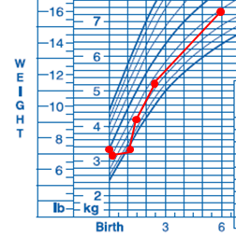

Slide 50
THANK YOU

