Slide 1
Diagnosis of skin disorders
HISTORY
EXAMINATION
TOOLS
TESTS

Slide 2
Clinical Dermatology
Visual Speciality

Slide 3
History
History of present skin condition
Duration, Site at onset, details of spread, Itch, Burning
Wet, dry, blisters,Exacerbating factors,Gowth,Bleeding
General health at present
Past history of skin disorders
Past general medical history
Family history of skin disorders
Social and occupational history
Drugs used to treat present skin condition
Drugs prescribed for other disorders

Slide 4
Examination
1.Distribution
A dermatological diagnosis is based both on the distribution of lesions and on their morphology and configuration.
if the skin disease is localized, universal or symmetrical. Symmetry implies a systemic origin, whereas unilaterality or asymmetry implies an external cause.
Look in the mouth and check the hair and the nails.

Slide 5
2.Morphology
The rule is to find an early or ‘primary’ lesion and to inspect it closely.
What is its shape?
What is its size?
What is its colour?
What are its margins like?
What are the surface characteristics?
What does it feel like?

Slide 6
Terminology of lesions Primary lesions
A macule is a small flat area, less than 5 mm in diameter, of altered colour or texture.
A patch is a large macule.

Slide 7
A papule is a small solid elevation of skin, less than0.5 cm in diameter
.A plaque is an elevated area of skin greater than 2 cm in diameter but without substantial depth.

Slide 8
A vesicle is a circumscribed elevation of skin, less than 0.5 cm in diameter,and containing fluid.
A bulla is a circumscribed elevation of skin over 0.5 cm in diameter and containing fluid.

Slide 9
An ulcer is an area of skin from which the whole of the epidermis and at least the upper part of the dermis has been lost. Ulcers may extend into subcutaneous fat, and heal with scarring.
An erosion is an area of skin denuded by a complete or partial loss of only the epidermis. Erosions heal without scarring.
An excoriation is an ulcer or erosion produced by scratching.
A fissure is a slit in the skin.

Slide 10
Erythema is redness caused by vascular dilatation.
pustule visible accumulation of pus in the skin.
abscess localized collection of pus in a cavity, more than 1 cm in diameter.
wheal is an elevated white compressible evanescent area produced by dermal oedema..
Angioedema is a diffuse swelling caused by oedema extending to the subcutaneous tissue.
A nodule is a solid mass in the skin, usually greater than 0.5 cm in diameter, in both width and depth

Slide 11
Petechiae are pinhead-sized macules of blood in the skin.
The term purpura describes a larger macule or papule of blood in the skin. Such blood-filled lesions do not blanch if a glass lens is pushed against them
An ecchymosis (bruise) is a larger extravasation of blood into the skin and deeper structures.
A haematoma is a swelling from gross bleeding.

Slide 12
comedon is a plug of greasy keratin wedged in adilated pilosebaceous orifice. Open comedon are blackheads. Closed comedon are whiteheads
Telangiectasia visible dilatation of small cutaneous blood vessels.
Erthyroderma is a generalized redness of skin that may be scaling (exfoliative erythroderma) or smooth.

Slide 13
Secondary lesions
scale is a flake arising from the horny layer.
crust like a scale, composed of dried blood or tissue fluid.
scar is a result of healing, where normal structures are permanently replaced by fibrous tissue.
Atrophy is a thinning of skin caused by diminution of the epidermis, dermis or subcutaneous fat.
Lichenification area of thickened skin with increased markings.
stria (stretch mark) is a streak-like linear atrophic pink, purple or white lesion of the skin.
Pigmentation, either more or less than surrounding skin

Slide 14
3.Configuration
Arrangements and configurations can be as discrete, confluent, grouped, annular, arcuate, segmental or dermatomal .
Individual lesions may be annular, several individual lesions may arrange themselves into polycyclic configuration.
The Köbner or isomorphic phenomenon is the induction of skin lesions by, and at the site of, trauma such as scratch marks or operative incisions.

Slide 15
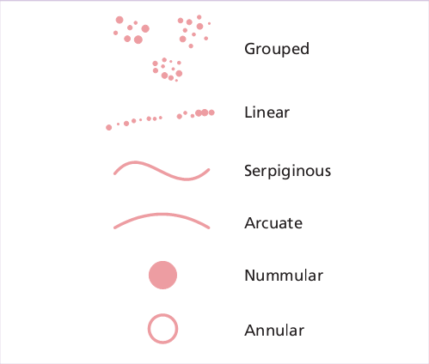

Slide 16
TOOLS
Wood’s light. a source of ultraviolet light from which virtually all visible rays have been excluded by a Wood’s (nickel oxide) filter.
Fluorescence is seen in some fungal infections , erythrasma and Pseudomonas infections.
Some subtle disorders of pigmentation can be seen more clearly under Wood’s light ( the pale patches of tuberous sclerosis,low-grade vitiligo and pityriasis versicolor, and the darker café au lait patches of neurofibromatosis).
The urine in hepatic cutaneous porphyria often fluoresces coral pink

Slide 17
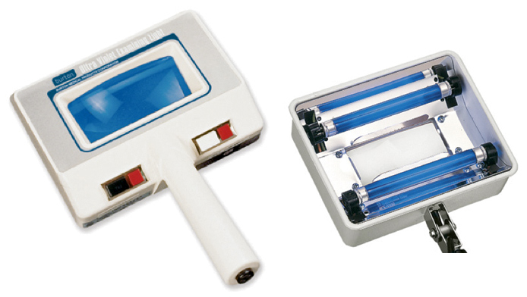
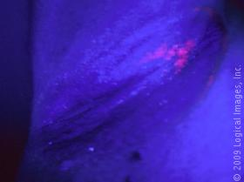

Slide 18
Diascopy a glass slide or clear plastic spoon is pressed on vascular lesions to blanch them and verify that their redness is caused by vasodilatation
confirm the presence of extravasated blood in the dermis
( petechia and purpura )

Slide 19
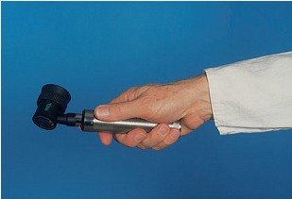
4.Dermatoscopy lesion covered with ultrasound gel, mineral oil, alcohol or water and then illuminated and observed with a hand-held dermatoscope.
The gel or fluid eliminates surface reflection and makes the horny layer translucent so that pigmented structures in the epidermis and superficial dermis, and the superficial vascular plexus , can be assessed.
identify scabies mites in their
burrows
diagnosing abnormalities of
hair shafts.

Slide 20
TESTS
Potassium hydroxide preparations. If a fungal infection is suspected, scales or plucked hairs can be dissolved in an aqueous solution of 20% potassium hydroxide (KOH).
Other samples can include nail clippings, the roofs of blisters, and the contents of pustules
A drop or two of the KOH solution is run under the cover slip. After 5 –10 min examined under a microscope .

Slide 21
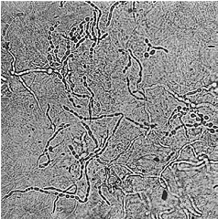

Slide 22
Cytology (Tzanck smear). Cytology can aid the diagnosis of viral infections such as herpes simplex and zoster, bullous diseases such as pemphigus.
A blister roof is removed and the cells from the base of the blister are scraped off and smeared on to a microscope slide, air-dried and fixed with methanol.
They are then stained with Giemsa, toluidine blue or Wright’s stain. Acantholytic cells are seen in pemphigus, and multinucleated giant cells in herpes simplex or varicella zoster infections.

Slide 23
Patch tests. detecting the allergens responsible for allergic contact dermatitis .
The test materials are applied to the back under aluminium discs or patches; the occlusion encourages penetration of the allergen. The patches are left in place for 48 h.
The test detects type IV delayed hypersensitivity reactions.
±Doubtful reaction (minimal erythema).
+Weak positive reaction (erythema and may be papules).
++Strong reaction (palpable erythema and/or vesicles).
+++Extreme reaction (vesicles and/or bullae).
IR Irritant reaction

Slide 24
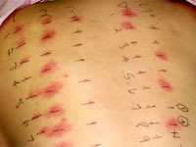

Slide 25
Prick testing. detects immediate (type I) hypersensitivity
should not take systemic antihistamines for 48 h before the test.
Commercially prepared diluted antigens and a control are placed as single drops on marked areas of the forearm.
skin is gently pricked through the drops using separate sterile fine needles without bleeding.
After 10 min, inspected and diameter of any wheal measured and recorded.
positive if the test antigen causes a wheal of 4 mm or greater and control elicits a negligible reaction.

Slide 26
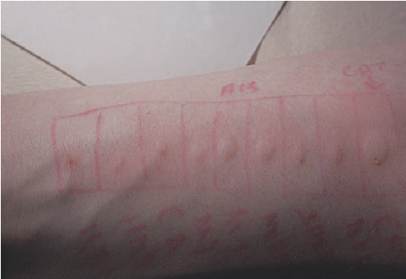

Slide 27
Skin biopsy
Biopsy (from the Greek bios meaning ‘life’ and opsis ‘sight’). A piece of tissue is removed surgically for histological examination and sometimes for other tests (e.g. culture for organisms).
Incisional : part of a lesion is removed.
Excisional : the whole lesion is cut out.
Excisional biopsy is preferable for most small lesions (up to 0.5 cm diameter) but incisional biopsy is chosen when the partial removal of a larger, and complete removal might leave an unnecessary and unsightly scar.
incisional biopsy should include a piece of the surrounding normal skin.

Slide 28
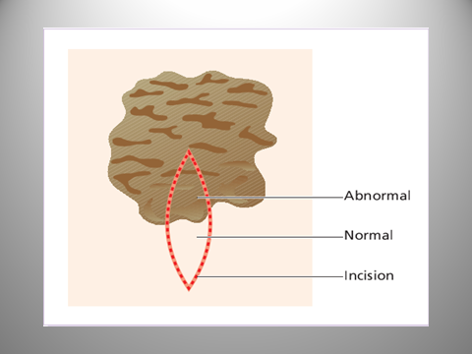

Slide 29
Punch biopsy. The skin is sampled with a small (3 – 4 mm diameter) tissue punch.
cylinder of skin is incised with the punch by rotating it back and forth.
The skin is lifted up carefully with a needle or forceps and the base is cut off at the level of subcutaneous fat.
The defect is cauterized or repaired with a single suture.
shave biopsy If a lesion is superficial

Slide 31
Local anaesthetic. Lidocaine 1–2% is used. Sometimes adrenaline (epinephrine) is added. This causes vasoconstriction, prolongation of local anaesthetic effect.
Plain lidocaine used on fingers ,toes, penis
avoid local anaesthesia during early pregnancy
If injected into the subcutaneous fat : pain-free, produce a diffuse swelling of skin, take several minutes
Intradermal injections are painful and produce a discrete wheal associated with rapid anaesthesia.

