Slide 1
Sexullay transmitted diseases
Sexullay transmitted diseases can present as:
Genital ulcers, Urethritis, Cervicitis, Vaginal discharge, and Papules.
In developed countries, most patients who have genital ulcer have either herpes virus, syphilis, or chancroid.
Herpes is the most prevalent.

Slide 2
Syphilis
Treponema pallidum
congenital
acquired ( blood, accidental inoculation )
most important route is through sexual contact
Congenital syphilis
congenital syphilis is rare. Otherwise, stillbirth is a common outcome, although some children with congenital syphilis may develop the stigmata of the disease only in late childhood.

Slide 3
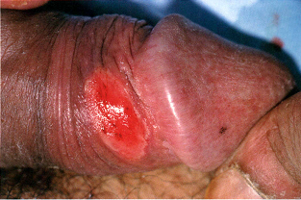
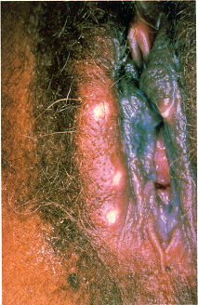
Acquired syphilis
After an incubation period
( 9 – 90 days ), a primary chancre develops at the site of inoculation. Often this is genital, but oral and anal chancres are not uncommon.
A typical chancre is a painless, button-like ulcer of up to 1 cm in diameter accompanied by local lymphadenopathy.

Slide 4
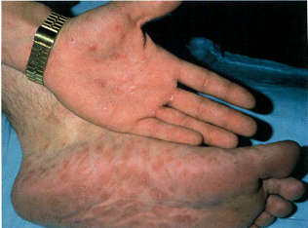
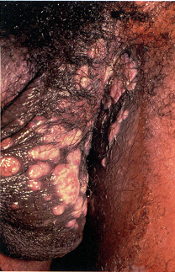
Secondary stage: Systemic symptoms and a generalized lymphadenopathy.
eruptions at first are macules and later papules. distributed symmetrically and are of a coppery ham colour.
Classically, there are obvious lesions on the palms and soles. Condylomata lata are moist papules in the genital and anal areas. ‘moth-eaten’alopecia and mucous patches in mouth.

Slide 5
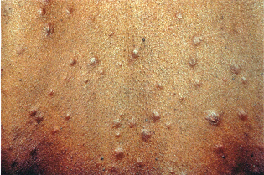
skin lesions of late syphilis may be nodules that spread peripherally and clear centrally,
Gummas granulomatous areas; they quickly break down to leave punched-out ulcers heal poorly, leaving papery white scars.

Slide 6
Diagnosis
dark-field microscopy in infectious stages
Serological tests positive only some 5 – 6 weeks after infection (week or two after the chancre).
The non-treponemal (rapid plasma reagin [RPR] and Venereal Disease Research Laboratory [VDRL])
specific treponemal tests such as the fluorescent treponemal antibody/absorption (FTA/ABS) and T. pallidum particle agglutination (TPPA) tests,

Slide 7
Penicillin G benzathine 2.4 million unit intramuscular once is still the treatment of choice, in early syphilis and weekly for three weeks in late-stage disease or in early syphilis with neurological involvement.
Doxycycline 100 mg twice daily for 14 days
Azithromycin 2 gm oral once

Slide 8
Chancroid
soft chancre is an infectious, ulcerative STD caused by the Gram-negative bacillus Haemoplzilus ducreyi . One or more deep or superficial tender ulcers on the genitalia, and painful inguinal adenitis in 50%, which may suppurate
begins as an inflammatory macule or pustule 1-5 days after intercourse. appears on distal penis or perianal area in men, or on the vulva, cervix, or perianal area in women.

Slide 9
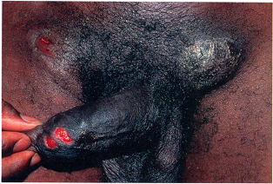
The ulcers appear punched out or have undermined irregular edges surrounded by mild hyperemia. base is covered with a purulent, dirty exudate. ulcers bleed easily and very tender.
azithromycin, 1 g orally cefotriaxone, 250 mg IM
ciprofloxacin, 500 mg orally twice a day for 3 days

Slide 10
Urethritis
urethral discharge of mucopurulent or purulent material and sometimes by dysuria or urethral pruritus.
N. gonorrhoeae and C. trachomatis
nongonococcal urethritis is demonstrated by the :
absence of gram negative intracellular diplococcic,
a negative gonococcal culture result, and the
detection of inflammatory cells (at lest five polymorphonuclear leukocytes)

Slide 11
Gonococcal urethritis
gram negative coccus infects columnar or cuboidal epithelium create a purulent discharge,
large numbers of phagocytosed gonococci in pairs ( diplococcic ) within polymorphonuclear leukocytes.
After 3-5 days incubation period, sudden onset of burning frequent urination, and a yellow, thick purulent urethral discharge.
may spread to prostate gland, seminal vesicles, epididymis

Slide 12
In females an asymptomatic disease, urethritis begins with frequency and dysuria.pus may discharge from red external urinary meatus or after urethra is milked with a finger in the vagina.
endocervicitis found in 40%-60%
endocervical infection nonspecific, pale yellow vaginal discharge. cervix may appear normal or show inflammatory changes with erosions.

Slide 13
Diagnosis
gram negative diplococcic are present inside polmorphonuclear leukocytes.
nucleic acid amplification tests and Culture
Treatment
Cefixime 400mg,ciprofloxacin 500mg,ofloxacin 400mg or cefotriaxone 500mg IM all in single dose.
all patients should receive treatment for Chlamydia.

Slide 14
Non-gonococcal urethritis
chlamydial infection is responsible for about half of NGU
In male urethritis begins with dysuria and urethral discharge 7 to 28 days after sexual contact with a smarting sensation while urinating and a mucoid discharge.
In female signs and symptoms in females are even more nonspecific.

Slide 15
Diagnosis
presence of C. trachomatis, and excluding gonococcal infection. the presence of polymorphonuclear leukocytes
Treatment
Doxycycline 100 mg twice daily for 7 days or azithromycin 1 gm oral once are the drugs of choice.
levofloxacin 500mg oral once daily for 7 days or erythromycin 500 mg four times daily for 7 days.

