Slide 1
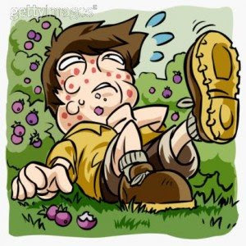
Urticaria
(hives, ‘nettle-rash’)

Slide 2
urticaria
appearance of wheals
severe itching, stinging, or pricking sensations
Do not last longer than 24 hrs
vascular reaction of the skin

Slide 3
Urticaria that persists for more than 6 weeks is classified as chronic
Urticaria that persists for less than 6 weeks is classified as acute

Slide 4
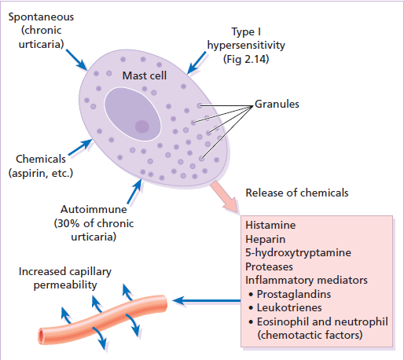

Slide 5
Etiologic factors
Drugs
Penicillin and related antibiotics
The incidence of aspirin-induced urticaria has fallen
Aspirin-sensitive persons tend to have cross-sensitivity with tartrazine, the yellow azo-benzone dye. These are common food additives and preservatives.
Aspirin exacerbates chronic urticaria in at least 30% of patients unknown.

Slide 6
Food
frequent in acute urticaria, less in chronic urticaria.
chocolate, shellfish, nuts, peanuts, tomatoes, strawberries, melons, cheese, garlic, onions, eggs, milk,and spices.
Food allergens that may cross-react with latex include chestnuts, bananas, avocado, and kiwi.
Food additives
Fewer than 10% of cases of chronic urticaria.
Natural food additives :yeasts, salicylates, citric acid, egg, and fish albumin.
Synthetic additives include azo dyes, benzoic acid derivatives, sulfite, and penicillin.

Slide 7
Infections
Acute urticaria may be associated with upper respiratory infections,
localized infection in the tonsils, a tooth, the sinuses, gallbladder, prostate, bladder, or kidney.
treatment with antibiotics for Helicobacter
Chronic viral infections, such as hepatitis B and C.
Helminths may cause urticaria
Emotional stress
Neoplasms : carcinomas and Hodgkin disease.
Inhalants : Grass pollens, house dust mites, feathers, formaldehyde, cottonseed, animal dander, cosmetics, aerosols, and molds

Slide 8
Physical urticarias
Cold urticaria : on the face when cycling .
Solar urticaria : within minutes of sun exposure.
Heat urticaria :contact with hot objects+solutions.
Cholinergic urticaria : Anxiety, heat, sexual excitement or strenuous exercise. The vessels over-react to acetylcholine liberated from sympathetic nerves in the skin.
Aquagenic urticaria : precipitated by contact with water, irrespective of its temperature.

Slide 9
Dermographism
This is the most common type of physical urticaria,the skin mast cells releasing extrahistamine after rubbing or scratching. The linear wheals are therefore an exaggerated triple response of Lewis.
They can be reproduced by rubbing the skin of the back lightly at different pressures, or by scratching the back with a fingernail or blunt object.

Slide 10
Delayed pressure urticaria
Sustained pressure causes oedema of the underlying skin and subcutaneous tissue 3–6 h later.
The swelling may last up to 48 h and kinins or prostaglandins, rather than histamine, probably mediate it.

Slide 11
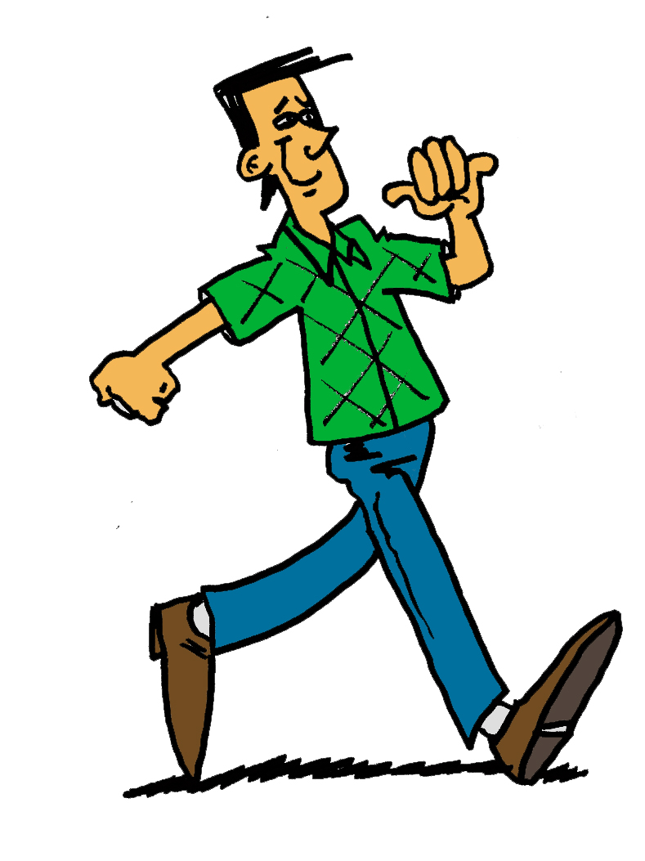

Slide 12
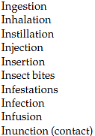
Hypersensitivity urticaria
IgE-mediated (type I) allergic reaction.
Allergens may be encountered in 10 different ways :

Slide 13
Autoimmune urticaria
Some patients with chronic urticaria have an autoimmune disease with IgG antibodies to IgE or to FcIgE receptors on mast cells.
Here the autoantibody acts as antigen to trigger mast cell degranulation.

Slide 14
Contact urticaria
IgE mediated or pharmacological effect.
The allergen is delivered to the mast cell from the skin surface rather than from the blood.
Wheals occur most often around the mouth.
Foods and food additives are the most common culprits
drugs, animal saliva, insect repellents and plants.
Recently, latex allergy has become a significant public health concern.

Slide 15
Pharmacological urticaria
This occurs when drugs cause mast cells to release histamine in a non-allergic manner
aspirin
non-steroidal anti-inflammatory drugs
angiotensin-converting enzyme inhibitors
morphine

Slide 16
Presentation
sudden appearance of pink itchy wheals
anywhere on the skin surface.
Each lasts for less than a day
Lesions may take up an annular shape.
Angioedema is a variant of urticaria that primarily affects the subcutaneous tissues, so that the swelling is less demarcated and less red than an urticarial wheal.
Angioedema at junctions between skin and mucous membranes( peri-orbital, peri-oral and genital ).

Slide 17
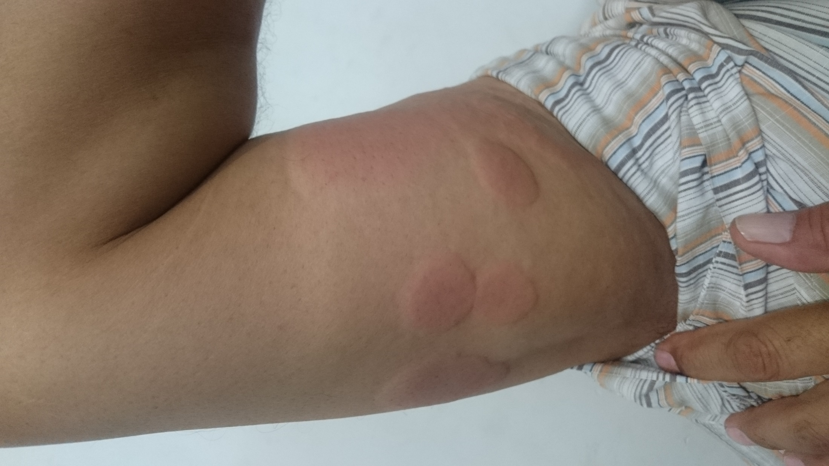

Slide 18
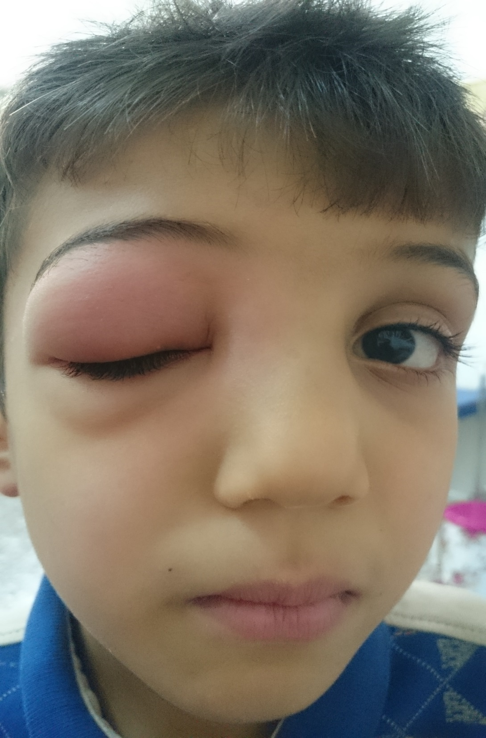

Slide 19
The course depends on its cause.
If the urticaria is allergic, it will continue until the allergen is removed, tolerated or metabolized.
Urticaria may recur if the allergen is met again. Only half of patients with chronic urticaria and angioedema will be clear 5 years later.
Those with urticarial lesions alone do better, half being clear after 6 months.

Slide 20
Differential diagnosis
Insect bites or stings and infestations
Erythema multiforme can mimic an annular urticaria.
urticarial vasculitis: individual lesions last for longer than 24 h, blanch incompletely,leave bruising.
Some bullous diseases ( dermatitis herpetiformis, bullous pemphigoid and pemphigoid gestationis) begin as urticarial papules or plaques, but later bullae make the diagnosis obvious.
On the face,erysipelas can be distinguished from angioedema by its sharp margin, redder colour and accompanying pyrexia.

Slide 21
Investigations
more is learned from the history than laboratory.
A review of systems.
Careful attention should be paid to drugs
investigations can be confined to a complete blood count and erythrocyte sedimentation rate (ESR).
An eosinophilia should lead to the exclusion of bullous and parasitic disease
raised ESR might suggest urticarial vasculitis or a systemic cause.
Prick tests are unhelpful.

Slide 22
Treatment
The ideal is to find a cause and then to eliminate it.
antihistamines are the mainstays of symptomatic treatment.
Cetirizine 10 mg/day and loratadine 10 mg/day
shorter acting antihistamines( hydroxyzine 10–25 mg).
H2-blocking antihistamines (cimetidine)
Chlorphenamine or diphenhydramine are used during pregnancy
Sympathomimetic agents can help urticaria, adrenaline
A tapering course of systemic corticosteroids
Low doses of ciclosporine

